Slide 1

“He’s got it locked in!”: metaphor in professional wrestling commentary
Robbie Love
Lancaster University
r.m.love@lancaster.ac.uk
lovermob

Slide 2
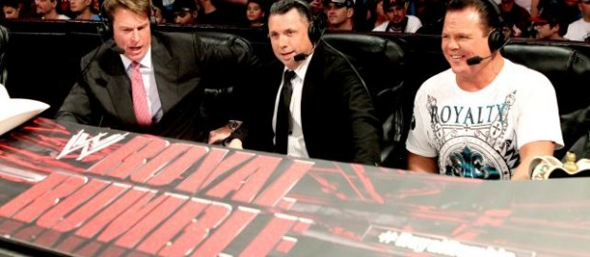
Introduction
How is metaphor used in professional wrestling commentary?
Why might this be interesting?

Slide 3
Metaphor
“the phenomenon whereby we talk and, potentially, think about something in terms of something else” (Semino 2008: 1)
The “fundamentally metaphorical” nature of our “ordinary conceptual system” (Lakoff & Johnson 2003 [1980]: 3)
“important and ubiquitous in language” (Zinken & Musolff 2009: 1)

Slide 4
Conceptual Metaphor Theory
Conceptual Metaphor Theory (CMT) (Lakoff & Johnson 1980)
Real-world concept = target domain
The metaphor = source domain
target source/vehicle
Conceptual metaphor = broader cognitive mapping
Linguistic metaphor = verbal instantiation of this

Slide 5
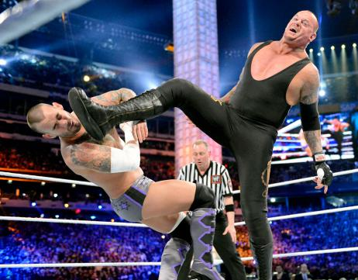
Professional wrestling
A “substantial American popular art form” (Sammond 2005: 1)
Also Mexico, UK, Japan
Performance of competitive physical conflict
Its fans know this (Barthes 1957)
Televised, with commentary

Slide 6
What do we already know?
Linguistic analyses of televised sports commentary
College basketball: racial/gender stereotyping (Eastman & Billings 2001; Billings et al. 2002); racial bias (Rada & Wulfemeyer 2005)
National basketball: racial identity, nationality, and masculinity (Lavelle 2010)
No metaphor analysis
No pro wrestling analysis

Slide 7
What do we already know?
Suspense -> enjoyment of televised sports (Peterson & Raney 2008)
However,
The audience knows it is not legitimate sport
Pro wrestling perceived as “less suspenseful” than sport -> awareness of fiction (Raney & Depalma 2006: 332)
Therefore,
Pressure to heighten/maintain suspense

Slide 8
Research questions
To what extent are linguistic metaphors present in professional wrestling commentary?
How can they be categorised and attributed to conceptual metaphors?
How (if at all) do they contribute to suspense and excitement?

Slide 9
Data
Commentary of 3 pro wrestling matches
3 commentators
World Wrestling Entertainment (WWE)
WrestleMania 29 (2013)
Orthographic transcription
 | Match | Length (mm:ss) | Length (words)
1 | The Undertaker def. CM Punk | 23:02 | 2,732
2 | Triple H def. Brock Lesnar | 24:01 | 3,099
3 | John Cena def. The Rock | 26:21 | 2,897
 | TOTAL | 73:24 | 8,729

Slide 10
Methodological approach
Primarily:
Metaphor identification procedure (MIP) (Pragglejaz Group 2007)
Also influenced by:
Discourse dynamics approach (Cameron et al. 2009)
Intuition/researcher knowledge relied upon heavily

Slide 11
Methodological approach
Manual identification of:
(Novel and) conventional metaphors
vehicle groups
Intuition used to filter potential metaphors
Then:
Frequency-driven analysis (cf. “quantitative description”, Cameron et al. 2009: 76)
Vehicles grouped into abstract conceptual metaphors (traditional CMT, Semino 2008)

Slide 12
Analysis
780 linguistic metaphors = 8.94%
331 novel conceptual metaphors
  names of characters and the signature moves they perform
  foregrounding aspects of character to assist ‘goodie’/‘baddie’ portrayal
  E.g. WRESTLERS ARE INHUMAN
  E.g. WRESTLING MOVES ARE NATURAL PHENOMENA
  E.g. WRESTLERS ARE NOT WRESTLERS

Slide 13
Conventional metaphors
449 conventional – main focus today
instantiate shared conceptualisations of the target domains among speakers (Semino 2008: 226)
less readily noticeable as metaphors
spontaneously produced, on-the-fly commentary
(1) WRESTLING IS A SERIES OF SHORT JOURNEYS
(2) WRESTLERS ARE CONTAINERS
(3) WRESTLING MOVES ARE CONTAINERS
(4) WRESTLING IS WAR

Slide 14
Conventional metaphors
 | Vehicle domain | Freq. | %
1 | MOVEMENT | 101 | 17.35
2 | CONCRETISING | 100 | 17.18
3 | WAR | 55 | 9.45
4 | VIOLENT ACTION | 54 | 9.28
5 | LOCATION | 46 | 7.90
6 | NONHUMAN | 26 | 4.47
7 | LIFE/DEATH | 20 | 3.44
8 | VISION | 17 | 2.92
9 | FINANCE/ECONOMY | 15 | 2.58
10 | GAME | 15 | 2.58
 | Total | 449 | 77.15

Slide 15
(1) WRESTLING IS A SERIES OF SHORT JOURNEYS
Evoked by MOVEMENT vehicle domain
Split further into GOAL and PATH domains (Cameron et al. 2009: 75)
GOAL = performance of signature move
go/going/went for (19)
PATH = the course of the match i.e. dominance
back and forth (4), bounced (back), turned

Slide 16
(1) WRESTLING IS A SERIES OF SHORT JOURNEYS
GOAL = performance of signature move
Shawn tried to go for Sweet Chin Music instead
(Jerry Lawler, Triple H vs. Brock Lesnar)
PATH = the course of the match i.e. dominance
this is back and forth but we’ve seen this before . just when the Game thinks he’s building momentum he just can’t keep it
(Jerry Lawler, Triple H vs. Brock Lesnar)

Slide 17
(2) WRESTLERS ARE CONTAINERS
Evoked by CONCRETISING vehicle domain; specifically the vehicle groups POSSESSION (14) and CAPACITY (10)
POSSESSION
the Rock has him . the Rock has him . the Rock’s got him . he’s done it twice
(John Bradshaw Layfield, The Rock vs. John Cena)
and Triple H . has got him again
(Michael Cole, Triple H vs. Brock Lesnar)

Slide 18
(2) WRESTLERS ARE CONTAINERS
Evoked by CONCRETISING vehicle domain; specifically the vehicle groups POSSESSION (14) and CAPACITY (10)
CAPACITY
it’s almost like these two superstars are back to square one . they’ve given it their all
(Jerry Lawler, The Undertaker vs. CM Punk)
uh oh . still some fight left in the Game
(Jerry Lawler, Triple H vs. Brock Lesnar)

Slide 19
(3) WRESTLING MOVES ARE CONTAINERS
Evoked by CONCRETISING vehicle domain; specifically the vehicle groups POSSESSION (14) and LOCK (11)
POSSESSION
he caught him with the Go To Sleep . Undertaker into the Tombstone
(Michael Cole, The Undertaker vs. CM Punk)
and he caught him with the Tombstone
(Jerry Lawler, The Undertaker vs. CM Punk)

Slide 20
(3) WRESTLING MOVES ARE CONTAINERS
Evoked by CONCRETISING vehicle domain; specifically the vehicle groups POSSESSION (14) and LOCK (11)
LOCK
and look . sleeper hold by the Rock . sleeper hold . Cena . trying to reverse . yeah but Rock has it locked in now . Cena’s in the centre of the ring
(Michael Cole, The Rock vs. John Cena)
referee checking the shoulders . Punk with the Vice locked in . here’s the two count . and Undertaker has to power up at two . look at this
(Michael Cole, The Undertaker vs. CM Punk)

Slide 21
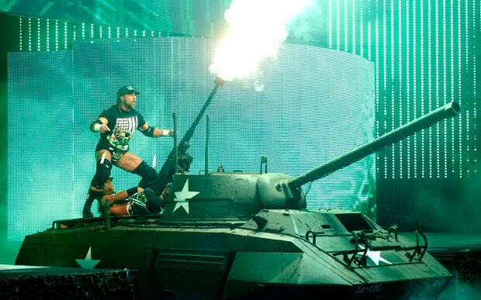
(4) WRESTLING IS WAR
Evoked by the WAR vehicle group (55 examples)
Vehicles include: striker, shots, exploded, fire, command, fighting machine, destroyer, bombs, battle, unloading and war itself

Slide 22
(4) WRESTLING IS WAR
as Rock exploded out of the corner . there’s Cena with the flying tackle
(Michael Cole, The Rock vs. John Cena)
these guys are throwing bombs at each other
(John Bradshaw Layfield, The Undertaker vs. CM Punk)
it is a war . Triple H with that sledgehammer in hand but he was caught
(Jerry Lawler, Triple H vs. Brock Lesnar)

Slide 23
Conclusion
To what extent are linguistic metaphors present in professional wrestling commentary?
The language of pro wrestling commentary is “extensively conceptualised” (Bergh 2011: 87) in terms of metaphor

Slide 24
Conclusion
How can they be categorised and attributed to conceptual metaphors?
(1) WRESTLING IS A SERIES OF SHORT JOURNEYS
(2) WRESTLERS ARE CONTAINERS
(3) WRESTLING MOVES ARE CONTAINERS
(4) WRESTLING IS WAR

Slide 25
Conclusion
How (if at all) do they contribute to suspense and excitement?
Short-term success goals of the characters
The rapidly-changing narrative of the match
Dominance, determination, and vulnerability
Physical conflict heightened
Metaphors as aids for the suspension of disbelief

Slide 26
What next?
(How) does this differ to legitimate sports commentary?
Explore researcher knowledge – could an outsider to wrestling replicate these results? Does this matter?
Diachronic analysis
Corpus approach – there is certainly enough content if someone can transcribe it!
How could such knowledge help pro wrestling companies enhance what they do?

Slide 27
Selected references
Barthes, R. (1957). The World of Wrestling. In Sammond, N. (ed.) (2005). Steel Chair to the Head: The Pleasure and Pain of Professional Wrestling. Durham, NC: Duke University Press. Pp. 23-32.
Bergh, G. (2011). Football is war: A case study of minute-by-minute football commentary. Revisita Revedas, 15(2). 83-93. Retrieved from http://www.ufjf.br/revistaveredas/files/2011/05/artigo-72.pdf
Billings, A.C., Halone, K.K. & Denham, B.E. (2002). “Man, That Was a Pretty Shot”: An Analysis of Gendered Broadcast Commentary Surrounding the 2000 Men’s and Women’s NCAA Final Four Basketball Championships. Mass Communication and Society, 5(3). 295-315. doi:10.1207/S15327825MCS0503_4
Cameron, L., Maslen, R., Todd, Z., Maule, J., Stratton, P. & Stanley, N. (2009) The Discourse Dynamics Approach to Metaphor and Metaphor-Led Discourse Analysis. Metaphor and Symbol, 24. 63-89. doi:10.1080/10926480902830821
Eastman, S.T. & Billings, A.C. (2001). Biased Voices of Sports: Racial and Gender Stereotyping in College Basketball Announcing. Howard Journal of Communications, 12(4). 183-201. doi:10.1080/106461701753287714
Gray, R. (2013). Part 2 of the JBL and Cole Show’s Halloween Special. Retrieved 12 November 2013, from Wrestling News World website, http://www.wrestlingnewsworld.com/part-2-of-the-jbl-cole-shows-halloween-special/#prettyPhoto
Lakoff, G. & Johnson, M. (2003 [1980]) Metaphors we live by (2nd ed.). Chicago: University of Chicago Press.
Lavelle, K.L. (2010). A Critical Discourse Analysis of Black Masculinity in NBA Game Commentary. Howard Journal of Communications, 21(3). 294-314. doi:10.1080/10646175.2010.496675
Mazer, S. (1998). “Real” Wrestling / “Real” Life. In Sammond, N. (ed.) (2005). Steel Chair to the Head: The Pleasure and Pain of Professional Wrestling. Durham, NC: Duke University Press. Pp. 67-87.
Peterson, E.M. & Raney, A.A. (2008). Reconceptualizing and Reexamining Suspense as a Predictor of Mediated Sports Enjoyment. Journal of Broadcasting & Electronic Media, 52(4). 544-562. doi:10.1080/08838150802437263
Pragglejaz Group. (2007). MIP: A method for identifying metaphorically used words in discourse. Metaphor and Symbol, 22(1), 1-39. Retrieved from http://www.academia.edu/235704/MIP_A_method_for_identifying_metaphorically_used_words_in_discourse
Rada, J.A. & Wulfemeyer, K.T. (2005). Color Coded: Racial Descriptors in Television Coverage of Intercollegiate Sports. Journal of Broadcasting & Electronic Media, 49(1). 65-85. doi: 10.1207/s15506878jobem4901_5
Raney, A.A. & Depalma, A.J. (2006) The Effect of Viewing Varying Levels and Contexts of Violent Sports Programming on Enjoyment, Mood and Perceived Violence. Mass Communication and Society, 9(3). 321-338. doi:10.1207/s15327825mcs0903_4
Sammond, N. (2005). Introduction: A Brief and Unnecessary Defence of Professional Wrestling. In Sammond, N. (ed.). Steel Chair to the Head: The Pleasure and Pain of Professional Wrestling. Durham, NC: Duke University Press. Pp. 1-21.
Semino, E. (2008). Metaphor in Discourse. Cambridge: Cambridge University Press.
Tamborini, R., Skalski, P., Lachlan, K., Westerman, D., Davis, J. & Smith, S.L. (2005). The raw nature of televised professional wrestling: Is the violence a cause for concern? Journal of Broadcast & Electronic Media, 49(2), 202-220. doi:10.1207/s15506878jobem4902_4
Zinken, J. & Musolff, A. (2009). Metaphor and Discourse. Basingstoke: Palgrave Macmillan. doi:10.1057/9780230594647

