Slide 1

Representations of Muslim people and Islam in the British national press after the 2013 Woolwich murder: a corpus analysis
Robbie Love
Centre for Corpus Approaches to Social Science (CASS)
Lancaster University, UK
r.m.love@lancaster.ac.uk
lovermob

Slide 2
Background: MA corpus research
LING421 Corpus Linguistics assignment 2013
Part of project with Tony McEnery, for iEngage
Also looked at depiction of Muslim people / Islam in Borough of Tower Hamlets
Now – wider project on Lee Rigby with Mark McGlashan, Tony McEnery & Stephen Wattam

Slide 3
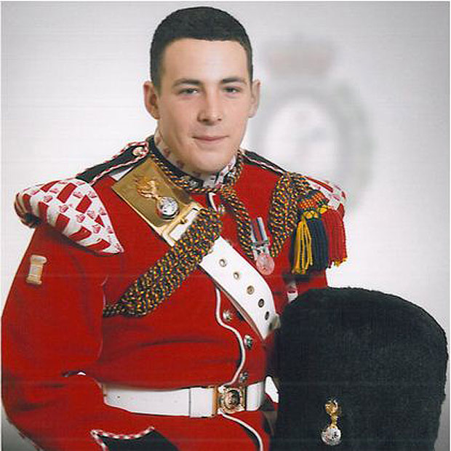
Background: the Woolwich murder
In May 2013, British soldier Lee Rigby was murdered by two men on a street in Woolwich, south east London
A major news story
The Muslim identity of the perpetrators and their motivations for killing Rigby were widely discussed as part of the reporting

Slide 4
Research aims
How were Muslim people and Islam represented by the British national press during the aftermath of the Woolwich incident?
Method: corpus-based critical discourse analysis

Slide 5
Data
Corpus of articles published by the British national press about the Woolwich murder within one month of the attack
22nd May – 21st June 2013
Collected using Nexis: News Search
Woolwich OR Rigby OR Adebolajo OR Adebowale
3,632 articles in total, 2,451,575 words

Slide 6
Analytical techniques
WordSmith Tools (Scott 2008)
Keywords – reference corpus BE06. Aim – to discover the ‘aboutness’ of the Woolwich reporting in general
Focused in on keywords MUSLIM and ISLAM
Grammatical forms - disambiguation
Collocation analysis
Concordancing used to look at the surrounding context in more detail

Slide 7
Keywords (against BE06)
 | Keyword | Freq. Woolwich | Freq. BE06 |  | Keyword | Freq. Woolwich | Freq. BE06
1 | Woolwich | 7744 | 2 | 11 | Drummer | 4078 | 0
2 | Rigby | 5513 | 0 | 12 | London | 7164 | 452
3 | May | 6637 | 112 | 13 | Muslim | 3776 | 76
4 | Lee | 5463 | 22 | 14 | Michael | 3357 | 69
5 | said | 16148 | 2007 | 15 | killing | 2526 | 32
6 | police | 7190 | 255 | 16 | Adebowale | 2112 | 0
7 | Adebolajo | 4670 | 0 | 17 | Islam | 2475 | 42
8 | attack | 5495 | 96 | 18 | arrested | 2364 | 31
9 | soldier | 4711 | 21 | 19 | Choudary | 2004 | 0
10 | murder | 4938 | 57 | 20 | Cameron | 2471 | 49

Slide 8
Forms of MUSLIM
 | muslim* | Raw Freq. | Relative Freq. (per million)
1 | Muslim | 3,776 | 1540.23
2 | Muslims | 2,091 | 852.92
3 | MUSLIM | 25 | 10.20
4 | MUSLIMS | 13 | 5.30
5 | muslims | 8 | 3.26
6 | muslim | 2 | 0.82
7 | Muslimhater | 1 | 0.41
8 | Muslimified | 1 | 0.41

Slide 9
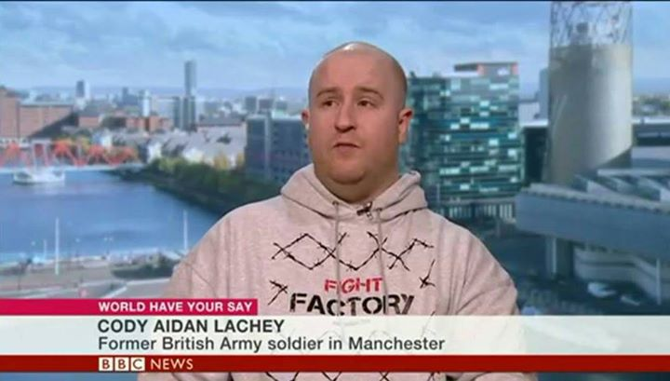
Muslimified and Muslimhater
He posted on his Twitter account: "This country has gone to the dogs if it gets anymore Muslimified we will all be wearing burkhas and raping and abusing white women and kids.”
(Daily Star, 9 June 2013)
“But we can reveal Lachey is a racist and a fantasist who has never served in the war-torn country.”
(Daily Star, 9 June 2013)

Slide 10
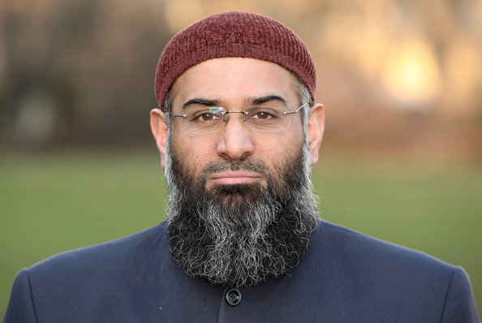
Muslimified and Muslimhater
He then threatened to expose the Sunday Times reporter who questioned him "for the closet Muslimhater that you obviously are".
(The Sunday Times, 2 June 2013)
It appears that this is used by Anjem Choudary as a strategy to divert the focus of enquiry away from himself and accuse the reporter of Islamophobic bias in their journalism strategy

Slide 11
Forms of ISLAM
 | islam* | Raw Freq. | Relative Freq. (per million) |  |  | islam* | Raw Freq. | Relative Freq. (per million)
1 | Islam | 2,475 | 1009.56 |  | 16 | Islamicist | 4 | 1.63
2 | Islamic | 1,888 | 770.12 |  | 17 | Islamiyya | 4 | 1.63
3 | Islamist | 1,064 | 434.01 |  | 18 | Islamophilia | 4 | 1.63
4 | Islamists | 279 | 113.80 |  | 19 | islamic | 3 | 1.22
5 | Islamism | 142 | 57.92 |  | 20 | Islamicain | 3 | 1.22
6 | Islamophobic | 70 | 28.55 |  | 21 | Islamicinspired | 2 | 0.82
7 | Islamophobia | 66 | 26.92 |  | 22 | Islamifi | 2 | 0.82
8 | Islamaphobic | 14 | 5.71 |  | 23 | Islamism's | 2 | 0.82
9 | Islam's | 14 | 5.71 |  | 24 | ISLAMIST | 2 | 0.82
10 | ISLAMIC | 13 | 5.30 |  | 25 | Islamization | 2 | 0.82
11 | Islamisation | 12 | 4.89 |  | 26 | Islamophobe | 2 | 0.82
12 | Islamically | 11 | 4.49 |  | 27 | Islamicised | 1 | 0.41
13 | Islamaphobia | 10 | 4.08 |  | 28 | Islamistrelated | 1 | 0.41
14 | Islamophobes | 5 | 2.04 |  | 29 | Islamofascists | 1 | 0.41
15 | ISLAM | 4 | 1.63

Slide 12
Islamism = violence
72 cases (50.7%):
comrades, recruits, violent, extremism, victimhood, victims, militant, extreme, radical, fascistic, gang culture, gangsterism and war
But the truth is that violent political Islamism - abhorrent though it certainly is - is a fringe view among Britain's small Muslim minority
(The Independent, 16 June 2013)

Slide 13
Islamism = a mobile threat
57 cases (40.14%), threat expressed through:
problem, evil ideology, affront, virus, spreading, bigoted, resistance, zero tolerance, global movement and flourished
By standing united, we can isolate the virus of Islamism; Those responsible for the Woolwich atrocity must not be allowed to provoke and divide us, writes Boris Johnson
(telegraph.co.uk, 26 May 2013)

Slide 14
‘Islamophobia words’
Islamophobic, Islamophobia, Islamaphobic, Islamaphobia, Islamophobes, Islamophilia, and Islamophobe
Work to describe the phenomenon of a fear of Islam or Muslim people
89 occurences (52.05%) refer to Islamophobia-related violence that had occurred in the aftermath of the Woolwich murder. This use of ‘Islamophobia words’ occurs with terms like
attacks, violent, targeting, backlash, hate crimes and incidents.

Slide 15
‘Islamophobia words’
The number of reported Islamophobic attacks since the Woolwich murder has continued to rise dramatically amid warnings from Muslim community leaders that the backlash that has seen attempted firebombings of mosques is being fuelled by far-right groups.
(i-Independent Print Ltd, 28 May 2013)

Slide 16
‘Islamophobia words’
68 occurrences (39.8%) = wider (negative) reflections on what the aftermath of the Woolwich incident reveals about British society
"There is an underlying Islamophobia in our society and the horrendous events in Woolwich have brought this to the fore and inflamed the situation."
(Fiyaz Mughal, The Guardian, 29 May 2013)

Slide 17
Collocates
 | Collocates of muslim* | Freq. | MI | Collocates of islam* | Freq. | MI
1 | MUSLIMS | 42 | 10.21 | ISLAM | 44 | 9.98
2 | CRUSADES | 25 | 10.18 | CONVERTED | 391 | 9.55
3 | FED | 73 | 9.96 | UNRESERVEDLY | 76 | 9.22
4 | MUSLIM | 366 | 9.46 | BASIS | 133 | 9.13
5 | DYING | 107 | 9.23 | BANNED | 172 | 9.08
6 | COUNTRIES | 217 | 8.90 | MUHAJIROUN | 145 | 8.83
7 | BRITANNIA | 25 | 8.69 | CENTRE | 342 | 8.80
8 | STRUGGLE | 60 | 8.41 | WORD | 113 | 8.38
9 | CONVERT | 180 | 8.39 | TURNING | 44 | 8.27
10 | COUNCIL | 212 | 8.33 | RADICAL | 107 | 8.07
11 | INMATES | 73 | 8.30 | EXTREMISTS | 220 | 8.00
12 | NON | 208 | 8.28 | AL | 219 | 7.93
13 | REPRESENTATIVES | 21 | 8.27 | SOCIETY | 132 | 7.86
14 | VAST | 36 | 8.20 | FANATICS | 75 | 7.74
15 | RADICALISING | 29 | 8.18 | SOMALIA | 45 | 7.71
16 | RAMADHAN | 22 | 8.18 | RADICAL | 147 | 7.31
17 | MAJORITY | 47 | 8.16 | CONDEMN | 85 | 7.27
18 | WAVE | 29 | 8.11 | RELIGION | 81 | 7.06
19 | CONVERTS | 41 | 8.10 | WITHIN | 109 | 7.03
20 | SCUM | 39 | 8.09 | CHOUDARY | 98 | 6.91

Slide 18
The majority view
57% of the time, Muslims are listed alongside ­non-Muslims as unified in their opposition to extremist attacks (coordination with and/or)
77% of the uses of the word “majority” in the context of Muslims occurs as the phrase “vast majority”
But it is already clear that the vast majority of British Muslims are as sickened by the events of Wednesday as is every other law-abiding citizen.
(Express Online, 25 May 2013)

Slide 19
The religious view
Reporting is careful to show that the murder should not be viewed as representative of Islam
Rather an isolated example of horrific violence by two individuals
95% of the occurrences of the word “religion” referring to Islam serve to separate it not only from the Woolwich attack but also Islamism and extremist behaviour in general
Some on the far right will use this tragedy to malign the religion of Islam. Others on the far left will exploit the moment to hold the UK's foreign policy hostage to terrorist demands.
(The Sunday Times, 26 May 2013)

Slide 20
Inconsistent quoting
"The only reason we have killed this man today is because Muslims are dying daily by British soldiers," (44 occurrences out of 98, 44.90%)
“The only reasons we have done this is because Muslims are dying every day.” (39 occurrences, 39.80%)
“The only reason we have done this is because Muslims are dying by British soldiers every day” (13 occurrences, 13.27%)
“the only reason we have killed this man today is because Muslims are dying by British soldiers every day". (1 occurrence, 1.02%)
“the only reason we killed this man is because Muslims are dying daily” (1 occurrence, 1.02%)

Slide 21
A or B?
"The only reason […]
Quote A:
…is because Muslims are dying daily by British soldiers"
Quote B:
…is because Muslims are dying every day”
CORRECT QUOTE = 45%
INCORRECT QUOTE = 40%

Slide 22
Crocodiles in the Swamp – the difference between and and or
Muslim/non-Muslim coordination mostly “and”
2 used “or”
Both occur in copies of the same article published by The Daily Telegraph:
“How to spot the crocodiles in the swamp”
and the Telegraph’s website
“How to spot a terrorist living in your neighbourhood”

Slide 23
Crocodiles in the Swamp – the difference between and and or
They might forbid or avoid music, collect jihadi material, withdraw from contact with non-Muslims or Muslims who are not extremist there [sic] may be single-issue conversation, vociferous hatred of the West and Israel, and perhaps attempted travel to troubled regions or misleading vagueness as to where they've been
(The Daily Telegraph, 29 May 2013)

Slide 24
Crocodiles in the Swamp – the difference between and and or
The ‘spot the terrorist’ theme occurs in the Mail also, and features to watch out for also include:
being “young, male and of Asian or African origin”,
“disproportionately well educated” (Daily Mail, 24 May 2013),
having an “obsession with physical fitness” or
adopting “traditional Arab dress” (The Daily Telegraph, 29 May 2013)
)

Slide 25
Conclusion: method
“Multi-method” approach to CDA (Marchi & Taylor 2009: 5) apparently successful
Found both widespread, hegemonic patterns of discourse as well as rare but nonetheless revealing phenomena
“Corpus data does not interpret itself” (Baker 2006: 18) – qualitative interpretation and decisions required – bias not entirely eliminated

Slide 26
Conclusion: findings
Much of the reporting took a responsible approach in representing Muslim people and Islam in the weeks following the Woolwich attack
The moves of the press to limit damage to community relations was predictable and reassuring
But inaccurate reporting and a tendency to scaremonger had the potential to undermine the work the papers were trying to do to support community relations

Slide 27
References
Baker, P. (2006). Using Corpora in Discourse Analysis. London: Continuum.
Baker, P. (2010). Representations of Islam in British broadsheet and tabloid newspapers 1999-2005. Journal of Language and Politics, 9(2), 310-338. doi:10.1075/jlp.9.2.07bak
Baker, P., Gabrielatos, C. & McEnery, T. (2013). Discourse Analysis and Media Attitudes: The Representation of Islam in the British Press. Cambridge: Cambridge University Press.
Marchi, A. & Taylor, C. (2009). If on a winter’s night two researchers. . .a challenge to assumptions of soundness of interpretation. CADAAD Journal 3(1), 1–20. Retrieved from CADAAD website, http://cadaad.net/2009_volume_3_issue_1/54-33
Mautner, G. (2009). Corpora and Critical Discourse Analysis. In Baker, P. (ed.) Contemporary Corpus Linguistics. London: Continuum. Pp. 32-46.
McEnery, T. & Hardie, A. (2012). Corpus Linguistics: Method, Theory and Practice. Cambridge: Cambridge University Press.
Nexis: News Search. (2013). Retrieved 29 September 2013 from LexisNexis website, http://www.lexisnexis.com/uk/nexis/search/loadForm.do?formID=GB01NBSimplSrch&random0.7450459500123497
Scott, M. (2008). [Computer Software] WordSmith Tools version 5. Liverpool: Lexical Analysis Software.
Wodak, R. (2001). What CDA is about – a summary of its history, important concepts and its developments. In Wodak, R. and Meyer, M. (eds.) Methods of Critical Discourse Analysis. London: Sage Publications Ltd. Pp. 1-13.

