Slide 1



“Normal with a brummy twang”: dealing with metadata in the Spoken BNC2014
Robbie Love
CASS, Lancaster University
r.m.love@lancaster.ac.uk
@lovermob

Slide 2
Today’s talk
The Spoken BNC2014
Region
Socio-economic status
How far is too far?
Summary
@lovermob

Slide 3
The Spoken BNC2014
Lancaster University + Cambridge University Press
Both parties
Fund project equally
Encourage participation – media campaigns
Disseminate information
CUP
Corresponds with contributors
Collects recordings
Transcribes data
Lancaster
Documents the compilation of the corpus
Carries out methodological investigations
Converts transcripts to XML, encoding
Annotates corpus
Initial analysis
Prepares for public release/hosts finished corpus
@lovermob

Slide 4

So far…
Over 800 hours of recordings submitted (nearly 1000 recordings)
Nearly 700 unique speakers
More than 10 million words transcribed
@lovermob

Slide 5
Recordings
 | Spoken BNC 1994 | Spoken BNC 2014
Interaction type | Demographic (40%); Context-governed (60%) | Demographic (100%)
Who? | “Carefully sampled individuals” (Leech 1993:6) | Open call for participation; Some targeting
How? | Tape recorders | Smartphone MP3 recordings
What? | All interactions in a given period | Conversations; some task-based interactions.
When? | Continuously over a 2-7 day period | As determined by participant
How many speakers? | 124 adults making recordings Over 1000 speakers | 668 unique speakers (so far)
Total data | ~10m words | 10m+ planned
@lovermob

Slide 6
Metadata
 | Spoken BNC 1994 | Spoken BNC 2014
Speaker | Age Gender Education Occupation Accent/dialect Socio-economic category | Age Gender Education Occupation Accent/dialect Birthplace Linguistic origin Where do you currently live? How long have you lived there? Nationality Do you speak other languages?
Recording | Title Date Recording location | Title Date File name Recording length Recording location Speaker relationship Topics covered
@lovermob

Slide 7
Dealing with metadata
Regional categorisation
Socio-economic status
  Movement towards dual compatibility (with BNC1994 + modern approaches)
  Movement towards nominal categorisation with data-driven analysis
How far is too far?
  Sexuality and religion
@lovermob

Slide 8
Region
“the concept of ‘dialect area’ as a fixed, tidy entity is ultimately a myth” (Kortmann & Upton 2008: 25)
Two approaches to analysing regional variation in corpus linguistics:
  (1) Pre-suppose metadata categories and compare contents
  (2) Data-driven: look at data and categorise
Aim: facilitate (1) and encourage (2)
@lovermob

Slide 9
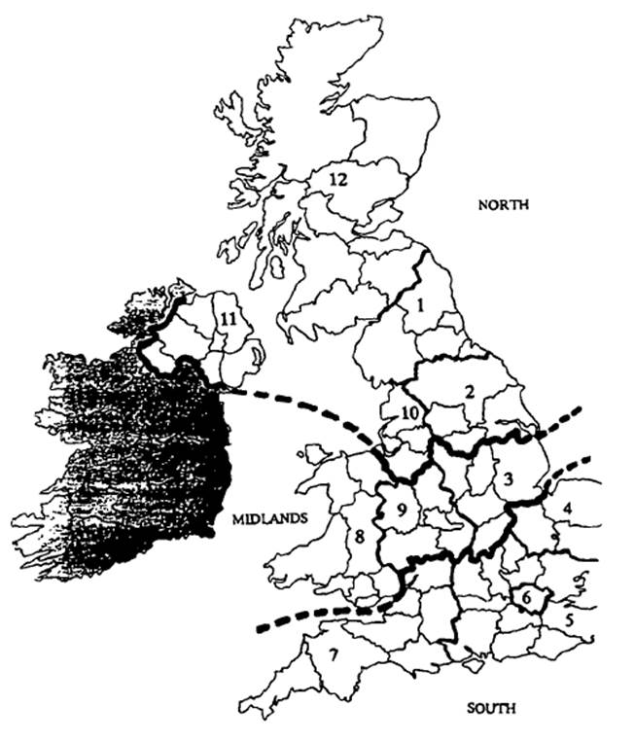
Region
Spoken BNC1994:
Crowdy
(1993: 260)
Recording location (North/Midlands/South)
‘Dialect/accent’ (32.9% speakers)
@lovermob

Slide 10
Region
What is region anyway? What are we trying to represent here?
Birthplace?
Recording location?
Location of current residence?
Location during acquisition?
@lovermob

Slide 11
Region – birthplace
My place of birth bears absolutely no relation to how I speak because I wasn’t brought up there; I was transported immediately somewhere else and brought up in a completely different place. But you wouldn’t know that from the form.
@lovermob

Slide 12
Region – recording location
Recordings are not just made in the speakers’ home
Holidays, visiting friends/family etc…
Location of recording may have no sociolinguistic relationship to speaker
@lovermob

Slide 13
Region – location of current residence
Chambers (1992: 680): “dialect acquirers make most of the lexical replacements they will make in the first two years”
Unreliable – where is the line?
Temporary idiolect features – new relationships, friendships etc.
@lovermob

Slide 14
Region – location during acquisition
Stanford (2008: 567): even though childhood language acquisition takes place “in the midst of a highly variable input”, it is the time where “coherent linguistic identity” is formed
But…
Like birthplace – people move around
Location ≈ linguistic identity?
@lovermob

Slide 15
Region
Purely objective metadata seems insufficient
Subjective metadata offers an imperfect solution:
Self-reported dialect
British Library’s Evolving English WordBank (2011)
E.g. “Geordie” = north east England
@lovermob

Slide 16
Self-reported dialect categorisation
Central midlands, north-east midlands, midlands, south midlands, north-west midlands…
“southern”
“normal with a brummy twang”
“mixed northern/somerset/rp”
@lovermob

Slide 17
Dialect categorisation
BNC1994: it’s a mess
Office for National Statistics’ scheme:
Nomenclature of Territorial Units for Statistics (NUTS)
Used in the census (ONS 2013)
(1) North East
(2) North West
(3) Merseyside
(4) Yorkshire & Humberside
(5) East Midlands
(6) West Midlands
(7) Eastern
(8) London
(9) South East
(10) South West
(11) Wales
(12) Scotland
(13) Northern Ireland
@lovermob

Slide 18
Dialect in the Spoken BNC2014
(1) Global | (2) Country | (3) Supra-region | (4) Region
UK | England | North | North East
 |  |  | Yorkshire & Humberside
 |  |  | North West (not Merseyside)
 |  |  | Merseyside
 |  | Midlands | East Midlands
 |  |  | West Midlands
 |  | South | Eastern
 |  |  | South West
 |  |  | South East (not London)
 |  |  | London
 | Scotland | Scotland | Scotland
 | Wales | Wales | Wales
 | Northern Ireland | Northern Ireland | Northern Ireland
Non-UK | Republic of Ireland | Republic of Ireland | Republic of Ireland
 | Other non-UK variety | Other non-UK variety | Other non-UK variety
Unspecified | Unspecified | Unspecified | Unspecified
Comparable with Spoken BNC1994 too!
@lovermob

Slide 19
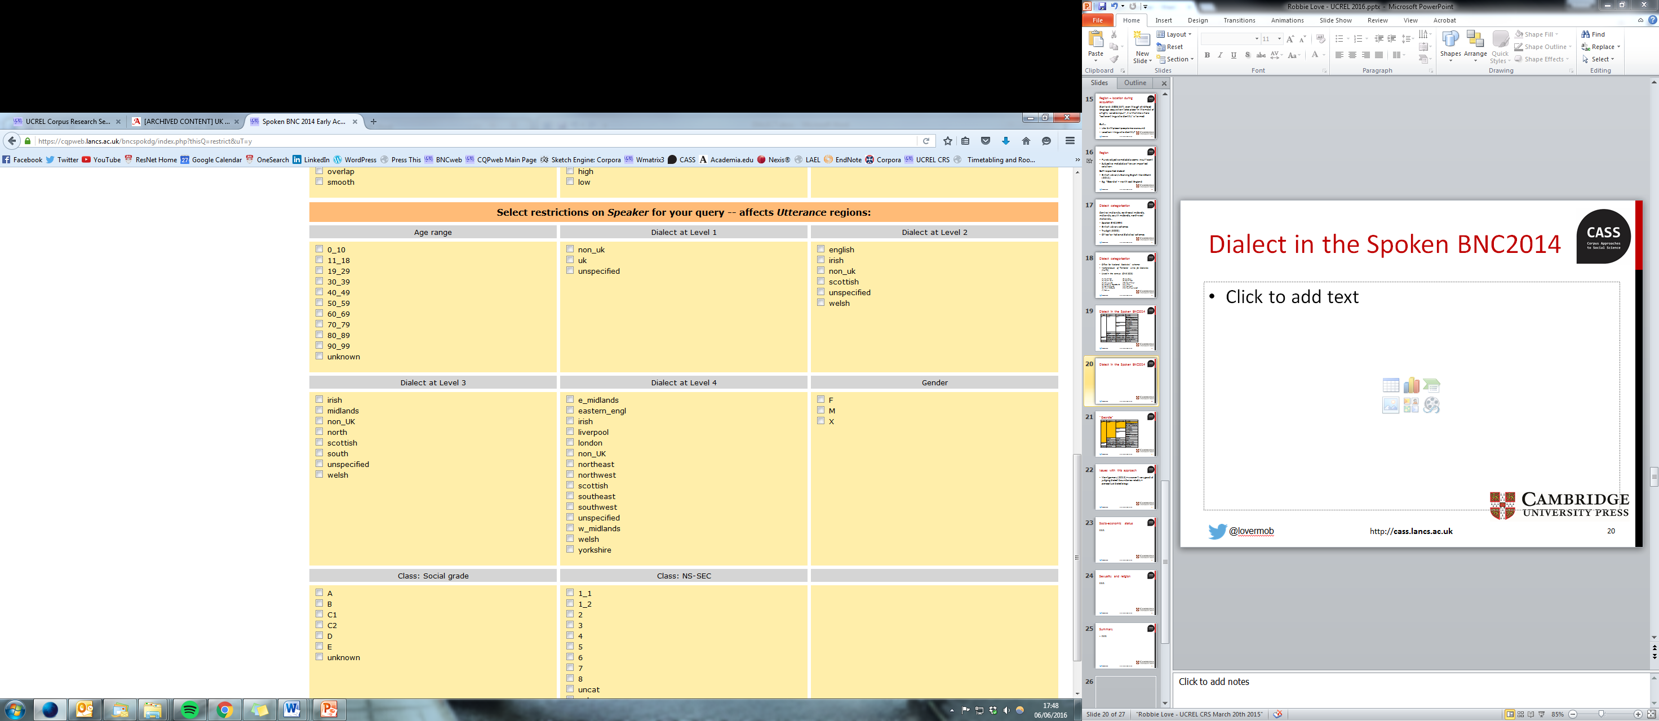
Dialect in the Spoken BNC2014
@lovermob

Slide 20
“Geordie”
(1) Global | (2) Country | (3) Supra-region | (4) Region
UK | England | North | North East
 |  |  | Yorkshire & Humberside
 |  |  | North West (not Merseyside)
 |  |  | Merseyside
 |  | Midlands | East Midlands
 |  |  | West Midlands
 |  | South | Eastern
 |  |  | South West
 |  |  | South East (not London)
 |  |  | London
 | Scotland | Scotland | Scotland
 | Wales | Wales | Wales
 | Northern Ireland | Northern Ireland | Northern Ireland
Non-UK | Republic of Ireland | Republic of Ireland | Republic of Ireland
 | Other non-UK variety | Other non-UK variety | Other non-UK variety
Unspecified | Unspecified | Unspecified | Unspecified
@lovermob

Slide 21
“Southern”
(1) Global | (2) Country | (3) Supra-region | (4) Region
UK | England | North | North East
 |  |  | Yorkshire & Humberside
 |  |  | North West (not Merseyside)
 |  |  | Merseyside
 |  | Midlands | East Midlands
 |  |  | West Midlands
 |  | South | Eastern
 |  |  | South West
 |  |  | South East (not London)
 |  |  | London
 | Scotland | Scotland | Scotland
 | Wales | Wales | Wales
 | Northern Ireland | Northern Ireland | Northern Ireland
Non-UK | Republic of Ireland | Republic of Ireland | Republic of Ireland
 | Other non-UK variety | Other non-UK variety | Other non-UK variety
Unspecified | Unspecified | Unspecified | Unspecified
@lovermob

Slide 22
“Normal with a brummy twang”
(1) Global | (2) Country | (3) Supra-region | (4) Region
UK | England | North | North East
 |  |  | Yorkshire & Humberside
 |  |  | North West (not Merseyside)
 |  |  | Merseyside
 |  | Midlands | East Midlands
 |  |  | West Midlands
 |  | South | Eastern
 |  |  | South West
 |  |  | South East (not London)
 |  |  | London
 | Scotland | Scotland | Scotland
 | Wales | Wales | Wales
 | Northern Ireland | Northern Ireland | Northern Ireland
Non-UK | Republic of Ireland | Republic of Ireland | Republic of Ireland
 | Other non-UK variety | Other non-UK variety | Other non-UK variety
Unspecified | Unspecified | Unspecified | Unspecified
@lovermob

Slide 23
“Mixed northern/somerset/rp”
(1) Global | (2) Country | (3) Supra-region | (4) Region
UK | England | North | North East
 |  |  | Yorkshire & Humberside
 |  |  | North West (not Merseyside)
 |  |  | Merseyside
 |  | Midlands | East Midlands
 |  |  | West Midlands
 |  | South | Eastern
 |  |  | South West
 |  |  | South East (not London)
 |  |  | London
 | Scotland | Scotland | Scotland
 | Wales | Wales | Wales
 | Northern Ireland | Northern Ireland | Northern Ireland
Non-UK | Republic of Ireland | Republic of Ireland | Republic of Ireland
 | Other non-UK variety | Other non-UK variety | Other non-UK variety
Unspecified | Unspecified | Unspecified | Unspecified
@lovermob

Slide 24
Evaluating this approach
Montgomery (2012) – we aren’t very good at judging dialect boundaries reliably – perceptual dialectology
  One speaker’s “southern” might be another speaker’s “midlands”
Requires some inference – i.e. a subjective metadata set
Contradictions in speaker reports
But…
More reliable method than BNC1994 – speak for yourself!
The best we can get for a top-down scheme
@lovermob

Slide 25
Regional distribution so far
@lovermob

Slide 26
Socio-economic status
Assumption: to rank according to socio-economic status = ordinal
My aim: encourage nominal use and allow data to do the talking (pun intended)
@lovermob

Slide 27
BNC1994: Social Grade
Code | Description
A | Higher managerial, administrative and professional
B | Intermediate managerial, administrative and professional
C1 | Supervisory, clerical and junior managerial, administrative and professional
C2 | Skilled manual workers
D | Semi-skilled and unskilled manual workers
E | State pensioners, casual and lowest grade workers, unemployed with state benefits only
(NRS 2014)
Dominant in market research (Collis 2009)
Few categories = low detail
Category E particularly problematic
@lovermob

Slide 28
Social Class based on Occupation (SC)
Social classes
I | Professional occupations
II | Managerial and technical occupations
III N | Skilled non-manual occupations
III M | Skilled manual occupations
IV | Partly-skilled occupations
V | Unskilled occupations
Government scheme 1913-2001 (Stuchbury 2013)
Only applicable to those with an occupation
“A hierarchy in relation to social standing or occupational skill” (Rose & Pevalin 2005: 10)
@lovermob

Slide 29
Socio-economic group (SEG)
Socio-economic categories
1.1 | Employers in industry, commerce, etc. - large establishments
1.2 | Managers in central and local government, industry, commerce, etc. - large establishments
2.1 | Employers in industry, commerce, etc. - small establishments
2.2 | Managers in industry, commerce, etc. - small establishments
3 | Professional workers - self-employed
4 | Professional workers - employees
5.1 | Ancillary workers and artists
5.2 | Foremen and supervisors - non-manual
6 | Junior non-manual workers
7 | Personal service workers
8 | Foremen and supervisors - manual
9 | Skilled manual workers
10 | Semi-skilled manual workers
11 | Unskilled manual workers
12 | Own account workers (other than professional)
13 | Famers - employers and managers
14 | Farmers - own account
15 | Agricultural workers
16 | Members of armed forces
17 | Inadequately described and not stated occupations
Government scheme 1951-2001 (Stuchbury 2013)
Not ordinally ranked (Stuchbury 2013)
Again, only applicable to those with an occupation
@lovermob

Slide 30
NS-SEC
Class | Analytic class
1 | Higher managerial, administrative and professional occupations
1.1 | Large employers and higher managerial and administrative occupations
1.2 | Higher professional occupations
2 | Lower managerial, administrative and professional occupations
3 | Intermediate occupations
4 | Small employers and own account workers
5 | Lower supervisory and technical occupations
6 | Semi-routine occupations
7 | Routine occupations
8 | Never worked and long-term unemployed
* | Students/unclassifiable
(ONS 2010)
Government standard – 2001-present
More categories than Social Grade
Nominal: “ordinality…should not be assumed and analyses should be performed by assuming nominality” (Rose & O’Reilly 1998: 4)
Automatic coding from occupation = consistency
@lovermob

Slide 31
Socio-economic status
Decision
Code using NS-SEC from occupation
Automatic mapping from NS-SEC -> Social Grade for backwards compatibility with BNC1994
Plan: attempt to retrofit the old data onto NS-SEC for two-way comparison
@lovermob

Slide 32
Mapping NS-SEC onto Social Grade
NS-SEC | Description | MAPS ON TO… | SG | Description
1 | Higher managerial, administrative and professional occupations
1.1 | Large employers and higher managerial and administrative occupations |  | A | Higher managerial, administrative and professional
1.2 | Higher professional occupations
2 | Lower managerial, administrative and professional occupations |  | B | Intermediate managerial, administrative and professional
3 | Intermediate occupations |  | C1 | Supervisory, clerical and junior managerial, administrative and professional
4 | Small employers and own account workers
5 | Lower supervisory and technical occupations |  | C2 | Skilled manual workers
6 | Semi-routine occupations |  | D | Semi-skilled and unskilled manual workers
7 | Routine occupations
8 | Never worked and long-term unemployed |  | E | State pensioners, casual and lowest grade workers, unemployed with state benefits only
* | Students/unclassifiable
@lovermob

Slide 33
Socio-economic status distribution so far
@lovermob

Slide 34
Socio-economic status distribution so far
@lovermob

Slide 35
Socio-economic status distribution (BNC1994)
@lovermob

Slide 36
How far is too far?
Pilot stage (30 speakers) – some new categories dropped
Why? Many speakers refused to answer
Sexuality 17/30 [prefer not to say]
Religion 16/30 [prefer not to say]
@lovermob

Slide 37
How far is too far?
I wasn’t quite sure why you needed to know sexual preference on there, but I suppose if you’re looking at how different factions use language and differences in language then that could be important.
There was some discussion about why you needed to know things like sexuality and religion. And some people said prefer not to say.
@lovermob

Slide 38
How far is too far?
17/30 disclosed sexuality
2/17 [homosexual]
A very large corpus would be required to overcome this difference in order to compare language of different sexualities
@lovermob

Slide 39
Summary
Self-reported speaker dialect > objective categories
Social Grade is outdated – NS-SEC gives new life to new and old data
Both need to be defined clearly
Balance between comparability & improvement & representativeness
Top-down categorisation is crucial, but limited, & new schemes should emerge from the data
Even though not ideal, we do have to be sensitive to speaker perceptions of the research
No one corpus can serve every imaginable purpose – and that’s okay!
@lovermob

Slide 40
References
British Library. (2011). Evolving English WordBank. Accessed 07 June 2016 at: http://sounds.bl.uk/Accents-and-dialects/Evolving-English-WordBank/
Chambers, J.K. (1992). Dialect Acquisition. Language, 68(4): 673-705.
Collis, D. (2009). Social Grade: A Classification Tool. Retrieved 06 January 2015 from Ipsos MediaCT: https://www.google.co.uk/url?sa=t&rct=j&q=&esrc=s&source=web&cd=1&ved=0ahUKEwiSlL7VjJXKAhUGiRoKHUahA0oQFggsMAA&url=https%3A%2F%2Fwww.ipsos-mori.com%2FDownloadPublication%2F1285_MediaCT_thoughtpiece_Social_Grade_July09_V3_WEB.pdf&usg=AFQjCNFYK_7QUoBKdeQhxFj6M8E2v8iplA&sig2=7ta53WYV0K9JufBZgLcYhw&cad=rja
Crowdy, S. (1993). Spoken Corpus Design. Literary and Linguistic Computing, 8(4), 259-265.
Kortmann, B. and Upton, C. (2008) Introduction: varieties of English in the British Isles. In Kortmann, B. and Upton, C. (eds.) Varieties of English: The British Isles. Berlin: Mouton de Gruyter. Pp. 23-32.
Montgomery, C. (2012), The effect of proximity in perceptual dialectology. Journal of Sociolinguistics, 16: 638–668. doi: 10.1111/josl.12003
NRS. (2014). Social Grade. Retrieved January 04, 2016, from National Readership Survey: http://www.nrs.co.uk/nrs-print/lifestyle-and-classification-data/social-grade/
Office for National Statistics. (2010c). The National Statistics Socio-economic Classification (NS-SEC rebased on the SOC2010). Retrieved December 12, 2013, from Office for National Statistics: http://www.ons.gov.uk/ons/guide-method/classifications/current-standard-classifications/soc2010/soc2010-volume-3-ns-sec--rebased-on-soc2010--user-manual/index.html
Office for National Statistics. (2013). Region and Country Profiles, Key Statistics, December 2013. Accessed 05 February 2015 at: http://www.ons.gov.uk/ons/publications/re-reference-tables.html?edition=tcm%3A77-337674
Rose, D. & O’Reilly, K. (1998). The ESRC Review of Government Social Classifications. London & Swindon: Office for National Statistics & Economic and Social Research Council. Retrieved 05 January 2016 from the Office for National Statistics: http://www.ons.gov.uk/ons/guide-method/classifications/archived-standard-classifications/soc-and-sec-archive/esrc-review/index.html
Rose, D. & Pevalin, D.J. (with O’Reilly, K.). (2005). The National Statistics Socio-economic Classification: Origins, Development and Use. Houndsmills: Palgrave Macmillan. Retrieved 05 January 2016 from the Office for National Statistics: http://www.ons.gov.uk/ons/guide-method/classifications/archived-standard-classifications/soc-and-sec-archive/index.html
Stanford, J. (2008). Child dialect acquisition: New perspectives on parent/peer influence. Journal of Sociolinguistics, 567-596.
Stuchbury, R. (2013a). Other classifications: SEG. Retrieved 06 January 2015 from the Centre for Longitudinal Study Information and User Support (CeLSIUS): https://www.ucl.ac.uk/celsius/online-training/socio/se050000
Stuchbury, R. (2013b). Social class (SC). Retrieved 06 January 2015 from the Centre for Longitudinal Study Information and User Support (CeLSIUS): https://www.ucl.ac.uk/celsius/online-training/socio/se040100
@lovermob

Slide 41
r.m.love@lancaster.ac.uk
@lovermob
@lovermob

