Slide 1



Sociolinguistics for spoken corpora: swearing in the Spoken BNC2014
Robbie Love
CASS, Lancaster University
r.m.love@lancaster.ac.uk
@lovermob

Slide 2
Today’s talk
Corpus linguistics and sociolinguistics
The BNC
FUCK in early 1990s
Methodological problems
The Spoken BNC2014 & socio-economic status
Findings
Summary & future work
@lovermob

Slide 3
Corpus linguistics
A set of methods, based on analysing (large) samples of real life language data
  Written, spoken, computer-mediated communication, etc…
Data & metadata can be annotated to enrich analytical power
  Spoken: e.g. “age, sex, occupation, geographic region, level of education” (Baker 2010: 6) etc.
@lovermob

Slide 4
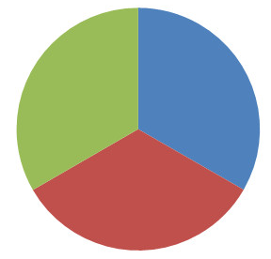
Corpus based sociolinguistics
Therefore useful for sociolinguistics
Diachronic
Synchronic
@lovermob

Slide 5

British National Corpus
“a corpus of 100 million words of written texts and spoken transcriptions of modern British English, to be stored on the computer in machine-readable form”
Leech (1993: 9)
@lovermob

Slide 6
McEnery & Xiao (2004)
Swearing in modern British English: the case of FUCK in the BNC
Original BNC’s spoken component (Leech 1993)
  Context & domain
  Type of interaction (dialogue vs. monologue)
  Gender
  Age
  Social class
  Education level
@lovermob

Slide 7
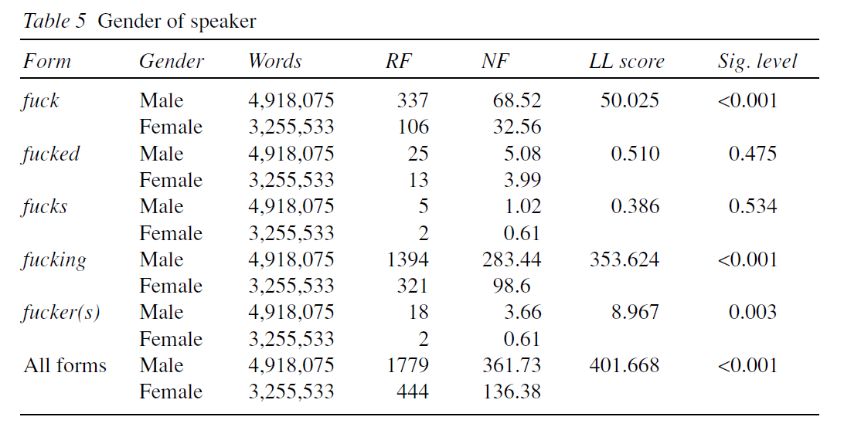
McEnery & Xiao (2004): gender
@lovermob

Slide 8
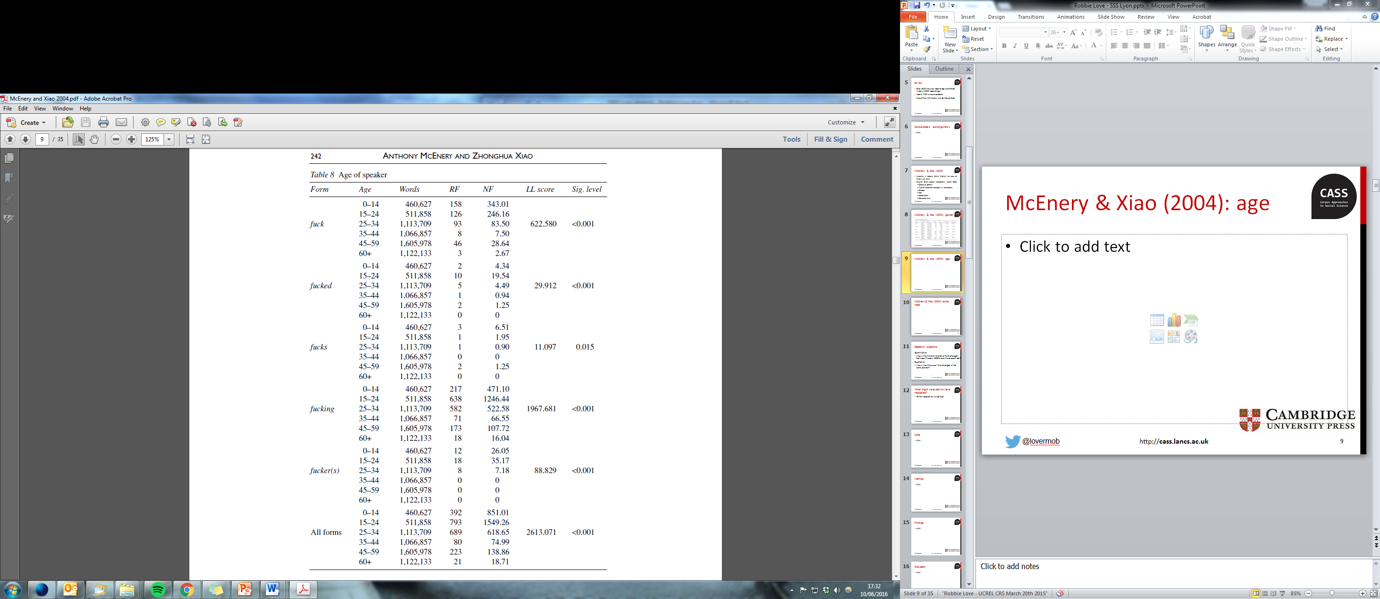
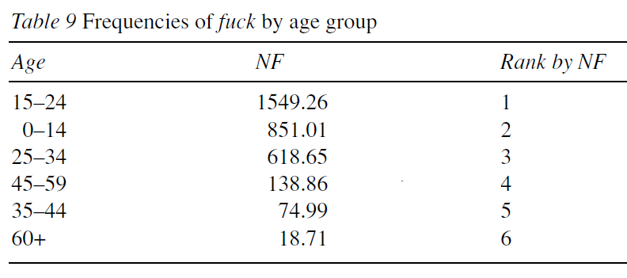
McEnery & Xiao (2004): age
@lovermob

Slide 9
BNC1994: Social Grade
Code | Description
A | Higher managerial, administrative and professional
B | Intermediate managerial, administrative and professional
C1 | Supervisory, clerical and junior managerial, administrative and professional
C2 | Skilled manual workers
D | Semi-skilled and unskilled manual workers
E | State pensioners, casual and lowest grade workers, unemployed with state benefits only
(NRS 2014)
Dominant in market research (Collis 2009)
Few categories = low detail
Category E particularly problematic
@lovermob

Slide 10
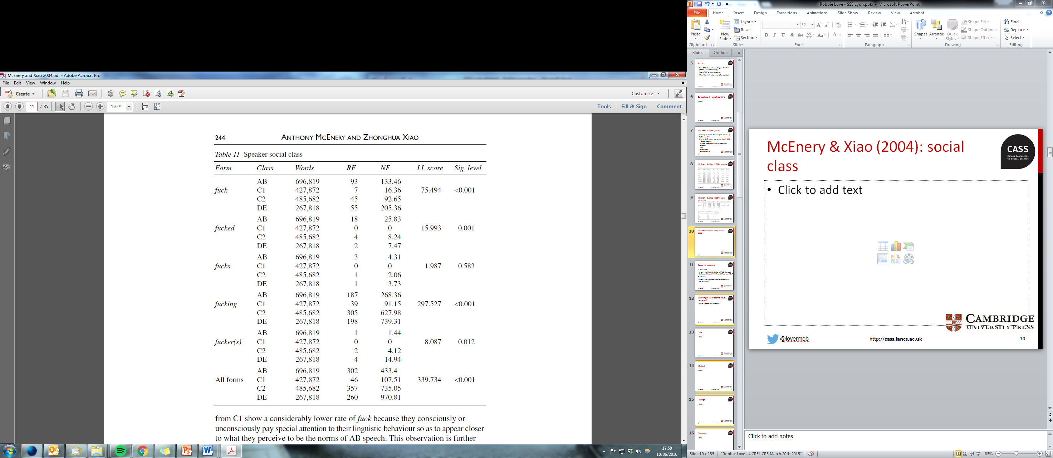
McEnery & Xiao (2004): social class
AB: “flaunt their seniority” (p. 243)
C1: “what they perceive to be the norms of AB speech” (p. 244)
@lovermob

Slide 11
This sort of work is problematic
Brezina & Meyerhoff (2014)
  Aggregate data method = “general comparisons of two or more sub-corpora such as the speech of all men in the corpus compared to all women in the corpus, or the speech of all younger speakers compared to the speech of all older speakers, etc.” (p. 3)
  Many speakers, & “extreme variance” in amount of speech produced (p. 7)
  Normalisation & use of LL “impossible” (ibid.)
@lovermob

Slide 12
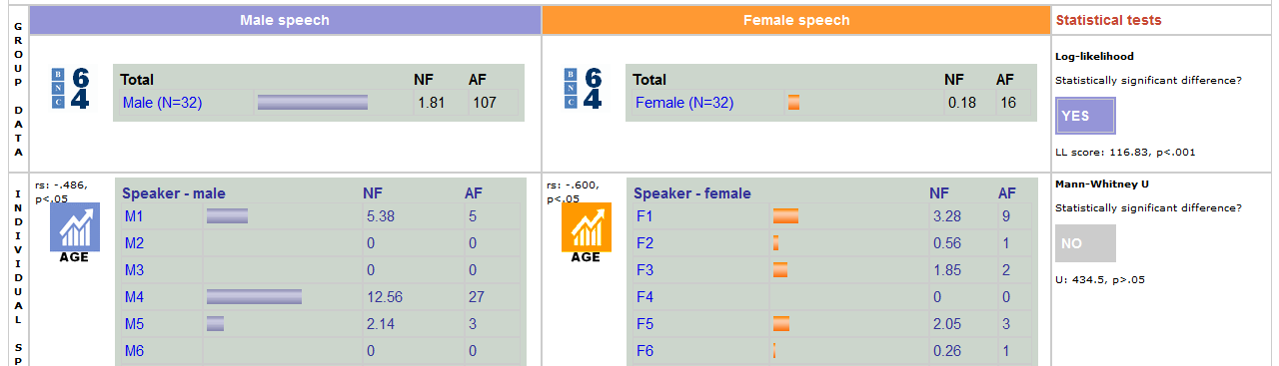
Warning: this sort of work is problematic
BNC 64 = 32 men + 32 women from BNC1994
  Only 9/32 men said fuck at all
  Only 5/32 men said fuck at all
@lovermob

Slide 13
Research questions
Quantitative
(How) has the distribution of FUCK changed between the early 1990s and the present day?
Qualitative
(How) has the use of FUCK changed in the same period?
Methodological
How should we classify speakers for corpus sociolinguistics?
@lovermob

Slide 14
Data
The Spoken BNC2014
Over 800 hours of recordings submitted (nearly 1000 recordings)
Nearly 700 unique speakers
More than 10 million words transcribed
@lovermob

Slide 15
Data
In-house beta version
4,789,185 words
376 speakers of British English
567 transcripts
Date range: 2012-2015
@lovermob

Slide 16
Method
Replication of McEnery & Xiao (2004)
  I have updated some metadata categories
Frequency searches of sub-corpora
Statistical significance testing – log-likelihood (Hardie 2014 – UCREL sig test)
Lemma FUCK (individual word forms fuck, fucked, fucks, fucking, fucker(s) + others)
Qualitative analysis of concordance lines
@lovermob

Slide 17
Findings: gender
@lovermob

Slide 18
Findings: gender
Form | Gender | Words | RF | NF | LL score | Sig. level
All forms | Male | 1911836 | 1073 | 561.2406 | 0 | 0.996
 | Female | 2872758 | 1612 | 561.1332
The gap appears to have completely closed
Or…perhaps the gap was never there in the first place (cf. Brezina & Meyerhoff 2014)
@lovermob

Slide 19
Findings: age
@lovermob

Slide 20
Findings: age
Form | Age | Words | RF | NF | LL score | Sig. level
All forms | 0-10 | 1281 | 0 | 0 | 1520.87 | 0.000
 | 11-18 | 191987 | 22 | 114.5911
 | 19-29 | 1961779 | 1944 | 990.9373
 | 30-39 | 834397 | 373 | 447.0294
 | 40-49 | 463022 | 180 | 388.7504
 | 50-59 | 375368 | 40 | 106.5621
 | 60-69 | 625013 | 76 | 121.5975
 | 70-79 | 254263 | 2 | 7.865871
 | 80-89 | 45066 | 0 | 0
 | 90-99 | 3812 | 0 | 0
The use of fuck peaks among speakers in their twenties and decreases with age
Does not support McEnery & Xiao’s analysis, unless parental age is more widely dispersed in the present day
@lovermob

Slide 21
Findings: Social Grade
@lovermob

Slide 22
Findings: Social Grade
Form | SG | Words | RF | NF | LL score | Sig. level
All forms | AB | 2641196 | 1213 | 459.2616 | 262.9 | 0.000
 | C1 | 622858 | 215 | 345.183
 | C2 | 93004 | 98 | 1053.718
 | DE | 1401946 | 1112 | 793.1832
The distribution of fuck according to social class is similar to that of McEnery & Xiao (2004) but only if the same classification scheme (Social Grade) is used
@lovermob

Slide 23
Findings: NS-SEC
@lovermob

Slide 24
Findings: NS-SEC
Form | NS-SEC | Words | RF | NF | LL score | Sig. level
All forms | 1.1 | 81728 | 4 | 48.94283 | 1321.89 | 0.000
 | 1.2 | 1060691 | 299 | 281.8917
 | 2 | 1498777 | 910 | 607.1617
 | 3 | 527335 | 82 | 155.4989
 | 4 | 95523 | 133 | 1392.335
 | 5 | 93005 | 98 | 1053.707
 | 6 | 78227 | 40 | 511.3324
 | 7 | 40390 | 23 | 569.4479
 | 8 | 668608 | 164 | 245.2857
 | Uncat | 614721 | 885 | 1439.678
Newer scheme: NS-SEC 3 (“intermediate occupations”) in particular could be prone to the norm perception effect
@lovermob

Slide 25
New forms
FUCK as lemma (1994)
  fucking (2164), fuck (583), fucked (62), fucker(s) (25), fucks (10), mother(-)fucker(s) (6), mother-fucking (1), fluctu-fucking-ation (1), fuckhead (1)
FUCK as lemma (2014)
  fucking (1530), fuck (912), fucked (168), fucker(s) (32), fucks (27), motherfucker(s) (9), fuck(-)head (5), fuckered (2), fuckwits (1), fucktard (1)
@lovermob

Slide 26
Summary
The use of FUCK does appear to have changed to some extent – gender & age particularly
New methods shine new light on previous hypotheses – socio-economic status
  Social Grade is outdated – NS-SEC gives new life to new and old data
Corpus-based sociolinguistics should be done with great caution
But it can be very powerful with large datasets such as the Spoken BNC2014
@lovermob

Slide 27
Looking ahead
Go back and re-do with a BNC 64-style sample
Analyse all swearing in the Spoken BNC2014
Evaluate McEnery’s (2006) annotation scheme & update if necessary
@lovermob

Slide 28
References
Baker, P. (2010) Sociolinguistics and Corpus Linguistics. Edinburgh: Edinburgh University Press.
Brezina, V. (2014). BNC64: Comparison of male and female speech (BETA). Accessed 14 June 2016 at http://corpora.lancs.ac.uk/bnc64/
Brezina, V., & Meyerhoff, M. (2014). Significant or random? A critical review of sociolinguistic generalisations based on large corpora. International Journal of Corpus Linguistics, 19(1), 1-28. doi:10.1075/ijcl.19.1.01bre
Collis, D. (2009). Social Grade: A Classification Tool. Retrieved 06 January 2015 from Ipsos MediaCT: https://www.google.co.uk/url?sa=t&rct=j&q=&esrc=s&source=web&cd=1&ved=0ahUKEwiSlL7VjJXKAhUGiRoKHUahA0oQFggsMAA&url=https%3A%2F%2Fwww.ipsos-mori.com%2FDownloadPublication%2F1285_MediaCT_thoughtpiece_Social_Grade_July09_V3_WEB.pdf&usg=AFQjCNFYK_7QUoBKdeQhxFj6M8E2v8iplA&sig2=7ta53WYV0K9JufBZgLcYhw&cad=rja
Crowdy, S. (1993). Spoken Corpus Design. Literary and Linguistic Computing, 8(4), 259-265.
Hardie, A. (2014). UCREL Significance Test System. Accessed 14 June 2016 at http://corpora.lancs.ac.uk/sigtest/
Leech, G. (1993). 100 million words of English. English Today, 9-15. doi:10.1017/S0266078400006854
Love, R., Dembry, C., Hardie, A., Brezina, V. and McEnery, T. (2017 fc). The Spoken BNC 2014 - designing and building a spoken corpus of everyday conversations. Special Issue of International Journal of Corpus Linguistics.
McEnery, T. (2006). Swearing in English: Bad language, purity and power from 1586 to the present. New York: Routledge.
McEnery, T. & Xiao, Z. (2004). Swearing in modern British English: the case of fuck in the BNC. In Language and Literature, 13(3). doi:10.1177/0963947004044873.
Montgomery, C. (2012), The effect of proximity in perceptual dialectology. Journal of Sociolinguistics, 16: 638–668. doi: 10.1111/josl.12003
NRS. (2014). Social Grade. Retrieved January 04, 2016, from National Readership Survey: http://www.nrs.co.uk/nrs-print/lifestyle-and-classification-data/social-grade/
Office for National Statistics. (2010c). The National Statistics Socio-economic Classification (NS-SEC rebased on the SOC2010). Retrieved December 12, 2013, from Office for National Statistics: http://www.ons.gov.uk/ons/guide-method/classifications/current-standard-classifications/soc2010/soc2010-volume-3-ns-sec--rebased-on-soc2010--user-manual/index.html
Rose, D. & O’Reilly, K. (1998). The ESRC Review of Government Social Classifications. London & Swindon: Office for National Statistics & Economic and Social Research Council. Retrieved 05 January 2016 from the Office for National Statistics: http://www.ons.gov.uk/ons/guide-method/classifications/archived-standard-classifications/soc-and-sec-archive/esrc-review/index.html
Rose, D. & Pevalin, D.J. (with O’Reilly, K.). (2005). The National Statistics Socio-economic Classification: Origins, Development and Use. Houndsmills: Palgrave Macmillan. Retrieved 05 January 2016 from the Office for National Statistics: http://www.ons.gov.uk/ons/guide-method/classifications/archived-standard-classifications/soc-and-sec-archive/index.html
@lovermob

Slide 29
r.m.love@lancaster.ac.uk
@lovermob
@lovermob

