Slide 1



Listening in on British chit chat: Building and using the Spoken BNC2014
Robbie Love
CASS, Lancaster University
r.m.love@lancaster.ac.uk
@lovermob

Slide 2
Today’s talk
Why build a new Spoken BNC?
Data collection
Metadata
Transcription
Case study: bad language
Forthcoming publications
Summary
@lovermob

Slide 3

British National Corpus
“a corpus of 100 million words of written texts and spoken transcriptions of modern British English, to be stored on the computer in machine-readable form”
Leech (1993: 9)
@lovermob

Slide 4

Why build a new Spoken BNC?
@lovermob

Slide 5
Why build a new Spoken BNC?
The BNC1994 is getting old
Can no longer be used as a proxy for present day British English
Nothing since the Spoken BNC1994:
- large size
- general coverage of spoken British English
- (low or no cost) public access
- transcribed
@lovermob

Slide 6
Why make a new one now?
Language has very likely changed during this time – lexical innovations, perhaps grammatical change etc.
Two decade comparison (1990s-2010s) never been done before
Mystery – we don’t know how else things have changed – let’s find out
@lovermob

Slide 7
The Spoken BNC2014
Lancaster University + Cambridge University Press
Both parties
Fund project equally
Encourage participation – media campaigns
Disseminate information
CUP
Corresponds with contributors
Collects recordings
Transcribes data
Lancaster
Documents the compilation of the corpus
Carries out methodological investigations
Converts transcripts to XML, encoding
Annotates corpus
Initial analysis
Prepares for public release/hosts finished corpus
@lovermob

Slide 8

So far…
1000 hours of recordings submitted (1,300 recordings)
Nearly 700 unique speakers
More than 11 million words transcribed
@lovermob

Slide 9
Data collection - decisions
‘Demographic’ data only
Opportunistic data collection
  The only reasonable approach given costs & time
  Full corpus = imbalanced e.g. England-centric
  With a smaller, balanced ‘core’
@lovermob

Slide 10
Getting started & scaling up
How can we recruit & motivate participants?
Money!
How can we gather good quality recordings?
Smartphones!
How can we gather good quality metadata?
Condition of payment; careful data management
@lovermob

Slide 11
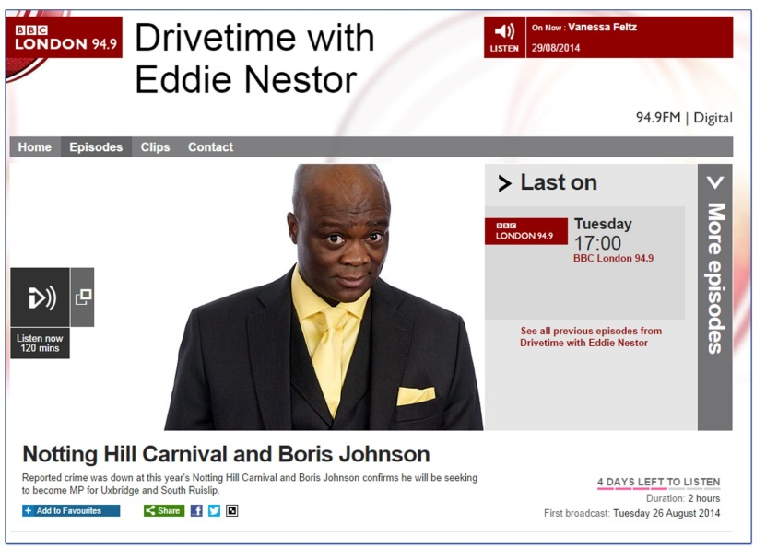
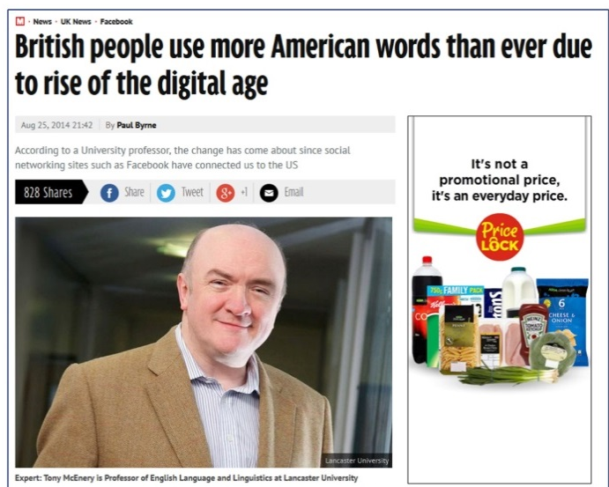
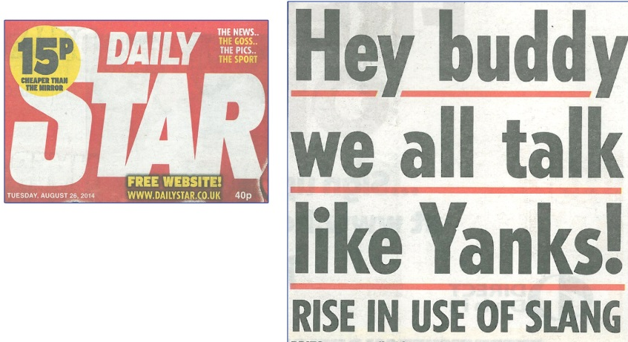
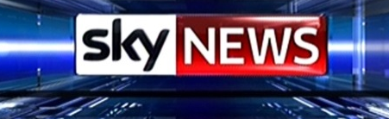

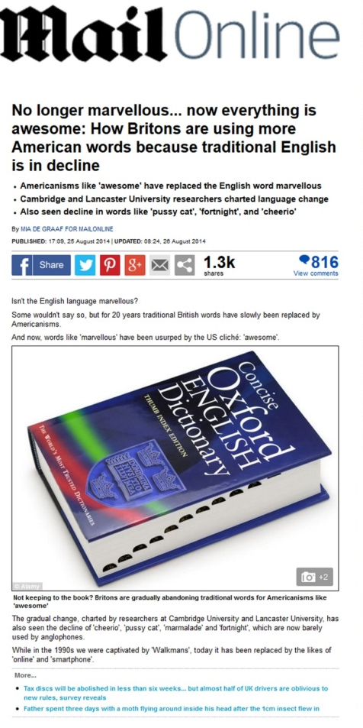
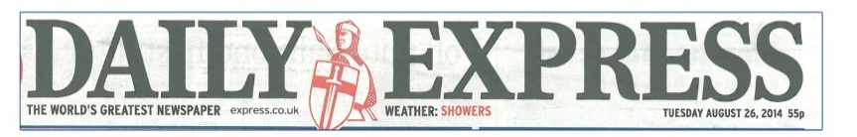
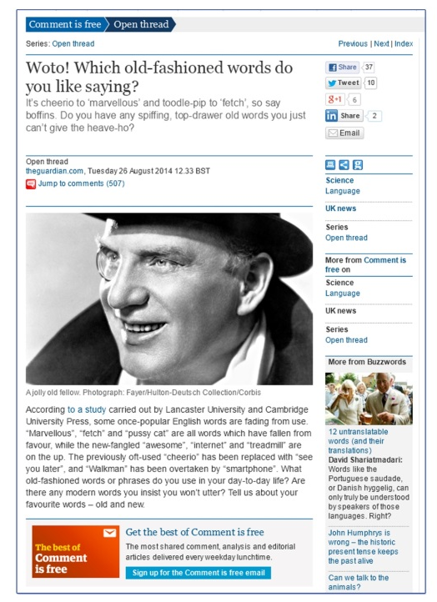
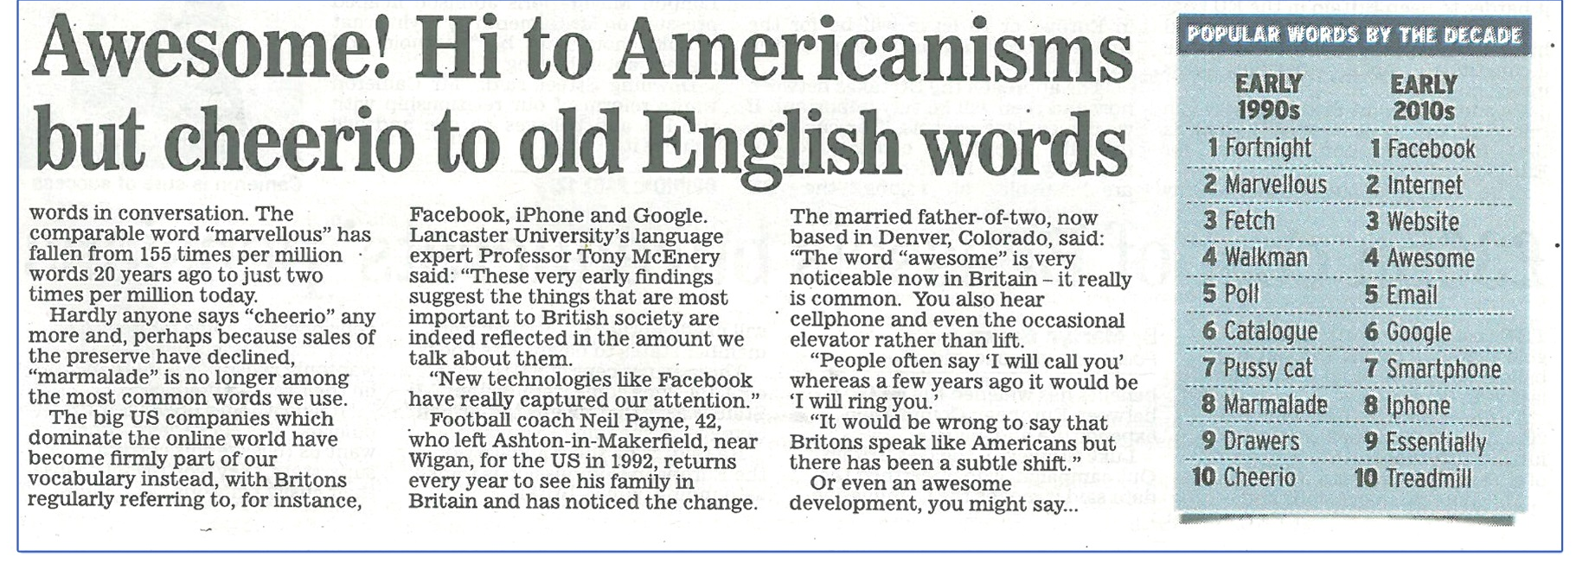
@lovermob
@lovermob
11

Slide 12
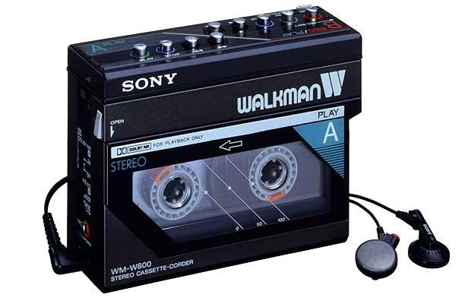
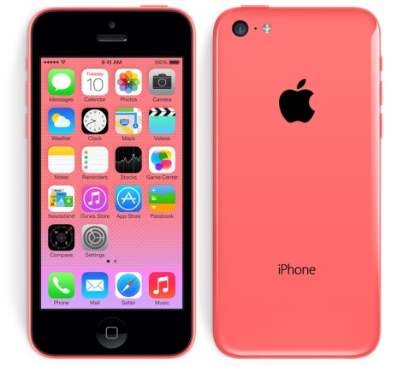


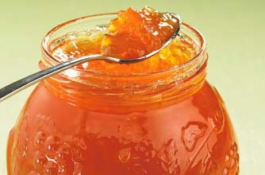


@lovermob

Slide 13
Recordings
 | Spoken BNC1994 | Spoken BNC2014
Interaction type | Demographic (40%); Context-governed (60%) | Demographic (100%)
Who? | “Carefully sampled individuals” (Leech 1993:6) | Open call for participation; Some targeting
How? | Tape recorders | Smartphone MP3 recordings
What? | All interactions in a given period | Conversations; some task-based interactions.
When? | Continuously over a 2-7 day period | As determined by participant
How many speakers? | 124 adults making recordings Over 1000 speakers | 700 unique speakers
Total data | ~10m words | 11+m
@lovermob

Slide 14
Metadata
 | Spoken BNC 1994 | Spoken BNC 2014
Speaker | Age Gender Education Occupation Accent/dialect Socio-economic category | Age Gender Education Occupation Accent/dialect Birthplace Linguistic origin Where do you currently live? How long have you lived there? Nationality Do you speak other languages?
Recording | Title Date Recording location | Title Date File name Recording length Recording location Speaker relationship Topics covered
@lovermob

Slide 15
Transcription

Slide 16
Transcription scheme development
Cambridge already had a scheme for their privately hosted spoken corpora
We worked together to refine and improve this existing work
Reviewed a range of sources, then decided upon crucial investigations to make
Recommendations reviewed and implemented to produce new Spoken BNC2014 scheme
@lovermob

Slide 17
Why not simply reuse the original transcription scheme?
Crowdy (1994) “Spoken Corpus Transcription”
Generally, it’s pretty good, but:
16 features identified in the 1,900 word scheme – very few examples
Not enough clarity in some areas, leading to ambiguity
@lovermob

Slide 18
Why not simply reuse the original?
EXAMPLE
using full stops and commas to “approximate to use in written text”, but also indicating pauses with ellipses
<2> I think it’s always, deceptive on days like this because its, overcast and [er]
[…]
<2> But, but er, he’s…just broken away from his girlfiend and [<unclear>]
<1> [Oh has] he, oh. Well he seemed happy enough when he called.
Crowdy (1994: 28)
@lovermob

Slide 19
Investigating transcription
Overlaps
Crowdy’s (1994) rather complicated system:
<1> So she was virtually a [a house prisoner]
<2> [house {bound}]
<3> {prisoner}
Decision to use simpler <OL> tag instead
@lovermob

Slide 20
Resulting scheme
From 1,900 words to 5,000 words!
Lots of examples
Minimal room for ambiguity = maximal room for inter-rater consistency
Delicate balance sought between
  backwards compatibility, and
  optimal practice
Will be made available as part of corpus documentation upon release
@lovermob

Slide 21
Case study: bad language

Slide 22
Case study: bad language
Replication of McEnery (2005) on the new data
Bad language words (BLWs) in Spoken BNC2014S compared to the Spoken BNC1994
Frequency comparison among sociolinguistic groups
Qualitative comparison – using the McEnery et al. (2000) categorization scheme

Slide 23
Research questions
Quantitative
(How) has the distribution of FUCK changed between the early 1990s and the present day?
Qualitative
(How) has the use of FUCK changed in the same period?
@lovermob

Slide 24
Data
Spoken BNC2014 Sample
4,789,185 words
376 speakers of British English
567 transcripts
Date range: 2012-2015
@lovermob

Slide 25
McEnery & Xiao (2004)
Swearing in modern British English: the case of FUCK in the BNC
Original BNC’s spoken component
  Context & domain
  Type of interaction (dialogue vs. monologue)
  Gender
  Age
  Social class
  Education level
@lovermob

Slide 26
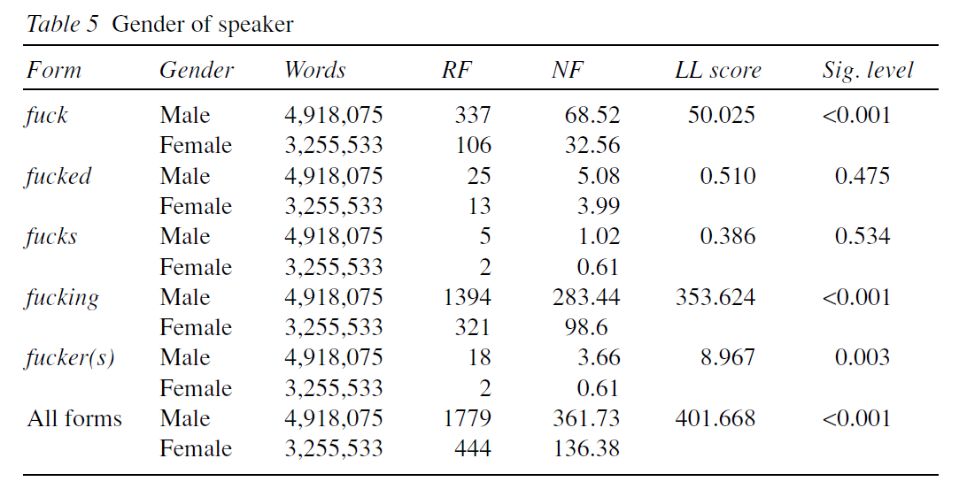
McEnery & Xiao (2004): gender
@lovermob

Slide 27
Findings: gender
@lovermob

Slide 28
Findings: gender
Form | Gender | Words | RF | NF | LL score | Sig. level
All forms | Male | 1911836 | 1073 | 561.2406 | 0 | 0.996
 | Female | 2872758 | 1612 | 561.1332
The gap appears to have completely closed
@lovermob

Slide 29
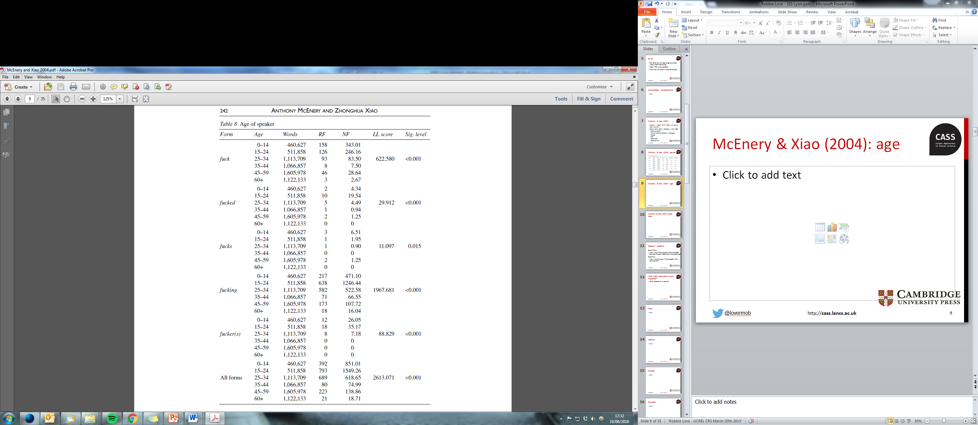
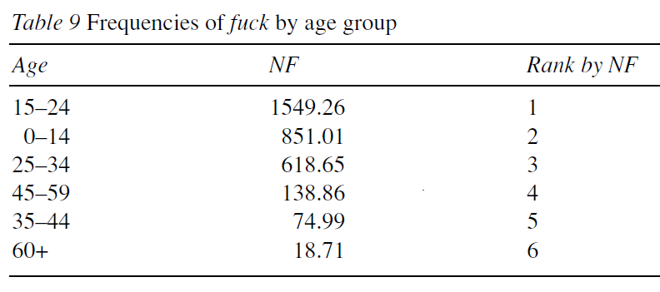
McEnery & Xiao (2004): age
@lovermob

Slide 30
Findings: age
@lovermob

Slide 31
Findings: age
Form | Age | Words | RF | NF | LL score | Sig. level
All forms | 0-10 | 1281 | 0 | 0 | 1520.87 | 0.000
 | 11-18 | 191987 | 22 | 114.59
 | 19-29 | 1961779 | 1944 | 990.94
 | 30-39 | 834397 | 373 | 447.03
 | 40-49 | 463022 | 180 | 388.75
 | 50-59 | 375368 | 40 | 106.56
 | 60-69 | 625013 | 76 | 121.60
 | 70-79 | 254263 | 2 | 7.87
 | 80-89 | 45066 | 0 | 0
 | 90-99 | 3812 | 0 | 0
The use of fuck peaks among speakers in their twenties and decreases with age
Does not support McEnery & Xiao’s analysis, unless parental age is more widely dispersed in the present day
@lovermob

Slide 32
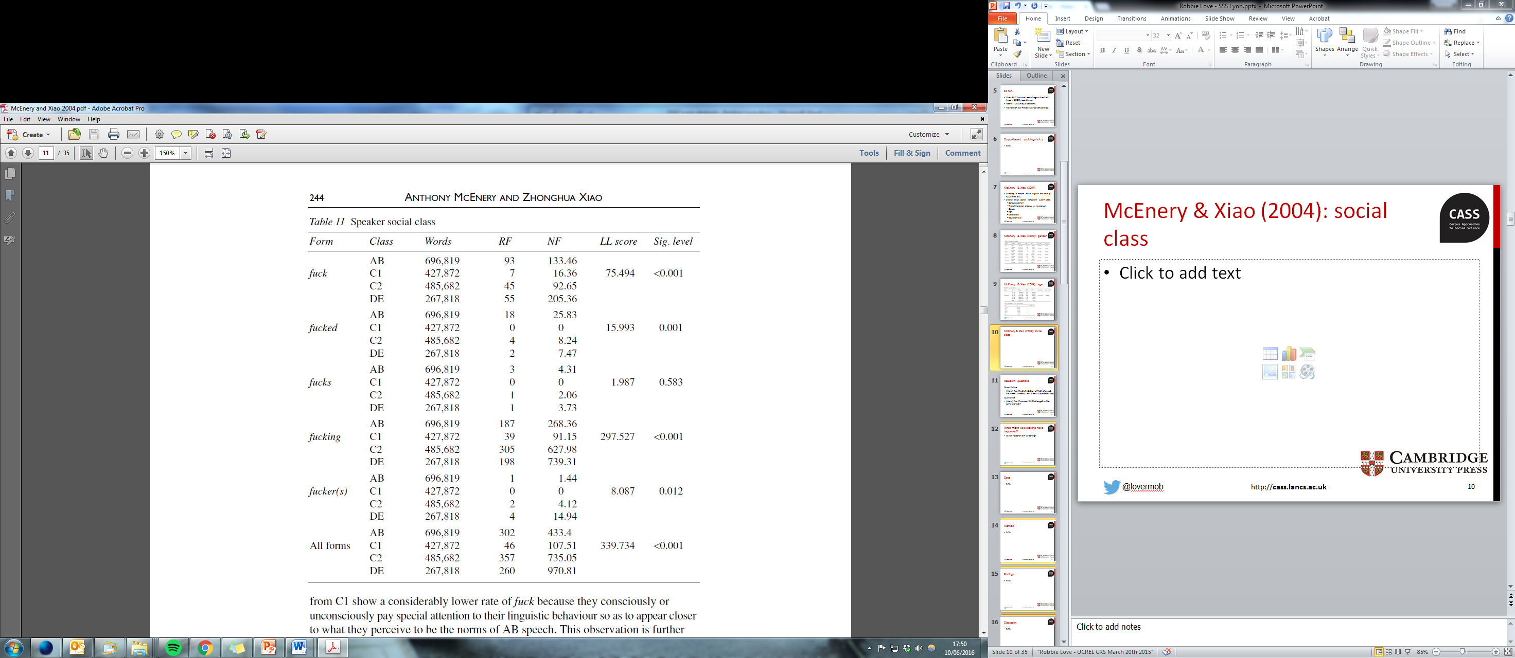
McEnery & Xiao (2004): social class
AB: “flaunt their seniority” (p. 243)
C1: “what they perceive to be the norms of AB speech” (p. 244)
@lovermob

Slide 33
Findings: Social Grade
@lovermob

Slide 34
Findings: Social Grade
Form | SG | Words | RF | NF | LL score | Sig. level
All forms | AB | 2641196 | 1213 | 459.26 | 262.9 | 0.000
 | C1 | 622858 | 215 | 345.18
 | C2 | 93004 | 98 | 1053.72
 | DE | 1401946 | 1112 | 793.18
The distribution of fuck according to social class is similar to that of McEnery & Xiao (2004) but only if the same classification scheme (Social Grade) is used
@lovermob

Slide 35
Findings: NS-SEC
@lovermob

Slide 36
Findings: NS-SEC
Form | NS-SEC | Words | RF | NF | LL score | Sig. level
All forms | 1.1 | 81728 | 4 | 48.94 | 1321.89 | 0.000
 | 1.2 | 1060691 | 299 | 281.89
 | 2 | 1498777 | 910 | 607.16
 | 3 | 527335 | 82 | 155.50
 | 4 | 95523 | 133 | 1392.34
 | 5 | 93005 | 98 | 1053.71
 | 6 | 78227 | 40 | 511.33
 | 7 | 40390 | 23 | 569.45
 | 8 | 668608 | 164 | 245.29
 | Uncat | 614721 | 885 | 1439.68
Newer scheme: NS-SEC 3 (“intermediate occupations”) in particular could be prone to the norm perception effect
@lovermob

Slide 37
Categorization
Spoken British National Corpus (1990s)
Rank | Code | Description
1 | E | Emphatic adverb/adjective: ‘He fucking did it’ ‘in the fucking car’
2 | N | Premodifying intensifying negative adjective: ‘the fucking idiot’
3 | G | General expletive ‘(Oh) Fuck!’
4 | I | Idiomatic ‘set phrase’: ‘fuck all’ ‘give a fuck’
5 | D | Destinational usage: ‘Fuck off!’ ‘He fucked off’
Spoken British National Corpus (2010s)
Rank | Code | Description
1 | I | Idiomatic ‘set phrase’: ‘fuck all’ ‘give a fuck’
2 | G | General expletive ‘(Oh) Fuck!’
3 | F | Figurative extension of literal meaning: ‘to fuck about’
4 | D | Destinational usage: ‘Fuck off!’ ‘He fucked off’
5 | A | Predicative negative adjective: ‘Is it fucked?’
McEnery & Love (fc) – Bad language
@lovermob

Slide 38
Categorization
Idioms e.g. what the fuck = 31%
Figurative e.g. fuck it up = 14%
Emphatic adverb & adjective e.g in the fucking car = 2.7% (was 55%)
@lovermob

Slide 39
New forms
FUCK as lemma (1994)
  fucking (2164), fuck (583), fucked (62), fucker(s) (25), fucks (10), mother(-)fucker(s) (6), mother-fucking (1), fluctu-fucking-ation (1), fuckhead (1)
FUCK as lemma (2014)
  fucking (1530), fuck (912), fucked (168), fucker(s) (32), fucks (27), motherfucker(s) (9), fuck(-)head (5), fuckered (2), fuckwits (1), fucktard (1)
@lovermob

Slide 40
Bad language: thoughts so far
The use of FUCK does appear to have changed to some extent – gender & age particularly
Convergence of ‘male speech’ & ‘female speech’?
New methods shine new light on previous hypotheses – socio-economic status
  Social Grade is outdated – NS-SEC gives new life to new and old data
Plan: analyse a set of 150 BLWs in both corpora in a similar way
Take into account individual variation
@lovermob

Slide 41
Spoken BNC2014: summary
Maximize efficiency of corpus construction in view of practical constraints: especially time
There is no one ‘right’ way to do this – e.g. data collection, metadata, transcription, processing
Decisions made = justified & transparent, including weaknesses e.g. imbalance, speaker identification
Ideal: (Spoken) BNC should be recollected more regularly – it’s getting easier
But, the issue of comparability versus improvement is unlikely to go away, e.g. Brown sampling frame
@lovermob

Slide 42
Forthcoming publications
McEnery et al. (2017) – IJCL special issue
  Love et al. – building the corpus
  Fuchs – intensifiers (broad view)
  Laws et al. – verb-forming suffixation
  Hessner & Gawlitzek – intensifiers (narrow view)
  Calude – demonstrative clefts
Brezina et al. (2018) – Routledge book
  Sociolinguistic focus
@lovermob

Slide 43
Fuchs (2017) - intensifiers
Sociolinguistic change over time
Age, gender, socio-economic status & dialect ALL influence intensifier use
Females > males in most age/socio-economic groups
But, some evidence of gender difference declining between 1990s and 2010s
@lovermob

Slide 44
Laws et al. (2017) – verb-forming suffixation
Sociolinguistic change over time with –ate, -en, -ify and –ize
Effects of age & gender on lexical diversity, density & creativity
Older > younger, & male > female (diversity)
But, no gender difference in frequency
@lovermob

Slide 45
Calude (2017) – demonstrative clefts
E.g. that’s what I wanted to talk about
Synchronic variation across categories inc. education level
Older > younger
More educated > less educated
Males > females
that > this
@lovermob

Slide 46
Hessner & Gawlitzek (2017) – intensifiers
Synchronic only, gender only
Females > males
But, difference only due to amplifiers (not downtoners)
A finer grained approach to a similar topic
@lovermob

Slide 47
Forthcoming events
May 2017 – talk at ICAME (Prague)
  swearing
June 2017 – Spoken BNC2014 symposium (Lancaster)
  Love & Dembry, various IJCL/Routledge authors
July 2017 – workshop at CL2017 (Birmingham)
  beta testing the full version
Autumn 2017 – full public release on CQPweb
@lovermob

Slide 48
References
Brezina, V., R. Love and K. Aijmer (eds.). (2018 fc). Corpus Approaches to Sociolinguistic Variation in Contemporary British English: An Exploration of the Spoken BNC2014. New York: Routledge.
Crowdy, S. (1993). Spoken Corpus Design. Literary and Linguistic Computing, 8(4), 259-265.
Crowdy, S. (1994). Spoken Corpus Transcription. Literary and Linguistic Computing, 9(1), 25-28.
Hardie, A. (2012). CQPweb – combining power, flexibility and usability in a corpus analysis tool. International Journal of Corpus Linguistics 17 (3): 380-409.
Hardie, A. (2014). Modest XML for corpora: not a standard, but a suggestion. ICAME Journal, 38, 73-103.
Leech, G. (1993). 100 million words of English. English Today, 9-15. doi:10.1017/S0266078400006854
Love, R., Dembry, C., Hardie, A., Brezina, V. and McEnery, T. (2017 fc). The Spoken BNC2014: designing and building a spoken corpus of everyday conversations. In International Journal of Corpus Linguistics, 22:3.
McEnery, T. (2005). Swearing in English: Bad language, purity and power from 1586 to the present. New York: Routledge.
McEnery, T., Baker, P. & Hardie, A. (2000). Swearing and abuse in modern British English. In: PALC ’99: Practical Applications in Language Corpora. Peter Lang, Frankfurt am Main, pp. 37-48.
McEnery, T., Love, R. and Brezina, V. (eds.). (2017 fc). International Journal of Corpus Linguistics, 22:3, Special Issue.
McEnery, T. and Love, R. (fc). Bad Language. In Culpeper, J., F. Katamba, P. Kerswill, R. Wodak and T. McEnery (eds.). (fc). English Language: Description, Variation and Context (2nd ed.). London: Palgrave.
McEnery, T. & Xiao, Z. (2004). Swearing in modern British English: the case of fuck in the BNC. In Language and Literature, 13(3). doi:10.1177/0963947004044873.
@lovermob

Slide 49
r.m.love@lancaster.ac.uk
@lovermob
@lovermob

