Slide 1



Listening in on British chit chat: Building and using the Spoken BNC2014
Robbie Love
CASS, Lancaster University
r.m.love@lancaster.ac.uk
@lovermob

Slide 2
Today’s talk
Background
Why build a new Spoken BNC?
Data collection
Metadata
Transcription
Case study: bad language
Forthcoming publications
Summary
@lovermob

Slide 3
About me
BA Hons Linguistics (2010-13)
MA Language and Linguistics (2013-14)
PhD Linguistics (2014-present)
ESRC Centre for Corpus Approaches to Social Science (CASS)
Tutor: LING103, LING220, LING326, LING401
@lovermob

Slide 4
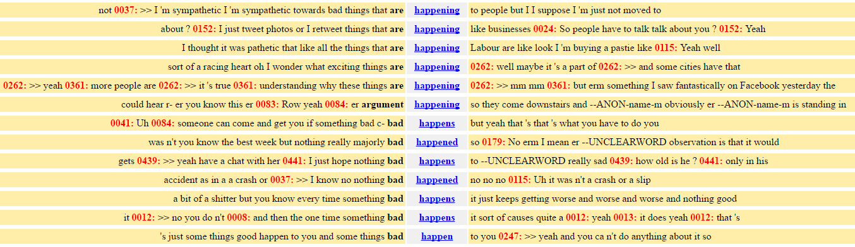
Corpus linguistics
Computer-assisted methods for the analysis of (usually large amounts of) language data
‘Corpus’ = body of texts under investigation
Unearthing patterns impossible to detect manually
@lovermob

Slide 5
CASS
Facilitating the uptake of corpus techniques in the social sciences:
Healthcare, aviation, climate change, immigration, translation, online aggression, distressed communities, genetically modified food, hate speech, language disorders, poverty, religion, history, learner language, language change, corporate communication…
All of this work requires DATA
Spoken BNC2014
@lovermob

Slide 6

British National Corpus
“a corpus of 100 million words of written texts and spoken transcriptions of modern British English, to be stored on the computer in machine-readable form”
Leech (1993: 9)
@lovermob

Slide 7





British National Corpus
@lovermob

Slide 8

Why build a new Spoken BNC?
@lovermob

Slide 9
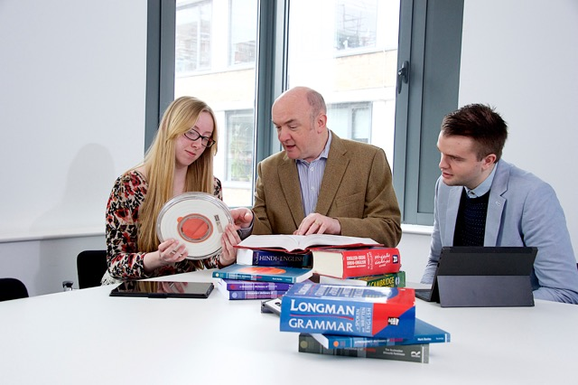

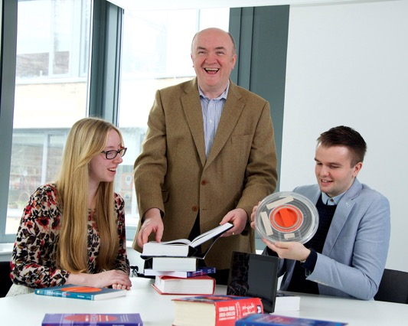
Why build a new Spoken BNC?
@lovermob

Slide 10
Why build a new Spoken BNC?
The BNC1994 is getting old
Can no longer be used as a proxy for present day British English
Nothing since the Spoken BNC1994:
- large size
- general coverage of spoken British English
- (low or no cost) public access
- transcribed
@lovermob

Slide 11
Why make a new one now?
Language has very likely changed during this time – lexical innovations, perhaps grammatical change etc.
Two decade comparison (1990s-2010s) never been done before
Mystery – we don’t know how else things have changed – let’s find out
@lovermob

Slide 12
The Spoken BNC2014
Lancaster University + Cambridge University Press
Both parties
Fund project equally
Encourage participation – media campaigns
Disseminate information
CUP
Corresponds with contributors
Collects recordings
Transcribes data
Lancaster
Documents the compilation of the corpus
Carries out methodological investigations
Converts transcripts to XML, encoding
Annotates corpus
Initial analysis
Prepares for public release/hosts finished corpus
@lovermob

Slide 13

So far…
1000 hours of recordings submitted (1,300 recordings)
Nearly 700 unique speakers
More than 11 million words transcribed
@lovermob

Slide 14
Getting started & scaling up
How can we recruit & motivate participants?
Money!
How can we gather good quality recordings?
Smartphones!
How can we gather good quality metadata?
Condition of payment; careful data management
@lovermob

Slide 15
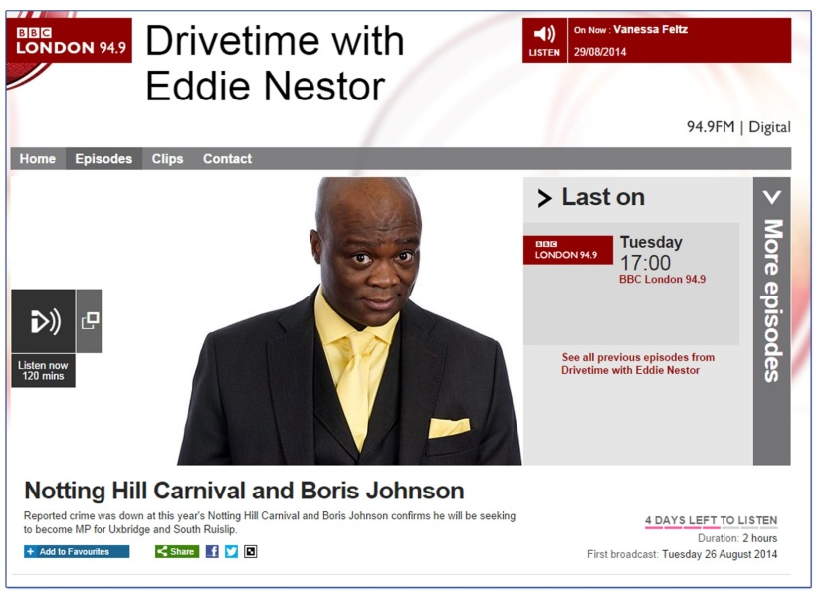
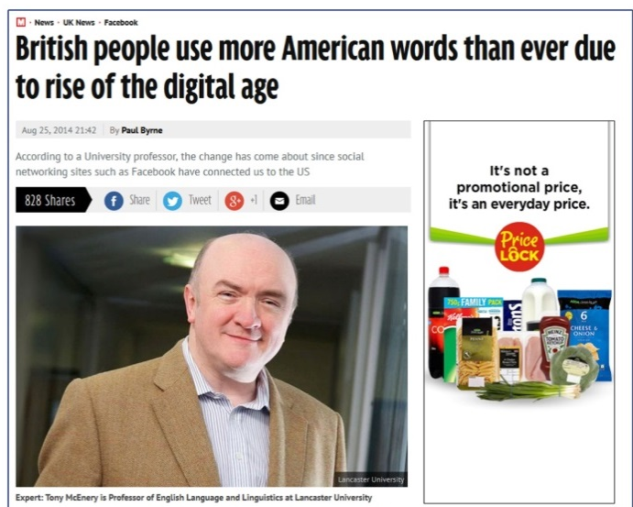
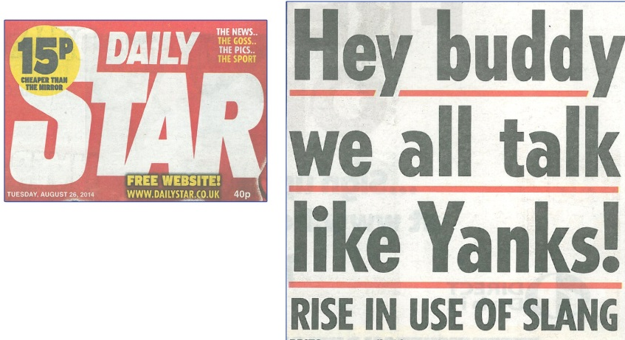
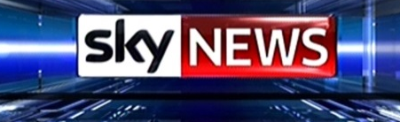

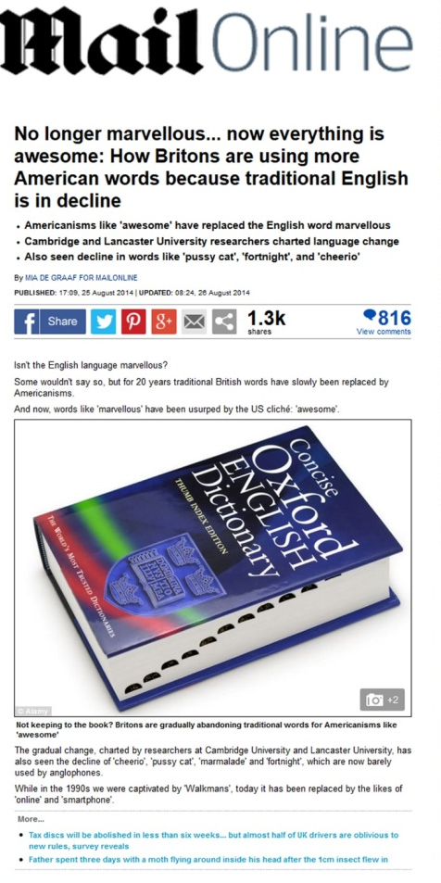
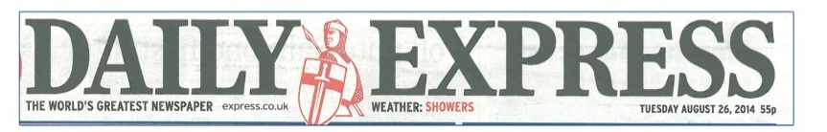
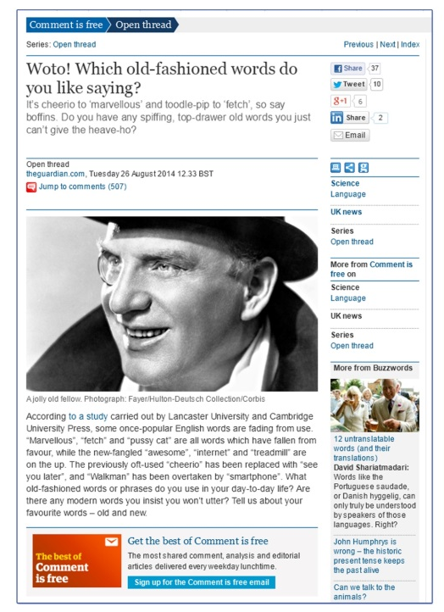
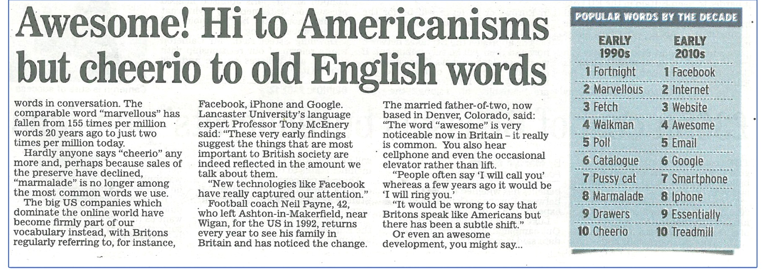
@lovermob
@lovermob
15

Slide 16
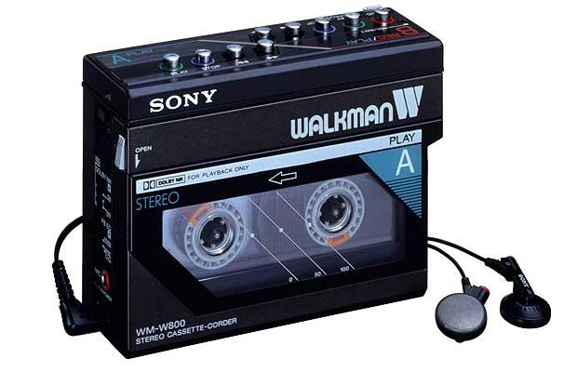
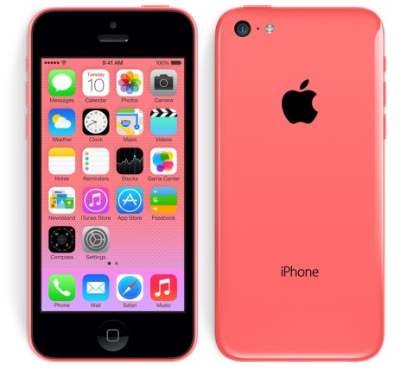


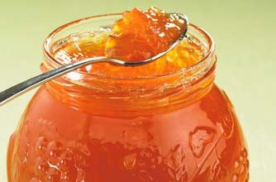


@lovermob

Slide 17
Recordings
 | Spoken BNC1994 | Spoken BNC2014
Interaction type | Demographic (40%); Context-governed (60%) | Demographic (100%)
Who? | “Carefully sampled individuals” (Leech 1993:6) | Open call for participation; Some targeting
How? | Tape recorders | Smartphone MP3 recordings
What? | All interactions in a given period | Conversations; some task-based interactions.
When? | Continuously over a 2-7 day period | As determined by participant
How many speakers? | 124 adults making recordings Over 1000 speakers | 700 unique speakers
Total data | ~10m words | 11+m
@lovermob

Slide 18
Metadata
 | Spoken BNC 1994 | Spoken BNC 2014
Speaker | Age Gender Education Occupation Accent/dialect Socio-economic category | Age Gender Education Occupation Accent/dialect Birthplace Linguistic origin Where do you currently live? How long have you lived there? Nationality Do you speak other languages?
Recording | Title Date Recording location | Title Date File name Recording length Recording location Speaker relationship Topics covered
@lovermob

Slide 19
Example
15m15s
http://www.bbc.co.uk/programmes/p04wkrxv#play

Slide 20



Transcription

Slide 21
Why not simply reuse the original transcription scheme?
Crowdy (1994) “Spoken Corpus Transcription”
Generally, it’s pretty good, but:
16 features identified in the 1,900 word scheme – very few examples
Not enough clarity in some areas, leading to ambiguity
@lovermob

Slide 22
Why not simply reuse the original?
EXAMPLE
using full stops and commas to “approximate to use in written text”, but also indicating pauses with ellipses
<2> I think it’s always, deceptive on days like this because its, overcast and [er]
[…]
<2> But, but er, he’s…just broken away from his girlfiend and [<unclear>]
<1> [Oh has] he, oh. Well he seemed happy enough when he called.
Crowdy (1994: 28)
@lovermob

Slide 23
Resulting scheme
From 1,900 words to 5,000 words!
Lots of examples
Minimal room for ambiguity = maximal room for inter-rater consistency
Delicate balance sought between
  backwards compatibility, and
  optimal practice
Will be made available as part of corpus documentation upon release
@lovermob

Slide 24
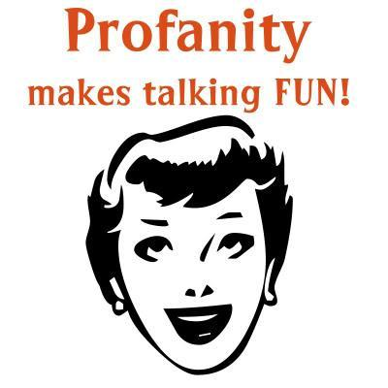
Case study: bad language*
*Contains bad language

Slide 25
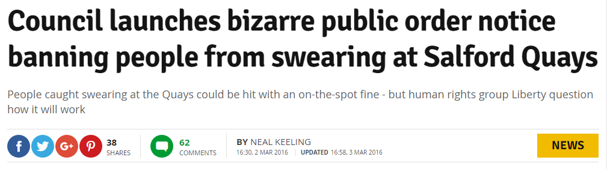
Analysing the data: bad language
Swearing is fascinating
A “marker of distinction” between social groups
People care about it – one way or another

Slide 26
Analysing the data: bad language
Bad language words = BLWS
Include swearing
  cunt
+ other potentially offensive words which you probably wouldn’t call “swearing”
  idiot

Slide 27
Analysing the data: bad language
Replication of McEnery (2005) on the new data
BLWs in Spoken BNC2014S compared to the Spoken BNC1994
Frequency comparison among sociolinguistic groups
Qualitative comparison – using the McEnery et al. (2000) categorization scheme

Slide 28
Research questions
Quantitative
Which BLWs are becoming more/less popular?
Which are stable across time?
(How) has the distribution of BLWs changed between the early 1990s and the present day?
Qualitative
(How) have the meanings of BLWs changed in the same period?
@lovermob

Slide 29
Annotation scheme
Letter code | Code | Description
A | PredNeg | Predicative negative adjective: ‘the film is shit’
B | AdvB | Adverbial booster: ‘Fucking marvellous’ ‘Fucking awful’
C | Curse | Cursing expletive: ‘Fuck You!/Me!/Him!/It!’
D | Dest | Destinational usage: ‘Fuck off!’ ‘He fucked off’
E | EmphAdv | Emphatic adverb/adjective: ‘He fucking did it’ ‘in the fucking car’
F | Figurtv | Figurative extension of literal meaning: ‘to fuck about’
G | Gen | General expletive ‘(Oh) Fuck!’
I | Idiom | Idiomatic ‘set phrase’: ‘fuck all’ ‘give a fuck’
L | Literal | Literal usage denoting taboo referent: ‘We fucked’
M | Image | Imagery based on literal meaning: ‘kick shit out of’
N | PremNeg | Premodifying intensifying negative adjective: ‘the fucking idiot’
O | Pron | ‘Pronominal’ form with undefined referent: ‘got shit to do’
P | Personal | Personal insult referring to defined entity: ‘You fuck!’/‘That fuck’
R | Reclaimed | ‘Reclaimed’ usage—no negative intent, e.g. Niggers/Niggaz as used by African American rappers
T | Oath | Religious oath used for emphasis: ‘by God’
X | Unc | Unclassifiable due to insufficient context
@lovermob

Slide 30
Data
Spoken BNC2014 Sample
4,789,185 words
376 speakers of British English
567 transcripts
Date range: 2012-2015
@lovermob

Slide 31
Data
173 BLWs searched
e.g.
[word=".*fuck.*"%c]
31,423 hits in both corpora!!!
@lovermob

Slide 32
‘Dead’ & ‘new’ BLWs?
‘Dead’ BLWs:
jizz, nig-nog, snatch, wog, gender bender, wop, son of a bitch, golliwog, chinky, slapper
‘New’ BLWs:
beaver, bellend, bint, chav, clunge, douche, fop, gippo, gook, minger, munter, papist, prod, rapey, wuss
@lovermob

Slide 33
Fallers, risers, stable BLWS
Fallers:
bastard, bloody, bollock, bugger, Christ, cow, cunt, damn, fag, git, hell, ho, jock, prat, pussy, sod, spastic, taff, wank
Risers:
boob, bullshit, chav, douche, dyke, gay, god, idiot, jeez, jew, mental, nazi, psycho, retard, shit, wuss
Stable:
arse, bitch, crap, dick, fuck, Jesus
@lovermob

Slide 34
Case study: FUCK
Swearing in modern British English: the case of FUCK in the BNC (McEnery & Xiao 2004)
Original BNC’s spoken component
  Context & domain
  Type of interaction (dialogue vs. monologue)
  Gender
  Age
  Social class
  Education level
@lovermob

Slide 35
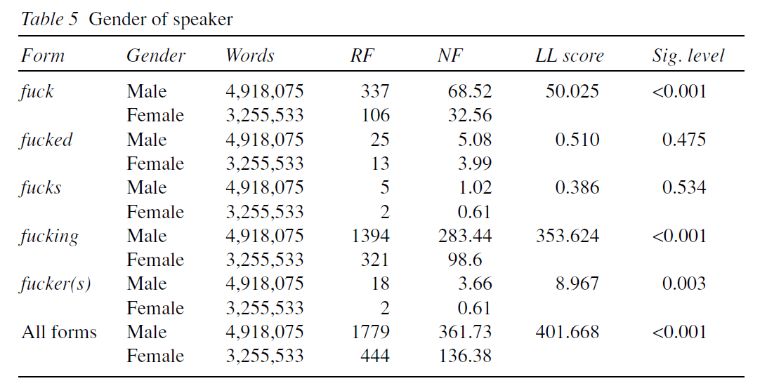
McEnery & Xiao (2004): gender
@lovermob

Slide 36
Findings: gender
Gap appears to have closed
@lovermob

Slide 37
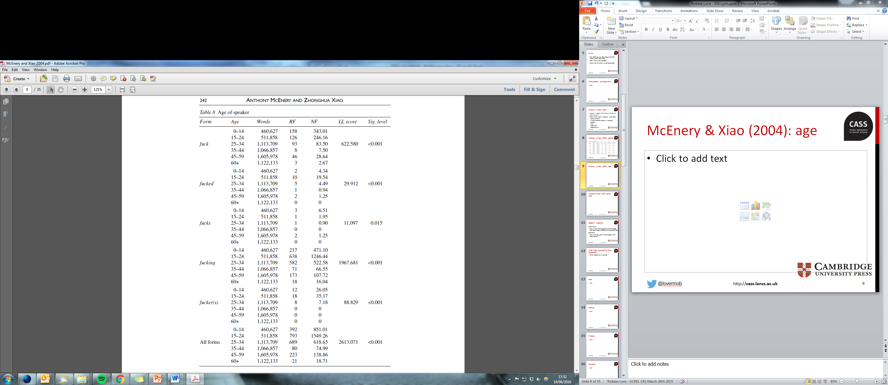
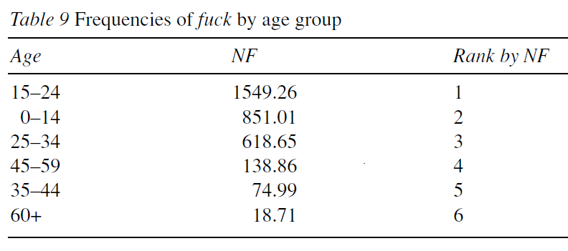
McEnery & Xiao (2004): age
@lovermob

Slide 38
Findings: age
Parental age is more widely dispersed in 2010s?
@lovermob

Slide 39
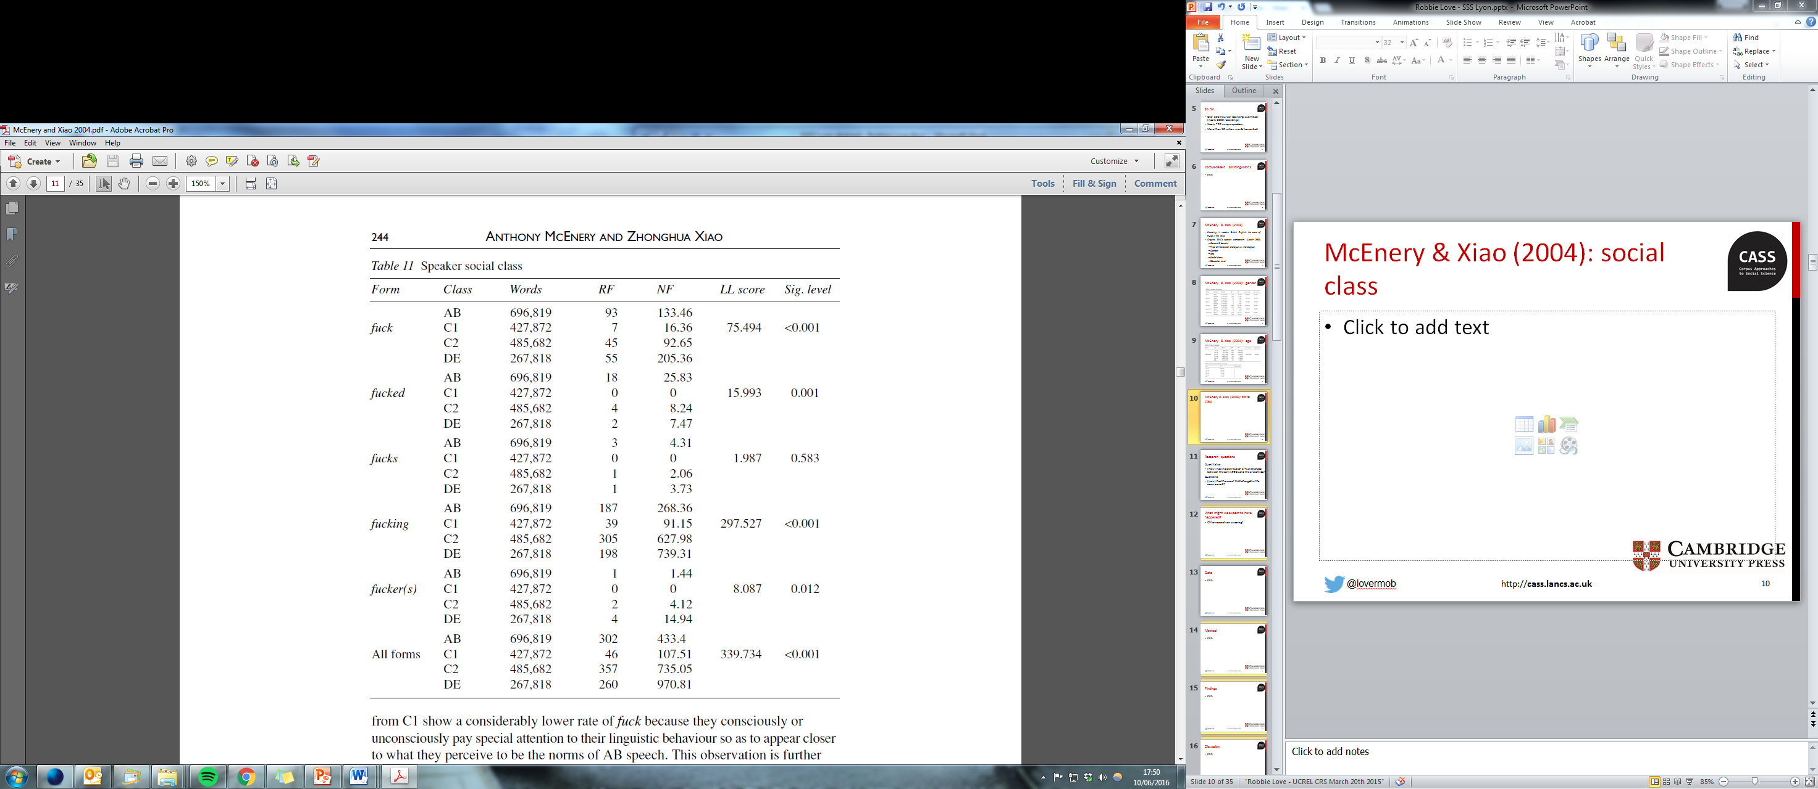
McEnery & Xiao (2004): social class
AB: “flaunt their seniority” (p. 243)
C1: “what they perceive to be the norms of AB speech” (p. 244) = norm perception effect
@lovermob

Slide 40
Findings: Social Grade
@lovermob

Slide 41
Findings: NS-SEC
NS-SEC 3 (“intermediate occupations”)
@lovermob

Slide 42
Categorization
Spoken British National Corpus (1990s)
Rank | Code | Description
1 | E | Emphatic adverb/adjective: ‘He fucking did it’ ‘in the fucking car’
2 | N | Premodifying intensifying negative adjective: ‘the fucking idiot’
3 | G | General expletive ‘(Oh) Fuck!’
4 | I | Idiomatic ‘set phrase’: ‘fuck all’ ‘give a fuck’
5 | D | Destinational usage: ‘Fuck off!’ ‘He fucked off’
Spoken British National Corpus (2010s)
Rank | Code | Description
1 | I | Idiomatic ‘set phrase’: ‘fuck all’ ‘give a fuck’
2 | G | General expletive ‘(Oh) Fuck!’
3 | F | Figurative extension of literal meaning: ‘to fuck about’
4 | D | Destinational usage: ‘Fuck off!’ ‘He fucked off’
5 | A | Predicative negative adjective: ‘Is it fucked?’
McEnery & Love (fc) – Bad language
@lovermob

Slide 43
Categorization
Idioms e.g. what the fuck = 31%
Figurative e.g. fuck it up = 14%
Emphatic adverb & adjective e.g in the fucking car = 2.7% (was 55%)
The ‘meaning’ of the word FUCK has changed!
@lovermob

Slide 44
New forms
FUCK as lemma (1994)
  fucking (2164), fuck (583), fucked (62), fucker(s) (25), fucks (10), mother(-)fucker(s) (6), mother-fucking (1), fluctu-fucking-ation (1), fuckhead (1)
FUCK as lemma (2014)
  fucking (1530), fuck (912), fucked (168), fucker(s) (32), fucks (27), motherfucker(s) (9), fuck(-)head (5), fuckered (2), fuckwits (1), fucktard (1)
@lovermob

Slide 45
Bad language: thoughts so far
Change in bad language – like all language – can happen very quickly
E.g. the use of FUCK does appear to have changed to some extent – gender & age particularly
Convergence of ‘male speech’ & ‘female speech’?
Frequency change is one thing, but social distribution & qualitative analysis very powerful
Bad language is very context-dependent – when is FUCK offensive? When is it not? Harder to tackle using corpus linguistics alone
@lovermob

Slide 46
Spoken BNC2014: summary
Maximize efficiency of corpus construction in view of practical constraints: especially time
There is no one ‘right’ way to do this – e.g. data collection, metadata, transcription, processing
Decisions made = justified & transparent, including weaknesses e.g. imbalance, speaker identification
Ideal: (Spoken) BNC should be recollected more regularly – it’s getting easier
But, the issue of comparability versus improvement is unlikely to go away, e.g. Brown sampling frame
@lovermob

Slide 47
Forthcoming events
May 2017 – talk at ICAME (Prague)
  swearing
June 2017 – Spoken BNC2014 symposium (Lancaster)
  Love & Dembry, various IJCL/Routledge authors
July 2017 – workshop at CL2017 (Birmingham)
  beta testing the full version
Autumn 2017 – full public release on CQPweb
@lovermob

Slide 48
References
Brezina, V., R. Love and K. Aijmer (eds.). (2018 fc). Corpus Approaches to Sociolinguistic Variation in Contemporary British English: An Exploration of the Spoken BNC2014. New York: Routledge.
Crowdy, S. (1993). Spoken Corpus Design. Literary and Linguistic Computing, 8(4), 259-265.
Crowdy, S. (1994). Spoken Corpus Transcription. Literary and Linguistic Computing, 9(1), 25-28.
Hardie, A. (2012). CQPweb – combining power, flexibility and usability in a corpus analysis tool. International Journal of Corpus Linguistics 17 (3): 380-409.
Hardie, A. (2014). Modest XML for corpora: not a standard, but a suggestion. ICAME Journal, 38, 73-103.
Leech, G. (1993). 100 million words of English. English Today, 9-15. doi:10.1017/S0266078400006854
Love, R., Dembry, C., Hardie, A., Brezina, V. and McEnery, T. (2017 fc). The Spoken BNC2014: designing and building a spoken corpus of everyday conversations. In International Journal of Corpus Linguistics, 22:3.
McEnery, T. (2005). Swearing in English: Bad language, purity and power from 1586 to the present. New York: Routledge.
McEnery, T., Baker, P. & Hardie, A. (2000). Swearing and abuse in modern British English. In: PALC ’99: Practical Applications in Language Corpora. Peter Lang, Frankfurt am Main, pp. 37-48.
McEnery, T., Love, R. and Brezina, V. (eds.). (2017 fc). International Journal of Corpus Linguistics, 22:3, Special Issue.
McEnery, T. and Love, R. (fc). Bad Language. In Culpeper, J., F. Katamba, P. Kerswill, R. Wodak and T. McEnery (eds.). (fc). English Language: Description, Variation and Context (2nd ed.). London: Palgrave.
McEnery, T. & Xiao, Z. (2004). Swearing in modern British English: the case of fuck in the BNC. In Language and Literature, 13(3). doi:10.1177/0963947004044873.
@lovermob

Slide 49
r.m.love@lancaster.ac.uk
@lovermob
@BNC_2014
@lovermob

