Slide 1



The Spoken BNC2014: project overview and methodological issues
Robbie Love
CASS, Lancaster University
r.m.love@lancaster.ac.uk
@lovermob

Slide 2
The original BNC (1994)
“a corpus of 100 million words of written texts and spoken transcriptions of modern British English, to be stored on the computer in machine-readable form”
(Leech 1993:9)
@lovermob

Slide 3
The original Spoken BNC (1994)
“an immense collection of conversational data, systematically sampled across the whole population of the UK…a comprehensive and carefully sampled record of how the language is used in living speech”
(Leech 1993:14)
@lovermob

Slide 4
Today’s talk
Why build a new Spoken BNC?
Data collection methods
Transcription scheme development
Annotation plans
Speaker identification
@lovermob

Slide 5


Why build a new Spoken BNC?
@lovermob

Slide 6
Why build a new Spoken BNC?
It’s getting old
Can no longer be used as a proxy for present day British English
Nothing since the Spoken BNC (1994):
- large size
- general coverage of spoken British English
- (low or no cost) public access
- transcribed
@lovermob

Slide 7
Why make a new one now?
Language has very likely changed during this time – lexical innovations, etc.
Grammar too - Geoff Leech’s work on modality (2003) shows that change can happen quickly
Two decade comparison (1990s-2010s) never been done before
Mystery – we don’t know how else things have changed – let’s find out
@lovermob

Slide 8
The Spoken BNC2014
Cambridge University Press started work
Lancaster joined in and formalised as BNC
10 million words spontaneous conversation
Smartphones (vs. tape recorders)
Non-surreptitious!
@lovermob

Slide 9
The Spoken BNC2014
Both parties
Fund project equally
Encourage participation – media campaigns
Disseminate information
CUP
Corresponds with contributors
Collects recordings
Transcribes data
Lancaster
Carries out methodological investigations
Converts transcripts to XML, encoding
Annotates corpus
Initial analysis
Prepares for public release/hosts finished corpus
@lovermob

Slide 10
Getting started & scaling up
How can we recruit & motivate participants?
Money!
How can we gather good quality recordings?
Smartphones!
How can we manage information?
Condition of payment; careful data management
@lovermob

Slide 11
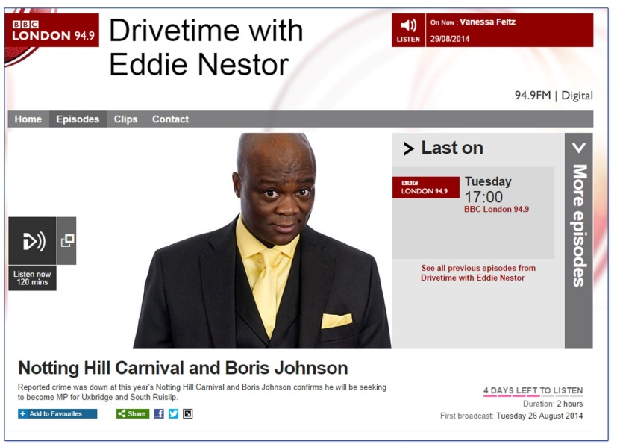
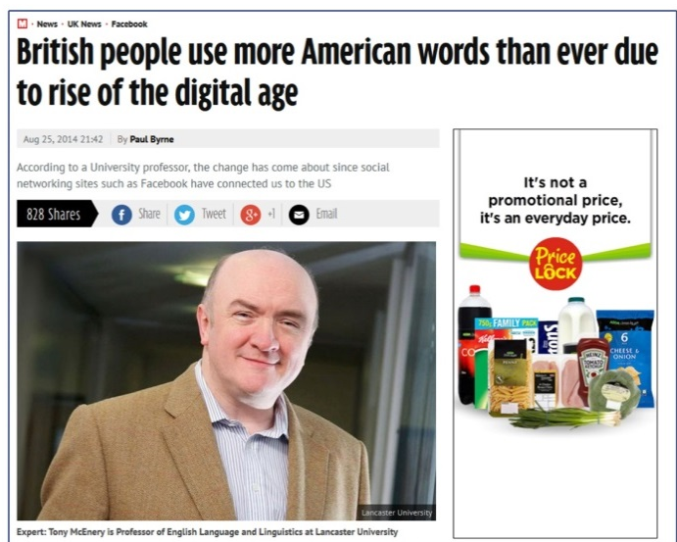
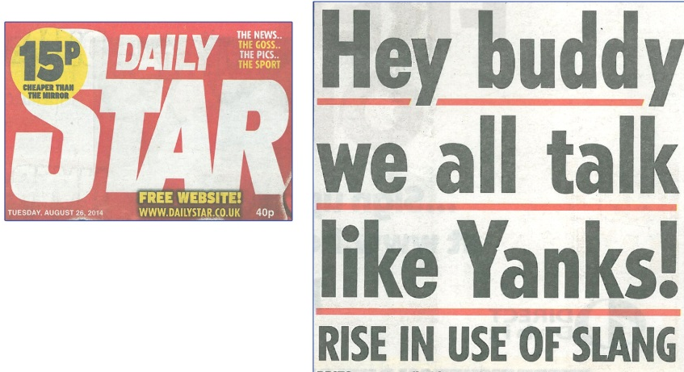
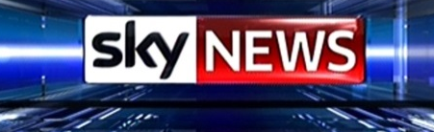

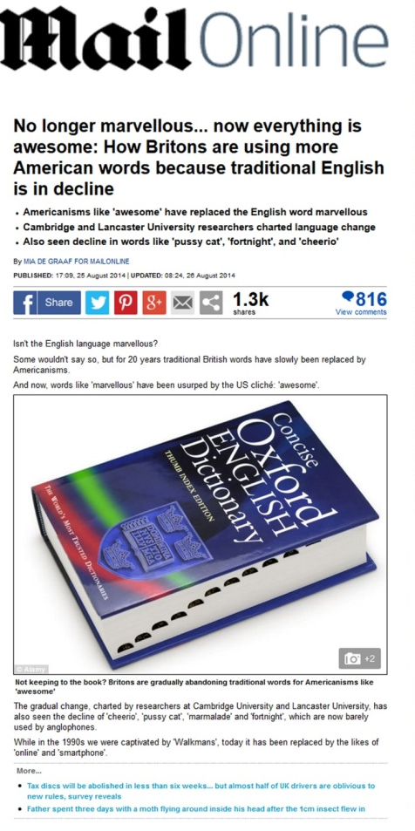
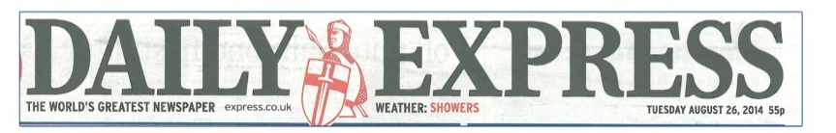
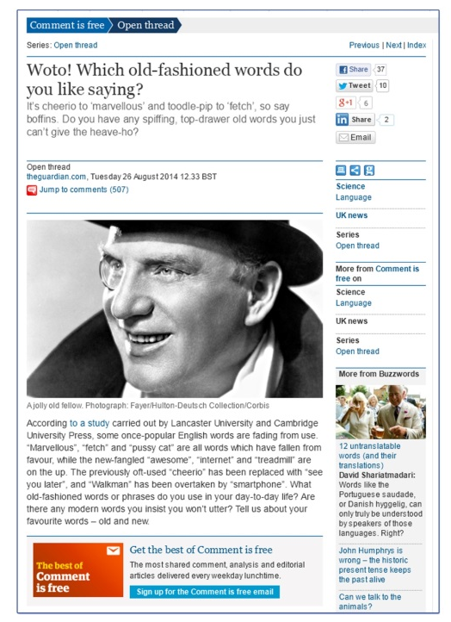
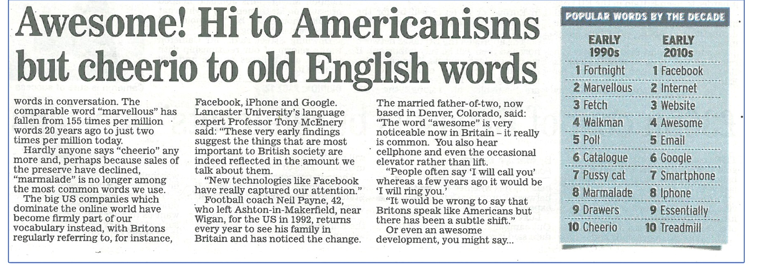
@lovermob
@lovermob
11

Slide 12
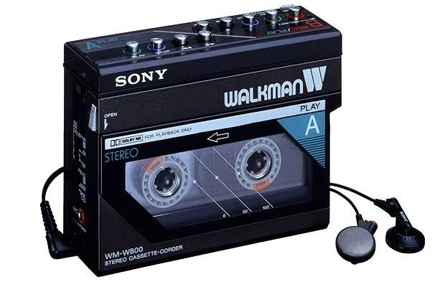
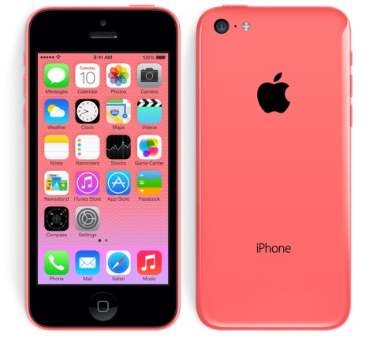


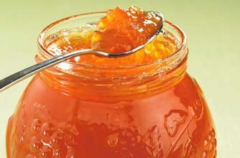


@lovermob

Slide 13
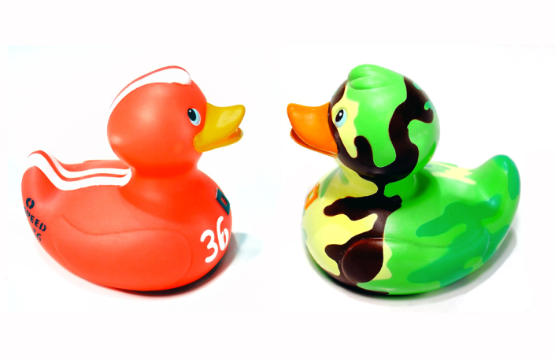
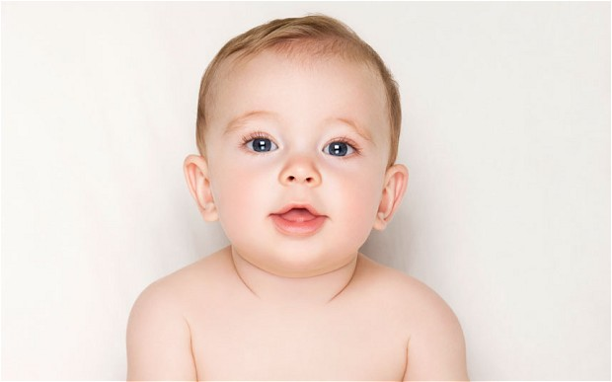
Social media campaigns
Baby or Bairn?
Ey up mi duck?
@lovermob

Slide 14
(Methodological) comparison to the original
Recordings
Metadata
@lovermob

Slide 15
Recordings
 | Spoken BNC 1994 | Spoken BNC 2014
Interaction type | Demographic (40%); Context-governed (60%) | Demographic (100%)
Who? | “Carefully sampled individuals” (Leech 1993:6) | Open call for participation; Some targeting
How? | Tape recorders | Smartphone MP3 recordings
What? | All interactions in a given period | Conversations; some task-based interactions.
When? | Continuously over a 2-7 day period | As determined by participant
How many speakers? | 124 adults making recordings | 438 unique speakers (so far)
Total data | ~10m words | ~6m words so far (10m planned)
@lovermob

Slide 16
Metadata
 | Spoken BNC 1994 | Spoken BNC 2014
Speaker | Age Gender Education Occupation Accent/dialect Socio-economic category | Age Gender Education Occupation Accent/dialect Birthplace Linguistic origin Where do you currently live? How long have you lived there? Nationality Do you speak other languages?
Recording | Title Date | Title Date File name Recording length Recording location Speaker relationship Topics covered
@lovermob

Slide 17
The question of region
Central midlands, north-east midlands, midlands, south midlands, north-west midlands…
Birthplace?
Current location?
Location during acquisition?
Self-reported dialect
@lovermob

Slide 18
So far…
Almost 500 hours of recordings submitted
505 unique speakers
More than 8 million words transcribed
@lovermob

Slide 19

Conversational topics
@lovermob

Slide 20
Summary so far
Mobile phones/social media aiding data collection
Public as independent freelancers
Opportunity for innovation
@lovermob

Slide 21
Transcription scheme development
Cambridge already had a scheme for their privately hosted spoken corpora
We worked together to refine and improve this existing work
Reviewed a range of sources, then decided upon crucial investigations to make
Recommendations reviewed and implemented to produce new Spoken BNC2014 scheme
@lovermob

Slide 22
Why not simply reuse the original transcription scheme?
Crowdy (1994) “Spoken Corpus Transcription”
Generally, it’s pretty good, but:
16 features identified in the 1,900 word scheme – very few examples
Not enough clarity in some areas, leading to ambiguity
Compatibility with CASS XML standards for automatic conversion
@lovermob

Slide 23
Why not simply reuse the original?
EXAMPLE
using full stops and commas to “approximate to use in written text”, but also indicating pauses with ellipses
<2> I think it’s always, deceptive on days like this because its, overcast and [er]
[…]
<2> But, but er, he’s…just broken away from his girlfiend and [<unclear>]
<1> [Oh has] he, oh. Well he seemed happy enough when he called.
Crowdy (1994: 28)
@lovermob

Slide 24
How we investigated the issues
Set #1 = decisions made based on evidence from sources
Set #2 = decisions made based on evidence from pilot study (Love 2014)
Observations discussed between Lancaster and Cambridge
Implemented to create the new Spoken BNC2014 transcription scheme
@lovermob

Slide 25
Investigating transcription
Set 1
Overlaps
Filled pauses
Pauses
Events
+ non-English speech
+ capitalisation
Set 2
Anonymization
+ speaker identification
+ quotative speech
@lovermob

Slide 26
Investigating transcription
Overlaps
Crowdy’s (1994) rather complicated system:
<1> So she was virtually a [a house prisoner]
<2> [house {bound}]
<3> {prisoner}
Not in Trinity Lancaster corpus (Gablasova et al. under review)
Decision to use simpler <OL> tag instead
@lovermob

Slide 27
Investigating transcription
Filled pauses = sound over function
What it sounds like | How to write it
Has the vowel found in “father” or a similar vowel; usually = realisation, frustration or pain | ah
Has the vowel found in “road” or a similar vowel; usually = mild surprise or upset | oh
Has the vowel in “bed” or the vowel in “made” or something similar, without an “R” or “M” sound at the end; usually = uncertainty, or ‘please say again?’ | eh
A long or short “er” or “uh” vowel, as in “bird”; there may or may not be an “R” sound at the end; usually = uncertainty | er
As for “er” but ends as a nasal sound | erm
Has a nasally “M” or “N” sound from start to end; usually = agreement | mm
Like an “er” but with a clear “H” sound at the start; usually = surprise | huh
Two shortened “uh” or “er”-type vowels with an “H” sound between them, usually = disagreement; OR, a sound like the word “ahah!”; usually = success or realisation | uhu
@lovermob

Slide 28
Investigating transcription
Pauses
Two types of pause but omitted noting the length
<001> I had pizza and (.) chips last night
<002> I can’t believe (…) I can’t believe that
Short pause | (.) | Only use this tag for pauses which are between one second and five seconds, and only which occur during utterances. Do not record pauses which are less than one second.
Long pause | (…) | Use this tag for any pauses which are over five seconds, either during or between utterances.
@lovermob

Slide 29
Investigating transcription
Events
Made clear that this is any non-vocal noise that is relevant to the discourse
e.g. background talk, unintelligible, sound of X, music, abrupt end, recording skips
More specific than Crowdy’s (1994) contextual comments, e.g. “playing croquet”
@lovermob

Slide 30
Issues investigated in the pilot study
The Spoken BNC2014 pilot corpus (Love 2014)
5.5 hours of audio data
Replicated the style of recordings in the Spoken BNC2014
14 recordings, 32 speakers, 47,000 words, 6,552 turns
Transcribed by two full-time, professional transcribers at CASS

Slide 31
Issues investigated in the pilot study
Anonymization
Omit “any reference that would allow an individual to be identified” (Crowdy 1994)
NOT automatically (Hasund 1998)
Hasund: Bank of English includes gender in anonymization tag
e.g. I bumped into <name F> yesterday
(+ male, neutral)
@lovermob

Slide 32
Issues investigated in the pilot study
Pilot study
Of the 380 <name> tags, only 1.8% not coded for gender
Also added place + other personal information
@lovermob

Slide 33
Resulting scheme
From 1,900 words to 5,000 words!
Lots of examples
(Hopefully) minimal room for ambiguity = maximal room for inter-rater consistency
@lovermob

Slide 34
The bird’s eye view
SPOKEN BNC (1994) | SPOKEN BNC2014
Speaker turns | Speaker IDs
Overlapping speech | Overlaps
Use of punctuation, and 'sentence' boundaries | Punctuation – question marks
 | Utterances
 | Unfinished words (false starts)
Pauses | Pauses and events
Vocalised pauses | Pauses and events
Accent, dialect, and representation of nonstandard forms | Nonstandard words or sounds
 | Nonstandard contractions or shortenings
 | Native speaker accent/dialect
Paralinguistic features | Pauses and events
Non-verbal sounds | Non-linguistic vocalisations
Contextual comments | Pauses and events
Unclear or inaudible text | Unintelligible speech/guesses
Unfamiliar words | Unintelligible speech/guesses
Spelt-out words | Acronyms/spelling/capitalisation
Acronyms and abbreviations | Acronyms/spelling/capitalisation
Telephone conversations | Pauses and events
Codes used to preserve anonymity | Anonymization
Text read out | Pauses and events
Section headings
EXTRA SPOKEN BNC2014
General guidelines
Document format
Line height and spacing
Header information
Tag format
Non-English speech
Numbers
@lovermob

Slide 35
The bird’s eye view
Delicate balance sought between
  backwards compatibility, and
  optimal practice
Similar enough to compare with original
Different enough to be better
@lovermob

Slide 36
Comparison: 1994 and new
<1> It’s a funny old day isn’t it.
<2> Mm it’s not cold is it? [I]
<1> [Well] I thought it was when I went out and exercised the dog before lunch. I went up to Jubilee Park, and er I had a very brisk walk indeed and I was absolutely lathered by the time I got back to [the]
<2> [Mm]
<1> car after half an hour
<2> I think it’s always, deceptive on days like this because its, overcast and [er]
<001> it’s a funny old day isn’t it?
<002> mm it’s not cold is it? I
<001> <OL> well I thought it was when I went out and exercised the dog before lunch (.) I went up to <place> (.) and er I had a very brisk walk indeed and I was absolutely lathered by the time I got back to the
<002> <OL> mm
<001> car after half an hour
<002> I think it’s always (.) deceptive on days like this because it’s (.) overcast and er
@lovermob

Slide 37
eXtensible Markup Language (XML)
Makes possible for automated mapping to XML, with minimal manual editing
Original Spoken BNC was not initially in XML, but later converted, therefore comparable
But even in XML it adheres to the highly complex Text Encoding Initiative (TEI) – as released on CDs
So we’re using Hardie’s (2014) “Modest XML for Corpora”
“any linguist from the level of a bright undergraduate upwards should be able to understand it”
(p. 79)
@lovermob

Slide 38
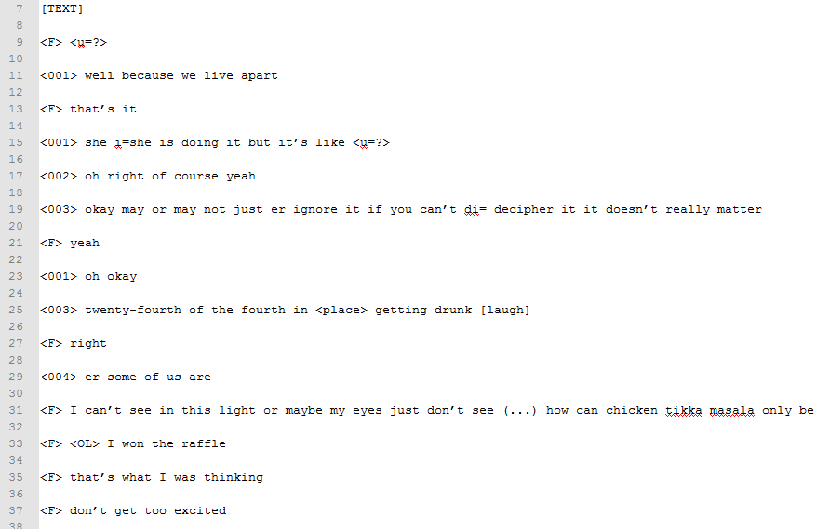
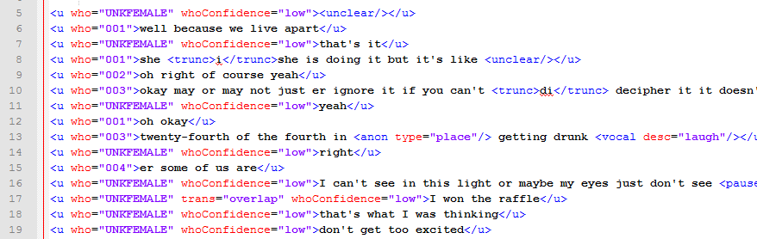
Comparison between original and new
@lovermob

Slide 39
Annotation
POS tagging via CLAWS (Constituent Likelihood Automatic Word-tagging System)
Semantic tagging via USAS (UCREL Semantic Analysis System)
@lovermob

Slide 40
Speaker identification
Quality control traditionally focusses on accuracy of transcription
Spoken BNC2014 is no exception – audio-checking and proofreading procedures in place at Cambridge
@lovermob

Slide 41
Speaker identification
= who said that?
has no bearing on the accuracy of the transcription of linguistic content itself
  what was said
refers to the identification of the speaker that produced the transcribed turn
  who said it
@lovermob

Slide 42
Speaker identification
= who said that?
Three tiers in the Spoken BNC2014
  Speaker ID code (certain) e.g. <001>
  Best guess e.g. <001?>
  Indeterminable (gender only) e.g. <F>
@lovermob

Slide 43
Distribution of ID types – pilot study (Love 2014)
@lovermob

Slide 44
Speaker identification
Two unavoidable deficiencies: transcribers’ lack of familiarity with
(i) the speakers
(ii) the context in which the conversations occurred
@lovermob

Slide 45

Major assumption
Speaker identification likely not an issue when
there are only two speakers
the speakers have highly contrasting voice qualities
the transcriber knows the speakers in the recording, and can recognise their voices
@lovermob

Slide 46

Major assumption
Speaker identification is likely an issue when
the differences in voice quality between two or more speakers are not sufficient to tell them apart
there are several speakers
@lovermob

Slide 47
Speakers per recording –
Spoken BNC2014 (to date)
@lovermob

Slide 48
Investigating speaker identification
‘Certainty’ ≠ accuracy
Ideal = gold standard
This does not exist
@lovermob

Slide 49
Current work
Assessing the Spoken BNC2014 transcripts rather than pilot recordings
  ‘Speaker-heavy’ recordings
Manufacturing a gold standard
@lovermob

Slide 50
Manufacturing a gold standard
8 speakers, 25 minutes, 775 turns, 4,886 words
My transcript (‘gold standard’) + 8 ‘test’ transcripts
  Average distribution of code types in each test transcript
    CERTAINTY
  Agreement on coding of specific IDs among test transcripts
    INTER-RATER AGREEMENT
  Agreement on coding of specific IDs codes between test transcripts & gold standard
    ‘ACCURACY’
@lovermob

Slide 51
Certainty
@lovermob

Slide 52
Inter-rater agreement
775 turns considered across all 8 transcribers
Average agreement 51.5%
Fleiss’ kappa 0.46
Only moderate strength agreement
@lovermob

Slide 53
Accuracy
775 turns considered across all 8 transcribers
Average accuracy 58.1%
Cohen’s kappa 0.54 = moderate strength
@lovermob

Slide 54
Speaker identification – consolidating the evidence
Manufactured gold standard
Certainty = high
Inter-rater agreement = low
Accuracy just over 50%
@lovermob

Slide 55
Speaker identification – consolidating the evidence
Accuracy of speaker identification in speaker-heavy recordings in the Spoken BNC2014 is very likely to be low
How do we plan to ameliorate this?
@lovermob

Slide 56
Next steps
Put appropriate warning label on finished corpus, ability to exclude ‘high risk’ recordings
  Corpus manuals
  Text-level metadata
  Utterance-level metadata
Check that ‘speaker-light’ recordings (c. 80% of corpus) are not affected by this problem
Argue that this is worth paying attention to
  Historical assessment of implications for previous spoken corpora/research
@lovermob

Slide 57
We may end up saying…
Accuracy of speaker identification in speaker-heavy recordings in the Spoken BNC2014 spoken corpora is very likely to be low
Studies that have been produced with blind faith in the accuracy of speaker identification should be revised
@lovermob

Slide 58
Early Access Data Grants
Early access to 5 million words of data
Proposals for first Spoken BNC2014 research
Access in February 2016
Submit work October 2016
Deadline: Friday 11th December!
@lovermob

Slide 59
References
Cohen, J. (1960). A coefficient of agreement for nominal scales. Educational and Psychological Measurement, 20(1), 37-46.
Crowdy, S. (1994). Spoken Corpus Transcription. Literary and Linguistic Computing, 9(1), 25-28.
Fleiss, J.L. (1971). Measuring nominal scale agreement among many raters. Psychological Bulletin, 76(5), 378-382.
Gablasova, D., Brezina, V., McEnery, T. & Boyd, E. (under review) Epistemic stance in spoken L2 English: The effect of task type and speaker style, submitted to Applied Linguistics.
Hardie, A. (2014). Modest XML for corpora: not a standard, but a suggestion. ICAME Journal, 38, 73-103.
Hasund, K. (1998). Protecting the innocent: The issue of informants' anonymity in the COLT corpus. In A. Renouf (Ed.), Explorations in corpus linguistics (pp. 13-28). Amsterdam: Rodopi.
Leech, G. (1993). 100 million words of English. English Today, 9-15. doi:10.1017/S0266078400006854
Leech, G. (2003). Modals on the move: The English modal auxiliaries 1961–1992. In R. Facchinetti, F. R. Palmer & M. Krug (Eds.), Modality in Contemporary English. Berlin/New York: Mouton de Gruyter, 223–240
Love, R. (2014). Methodological issues in the compilation of spoken corpora: the Spoken BNC2014 pilot study. Lancaster University: unpublished Masters dissertation.
@lovermob

Slide 60
r.m.love@lancaster.ac.uk
@lovermob
@lovermob

