Slide 1



FUCK in spoken British English revisited with the Spoken BNC2014
Robbie Love
CASS, Lancaster University
r.m.love@lancaster.ac.uk
@lovermob

Slide 2
Today’s talk
The Spoken BNC2014
Bad language – why?
Data & methods
Findings
Thoughts so far & further work
Important Spoken BNC2014 dates
@lovermob

Slide 3

The Spoken BNC2014
1000 hours of conversation (1,252 texts)
Nearly 700 unique speakers
More than 11 million words
@lovermob

Slide 4
The Spoken BNC2014
Lancaster University + Cambridge University Press
Both parties
Plan & design
Encourage participation – media campaigns
Disseminate information
Fund project equally
CUP – Claire Dembry
Corresponds with contributors
Collects & transcribes recordings
Lancaster – Robbie Love, Andrew Hardie, Vaclav Brezina, Tony McEnery
Documents the compilation of the corpus
Carries out methodological investigations
Converts transcripts to XML, encoding
Annotates corpus
Initial analysis
Prepares for public release/hosts corpus
@lovermob

Slide 5
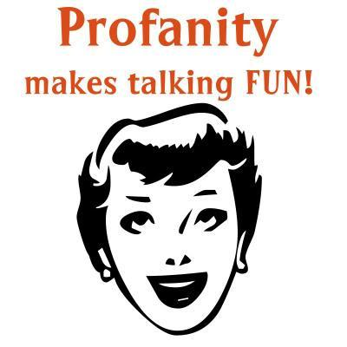
Bad language

Slide 6
Bad language
Swearing is fascinating…a “marker of distinction” between social groups (McEnery 2005: 24)
“a rich emotional, psychological, and sociocultural phenomenon” (Jay 2009: 153)
More psychologically arousing (Janschewitz 2008)
More memorable (Jay et al. 2008)
More stressful to produce (Bowers & Pleydell-Pearce 2011)

Slide 7
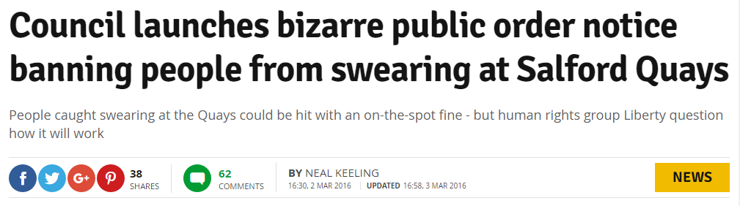
Bad language
People care about it – one way or another
e.g. links to anti-social behaviour

Slide 8
Bad language
McEnery (2005):
Bad language words = BLWs
  swear words, always taboo
  cunt, fuck, shit, twat
  words which are not inherently taboo but can be used to offend
  tart, pig, god, gay

Slide 9
Bad language revisited
Replication of McEnery (2005) on the new data
BLWs in Spoken BNC2014S compared to the Spoken BNC1994DS:
  Frequency – wholesale & within social groups
  Strength
  Meaning – using the McEnery et al. (2000) categorization scheme
Looking at over 150 BLWs including FUCK (cf. McEnery & Xiao 2004)

Slide 10
Research questions
Quantitative
Is FUCK becoming more/less popular?
(How) has the distribution of FUCK changed between the early 1990s and the present day?
Qualitative
(How) has the meaning of FUCK changed in the same period?
Search term: [word=".*fuck.*"%c]
@lovermob

Slide 11

Data
Spoken BNC1994DS (demographically-sampled)
5,014,655 words
1000+ speakers of British English
153 texts
Date range: 1985-1993
@lovermob

Slide 12
Data
Spoken BNC2014S (Sample)
4,789,185 words
376 speakers of British English
567 texts
Date range: 2012-2015
Used by early access data grant recipients for launch publications
Search term: [word=".*fuck.*"%c]
@lovermob

Slide 13
Overall frequency
1990s: 564.3 per million
2010s: 561.1 per million
Difference not significant i.e. stable
2nd most frequent BLW in both corpora
  Behind BLOODY (1990s)
  Behind GOD (2010s)
Considered ‘strongest’ (Ofcom 2016), in the company of only 15 other BLWs including cunt, faggot, golliwog, motherfucker, nigger, retard, spastic
@lovermob

Slide 14
Strength
@lovermob

Slide 15
FUCK: gender
@lovermob

Slide 16
FUCK: age
@lovermob

Slide 17
FUCK: Social Grade
@lovermob

Slide 18
FUCK: NS-SEC
NS-SEC 3 (“intermediate occupations”) + 4 (“small employers & own account workers”) = Social Grade C1
@lovermob

Slide 19
Categorization
Spoken British National Corpus (1990s)
Rank | Code | Description
1 | E | Emphatic adverb/adjective: ‘He fucking did it’ ‘in the fucking car’
2 | N | Premodifying intensifying negative adjective: ‘the fucking idiot’
3 | G | General expletive ‘(Oh) Fuck!’
4 | I | Idiomatic ‘set phrase’: ‘fuck all’ ‘give a fuck’
5 | D | Destinational usage: ‘Fuck off!’ ‘He fucked off’
Spoken British National Corpus (2010s)
Rank | Code | Description
1 | I | Idiomatic ‘set phrase’: ‘fuck all’ ‘give a fuck’
2 | G | General expletive ‘(Oh) Fuck!’
3 | F | Figurative extension of literal meaning: ‘to fuck about’
4 | D | Destinational usage: ‘Fuck off!’ ‘He fucked off’
5 | A | Predicative negative adjective: ‘Is it fucked?’
@lovermob

Slide 20
Categorization
In the Spoken BNC2014S
Idioms e.g. what the fuck = 31%
Figurative e.g. fuck it up = 15%
Emphatic adverb & adjective e.g. in the fucking car = 2.7% (was 55% in Spoken BNC1994DS)
The meaning appears to have changed
Grammaticalization?
@lovermob

Slide 21
Old/new forms
FUCK as lemma (1994)
  fucking (2164), fuck (583), fucked (62), fucker(s) (25), fucks (10), mother(-)fucker(s) (6), mother-fucking (1), fluctu-fucking-ation (1), fuckhead (1)
FUCK as lemma (2014)
  fucking (1530), fuck (912), fucked (168), fucker(s) (32), fucks (27), motherfucker(s) (9), fuck(-)head (5), fuckered (2), fuckwits (1), fucktard (1)
@lovermob

Slide 22
Bad language: thoughts so far
Change in bad language – like all language – can happen very quickly
the use of FUCK does appear to have changed to some extent – gender & age particularly
Convergence of ‘male speech’ & ‘female speech’?
Frequency change is one thing, but social distribution & qualitative analysis very powerful
Bad language is very context-dependent – when is FUCK offensive? When is it not? Harder to tackle using corpus linguistics alone
@lovermob

Slide 23
Important dates & publications
June 2017: Spoken BNC2014 symposium (Lancaster)
July 2017: workshop + paper at CL2017 (Birmingham)
Autumn 2017: full public release on CQPweb
IJCL 22(3), Spoken BNC2014 special issue, inc. Love, Dembry, Hardie, Brezina & McEnery (2017 fc)
Routledge book Corpus Approaches to Contemporary British Speech (2018, eds. Brezina, Love & Aijmer)
@lovermob

Slide 24
References
Bowers JS, Pleydell-Pearce CW (2011) Swearing, Euphemisms, and Linguistic Relativity. PLoS ONE 6(7). doi:10.1371/journal.pone.0022341
Brezina, V., R. Love and K. Aijmer (eds.). (2018 fc). Corpus Approaches to Sociolinguistic Variation in Contemporary British English: An Exploration of the Spoken BNC2014. New York: Routledge.
Hardie, A. (2012). CQPweb – combining power, flexibility and usability in a corpus analysis tool. International Journal of Corpus Linguistics 17 (3): 380-409.
Janschewitz, K. (2008). Taboo, emotionally-valenced, and emotionally-neutral word norms. Behavior Research Methods, Instruments, & Computers, 40, 1065–1074.
Jay, T. (2009a). The utility and ubiquity of taboo words. Perspectives on Psychological Science 4. 153–161.
Jay, T., Caldwell-Harris, C., & King, K. (2008). Recalling taboo and nontaboo words. American Journal of Psychology, 121, 83–103.
Love, R., Dembry, C., Hardie, A., Brezina, V. and McEnery, T. (2017 fc). The Spoken BNC2014: designing and building a spoken corpus of everyday conversations. In International Journal of Corpus Linguistics, 22:3.
McEnery, T. (2005). Swearing in English: Bad language, purity and power from 1586 to the present. New York: Routledge.
McEnery, T., Baker, P. & Hardie, A. (2000). Swearing and abuse in modern British English. In: PALC ’99: Practical Applications in Language Corpora. Peter Lang, Frankfurt am Main, pp. 37-48.
McEnery, T., Love, R. and Brezina, V. (eds.). (2017 fc). International Journal of Corpus Linguistics, 22:3, Special Issue.
McEnery, T. & Xiao, Z. (2004). Swearing in modern British English: the case of fuck in the BNC. In Language and Literature, 13(3). doi:10.1177/0963947004044873.
@lovermob

Slide 25
r.m.love@lancaster.ac.uk
@lovermob
@BNC_2014
@lovermob

