Slide 1



Introducing the Spoken BNC2014 Explore the data yourself!
Robbie Love
Cambridge English / Lancaster University
Andrew Hardie
Lancaster University
#CL2017bham #BNC2014

Slide 2
Workshop structure
1. Robbie
  Background – compiling the corpus
  Speaker & text metadata
2. Andrew
  Exploring the Spoken BNC2014 with CQPweb
3. You!
  Practical session
#CL2017bham #BNC2014

Slide 3
Introducing the Spoken BNC2014
Robbie Love
Cambridge English / Lancaster University
r.m.love@lancaster.ac.uk
Twitter: lovermob
#CL2017bham #BNC2014

Slide 4


Why build a new Spoken BNC?
BNC1994
BNC2014
#CL2017bham #BNC2014

Slide 5
Who built the Spoken BNC2014?
Lancaster University:
Robbie Love, Andrew Hardie, Vaclav Brezina, Tony McEnery
Cambridge University Press:
Claire Dembry
Olivia Goodman, Imogen Dickens, Sarah Grieves, Laura Grimes, Samantha Owen, 20 transcribers
#CL2017bham #BNC2014

Slide 6
The Spoken BNC2014
Lancaster University + Cambridge University Press
Lancaster & CUP
Plan & design
Encourage participation – media campaigns
Disseminate information
Fund project equally
CUP – Claire Dembry & team
Corresponds with contributors
Collects & transcribes recordings
Lancaster – Robbie Love, Andrew Hardie, Vaclav Brezina, Tony McEnery
Documents the compilation of the corpus
Carries out methodological investigations
Converts transcripts to XML, encoding
Annotates corpus
Initial analysis
Prepares for public release/hosts corpus
#CL2017bham #BNC2014

Slide 7
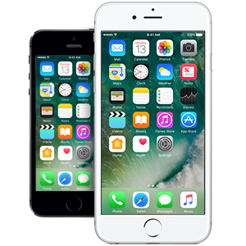
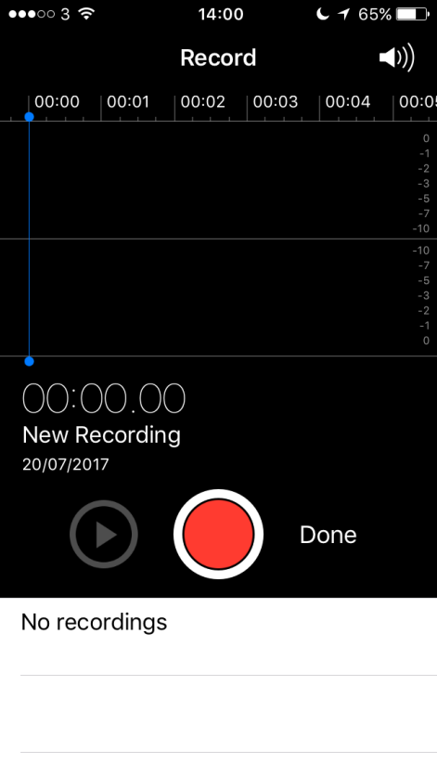
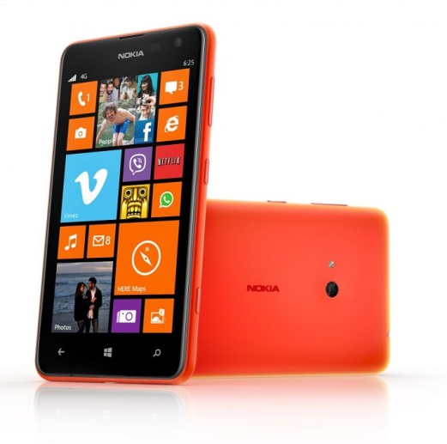
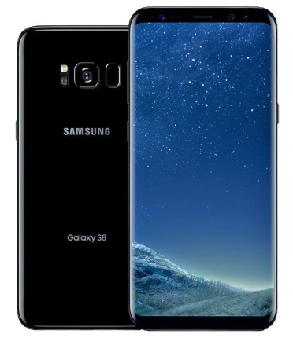
Data collection
#CL2017bham #BNC2014

Slide 8



Transcription
#CL2017bham #BNC2014

Slide 9
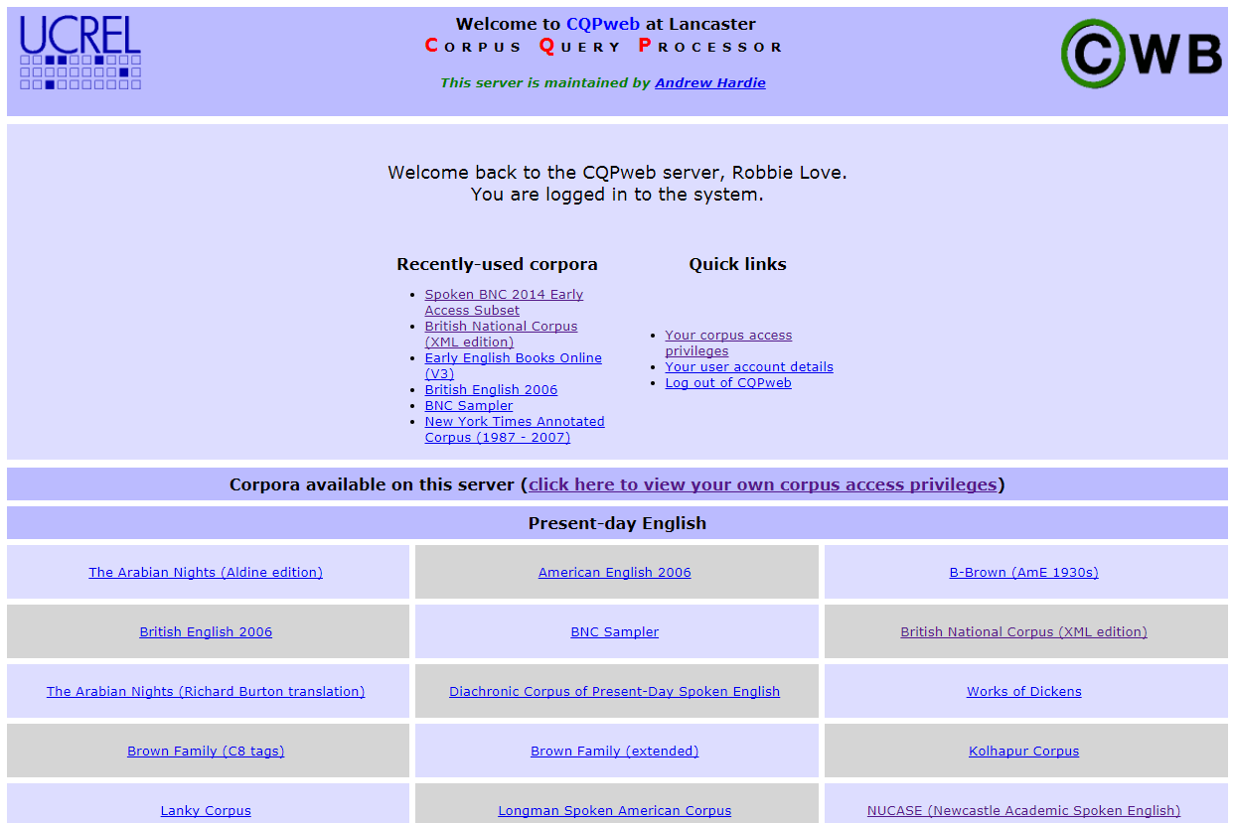
Processing --> CQPweb
#CL2017bham #BNC2014

Slide 10
The Spoken BNC2014
SPOKEN
#CL2017bham #BNC2014

Slide 11
The Spoken BNC2014
Conversational, L1 British English
2012-2016
672 speakers
1,251 texts
11,422,622 words
#CL2017bham #BNC2014

Slide 12
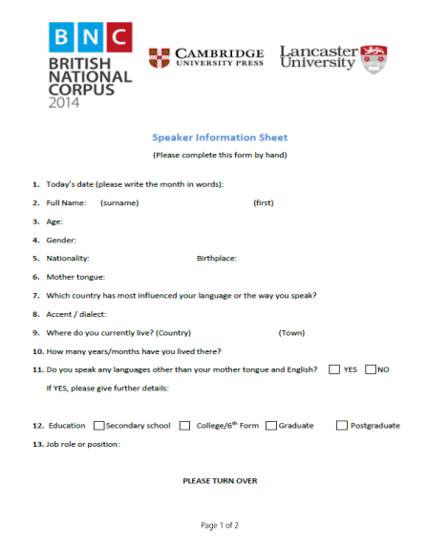
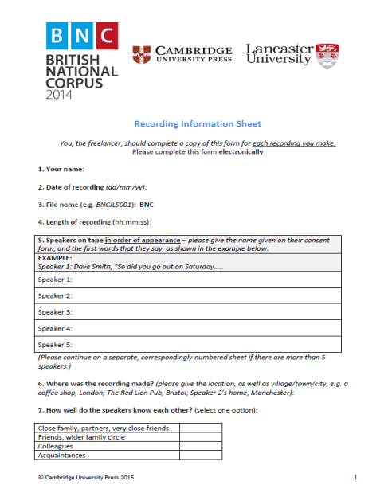
Metadata
Speaker metadata provided by speakers as part of consent form
Text metadata provided by contributors
#CL2017bham #BNC2014

Slide 13
Speaker metadata: age
BNC1994 categorisation scheme:
0-14|15-24|25-34|35-44|45-59|60+|Unknown
BNC2014 offers two schemes – the original, plus:
0-10|11-18|19-29|30-39|40-49|50-59|60-69|
70-79|80-89|90-99|Unknown
#CL2017bham #BNC2014

Slide 14
Speaker metadata: age
(1994 scheme)
#CL2017bham #BNC2014

Slide 15
Speaker metadata: age
(new scheme)
#CL2017bham #BNC2014

Slide 16
Speaker metadata: dialect
Purely objective metadata seems insufficient
Subjective metadata offers an imperfect solution:
Self-reported dialect
E.g. “Geordie” = north east England
#CL2017bham #BNC2014

Slide 17
Speaker metadata: dialect
(1) Global | (2) Country | (3) Supra-region | (4) Region
UK | England | North | North East
 |  |  | Yorkshire & Humberside
 |  |  | North West (not Merseyside)
 |  |  | Merseyside
 |  | Midlands | East Midlands
 |  |  | West Midlands
 |  | South | Eastern
 |  |  | South West
 |  |  | South East (not London)
 |  |  | London
 | Scotland | Scotland | Scotland
 | Wales | Wales | Wales
 | Northern Ireland | Northern Ireland | Northern Ireland
Non-UK | Republic of Ireland | Republic of Ireland | Republic of Ireland
 | Other non-UK variety | Other non-UK variety | Other non-UK variety
Unspecified | Unspecified | Unspecified | Unspecified
#CL2017bham #BNC2014

Slide 18
Speaker metadata: dialect
(level 1 – global)
#CL2017bham #BNC2014

Slide 19
Speaker metadata: dialect
(level 2 – country)
#CL2017bham #BNC2014

Slide 20
Speaker metadata: dialect
(level 3 – supra-region)
#CL2017bham #BNC2014

Slide 21
Speaker metadata: dialect
(level 4 – region)
#CL2017bham #BNC2014

Slide 22
Speaker metadata: highest qualification
#CL2017bham #BNC2014

Slide 23
Speaker metadata: gender
#CL2017bham #BNC2014

Slide 24
Speaker metadata: socio-economic status
Occupation --> socio-economic status
BNC1994: Social Grade
AB|C1|C2|DE|Unknown
BNC2014: NS-SEC (--> Social Grade)
1.1|1.2|2|3|4|5|6|7|8|*|Unknown
#CL2017bham #BNC2014

Slide 25
Speaker metadata: socio-economic status
NS-SEC | Description | MAPS ON TO… | Social Grade | Description
1 | Higher managerial, administrative and professional occupations:⁸ |  | A | Higher managerial, administrative and professional
1.1 | Large employers and higher managerial and administrative occupations
1.2 | Higher professional occupations
2 | Lower managerial, administrative and professional occupations |  | B | Intermediate managerial, administrative and professional
3 | Intermediate occupations |  | C1 | Supervisory, clerical and junior managerial, administrative and professional
4 | Small employers and own account workers
5 | Lower supervisory and technical occupations |  | C2 | Skilled manual workers
6 | Semi-routine occupations |  | D | Semi-skilled and unskilled manual workers
7 | Routine occupations
8 | Never worked and long-term unemployed |  | E | State pensioners, casual and lowest grade workers, unemployed with state benefits only
* | Students/unclassifiable
#CL2017bham #BNC2014

Slide 26
Speaker metadata: socio-economic status (2014 scheme)
#CL2017bham #BNC2014

Slide 27
Speaker metadata: socio-economic status (1994 scheme)
#CL2017bham #BNC2014

Slide 28
Speaker metadata: core set
#CL2017bham #BNC2014

Slide 29
Text metadata: conventions
#CL2017bham #BNC2014

Slide 30
Text metadata: sample release
#CL2017bham #BNC2014

Slide 31
Text metadata: no. of speakers
#CL2017bham #BNC2014

Slide 32
Text metadata: year of recording
#CL2017bham #BNC2014

Slide 33
Text metadata: transcriber
#CL2017bham #BNC2014

Slide 34
Publications
International Journal of Corpus Linguistics
  Spoken BNC2014 special issue, eds. McEnery, Love & Brezina
  Love, Dembry, Hardie, Brezina & McEnery
  Fuchs; Laws et al.; Hessner & Gawlitzek; Calude
Routledge Advances in Corpus Linguistics book
  Corpus Approaches to Contemporary British Speech eds. Brezina, Love & Aijmer
  Wong & Kruger; Culpeper & Gillings; Aijmer; Jenset et al.; Caines et al.; Paterson
#CL2017bham #BNC2014

Slide 35
A date for your diary…
SPOKEN
25 SEPTEMBER 2017
#CL2017bham #BNC2014

Slide 36
References
Brezina, V., R. Love and K. Aijmer (eds.). (forthcoming). Corpus Approaches to Contemporary British Speech: Sociolinguistic Studies of the Spoken BNC2014. New York: Routledge.
Hardie, A. (2012). CQPweb – combining power, flexibility and usability in a corpus analysis tool. International Journal of Corpus Linguistics 17 (3): 380-409.
Love, R., Dembry, C., Hardie, A., Brezina, V. and McEnery, T. (2017 fc). The Spoken BNC2014: designing and building a spoken corpus of everyday conversations. In International Journal of Corpus Linguistics, 22:3.
McEnery, T., Love, R. and Brezina, V. (eds.). (2017, forthcoming). International Journal of Corpus Linguistics, 22:3, Special Issue.
#CL2017bham #BNC2014

Slide 37
r.m.love@lancaster.ac.uk
@lovermob
@BNC_2014
#CL2017bham #BNC2014

Slide 38
Exploring the Spoken BNC2014 with CQPweb
Andrew Hardie
Lancaster University
a.hardie@lancaster.ac.uk
Twitter: HardieResearch
#CL2017bham #BNC2014

Slide 39
Login details
Go to: cqpweb.lancs.ac.uk
Username: spokbnc[1-50]
Password: cl2017
Then go to:
cqpweb.lancs.ac.uk/bnc2014spoken
#CL2017bham #BNC2014

Slide 40
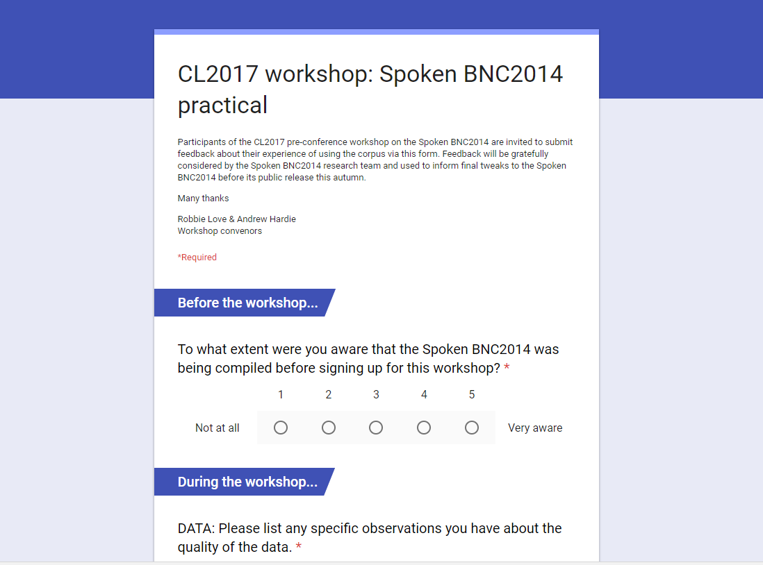
Please give us your feedback!
tinyurl.com/bncworkshop
#CL2017bham #BNC2014

