Slide 1
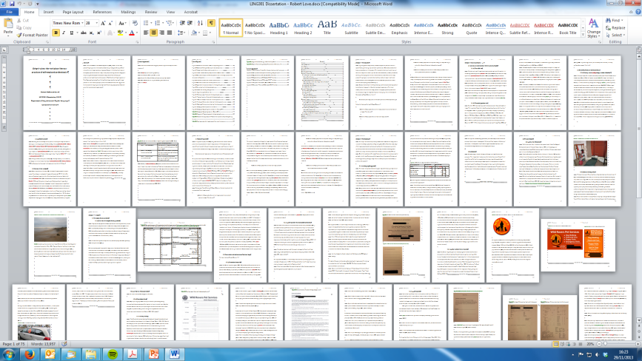

Writing a dissertation: my experience
Robbie Love
ESRC Centre for Corpus Approaches to Social Science (CASS)
Lancaster University, UK
lovermob r.m.love@lancaster.ac.uk

Slide 2
About me
Linguistics and English Language, Lancaster
Undergraduate, 2010-2013
Masters, 2013-2014
(PhD, 2014-2017)
Academic Writing Zone, 2012-present
lovermob r.m.love@lancaster.ac.uk

Slide 3
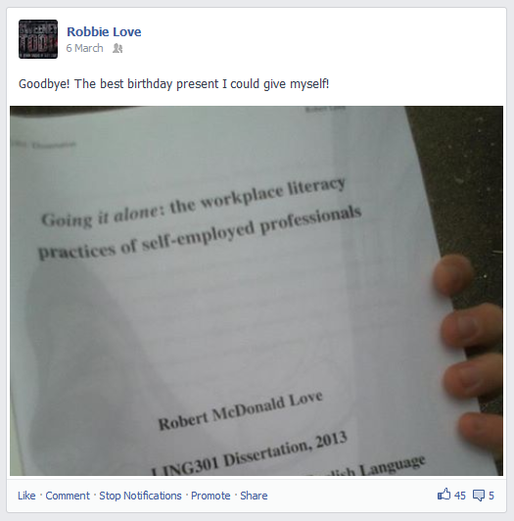
My dissertation
lovermob r.m.love@lancaster.ac.uk

Slide 4
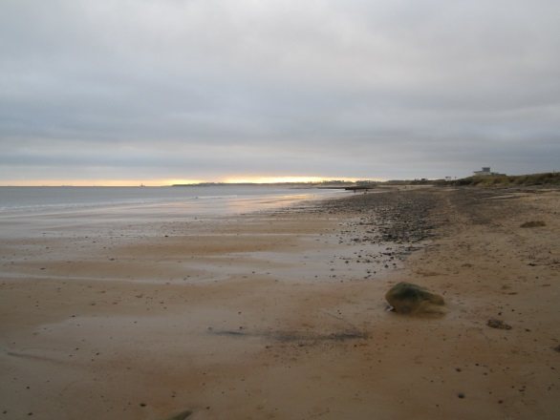
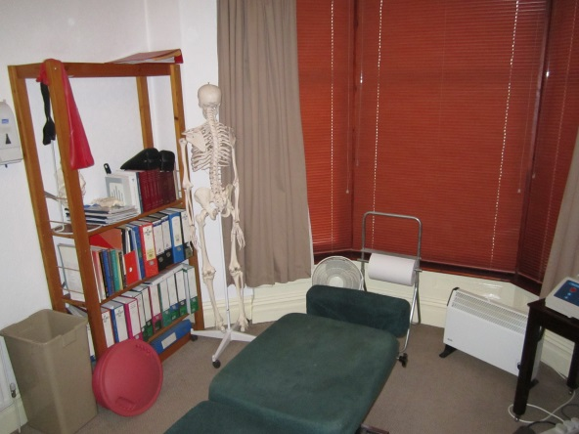
My dissertation
Workplace literacy practices
Word limit = 10,000 words
Dog walker vs. chiropractor
F2F vs. non-F2F contact
Ethnographic study
Interview data
lovermob r.m.love@lancaster.ac.uk

Slide 5
My timeline
March 2012: assigned supervisor / decided topic
June 2012: some preliminary notes
Summer 2012: NOTHING ☺ (holiday in Thailand)
September – December 2012: reading, interview design, interviews, lit review, method
lovermob r.m.love@lancaster.ac.uk

Slide 6
My timeline
Christmas 2012: NOTHING ☺ (3 assignments)
January – March 2013: rough analysis, written analysis, peripheral sections, cutting down
March 2013: HANDED IN ☺
lovermob r.m.love@lancaster.ac.uk

Slide 7
My process
Dissertation module = ¼ of my courses
= ¼ of my work time,
from the start of term
About a day or so every week
Met advisor every few weeks / occasional emails
It wasn’t scary, and I didn’t lose (much) sleep
lovermob r.m.love@lancaster.ac.uk

Slide 8
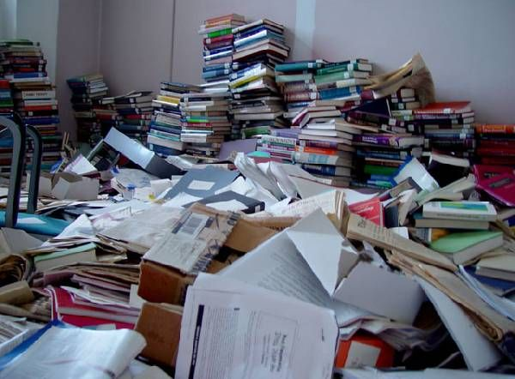

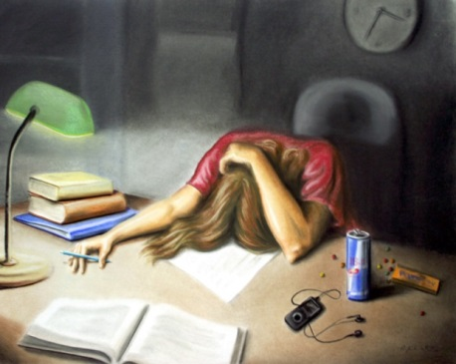
Some myth busting…
Dissertations are no harder than anything you have already done
They are just a more long-term process!
Only horrible if you make it!
Don’t listen to the whingers…
Don’t give up your social life!
lovermob r.m.love@lancaster.ac.uk

Slide 9
Thank you
Ask me anything!
lovermob r.m.love@lancaster.ac.uk

