Slide 1


Overcoming challenges in corpus linguistics: Reflections on the Spoken BNC2014Reflections on the Spoken BNC2014
Dr Robbie Love
Research Fellow
School of Education
University of Leeds
r.love@leeds.ac.uk
lovermob

Slide 2
Plan
About me
Background – the original British National Corpus
The BNC2014 project
Building the Spoken BNC2014
Evaluating the Spoken BNC2014
Facilitating offline analysis with AntConc
Some challenges and reflections

Slide 3
About me
Research Fellow at the School of Education, University of Leeds, UK
Corpus linguistics and language (in) education:
- spoken English
- corpora and English language teaching (ELT)
- corpora and school language
PhD from Lancaster University (2017)
Visiting Research Fellow at Waseda, working with Laurence Anthony (Nov-Dec 2018)
Funded by the Japan Society for the Promotion of Science (JSPS) – post-doctoral research fellowship

Slide 4

The British National Corpus (1994)
“a corpus of 100 million words of written texts and spoken transcriptions of modern British English, to be stored on the computer in machine-readable form”
(Leech 1993: 9)

Slide 5

The BNC2014 project

Slide 6
Aims of the BNC2014
Broadly comparable to the BNC1994, compiled two decades later
A new resource for research & teaching
100 million words of written British English, variety of registers
10 million words of spoken British English, one register = casual conversation
Phase 1 (2014-2017) = Spoken BNC2014
Lancaster University + Cambridge University Press
Phase 2 (2015-present) = Written BNC2014
Lancaster University

Slide 7
Why?
Nothing since the Spoken BNC1994:
orthographically transcribed
large size
general coverage of spoken British English
(low or no cost) public access
Language has very likely changed during this time – lexical innovations, perhaps grammatical change etc.
Two decade comparison (1990s-2010s) never been done before
Build towards a set of sampling points for diachronic analysis of spoken British English

Slide 8

English language teaching
What we teach vs. what we do
Focus less on structures we produce less frequently
What are we talking about?
Inspiration for current/realistic conversational topics
Speaking and ELT teaching
Teaching speaking is tough

Slide 9


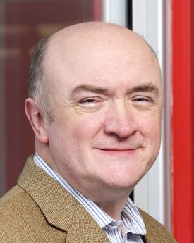
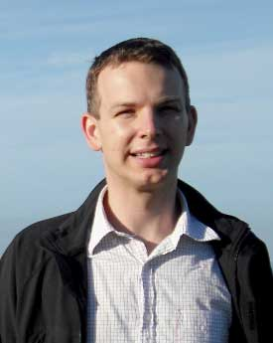
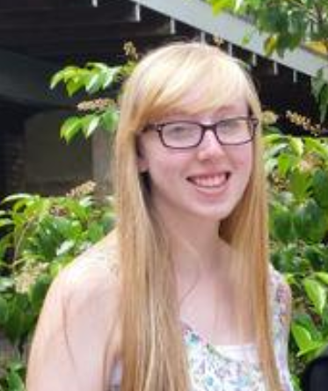
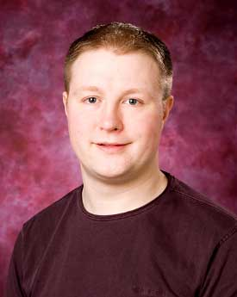
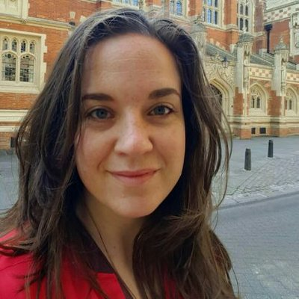

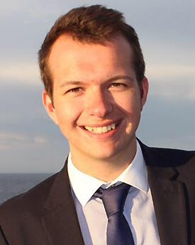
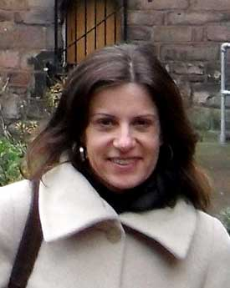
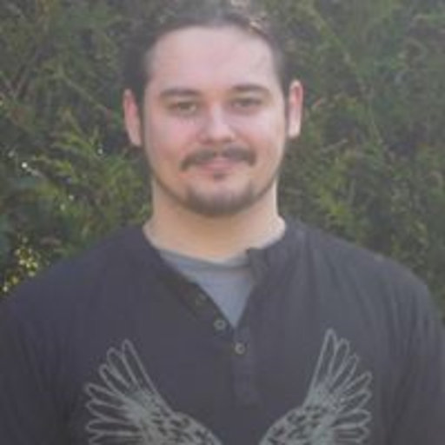
The BNC2014 team
10 million words
Phase 1 (2013-2017):
Spoken BNC2014
Phase 2 (2014-):
Written BNC2014
90 million words
Tony
McEnery
Vaclav
Brezina
Robbie
Love
Abi
Hawtin
Andrew
Hardie
Claire
Dembry
Olivia
Goodman
Mathew
Gillings
Carmen
Dayrell
Matt
Timperley

Slide 10
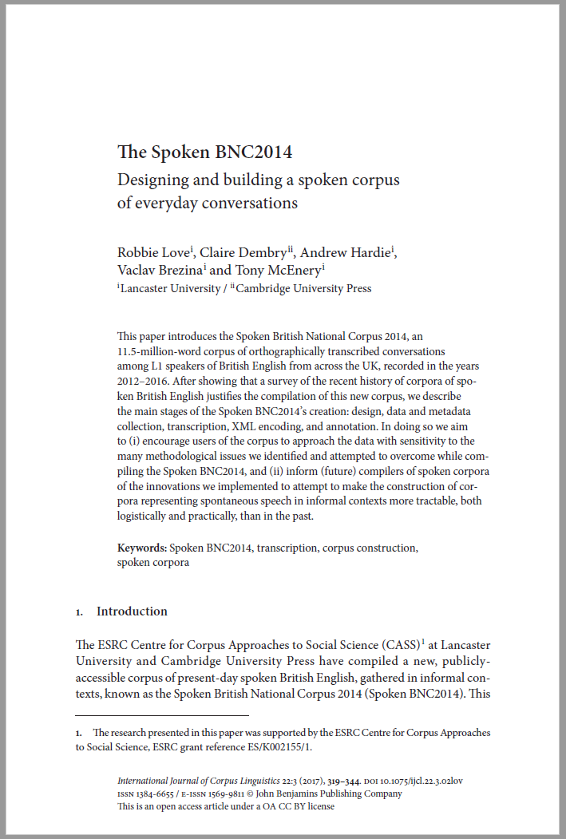


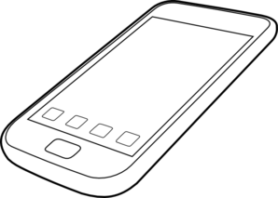





Building the Spoken BNC2014
SPOKEN
Existing corpora
Design
Representativeness
Target population
Sampling goals
Who is it for?
What do people want?
What have people done?
Finding participants
Recording equipment
Metadata collection
Automated? Manual?
Conventions
Accuracy
XML conversion
Annotation
Tool development
User guide
Website
Publications
What have we got?
Representativeness
Pilot research
Data collection
Transcription
Processing
Review
Document
Release

Slide 11
Corpus design
“The design of a representative corpus is not truly finalized until the corpus is completed, and analyses of the parameters of variation are required throughout the process of corpus development in order to fine-tune the representativeness of the resulting collection of texts”
(Biber 1993)
“A seminal article by Biber (1993) has frequently been cited, but no attempt (to my knowledge) has been made to implement Biber’s plan for building a representative corpus. […] Without representativeness, whatever is found to be true of a corpus, is simply true of that corpus – and cannot be extended to anything else.”
(Leech 2006)

Slide 12
Corpus design
The 2nd version of the BNC – promise and expectation of comparability
In terms of spoken data, needs had changed – just informal conversation
Convenience
Goals:
- priority = England; aim for rest of UK
- spread of age, gender, region, socio-economic status etc.
- but: no pre-determined category sizes
- broadly comparable to the Spoken BNC1994DS
Describe representativeness upon completion
We had to facilitate comment on some wider population, otherwise what is the point?

Slide 13
Corpus design
 | Spoken BNC1994 | Spoken BNC2014
Interaction type | Demographic (40%); Context-governed (60%) | Demographic (100%)
Who? | “Carefully sampled individuals” (Leech 1993:6) | Open call for participation; Some targeting
How? | Tape recorders | Smartphone MP3 recordings
What? | All interactions in a given period | Conversations; some task-based interactions.
When? | Continuously over a 2-7 day period | As determined by participant
How many speakers? | 124 adults making recordings Over 1000 speakers | 700 unique speakers
Total data | ~10m words | 11+m

Slide 14
Corpus design
 | Spoken BNC1994 | Spoken BNC2014
Speaker | Age Gender Education Occupation Accent/dialect Socio-economic category | Age Gender Education Occupation Accent/dialect Birthplace Linguistic origin Where do you currently live? How long have you lived there? Nationality Do you speak other languages?
Recording | Title Date Recording location | Title Date File name Recording length Recording location Speaker relationship Topics covered

Slide 15

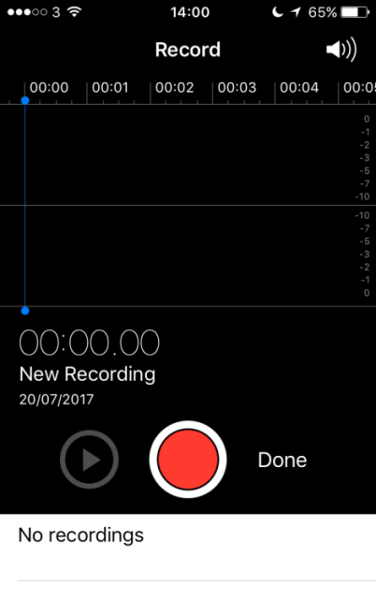
Data collection
How can we recruit & motivate participants?
Money!
How can we gather good quality recordings?
Smartphones!
How can we gather good quality metadata?
Condition of payment; careful data management

Slide 16
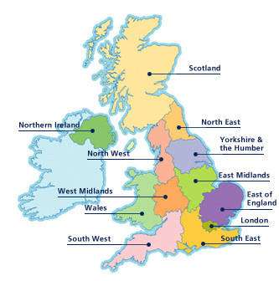
Metadata issues
Accent/dialect -> region

Slide 17
Dialect in the Spoken BNC2014
(1) Global | (2) Country | (3) Supra-region | (4) Region
UK | England | North | North East
 |  |  | Yorkshire & Humberside
 |  |  | North West (not Merseyside)
 |  |  | Merseyside
 |  | Midlands | East Midlands
 |  |  | West Midlands
 |  | South | Eastern
 |  |  | South West
 |  |  | South East (not London)
 |  |  | London
 | Scotland | Scotland | Scotland
 | Wales | Wales | Wales
 | Northern Ireland | Northern Ireland | Northern Ireland
Non-UK | Republic of Ireland | Republic of Ireland | Republic of Ireland
 | Other non-UK variety | Other non-UK variety | Other non-UK variety
Unspecified | Unspecified | Unspecified | Unspecified
Comparable with the Spoken BNC1994 too!

Slide 18
Transcription
Audio recording & signed consent forms received
Metadata recorded from consent forms
Audio recording assigned to transcriber
Transcript produced
Check #1: Audio checking
Check #2: Proofreading
Proofread word doc sent to Lancaster

Slide 19
Transcription
Why not use exactly the same transcription scheme as the original?
EXAMPLE
using full stops and commas to “approximate to use in written text”, but also indicating pauses with ellipses
<2> I think it’s always, deceptive on days like this because its, overcast and [er]
[…]
<2> But, but er, he’s…just broken away from his girlfriend and [<unclear>]
<1> [Oh has] he, oh. Well he seemed happy enough when he called.
Crowdy (1994: 28)

Slide 20
Transcription
Filled pauses
What it sounds like | How to write it
Has the vowel found in “father” or a similar vowel; usually = realisation, frustration or pain | ah
Has the vowel found in “road” or a similar vowel; usually = mild surprise or upset | oh
Has the vowel in “bed” or the vowel in “made” or something similar, without an “R” or “M” sound at the end; usually = uncertainty, or ‘please say again?’ | eh
A long or short “er” or “uh” vowel, as in “bird”; there may or may not be an “R” sound at the end; usually = uncertainty | er
As for “er” but ends as a nasal sound | erm
Has a nasally “M” or “N” sound from start to end; usually = agreement | mm
Like an “er” but with a clear “H” sound at the start; usually = surprise | huh
Two shortened “uh” or “er”-type vowels with an “H” sound between them, usually = disagreement; OR, a sound like the word “ahah!”; usually = success or realisation | uhu

Slide 21
Processing
Word docs -> text
Text -> XML, automatic conversion scripts to (a) translate transcripts into XML, (b) check & correct transcription convention errors
Used “modest” XML (Hardie 2014), a simpler derivative of TEI
Tagged for POS and lemma, CLAWS (Garside & Smith 1997)
Lancaster University’s CQPweb server (Hardie 2012)

Slide 22
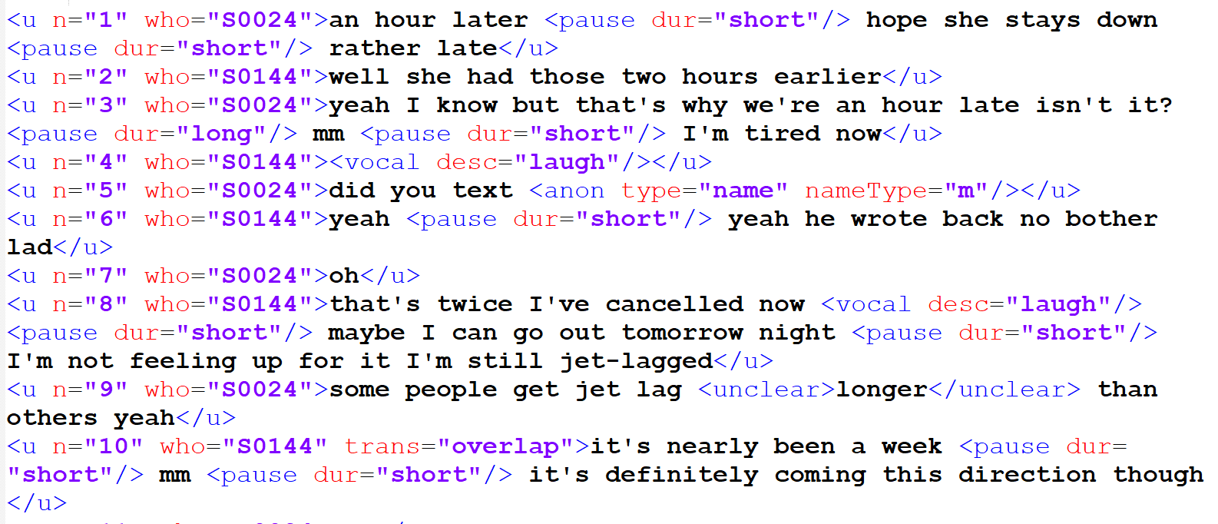
Processing

Slide 23
The Spoken BNC2014
Conversational, L1 British English
2012-2016
672 speakers
1,251 texts
11,422,617 words
Freely available to the public:
    (1) on Lancaster’s CQPweb, and
    (2) file download

Slide 24
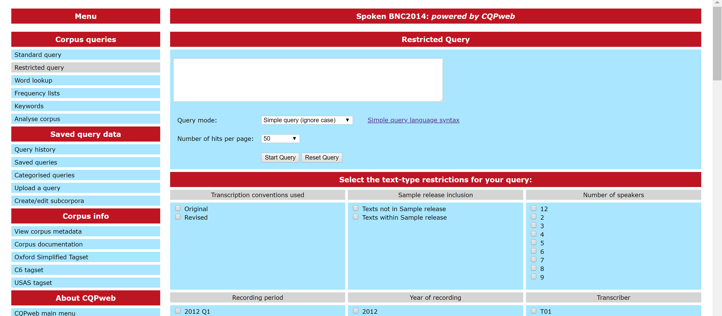
The Spoken BNC2014

Slide 25
The Spoken BNC2014

Slide 26
The Spoken BNC2014

Slide 27
So…what the Spoken BNC2014 is
A large corpus of informal spoken British English, as spoken mostly in England
Within England, it represents a spread of demographics including gender, age, socio-economic status and region
Comparable in terms of register to the Spoken BNC1994DS
A resource for the study of:
- lexical/grammatical variation & change in England
- how inf. English is spoken in England (2012-2016)
- functional variation according to situational context
- how inf. spoken English differs from writing & online comm.
- how inf. spoken English differs from other spoken registers
- (critical) discourse analysis
- much more…

Slide 28
What the Spoken BNC2014 isn’t
Perfect!
A corpus of a range of spoken registers
Comparable in terms of register with the whole Spoken BNC1994
A corpus built in exactly the same way as the Spoken BNC1994
A corpus designed with phonetics in mind
A corpus that represents the whole of the UK – more to come

Slide 29
Offline analysis
Current JSPS-funded project with Laurence Anthony
The Spoken BNC2014 is designed to be analysed either as a whole unit or as a variety of sub-corpora
Popular offline corpus software only facilitates ‘whole-corpus’ analysis
So how can users analyse the corpus using a tool like AntConc?

Slide 30
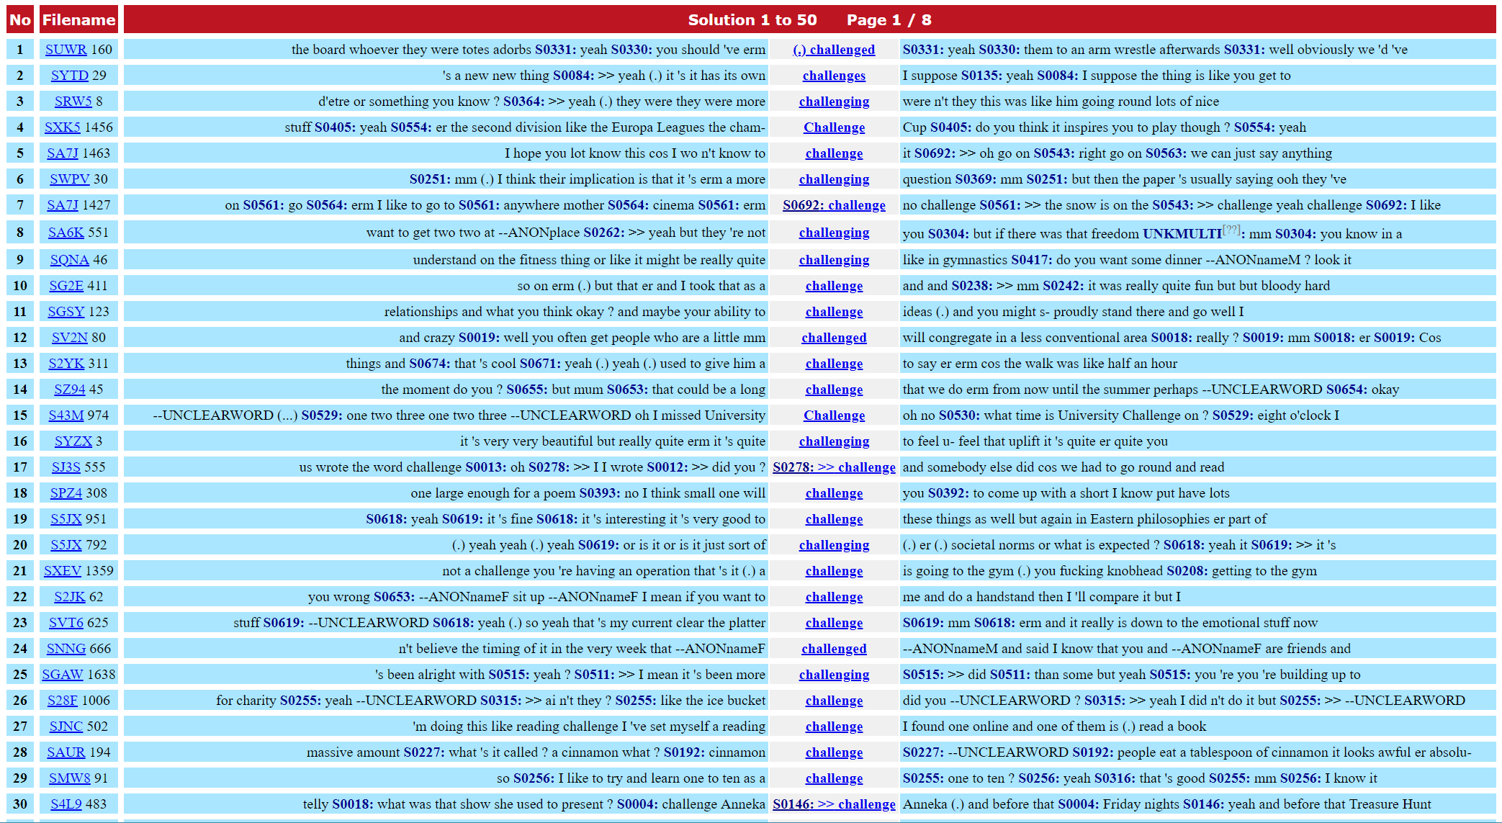
Challenges in corpus linguistics
Engaging with the media
The growth of corpus linguistics
‘Blind faith’ in corpus linguistics
Who is responsible for good corpus research?
What is a corpus linguist? And future challenges

Slide 31
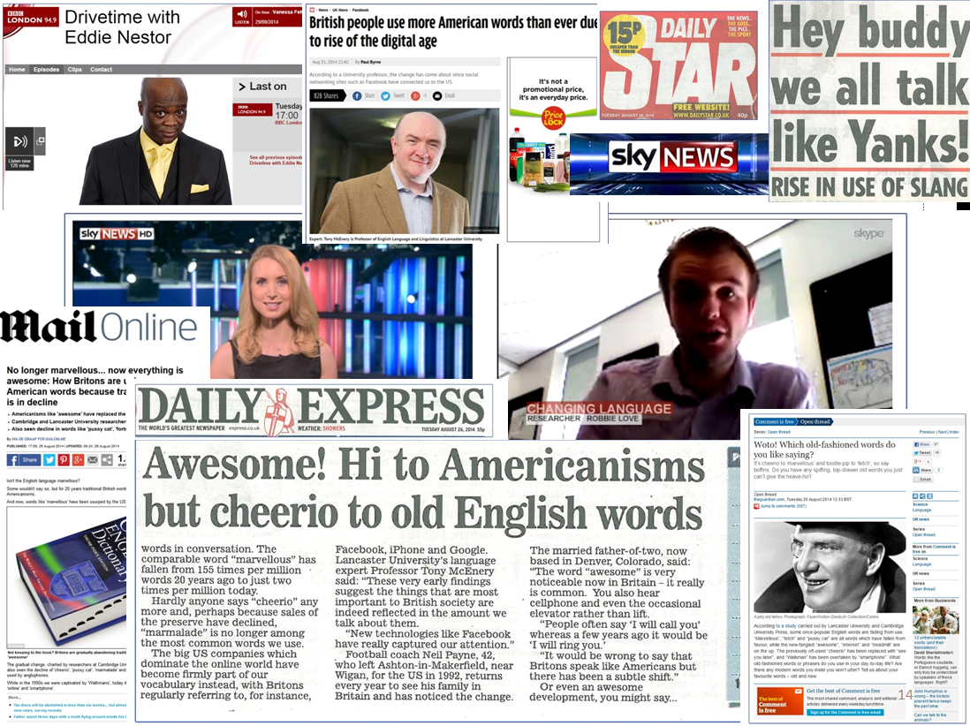
Engaging with the media
Finding and recruiting participants for the Spoken BNC2014
The media as an advertising tool
Working with university press office
Researchers and journalists…a love/hate relationship
The truth of the matter is that the principles we hold dear (thoroughness, accuracy, taking your time to get it 100% right) are not conducive to getting headlines
Often, my work was watered down, censored and simplified

Slide 32
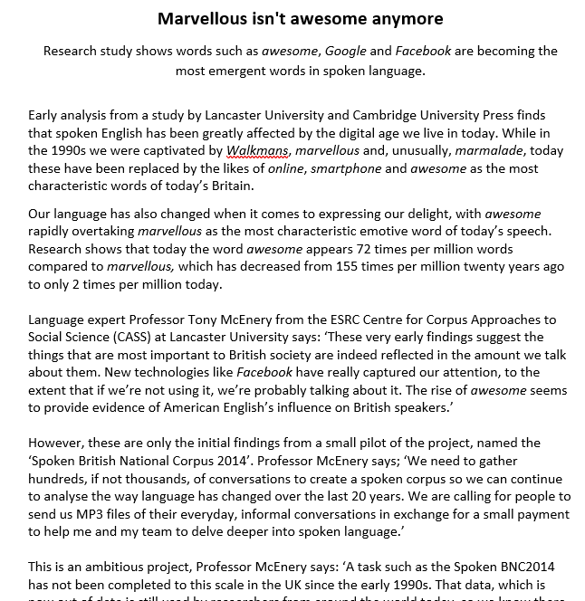
Example: the pussy cat
Early 1990s Early 2010s
fortnight facebook
marvellous internet
fetch website
walkman awesome
poll email
catalogue google
pussy cat smartphone
marmalade iphone
drawers essentially
cheerio treadmill

Slide 33
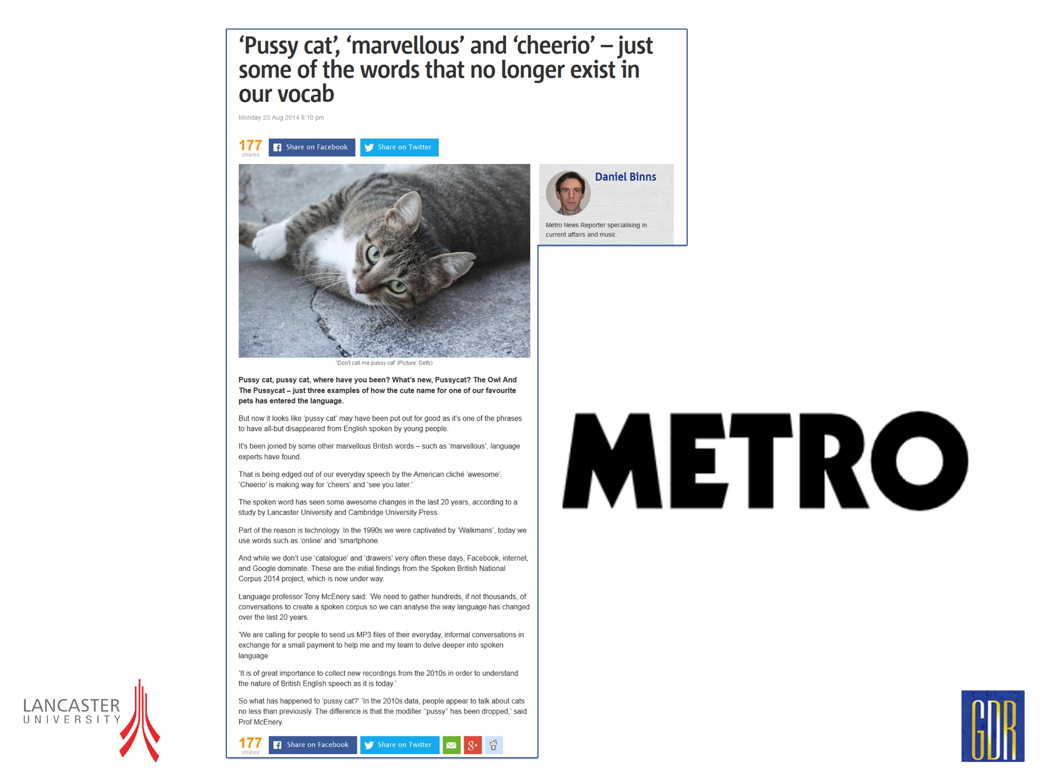
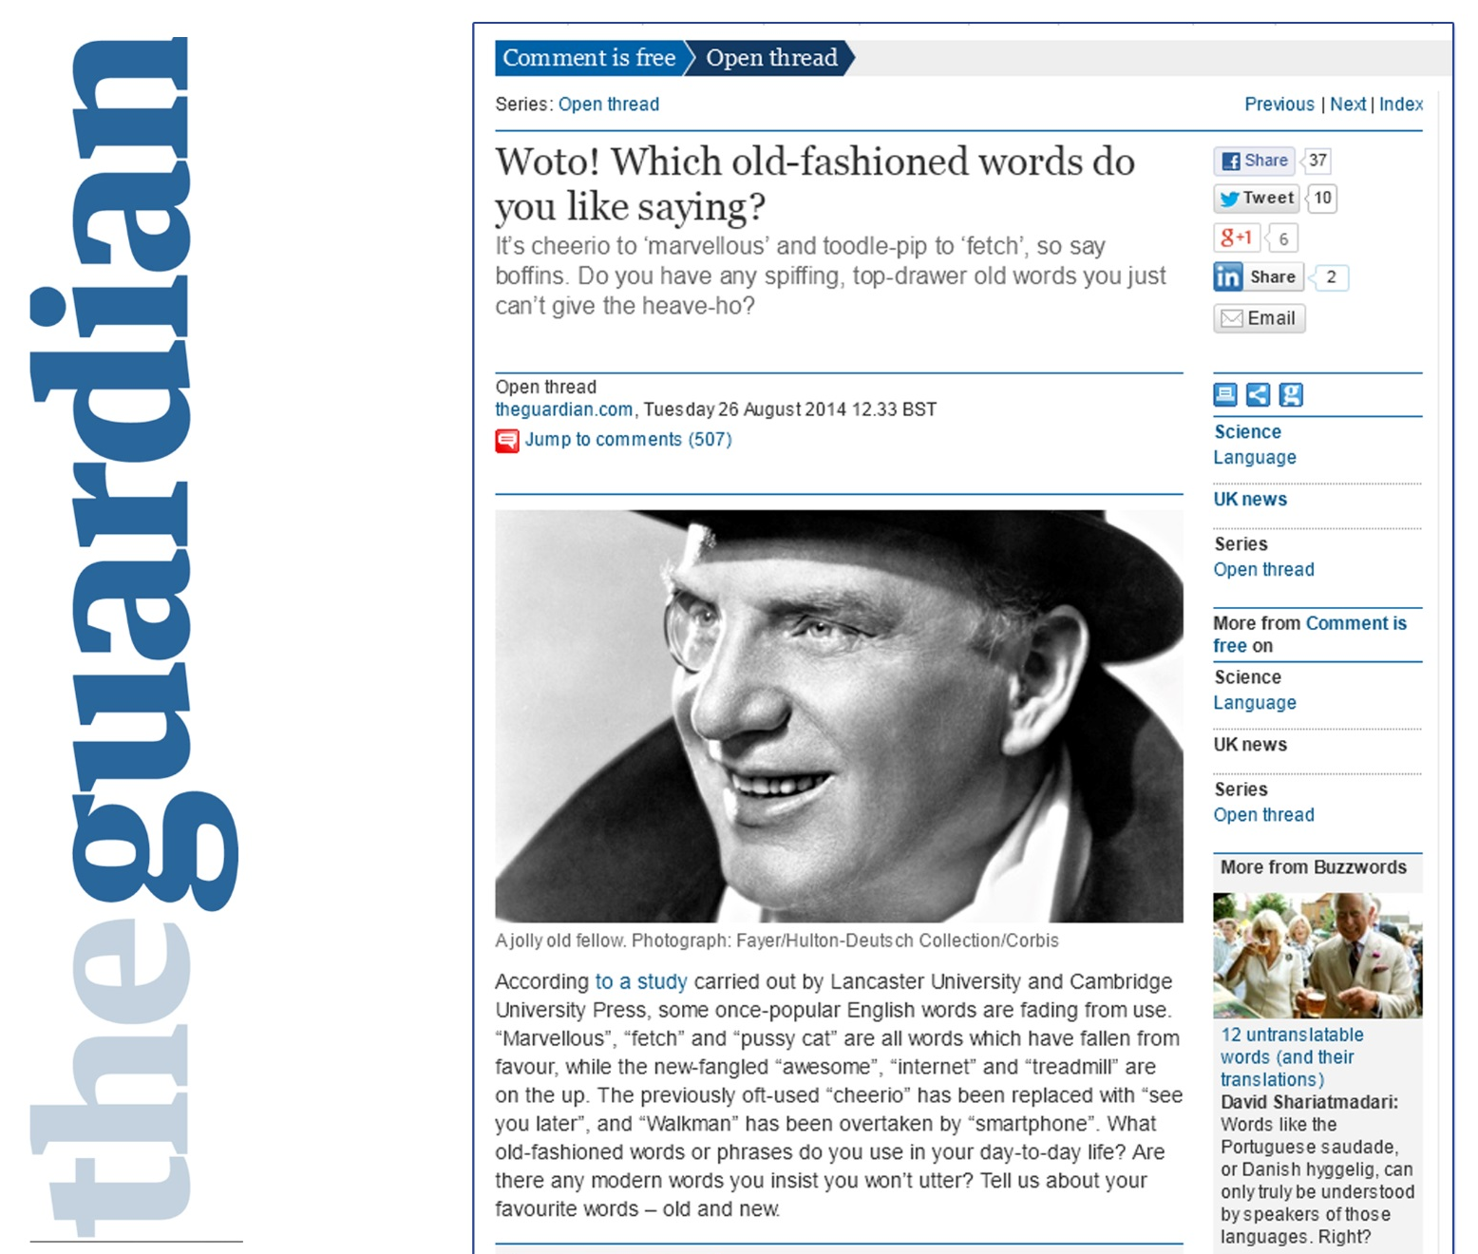
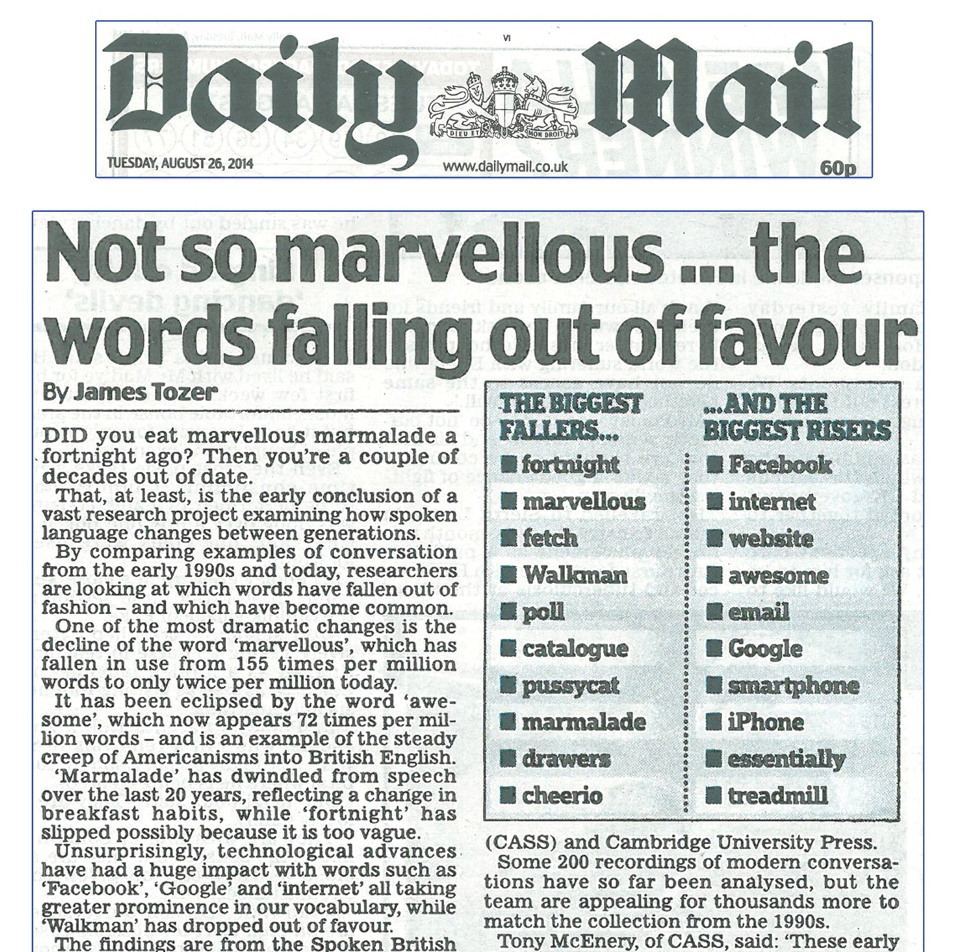
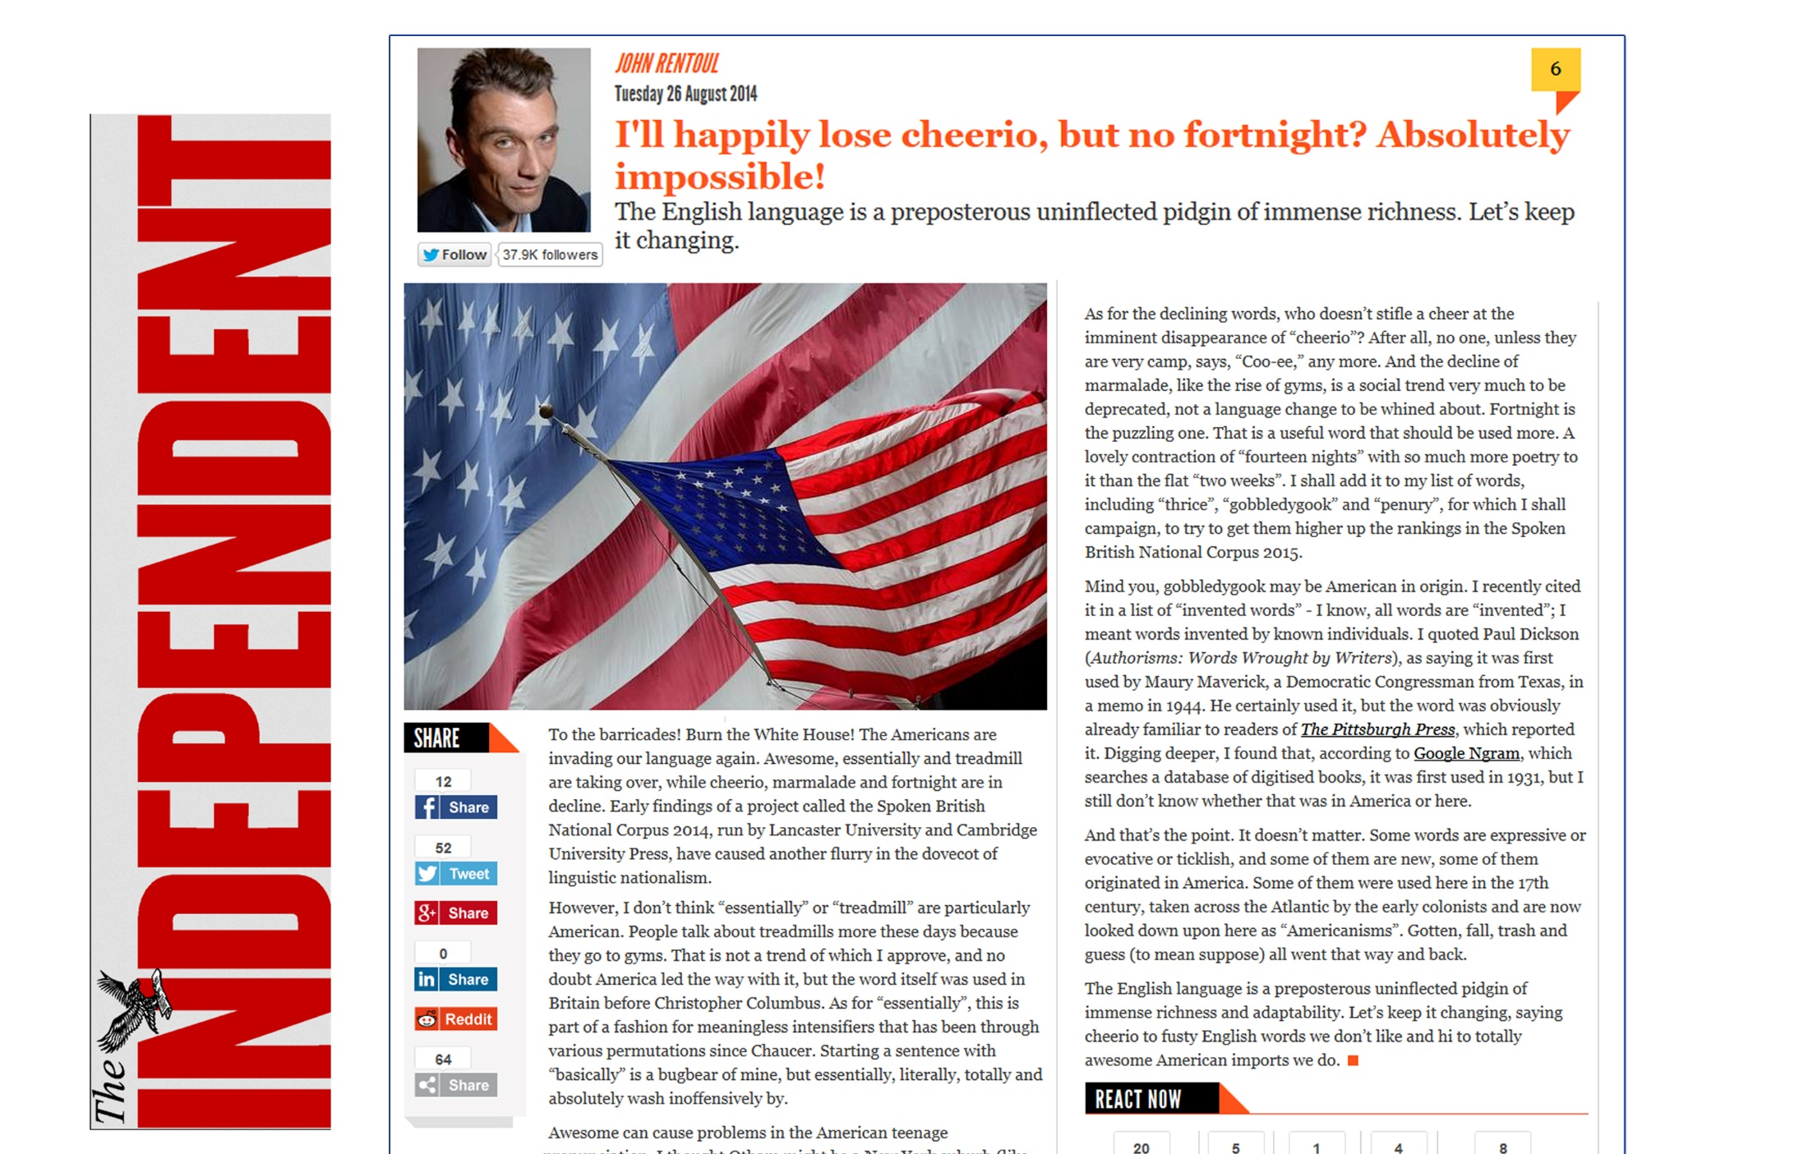
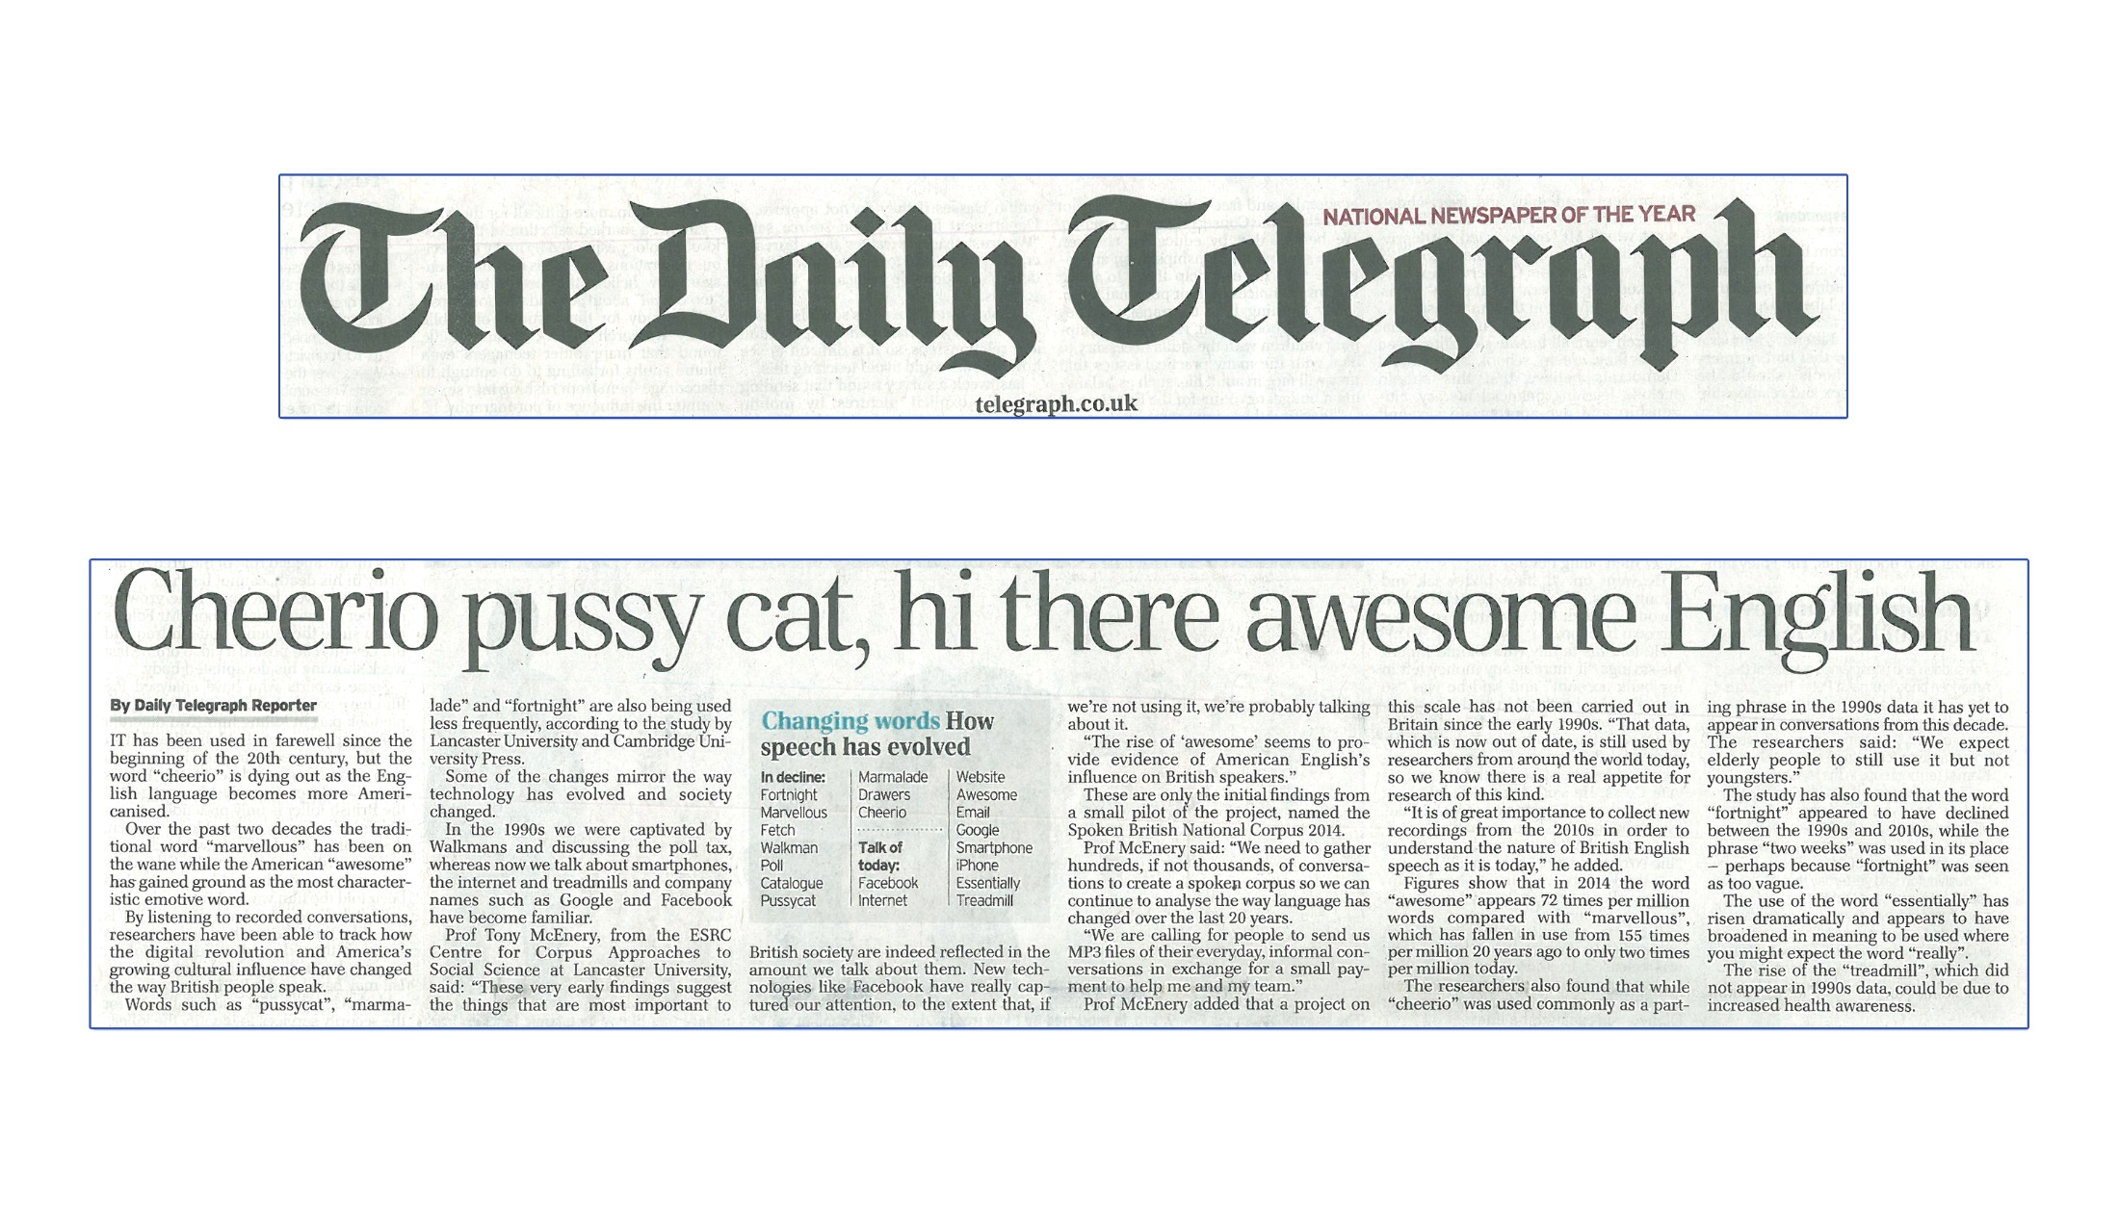
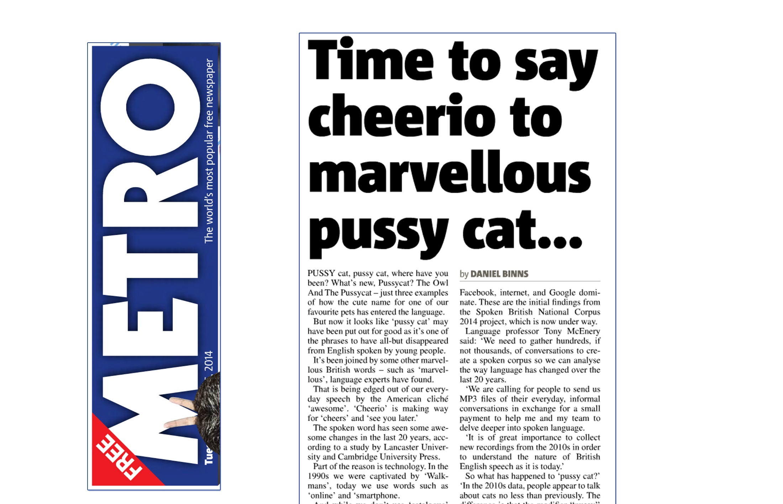
Example: the pussy cat

Slide 34
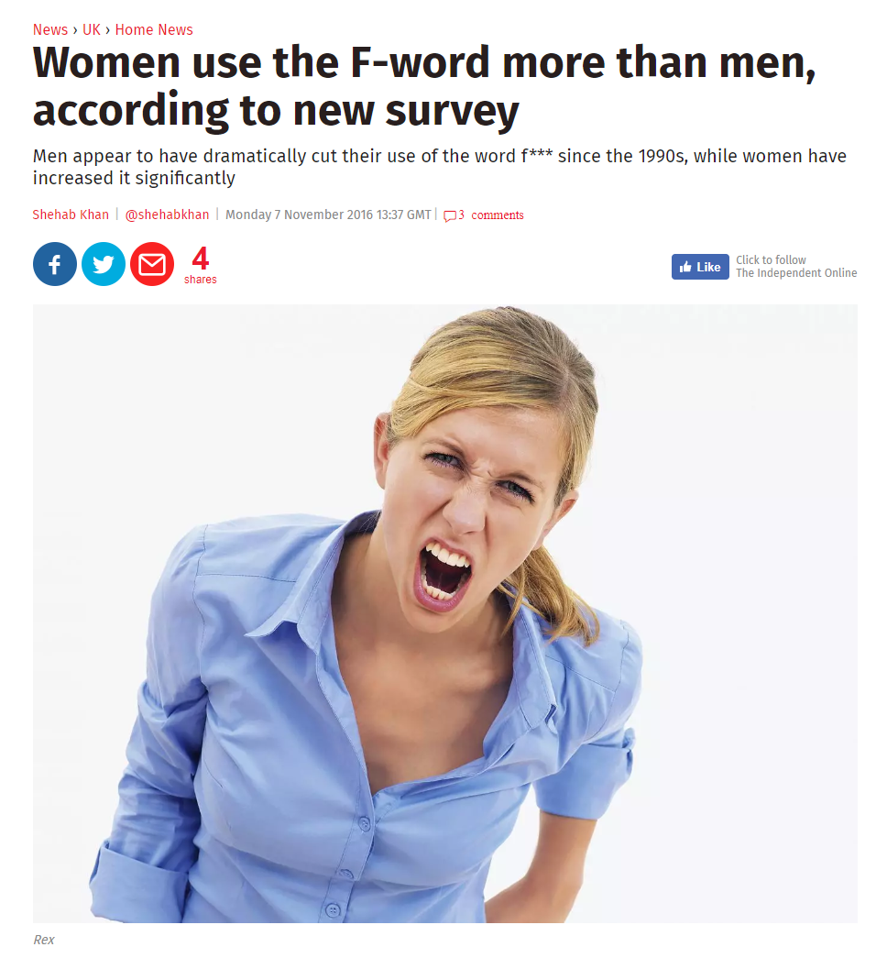
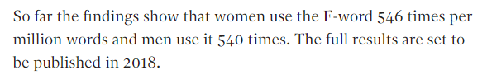
Example: swearing

Slide 35
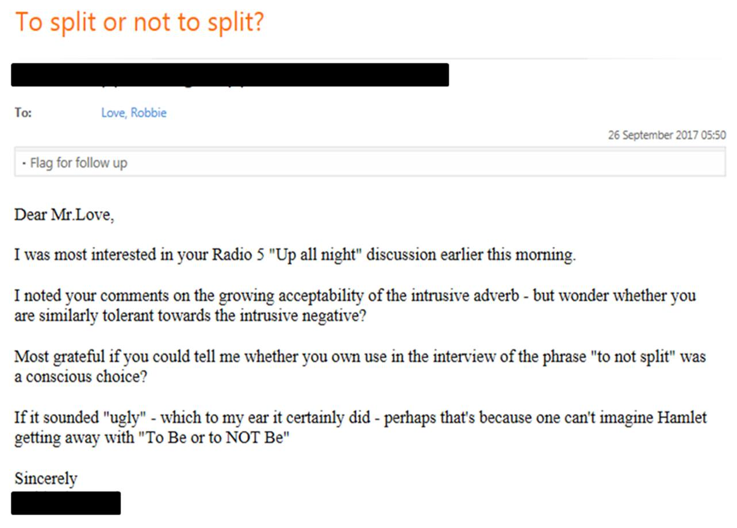
Prescriptive audiences
Some people think I am:
announcing the death of the English language
actively promoting the changes I am reporting

Slide 36
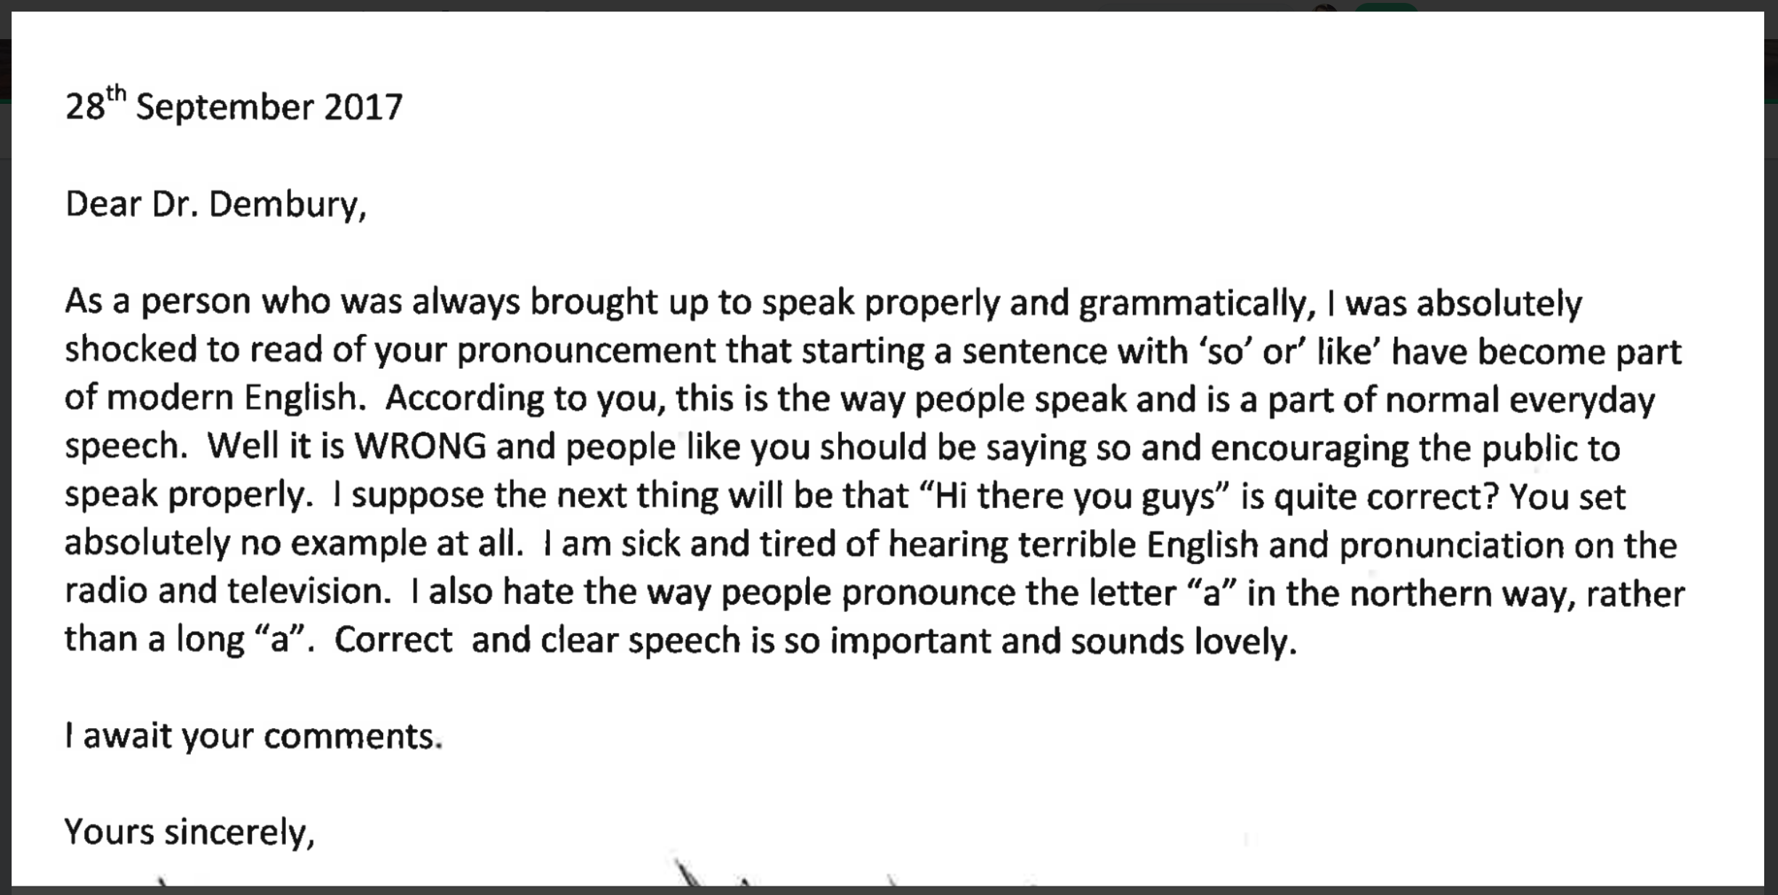
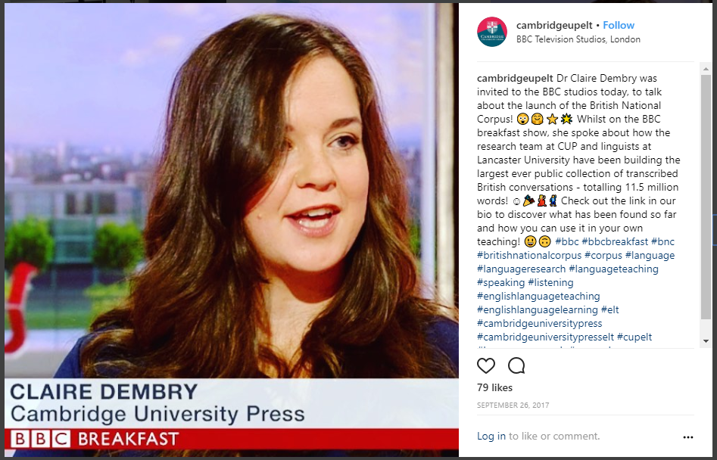
Prescriptive audiences

Slide 37
The growth of corpus linguistics
“No corpus linguist is an island”
(Römer 2013)
CL increasingly interacting with other fields, e.g.:
Language learning e.g. Cambridge Learner Corpus, Trinity Lancaster Corpus
Literature e.g. CLiC Dickens project (Nottingham/Birmingham)
Education e.g. Leeds ‘linguistic challenges’ project
Health(care) e.g. Lancaster/CASS extension and specialisation
Forensic/legal contexts e.g. ‘incitement of violence’ project (Nottingham Trent)
Also:
blind faith in CL
our sensitivity to needs and standards in other fields

Slide 38
Who is responsible for good corpus research?
Corpus creator:
Do your best relative to time, resource and other pragmatic considerations
Report methods
- Document the compilation process
- Justify methodological decisions clearly
- Acknowledge other ways of doing
- Check assumptions (“that surely won’t work…”)
Bear in mind that the ‘final release’ of the corpus need not be the end of its development

Slide 39
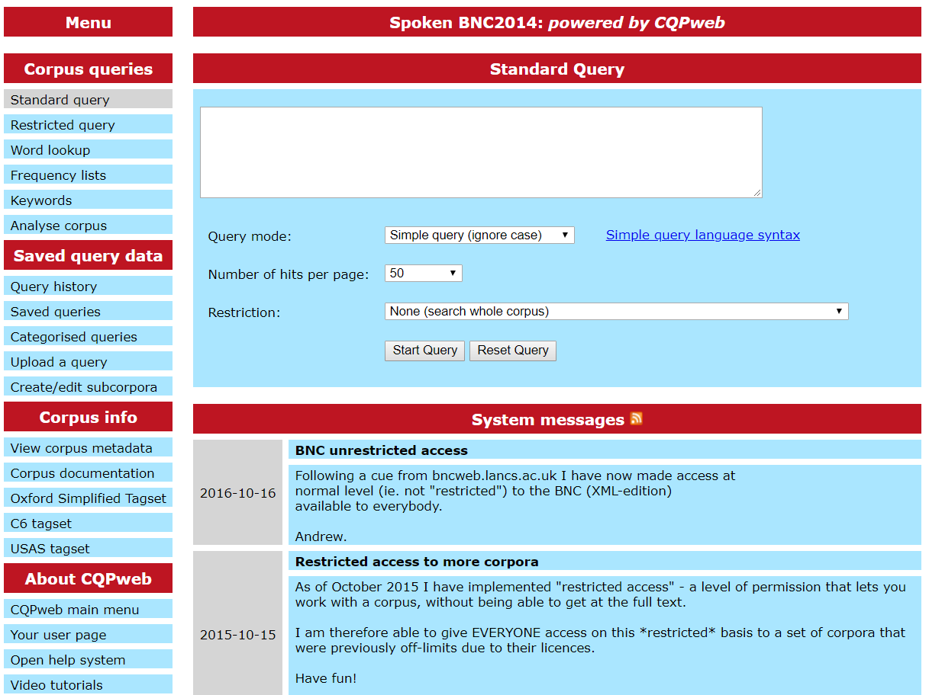
Who is responsible for good corpus research?
Tool developer:
Bridge the gap between the corpus compiler and the researcher
Bridge the gap between the corpus and the researcher
e.g. Spoken BNC2014 on CQPweb
Functionalities which are currently exclusive to this tool
So…is it the responsibility of other tool developers to follow suit to accommodate new corpora like this one?

Slide 40
Who is responsible for good corpus research?
Researcher:
Seek out materials that accompany the corpus (they should be easy to find)
Check assumptions, about:
- what is (not) in the corpus
- what the corpus does (not) represent
- what the corpus was (not) intended for
If in doubt, contact the compilers
Report methods thoroughly
Consider secondary data analysis e.g. pragmatic annotation
Don’t have blind faith in ‘corpus as brand’
Consumer:
Question everything!

Slide 41
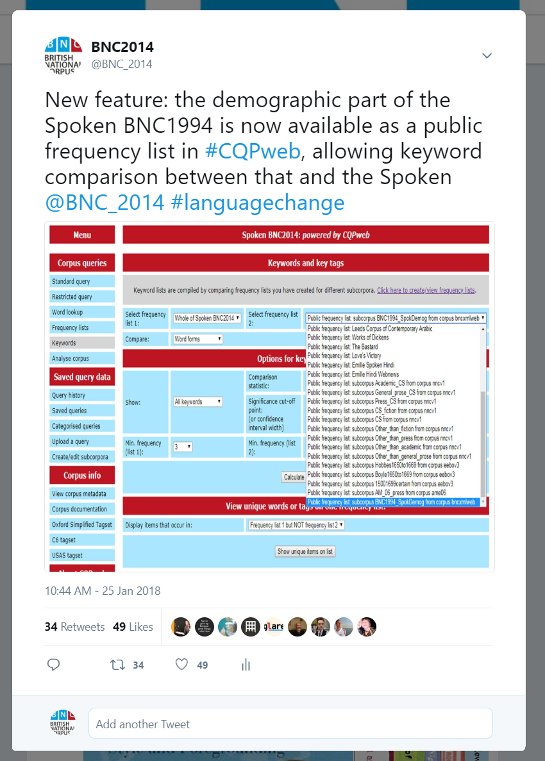
Example: keywords

Slide 42
Example: keywords
XXUNCLEARWORD
l-
a-
e-
st-
XXANONnameM
c-
internet
o-
woah
XXANONnameF
n-
u-
ye-
th-
XXANONplace
D-
T-
awesome
ma-
s-
email
b-
XXFOREIGNWORD
emails
XXANONnameN
g-
m-
twenty-four
youtube
uhu
I-
website
ca-
thi-
y-
facebook
UK
uh-huh
ch-
w-
h-
google
laptop
ipad
f-
ha-
r-
online
XXANONmiscPersonalInfo

Slide 43
Example: keywords
s-
g-
m-
ca-
thi-
XXUNCLEARWORD
uhu
I-
website
uh-huh
ch-
XXANONnameM
y-
facebook
UK
laptop
ipad
XXANONnameF
w-
h-
google
online
XXANONplace
f-
ha-
r-
st-
XXANONnameN
l-
a-
e-
woah
XXFOREIGNWORD
c-
internet
o-
th-
XXANONmiscPersonalInfo
n-
u-
ye-
ma-
D-
T-
awesome
emails
email
b-
twenty-four
youtube

Slide 44
Example: keywords
uhu
laptop
XXUNCLEARWORD
f-
u-
th-
email
online
XXANONnameM
l-
T-
ma-
facebook
woah
XXANONnameF
c-
b-
thi-
internet
emails
XXANONplace
n-
m-
ch-
website
youtube
XXANONnameN
D-
r-
UK
ipad
XXFOREIGNWORD
g-
e-
google
XXANONmiscPersonalInfo
I-
o-
awesome
s-
ye-
h-
twenty-four
y-
ha-
ca-
uh-huh
w-
a-
st-

Slide 45
Example: keywords
email
ipad
XXUNCLEARWORD
f-
u-
th-
facebook
XXANONnameM
l-
T-
ma-
internet
XXANONnameF
c-
b-
thi-
website
XXANONplace
n-
m-
ch-
google
XXANONnameN
D-
r-
uhu
awesome
XXFOREIGNWORD
g-
e-
UK
laptop
XXANONmiscPersonalInfo
I-
o-
twenty-four
online
s-
ye-
uh-huh
h-
emails
y-
ha-
ca-
woah
youtube
w-
a-
st-

Slide 46
Who are corpus linguists?
People who
build corpora?
build tools to analyse corpora?
are students of corpus linguistics?
analyse corpora using existing tools and methods (non-programmers)?
formulate new (statistical) methods to interpret corpora?
apply corpora in other contexts (e.g. teaching)?
Future challenges
differences in statistical literacy
complacency

Slide 47
Conclusions
BNC2014: a contribution to corpus linguistics and beyond
Be honest, critical and realistic about representativeness
Maximize efficiency of corpus construction in view of practical constraints
There is no one ‘right’ way to do this – e.g. data collection, metadata, transcription, processing
Decisions made = justified & transparent, including weaknesses e.g. imbalance
As CL grows, so should the responsibility of all to protect its integrity

Slide 48
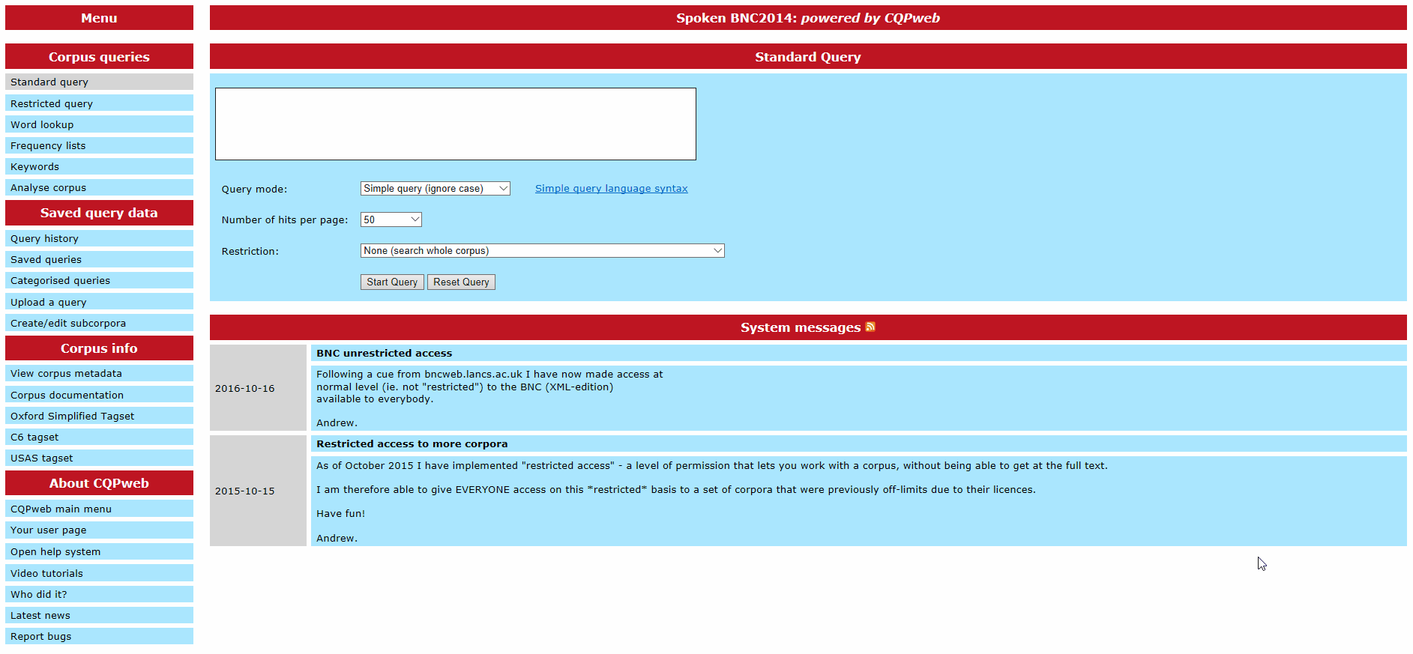
Thank you – questions?

Slide 49
References
Biber, D. (1993). Representativeness in corpus design. Literary and Linguistic Computing, 8(4), 243-257.
Crowdy, S. (1995). The BNC spoken corpus. In G. Leech, G. Myers, & J. Thomas (Eds.), Spoken English on Computer: Transcription, Mark-Up and Annotation (pp. 224-234). Harlow: Longman.
Garside, R., & Smith, N. (1997). A hybrid grammatical tagger: CLAWS4. In R. Garside, G. Leech & A. McEnery (Eds.), Corpus Annotation: Linguistic Information from Computer Text Corpora (pp. 102-121). London: Longman.
Hardie, A. (2012). CQPweb – Combining power, flexibility and usability in a corpus analysis tool. International Journal of Corpus Linguistics, 17(3), 380-409.
Hardie, A. (2014). Modest XML for corpora: not a standard, but a suggestion. ICAME Journal, 38, 73-103.
Leech, G. (2007). New resources, or just better old ones? The Holy Grail of representativeness. In: Corpus Linguistics and the Web. Rodopi, Amsterdam, pp. 133-149.
Love, R., Dembry, C., Hardie, A., Brezina, V., & McEnery, T. (2017). The Spoken BNC2014: Designing and building a spoken corpus of everyday conversations. International Journal of Corpus Linguistics, 22(3), 319-344.

