Slide 1


Building and analysing a national corpus of spoken English for ELT research
The Spoken BNC2014
Dr Robbie Love
Research Fellow
School of Education
University of Leeds
r.love@leeds.ac.uk
lovermob

Slide 2
Plan
The BNC2014 project
What the Spoken BNC2014 is and isn’t
Recent change in spoken English
Conclusions

Slide 3

The British National Corpus (1994)
“a corpus of 100 million words of written texts and spoken transcriptions of modern British English, to be stored on the computer in machine-readable form”
(Leech 1993: 9)

Slide 4

The BNC2014 project

Slide 5
Aims of the BNC2014
Broadly comparable to the BNC1994, compiled two decades later
A new resource for research & teaching
100 million words of written British English, variety of registers
10 million words of spoken British English, one register = casual conversation
Phase 1 (2014-2017) = Spoken BNC2014
Lancaster University + Cambridge University Press
Phase 2 (2015-present) = Written BNC2014
Lancaster University

Slide 6

English language teaching
What we teach vs. what we do
Focus less on structures we produce less frequently
What are we talking about?
Inspiration for current/realistic conversational topics
Speaking and ELT teaching
Teaching speaking is tough

Slide 7


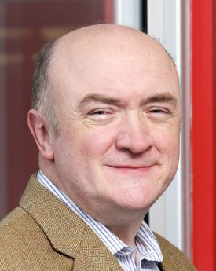
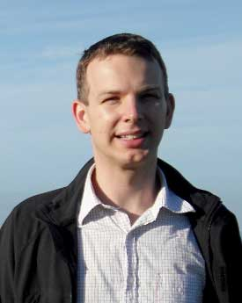
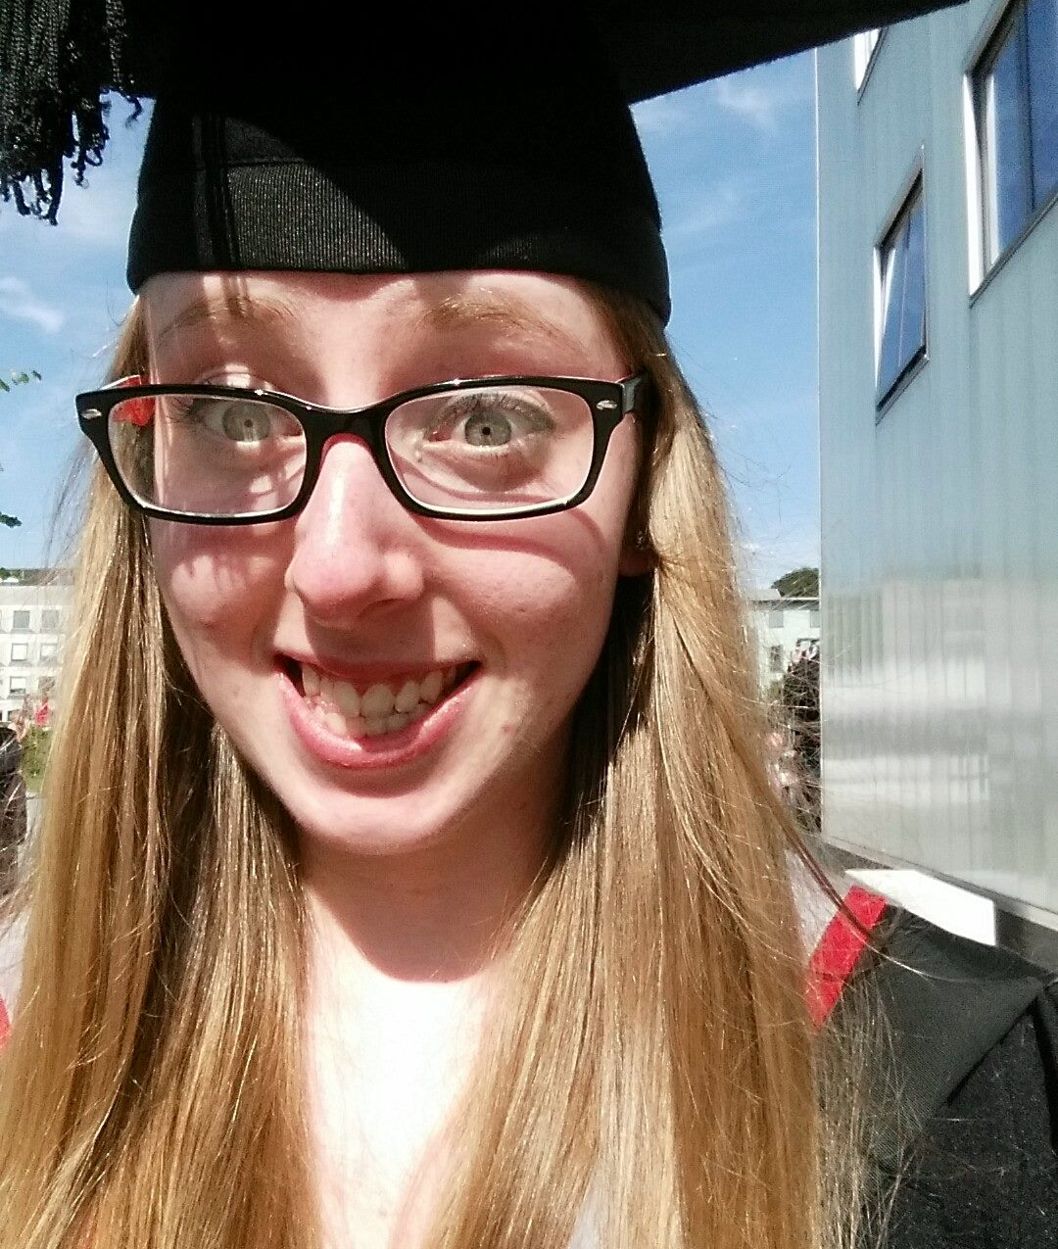
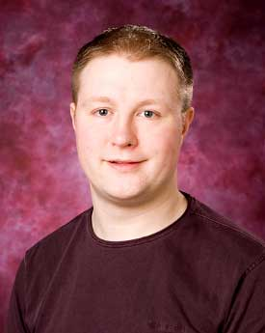
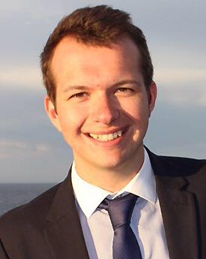
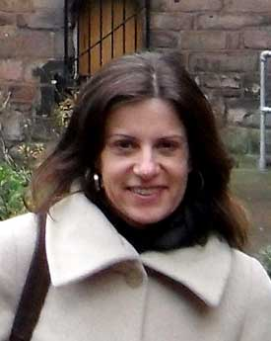
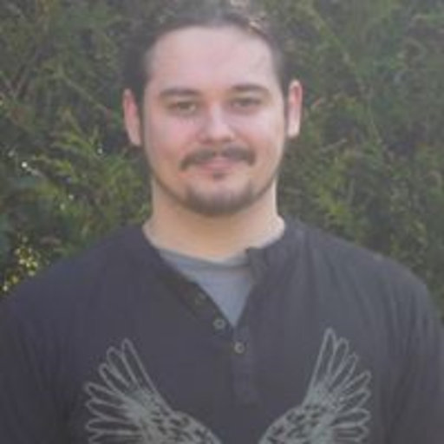
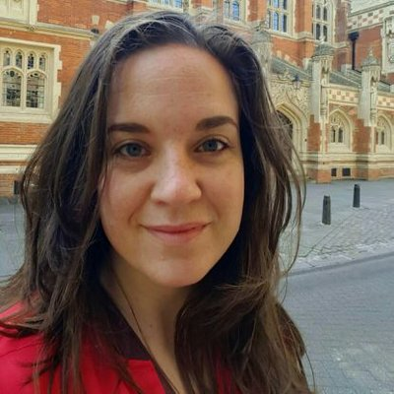

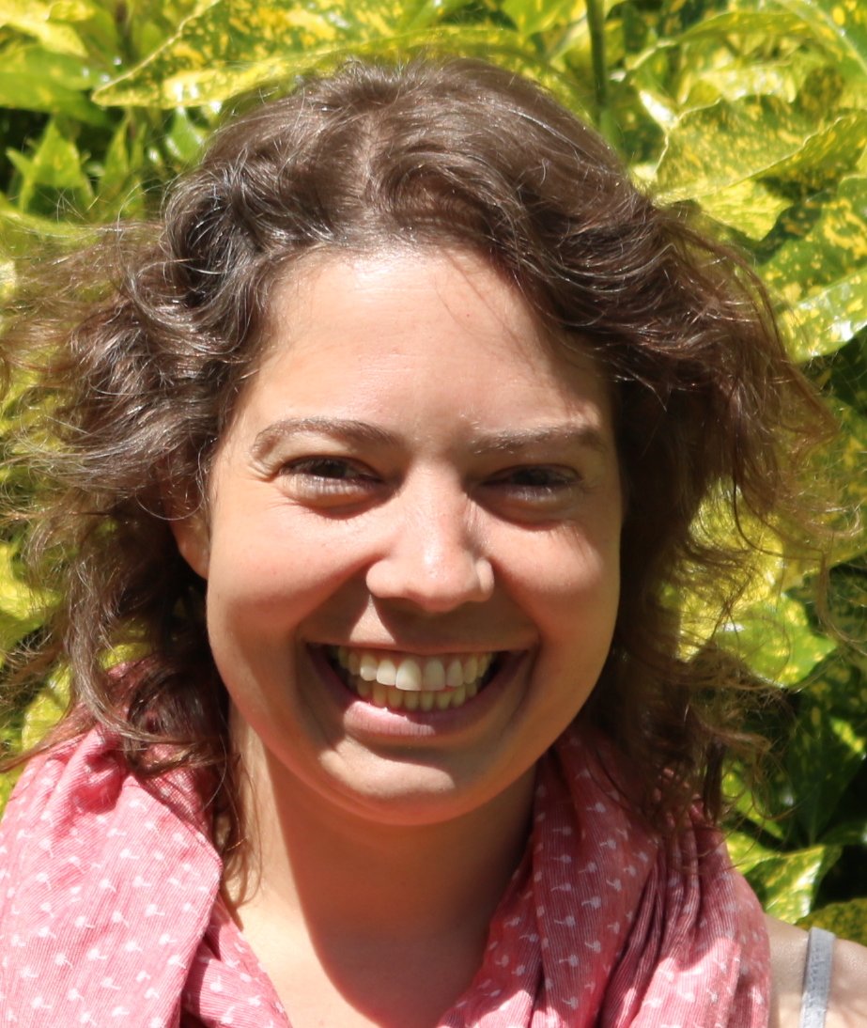
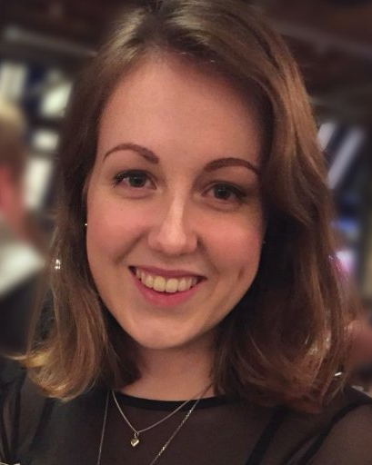
The BNC2014 team
10 million words
Phase 1 (2013-2017):
Spoken BNC2014
Phase 2 (2014-):
Written BNC2014
90 million words
Tony
McEnery
Vaclav
Brezina
Abi
Hawtin
Robbie
Love
Mathew
Gillings
Carmen
Dayrell
Matt
Timperley
Andrew
Hardie
Claire
Dembry
Olivia
Goodman
Andressa Rodrigues Gomide
Isolde van Dorst

Slide 8
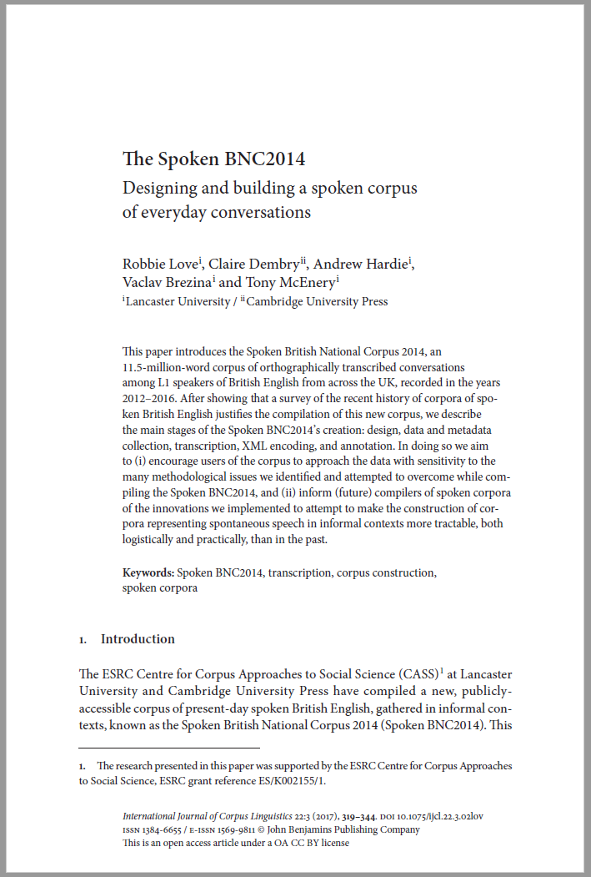


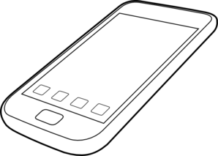





Building the Spoken BNC2014
SPOKEN
Existing corpora
Design
Representativeness
Target population
Sampling goals
Who is it for?
What do people want?
What have people done?
Finding participants
Recording equipment
Metadata collection
Automated? Manual?
Conventions
Accuracy
XML conversion
Annotation
Tool development
User guide
Website
Publications
What have we got?
Representativeness
Pilot research
Data collection
Transcription
Processing
Review
Document
Release

Slide 9
Corpus design
“The design of a representative corpus is not truly finalized until the corpus is completed, and analyses of the parameters of variation are required throughout the process of corpus development in order to fine-tune the representativeness of the resulting collection of texts”
(Biber 1993)
“A seminal article by Biber (1993) has frequently been cited, but no attempt (to my knowledge) has been made to implement Biber’s plan for building a representative corpus. […] Without representativeness, whatever is found to be true of a corpus, is simply true of that corpus – and cannot be extended to anything else.”
(Leech 2006)

Slide 10
Corpus design
The 2nd version of the BNC – promise and expectation of comparability
In terms of spoken data, needs had changed – just informal conversation
Goals:
- priority = England; aim for rest of UK
- spread of age, gender, region, socio-economic status etc.
- but: no pre-determined category sizes
- broadly comparable to the Spoken BNC1994DS
Describe representativeness upon completion
We had to facilitate comment on some wider population, otherwise what is the point?

Slide 11
Corpus design
 | Spoken BNC1994 | Spoken BNC2014
Interaction type | Demographic (40%); Context-governed (60%) | Demographic (100%)
Who? | “Carefully sampled individuals” (Leech 1993:6) | Open call for participation; Some targeting
How? | Tape recorders | Smartphone MP3 recordings
What? | All interactions in a given period | Conversations; some task-based interactions.
When? | Continuously over a 2-7 day period | As determined by participant
How many speakers? | 124 adults making recordings Over 1000 speakers | 700 unique speakers
Total data | ~10m words | 11+m

Slide 12
Corpus design
 | Spoken BNC1994 | Spoken BNC2014
Speaker | Age Gender Education Occupation Accent/dialect Socio-economic category | Age Gender Education Occupation Accent/dialect Birthplace Linguistic origin Where do you currently live? How long have you lived there? Nationality Do you speak other languages?
Recording | Title Date Recording location | Title Date File name Recording length Recording location Speaker relationship Topics covered

Slide 13

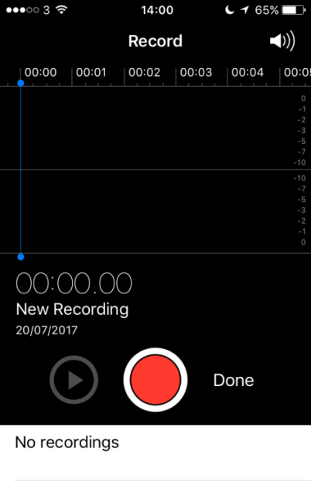
Data collection
How can we recruit & motivate participants?
Money!
How can we gather good quality recordings?
Smartphones!
How can we gather good quality metadata?
Condition of payment; careful data management

Slide 14
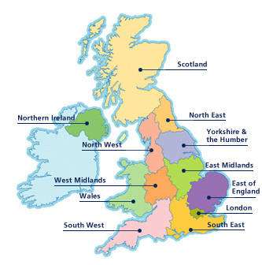
Metadata issues
Accent/dialect -> region

Slide 15
Dialect in the Spoken BNC2014
(1) Global | (2) Country | (3) Supra-region | (4) Region
UK | England | North | North East
 |  |  | Yorkshire & Humberside
 |  |  | North West (not Merseyside)
 |  |  | Merseyside
 |  | Midlands | East Midlands
 |  |  | West Midlands
 |  | South | Eastern
 |  |  | South West
 |  |  | South East (not London)
 |  |  | London
 | Scotland | Scotland | Scotland
 | Wales | Wales | Wales
 | Northern Ireland | Northern Ireland | Northern Ireland
Non-UK | Republic of Ireland | Republic of Ireland | Republic of Ireland
 | Other non-UK variety | Other non-UK variety | Other non-UK variety
Unspecified | Unspecified | Unspecified | Unspecified
Comparable with the Spoken BNC1994 too!

Slide 16
Transcription
Audio recording & signed consent forms received
Metadata recorded from consent forms
Audio recording assigned to transcriber
Transcript produced
Check #1: Audio checking
Check #2: Proofreading
Proofread word doc sent to Lancaster

Slide 17
Transcription
Why not use exactly the same transcription scheme as the original?
EXAMPLE
using full stops and commas to “approximate to use in written text”, but also indicating pauses with ellipses
<2> I think it’s always, deceptive on days like this because its, overcast and [er]
[…]
<2> But, but er, he’s…just broken away from his girlfriend and [<unclear>]
<1> [Oh has] he, oh. Well he seemed happy enough when he called.
Crowdy (1994: 28)

Slide 18
Transcription
Filled pauses
What it sounds like | How to write it
Has the vowel found in “father” or a similar vowel; usually = realisation, frustration or pain | ah
Has the vowel found in “road” or a similar vowel; usually = mild surprise or upset | oh
Has the vowel in “bed” or the vowel in “made” or something similar, without an “R” or “M” sound at the end; usually = uncertainty, or ‘please say again?’ | eh
A long or short “er” or “uh” vowel, as in “bird”; there may or may not be an “R” sound at the end; usually = uncertainty | er
As for “er” but ends as a nasal sound | erm
Has a nasally “M” or “N” sound from start to end; usually = agreement | mm
Like an “er” but with a clear “H” sound at the start; usually = surprise | huh
Two shortened “uh” or “er”-type vowels with an “H” sound between them, usually = disagreement; OR, a sound like the word “ahah!”; usually = success or realisation | uhu

Slide 19
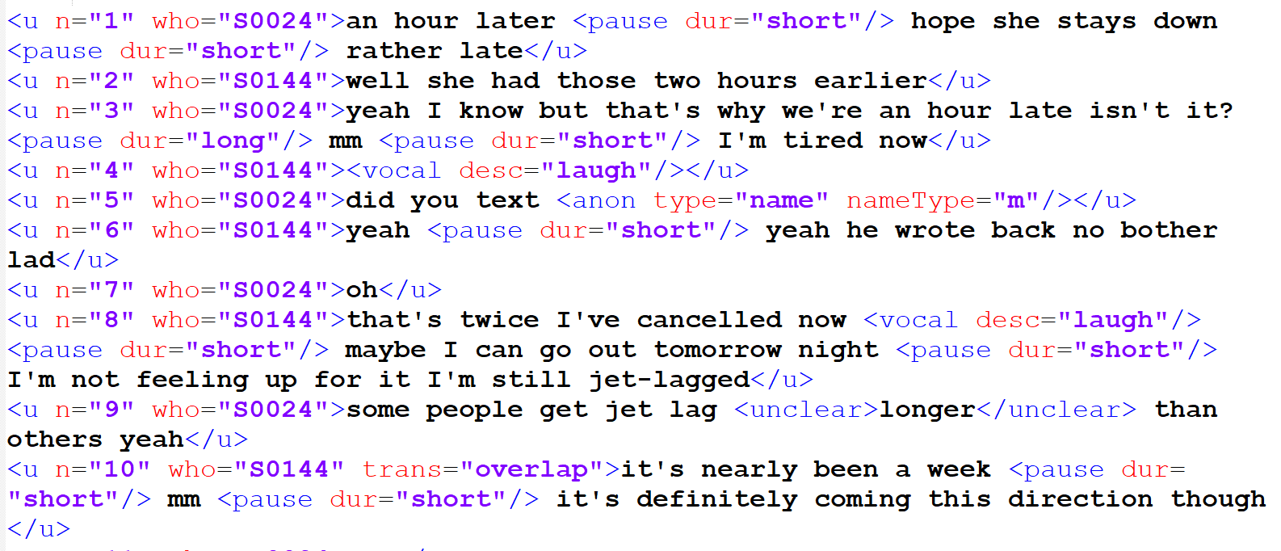
Processing

Slide 20
The Spoken BNC2014
Conversational, L1 British English
2012-2016
672 speakers
1,251 texts
11,422,617 words
Freely available to the public:
    on Lancaster’s CQPweb
    BNClab
    file download

Slide 21
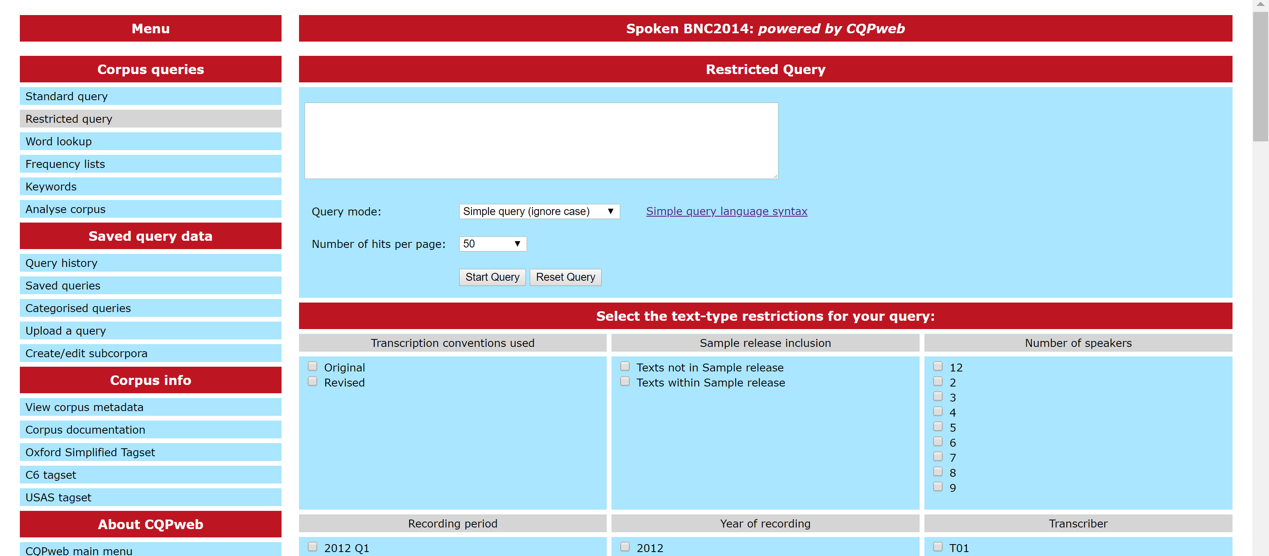
The Spoken BNC2014

Slide 22
The Spoken BNC2014

Slide 23
The Spoken BNC2014

Slide 24
So…what the Spoken BNC2014 is
A large corpus of informal spoken British English, as spoken mostly in England
Within England, it represents a spread of demographics including gender, age, socio-economic status and region
Comparable in terms of register to the Spoken BNC1994DS
A resource for the study of:
- lexical/grammatical variation & change in England
- how inf. English is spoken in England (2012-2016)
- functional variation according to situational context
- how inf. spoken English differs from writing & online comm.
- how inf. spoken English differs from other spoken registers
- (critical) discourse analysis
- much more…

Slide 25
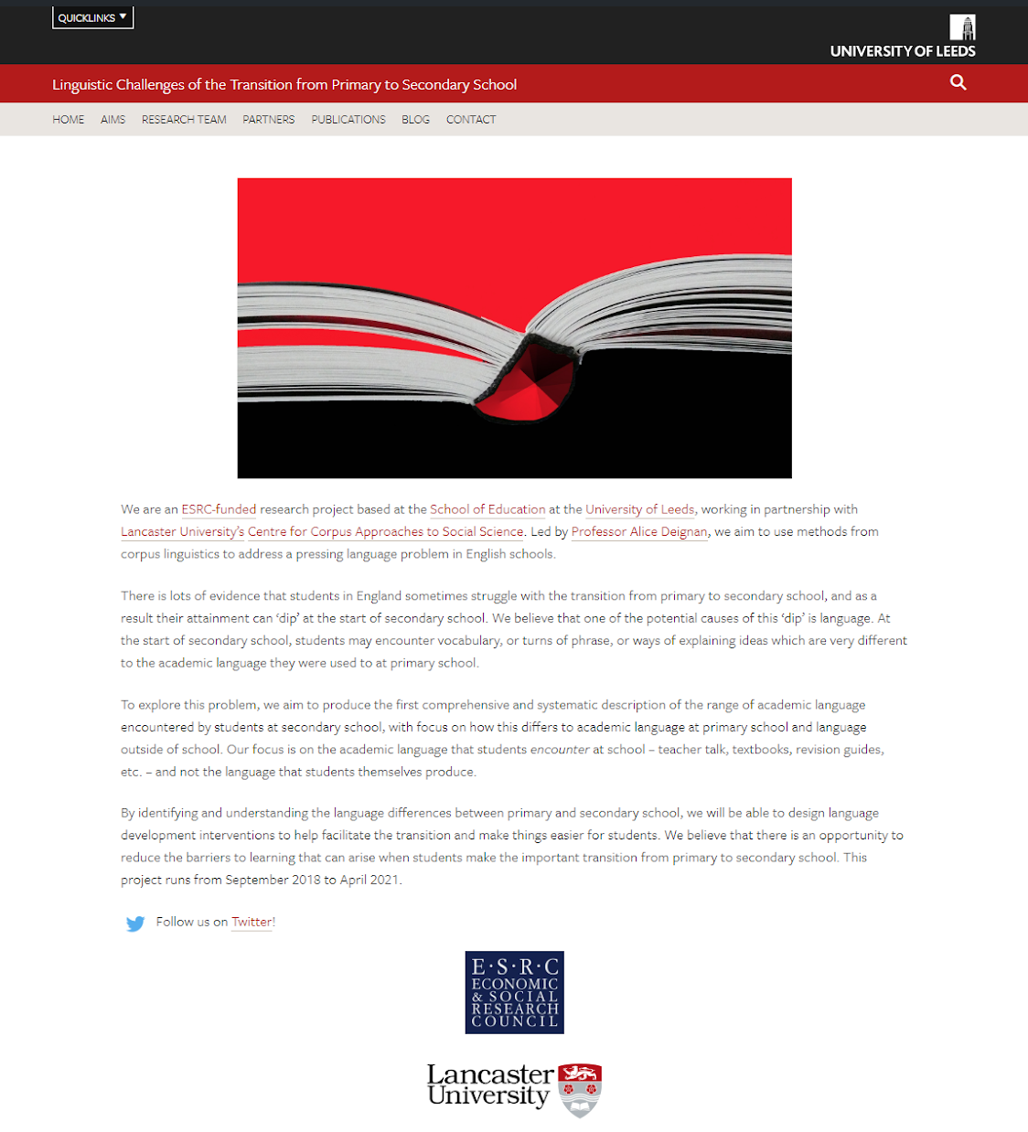
So…what the Spoken BNC2014 is
A useful reference corpus, e.g.
University of Leeds: The linguistic challenges of the transition from primary to secondary school
Research team led by Prof Alice Deignan
Analysing corpora of classroom language in primary & secondary school
How does the language that students encounter change when they move up to secondary school?
How does this language compare to the everyday language they use at home?
https://linguistictransition.leeds.ac.uk/

Slide 26
What the Spoken BNC2014 isn’t
Perfect!
A corpus of a range of spoken registers
Comparable in terms of register with the whole Spoken BNC1994
A corpus built in exactly the same way as the Spoken BNC1994
A corpus designed with phonetics in mind
A corpus that represents the whole of the UK

Slide 27
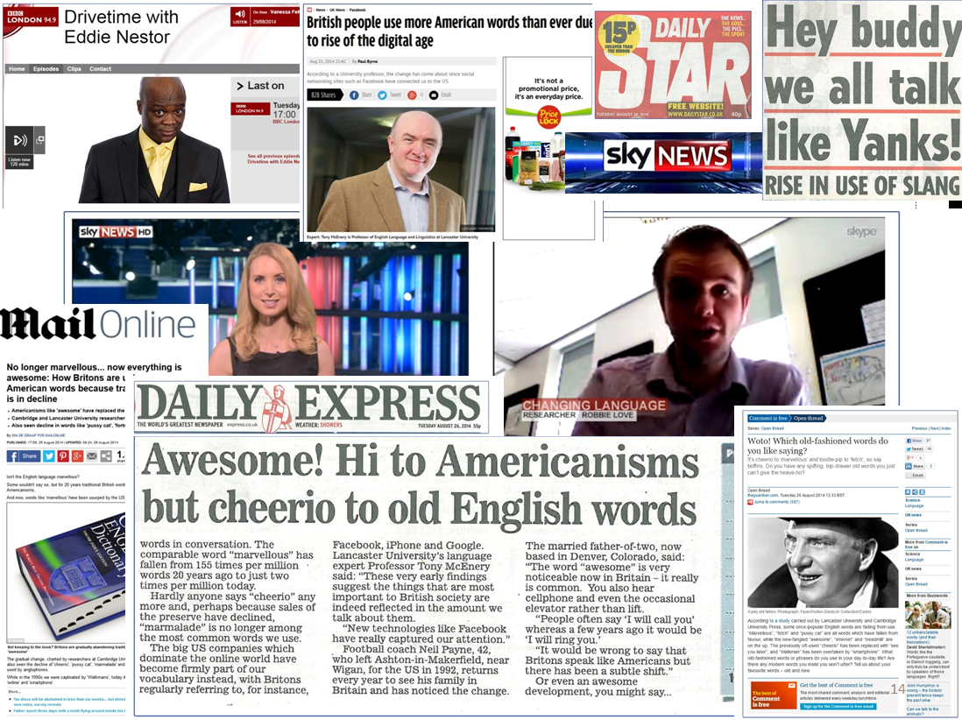
Engaging with the media
Finding and recruiting participants for the Spoken BNC2014
The media as an advertising tool
Working with university press office
Researchers and journalists…a love/hate relationship
The truth of the matter is that the principles we hold dear (thoroughness, accuracy, taking your time to get it 100% right) are not conducive to getting headlines
Often, my work was watered down, censored and simplified

Slide 28
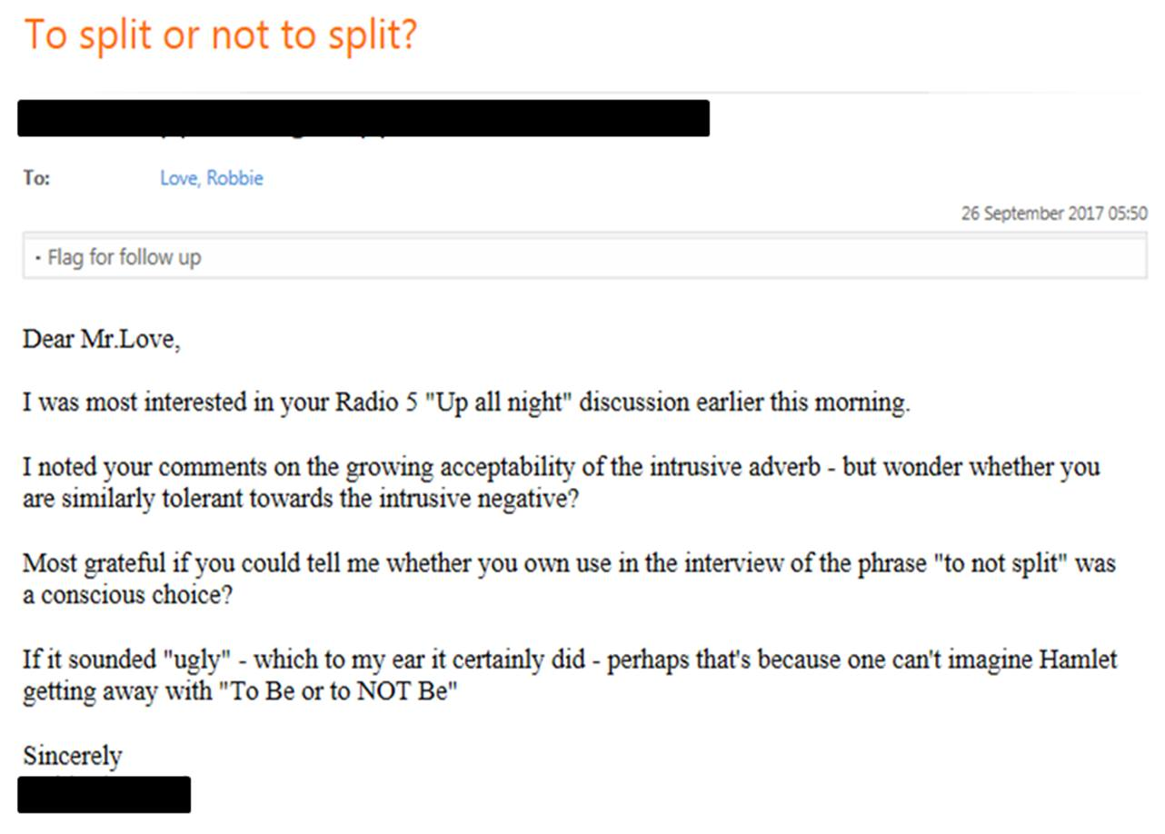
Prescriptive audiences
Some people think I am:
announcing the death of the English language
actively promoting the changes I am reporting

Slide 29
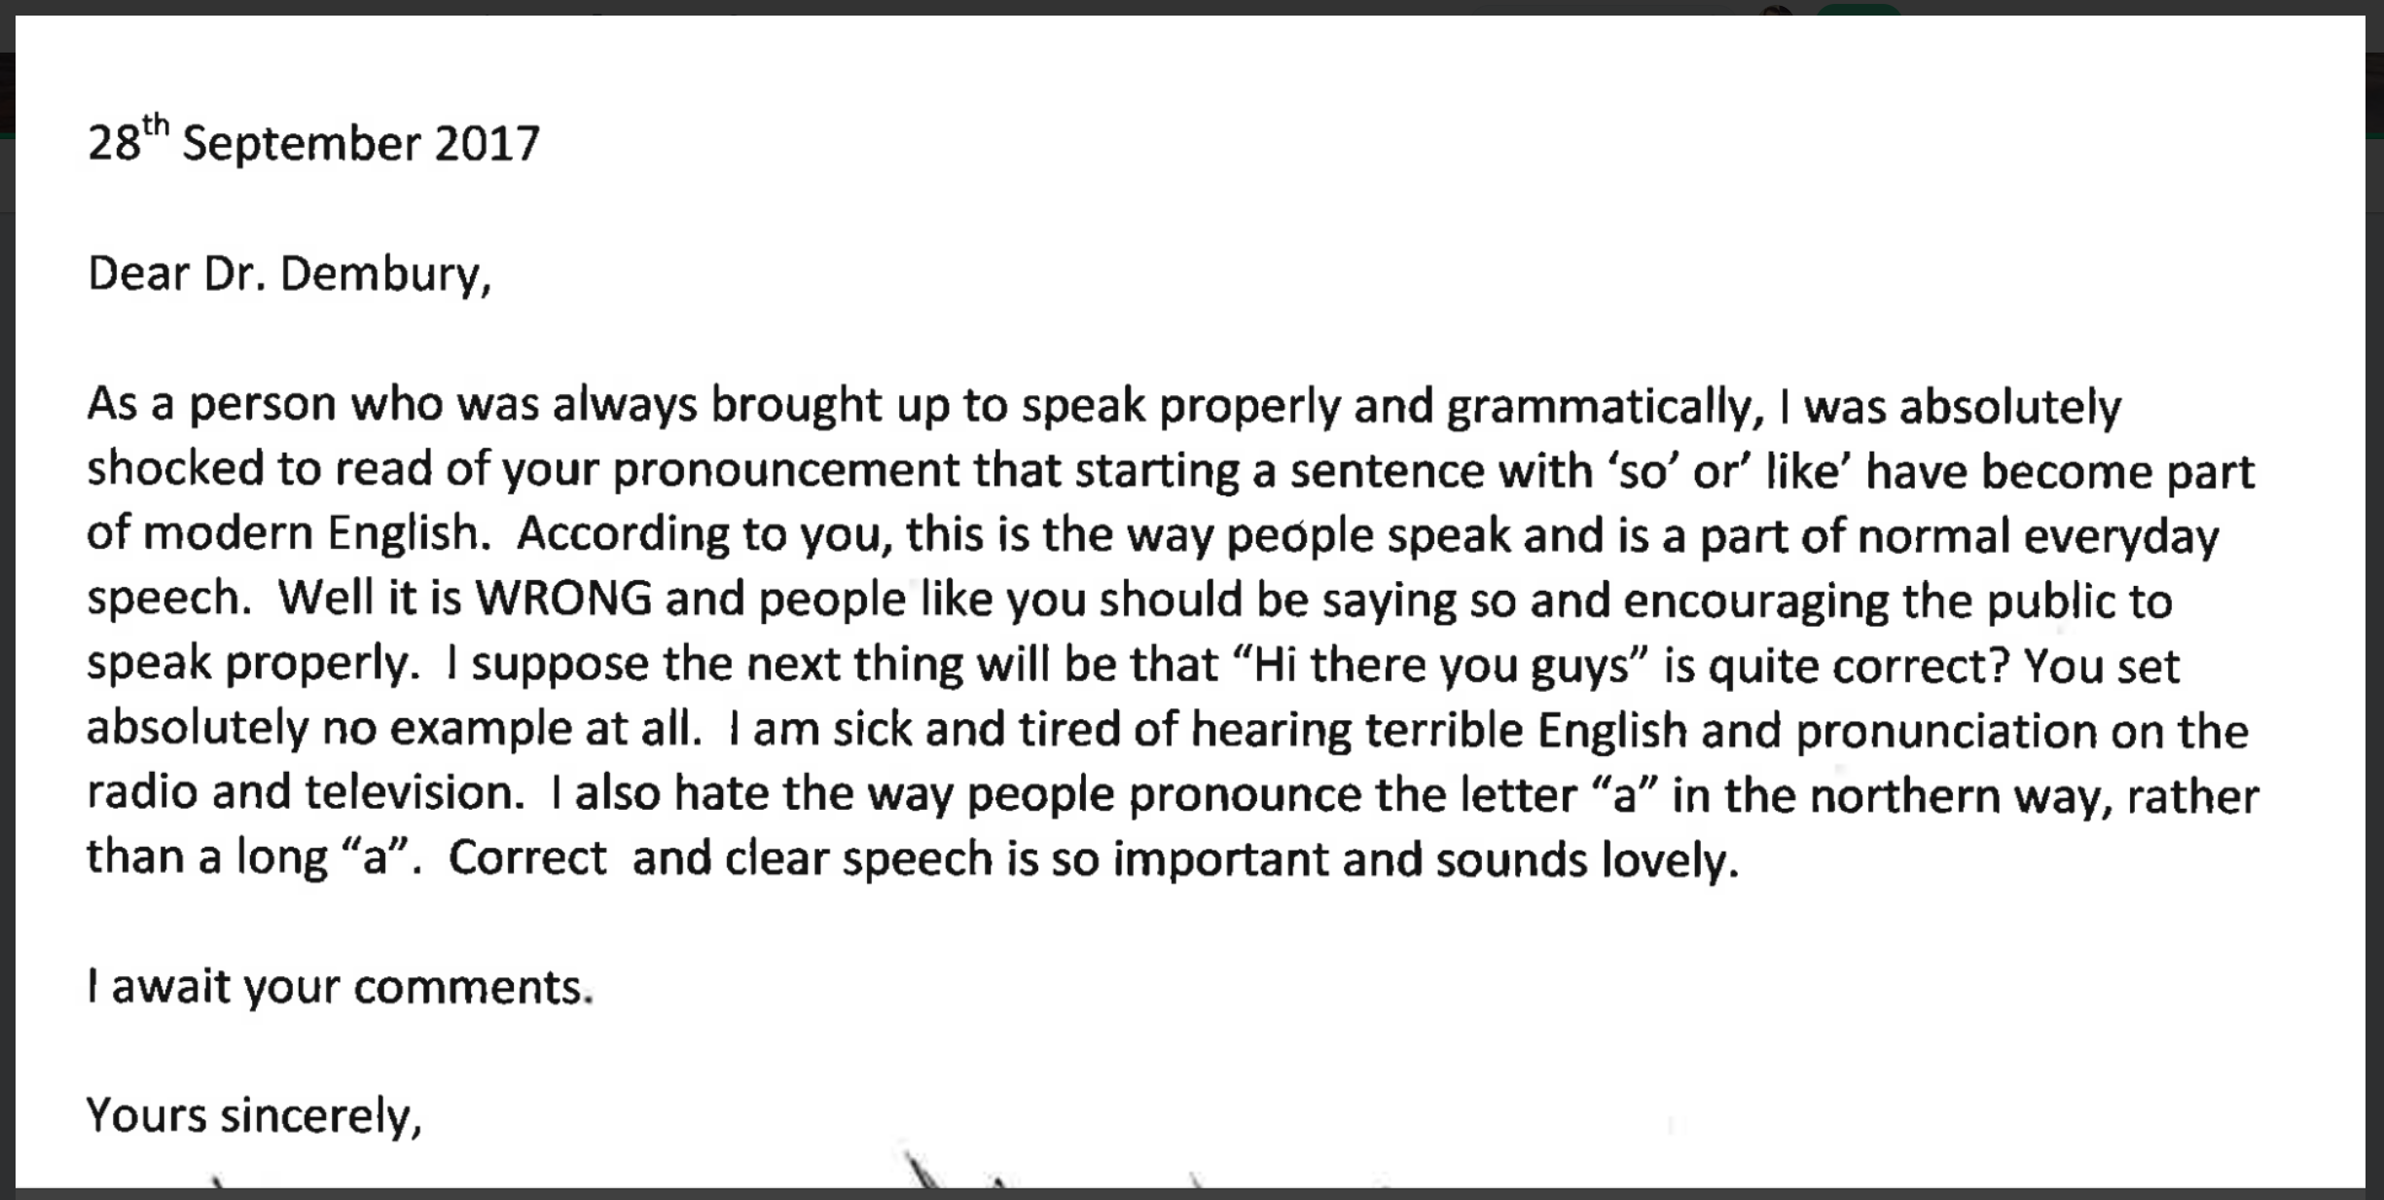
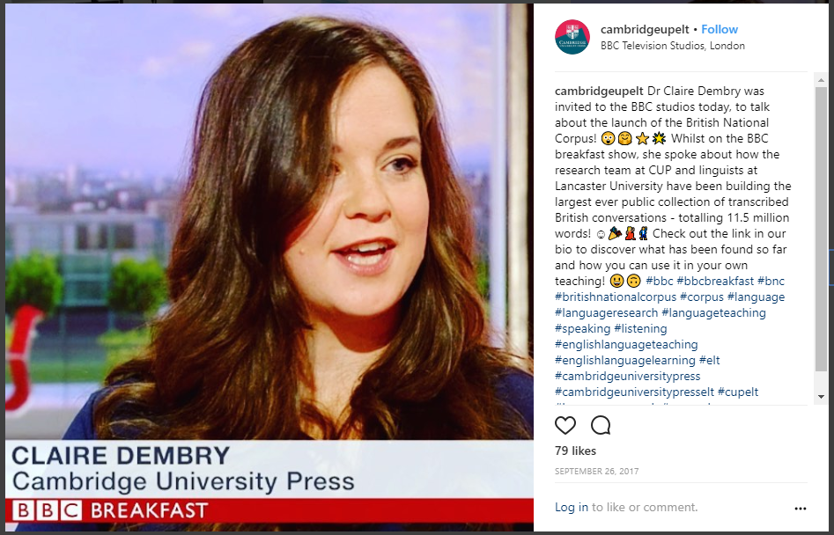
Prescriptive audiences

Slide 30
Recent change in spoken English & implications for ELT
With thanks to Niall Curry and Olivia Goodman, Cambridge University Press
(Curry, Love & Goodman in prep)

Slide 31
Indirect corpus applications in ELT
Nowadays it is commonplace for materials for language learning to be corpus informed (Hunston, 2002)
CUP currently use their own purpose-built corpora (The Cambridge English Corpus) to inform the development of their ELT materials, including English course books, exam preparation materials and grammar references
The Spoken BNC2014 allows the investigation of recent change in spoken English – comparing to the Spoken BNC1994
There remains a 'fuzziness' surrounding the processes involved in developing corpus based materials
Case study: adverbs
owing to recent research on their value for ELT learners (Pérez-Paredes & Mark, Forthcoming)

Slide 32
Recent change in adverb use

Slide 33
Recent change in adverb use
Three of the most frequent types in both corpora:
like, well and just
Analysed syntax, function and frequency (Carter & McCarthy 2006)
Random samples of c. 400 instances of each, in both corpora

Slide 34
like

Slide 35
like – reported speech/thought

Slide 36
like – reported speech/thought
I saw so many shooting stars I was like ah did you? (2014, SLSS)
And we were like can we just can we just have a few more minutes? (2014, SD6X)
Then they said oh you know erm leave a message I’m like I’m not leaving a message I’m hanging up (2014, SUVL)
I was like I know how you feel (2014, S7KD)

Slide 37
well

Slide 38
well – linking function

Slide 39
well – linking function
I’m free you’re up for it as well? (2014, SJNB)
Yeah I’m going home as well (2014, SESD)
I think so cos it varies it as well yeah (2014, SP2Y)
My mum watches it as well (2014, SUVL)

Slide 40
just

Slide 41
just – VP & clause modification

Slide 42
just – VP & clause modification
then you just have to scan your receipt (2014, SYRT)
no just walk forward a little bit (2014, SP6E)
no just in my head we have a really similar reaction (2014, SNAS, disc. marker)
oh just like er I mean like that would be the worst nightmare (2014, 2954, disc. marker)

Slide 43
Response from materials writers
Based on the analysis, we have evidence of notable language change at the level of adverb use in casual spoken English. This change occurs not only in frequency, but also in syntax and function
This evidence has surprised materials writers, challenged preconceptions and has changed the representation of language in materials in a number of ways
According to experts in materials writing and teacher training, overall, corpora are effective and useful in dispelling myths, guiding choices and empowering teachers and learners with real language use
however, they stress the importance of taking a critical approach to using the data

Slide 44
Conclusions
BNC2014: a contribution to corpus linguistics and beyond
It is important to be honest, critical and realistic about representativeness
We have aimed to maximize efficiency of corpus construction in view of practical constraints
There is no one ‘right’ way to do this – e.g. data collection, metadata, transcription, processing
Decisions made = justified & transparent, including weaknesses e.g. imbalance
The corpus can be used to look at recent change in spoken English, and this is already starting to inform ELT materials

Slide 45
Thank you
http://corpora.lancs.ac.uk/bnc2014/
@lovermob
r.love@leeds.ac.uk

Slide 46
References
Biber, D. (1993). Representativeness in corpus design. Literary and Linguistic Computing, 8(4), 243-257.
Carter, R. and McCarthy, M.J., 2006. Cambridge grammar of English: A comprehensive guide to spoken and written grammar and usage. Cambridge University Press.
Crowdy, S. (1995). The BNC spoken corpus. In G. Leech, G. Myers, & J. Thomas (Eds.), Spoken English on Computer: Transcription, Mark-Up and Annotation (pp. 224-234). Harlow: Longman.
Curry, N., Love, R., & Goodman, O. Keeping up with language change: Using the Spoken BNC2014 in ELT materials development.
Garside, R., & Smith, N. (1997). A hybrid grammatical tagger: CLAWS4. In R. Garside, G. Leech & A. McEnery (Eds.), Corpus Annotation: Linguistic Information from Computer Text Corpora (pp. 102-121). London: Longman.
Hardie, A. (2012). CQPweb – Combining power, flexibility and usability in a corpus analysis tool. International Journal of Corpus Linguistics, 17(3), 380-409.
Hardie, A. (2014). Modest XML for corpora: not a standard, but a suggestion. ICAME Journal, 38, 73-103.
Leech, G. (2007). New resources, or just better old ones? The Holy Grail of representativeness. In: Corpus Linguistics and the Web. Rodopi, Amsterdam, pp. 133-149.
Love, R., Dembry, C., Hardie, A., Brezina, V., & McEnery, T. (2017). The Spoken BNC2014: Designing and building a spoken corpus of everyday conversations. International Journal of Corpus Linguistics, 22(3), 319-344.
Pérez-Paredes, P. and Mark, G. (forthcoming) Adverbs in spoken language: a corpus-based analysis of learner and native-speaker language and its pedagogical implications. Studies in Corpus Linguistics series. Amsterdam: John Benjamins.

