Slide 1


Building and analysing a national corpus of informal spoken English
The Spoken BNC2014
Dr Robbie Love
School of Education
University of Leeds, UK
r.love@leeds.ac.uk
@lovermob

Slide 2
Plan
The BNC2014
Representativeness in corpus design
What does the Spoken BNC2014 represent?
Recent change: the case of literally
Conclusions

Slide 3
The BNC2014

Slide 4

The British National Corpus (1994)
“a corpus of 100 million words of written texts and spoken transcriptions of modern British English, to be stored on the computer in machine-readable form”
(Leech 1993: 9)
Oxford University Press
Longman
Chambers Harrap
Oxford University Computing Services
Lancaster University
British Library
http://www.natcorp.ox.ac.uk/

Slide 5

The BNC2014 project

Slide 6
The BNC2014 project
Broadly comparable to the BNC1994, compiled two decades later
A new resource for research and teaching
90 million words of written British English, variety of registers
10 million words of spoken British English, one register = casual conversation
Led by Tony McEnery
Phase 1 (2014-2017) = Spoken BNC2014
Lancaster University + Cambridge University Press
Phase 2 (2015-present) = Written BNC2014
Lancaster University

Slide 7
Representativeness in corpus design

Slide 8
Corpus design
Every corpus is a sample of something
Biber (1993)
Define the target domain (population)
Design the corpus (sampling frame)
Gather some of the corpus data
Evaluate two types of representativeness
    target domain representativeness
    linguistic representativeness
Repeat until maximal representativeness is achieved

Slide 9
Corpus design
Samples lie on a “continuum” (Phillips & Egbert 2018: 108) of design regimes
Probability sampling | Convenience sampling
Target domain is ‘known’ | Target domain is not ‘known’
Take a random sample of texts from the target domain | Create a sampling frame to best approximate the target domain

Slide 10
Sampling spoken British English
“Without representativeness, whatever is found to be true of a corpus, is simply true of that corpus – and cannot be extended to anything else.”
(Leech 2007)
How can a corpus be ‘representative’ of ‘the spoken British English language’ if one cannot accurately say, in concrete terms, what does and does not constitute ‘the spoken British English language’?
Even a large national spoken corpus is a tiny, tiny sample of the language population

Slide 11
The Spoken BNC2014: design
Original design:
“Informal spoken British English, produced by L1 speakers of British English in the mid-2010s, whereby ‘British English’ comprises four major varieties: English, Scottish, Welsh and Northern Irish English.”
(Love 2020)
Promise and expectation of comparability with BNC1994
    But: just one register – informal conversation
Priority = England; aim for rest of UK
Spread of age, gender, region, socio-economic status etc.
    But: no pre-determined category sizes – i.e. non-stratified convenience sample
10 million words

Slide 12
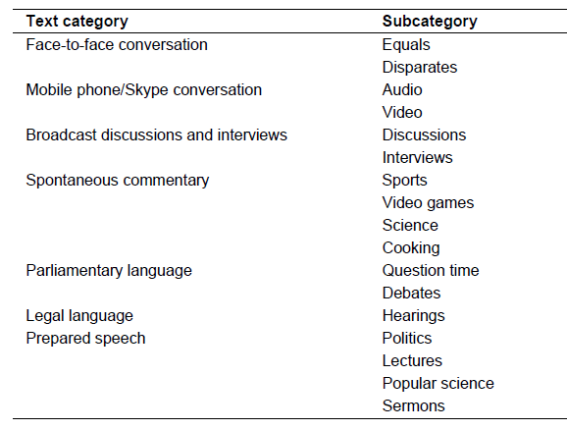
The LLC-2: design
“LLC–2 contains seven broad text categories representing a wide range of speech settings in which people participate in the 21st century, either as speakers or listeners.”
(Pöldvere 2019)
Stratified convenience sample
Range of spoken registers
2014-2019
Compromise between comparability with the LLC-1 and modern representativeness (e.g. landline phone calls replaced with mobile/Skype calls)
500,000 words

Slide 13
What does the Spoken BNC2014 represent?

Slide 14
The Spoken BNC2014
Conversational, L1 British English
2012-2016
672 speakers
1,251 texts
11,422,617 words
Freely available to the public:
    on Lancaster’s CQPweb
    BNClab
    file download
http://corpora.lancs.ac.uk/bnc2014/

Slide 15
Target domain representativeness
(Love 2020)

Slide 16

Linguistic representativeness
Randomly divided corpus into 10 roughly equal parts
Frequency of eight major POS categories (85.5% of all tokens)
Tolerable deviation of +/- 5% from mean (Biber 1993)
POS category | mean (%) | standard deviation | normalised deviation (%)
adjective | 3.97 | 0.04 | 0.98
adverb | 10.07 | 0.15 | 1.50
determiner | 9.68 | 0.07 | 0.68
interjection | 6.22 | 0.17 | 2.72
noun | 11.84 | 0.16 | 1.33
preposition | 5.86 | 0.07 | 1.28
pronoun | 14.89 | 0.13 | 0.85
verb | 22.97 | 0.17 | 0.72
Frequency is stable across the 10 parts
(Love 2020)

Slide 17
What does it represent?
Revised target domain:
“The Spoken BNC2014 represents informal spoken English, produced by L1 speakers of British English, in England, in the mid-2010s.”
(Love 2020)
Within England, it represents a spread of demographics including gender, age, socio-economic status and region
Comparable in terms of register to the Spoken BNC1994 (demo. sampled)

Slide 18

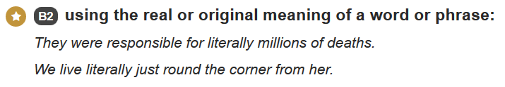
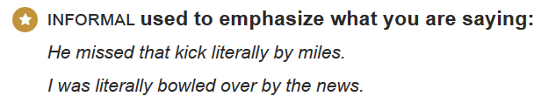
Recent change: the case of literally
(Curry, Love & Goodman in prep)

Slide 19
Indirect corpus applications in ELT
One application of spoken corpora – language teaching
Nowadays it is commonplace for materials for language learning to be corpus informed
Recent change in spoken English – comparing to the Spoken BNC1994 – to inform the development of their ELT materials, including English course books, exam preparation materials and grammar references
Case study: adverbs
Owing to current research on their value for ELT learners (e.g. Pérez-Paredes & Mark, forthcoming)

Slide 20
Recent change in adverb use
(Curry, Love & Goodman in prep)

Slide 21
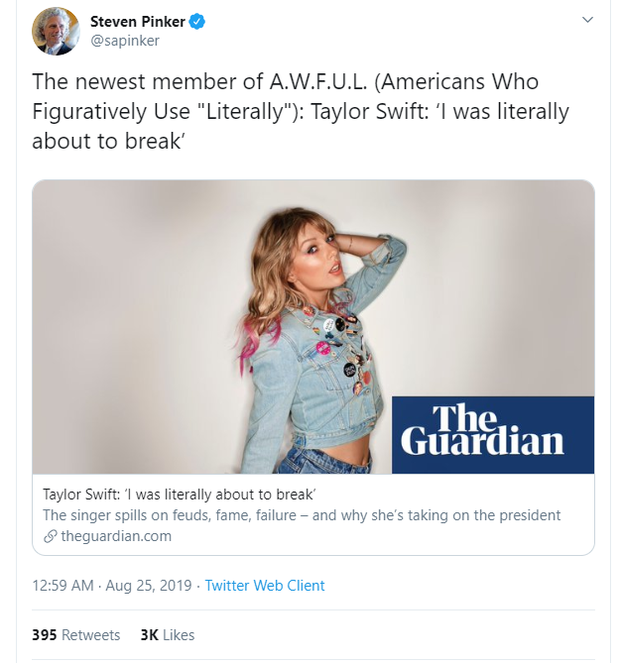
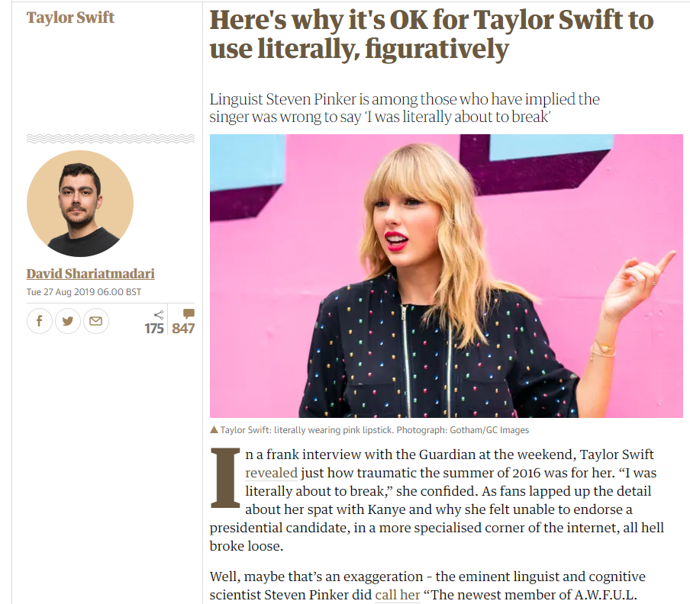
literally in the news

Slide 22
literally
Use of literally has increased from 19 per million in the 1990s to nearly 200 per million in the 2010s
Competition between two main usages
literal
we were literally getting into the car and it was about half past seven
metaphorical/figurative
oh I literally haven’t moved all day
metaphorical literally is more than twice as common now as it was in the 1990s

Slide 23
literally
(Curry, Love & Goodman in prep)

Slide 24
Response from materials writers
Based on the analysis, we have evidence of notable language change at the level of adverb use in casual spoken English. This change occurs not only in frequency, but also in syntax and function
This evidence has surprised materials writers, challenged preconceptions and has changed the representation of language in materials in a number of ways
According to experts in materials writing and teacher training, overall, corpora are effective and useful in dispelling myths, guiding choices and empowering teachers and learners with real language use
However, they stress the importance of taking a critical approach to using the data
(Curry, Love & Goodman in prep)

Slide 25
Conclusions

Slide 26
Conclusions
BNC2014: a contribution to corpus linguistics and beyond
Deficiencies in corpus design are too often overlooked
It is important to be honest, critical and realistic about design issues such as representativeness
We have aimed to maximize efficiency and quality of corpus construction in view of practical constraints
There is no one ‘right’ way to do this – corpus construction is a process of compromise
Process is justified and transparent, including weaknesses
The corpus can be used to look at recent change in spoken English, and this is already starting to inform ELT materials

Slide 27
Thank you
http://corpora.lancs.ac.uk/bnc2014/
@lovermob
r.love@leeds.ac.uk

Slide 28
References
Biber, D. (1993). Representativeness in corpus design. Literary and Linguistic Computing, 8(4), 243-257.
Curry, N., Love, R., & Goodman, O. Keeping up with language change: Using the Spoken BNC2014 in ELT materials development.
Leech, G. (1993). 100 million words of English. English Today, 9-15. DOI: 10.1017/S0266078400006854
Leech, G. (2007). New resources, or just better old ones? The Holy Grail of representativeness. In: Corpus Linguistics and the Web. Rodopi, Amsterdam, pp. 133-149.
Love, R. (2020). Overcoming challenges in corpus construction: the Spoken British National Corpus 2014. New York: Routledge.
Love, R., Dembry, C., Hardie, A., Brezina, V., & McEnery, T. (2017). The Spoken BNC2014: Designing and building a spoken corpus of everyday conversations. International Journal of Corpus Linguistics, 22(3), 319-344.
Pérez-Paredes, P. and Mark, G. (forthcoming) Adverbs in spoken language: a corpus-based analysis of learner and native-speaker language and its pedagogical implications. Studies in Corpus Linguistics series. Amsterdam: John Benjamins.
Phillips, J.C. & Egbert, J. (2018). Advancing law and corpus linguistics: Importing principles and practices from survey and content-analysis methodologies to improve corpus design and analysis. Brigham Young University Law Review, 2017(6), 101-131.
Pöldvere, N. (2019). What's in a dialogue? On the dynamics of meaning-making in English conversation. Lund: Media-Tryck, Lund University, Sweden.

