Slide 1


Fuck yeah! Swearing in spoken
British English
Dr Robbie Love
Research Fellow in Applied and Corpus Linguistics
School of Education
University of Leeds
r.love@leeds.ac.uk
lovermob

Slide 2
Plan of action
Part 1: Swearing in spoken British English
Why bad language?
So…do we swear more now?
The interesting case of FUCK
Part 2: My academic story so far
Studying at Lancaster
Commercial research in Cambridge
Academic research at Leeds
Top tips!

Slide 3
FUCK

Slide 4
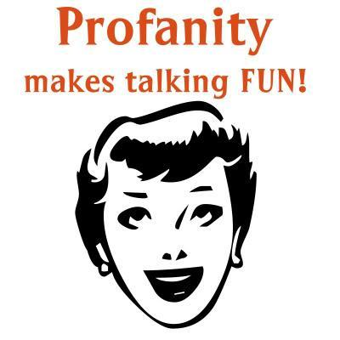
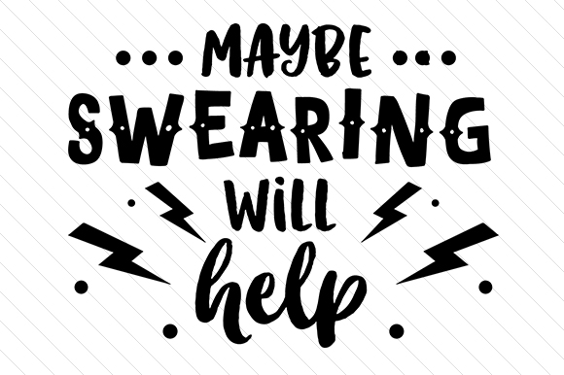
Bad language

Slide 5
Bad language
Swearing is fascinating…a “marker of distinction” between social groups (McEnery 2005: 24)
“a rich emotional, psychological, and sociocultural phenomenon” (Jay 2009: 153)
More psychologically arousing (Janschewitz 2008)
More memorable (Jay et al. 2008)
More stressful to produce (Bowers & Pleydell-Pearce 2011)

Slide 6
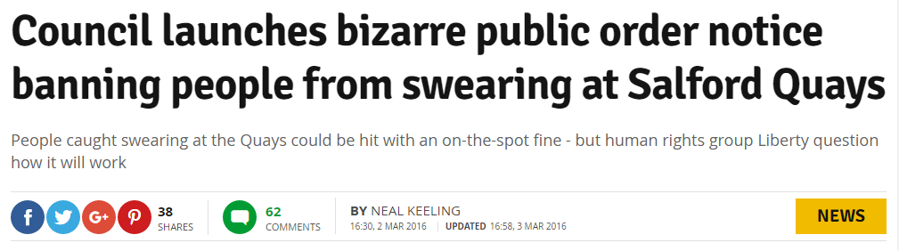
Bad language
People care about it – one way or another
e.g. links to anti-social behaviour

Slide 7
Bad language
McEnery (2005):
Bad language words = BLWs
  swear words, always taboo
  cunt, fuck, shit, twat
  words which are not inherently taboo but can be used to offend
  tart, pig, god, gay
But just how many bad language words are there? Take a guess…

Slide 8
Research questions
1. How does the overall frequency of BLW occurrence differ between the 1990s and 2010s?
2. How does the distribution of BLW strength differ between the 1990s and 2010s?
3. How does the social distribution of BLWs differ between the 1990s and 2010s?

Slide 9
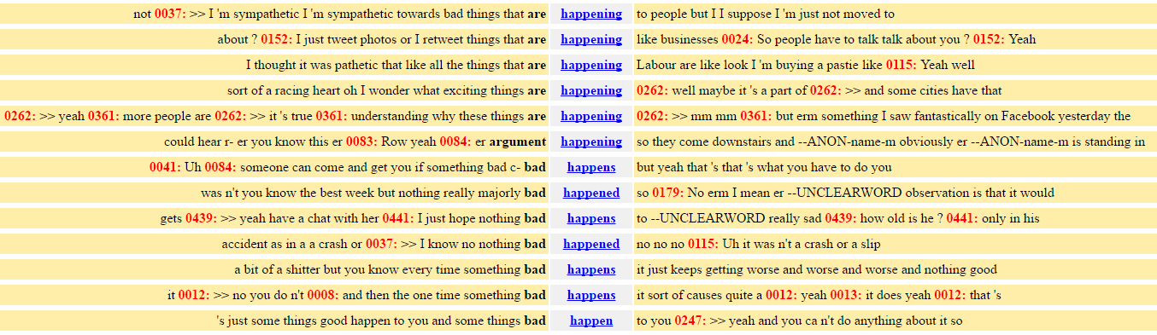
Method – corpus linguistics
Computer-assisted methods for the analysis of (usually large amounts of) language data
‘Corpus’ = body of texts under investigation
Unearthing patterns impossible to detect manually

Slide 10

Data
BNC (XML edition) – CQPweb
Spoken BNC1994DS (demographically-sampled)
5,014,655 tokens
1408 speakers of British English
153 texts
Date range: 1985-1993

Slide 11

Data
Spoken BNC2014
 | Spoken BNC2014
Tokens | 11,422,622
Speakers | 627
Texts | 1,251
Date range | 2012-2016

Slide 12
How many bad language words?
Over 150 BLWs, drawn from:
McEnery (2005)
ARSE, ARSEHOLE, BALLS, BASTARD, BIRD, BITCH, BLOODY, BOLLOCKS, BUGGER, CHRIST, COW, CRAP, CUNT, DAMN, DICKHEAD, FUCK, GAY, GIT, GOD, HELL, HUSSY, IDIOT, JESUS, JEW, MORON, MOTHERFUCKER, NIGGER, PAKI, PIG, PILLOCK, PISS, PISSED OFF, POOFTER, PRICK, SCREW, SHAG, SHIT, SLAG, SLUT, SOD, SON-OF-A-BITCH, SPASTIC, TART, TIT, TITS, TOSSER, TWAT, WANKER, WHORE
Ofcom (2016)
BATTY BOY, BEAVER, BEEF CURTAINS, BELLEND, BENDER, BINT, BLOODCLAAT, BONK, BUKKAKE, BULLSHIT, BUM BOY, BUMCLAT, BUMMER, CHI-CHI MAN, CHICK WITH A DICK, CHINKY, CHOC ICE, CLUNGE, COCK, COCKSUCKER, COFFIN DODGER, COLOURED, COON, CRETIN, CRIPPLE, DAGO, DARKY, DICK, DILDO, DIV, DYKE, FAGGOT, FAIRY, FANNY, FECK/EFFING, FENIAN, FLAPS, FOP (FUCKING OLD PERSON) , FUDGE-PACKER, GASH, GENDER BENDER, GINGER, GIPPO, GODDAM, GOLLIWOG, GOOK, HE-SHE, HO, HOMO, HONKY, HUN, JAP, JESUS CHRIST, JIZZ, JOCK, KAFIR/KUFAAR, KIKE*, KNOB, KRAUT, LEZZA/LESBO, LOONY, MENTAL, MIDGET, MINGE, MINGER, MONG, MUFF DIVER, MUNTER, NANCY, NAZI, NEGRO, NIG-NOG, NONCE, NUTTER, OLD BAG, PANSY, PAPIST, PIKEY, PISSED / PISSED OFF, POLACK, POOF, PRICKTEASER, PROD, PSYCHO, PUNANI, PUSSY, QUEER, RAGHEAD, RAPEY, RETARD, RUGMUNCHER/ CARPETMUNCHER, SAMBO, SCHIZO, SHIRT LIFTER, SKANK, SLAPPER, SLOPE, SNATCH, SOD-OFF, SON OF A BITCH, SPADE, SPASTIC/SPAKKA/SPAZ, SPECIAL, SPIC, TAFF, TAIG, TRANNY, VEGETABLE, WINDOW LICKER, WOG, WOP
Lutsky & Kehoe (2015)
BIMBO, BOLLOCK, BOOB, BUTT, CHAV, DORK, DOUCHE, DUMB, FAG, FART, FATASS, FFS, IMBECILE, JEEZ, JERK, OMG, PIMP, PRAT, SONOFABITCH, SUCK, SWINE, TURD, WANK, WTF, WUSS

Slide 13
Overall frequency
1990s: 3,433 per million
2010s: 2,862 per million
Some BLWs = zero in both corpora:
BATTY BOY, BEEF CURTAIN, BLOODCLAAT, BUKKAKE, BUM BOY, BUMCLAT, CHI-CHI MAN, CHICK WITH A DICK, COCKSUCKER, COFFIN DODGER, DAGO, FATASS, FFS, FOP, KAFIR/KUFAAR, KIKE, LEZZA/LESBO, MUFF DIVER, POLACK, PRICKTEASE, PUNANI, RAGMUNCHER/CARPETMUNCHER, SHIRT LIFTER, SPIC, TAIG, WINDOW LICKER, WTF

Slide 14
Strength

Slide 15
Strength
FUCK
Considered ‘strongest’ (Ofcom 2016), in the company of only 15 other BLWs including CUNT, FAGGOT, GOLLIWOG, MOTHERFUCKER, NIGGER, RETARD, SPASTIC
BUT
2nd most frequent BLW in both corpora
  Behind BLOODY (1990s)
  Behind GOD (2010s)

Slide 16
FUCK

Slide 17
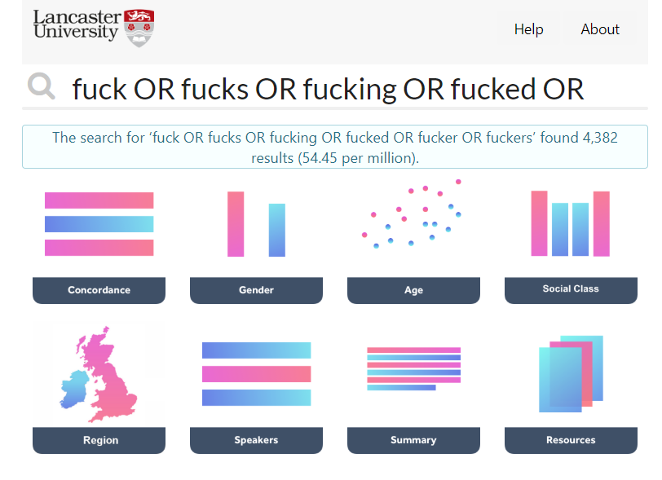
FUCK: sociolinguistic distribution
BNClab (Brezina et al. 2018)

Slide 18
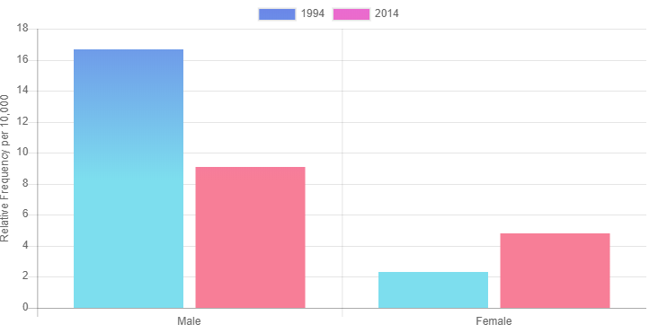
FUCK: gender

Slide 19
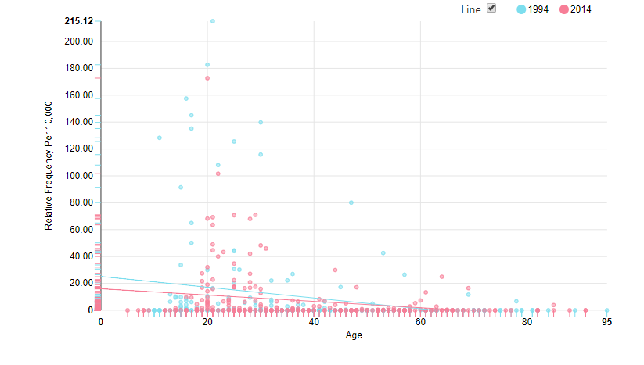
FUCK: age

Slide 20
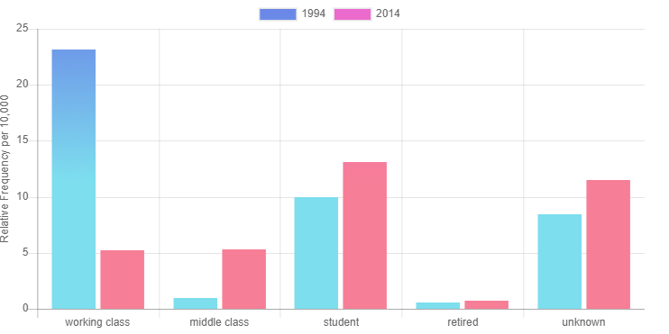
FUCK: socio-economic status

Slide 21
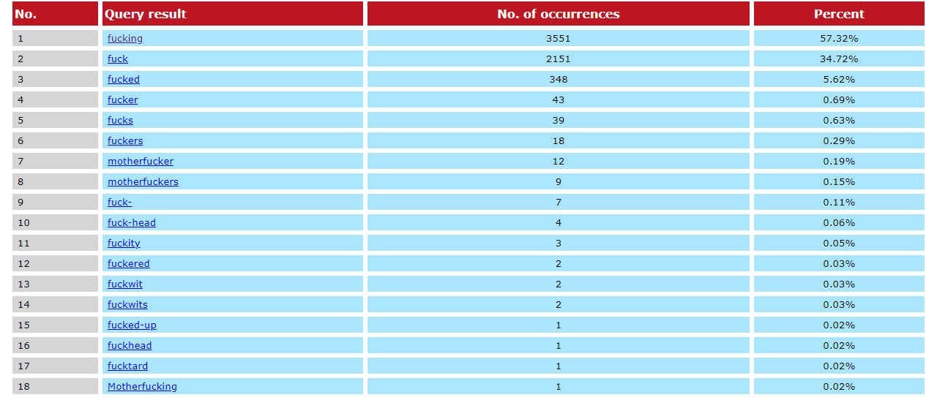
FUCK: forms

Slide 22
FUCK: functions
The intensifier fucking was, and is, the most common
Emphasise an entire clause (EmphAdv) = 24%
  I don’t fucking believe this
  she can get hold of her mum so she can fucking talk to us
  but I was like are you fucking joking
  I do n't fucking spend much money
  he 's fucking got them on like odd ones as well like at least fucking put a pair on
  it fucking drives me up the wall

Slide 23
FUCK: functions
Negative intensification (PremNeg) = 14%
  the fucking twat
  it 's fucking expensive in there

Slide 24
FUCK: functions
Positive intensification (AdvB) = 12%
  fucking awesome
  you walk in through there and it 's just fucking massive
  that 's fucking still good

Slide 25
FUCK: functions
Two functions have notably risen; namely cursing (fuck that) and the predicative negative adjective (he got absolutely fucked)
Literal meaning – sex – among the least frequent = 0.7%
he 's a dick he 'll bang someone and then just think oh that 's it I fucked her
I would fuck her I would totally fuck her she 's fit

Slide 26

Fuck yeah!

Slide 27
Fuck yeah!
S0192: where are the cigarettes ?
S0198: er that 's your department I think
S0192: >> it 's Drum
S0198: yeah what how many grams is it ?
S0192: it 's not the best tobacco
S0198: how many grams is it ?
S0192: it 's a fifty gram pouch
S0198: oh
S0192: so it 's going to last a while
S0198: oh how much was that ? oh it 's our pouch
S0192: yeah of course
S0198: oh fuck yeah awesome
S0192: yeah

Slide 28
Bad language: conclusions
BLW use significantly lower in 2010s vs 1990s
FUCK is much more common than expected given it is rated so strongly
fucking is by far the most common & versatile form of FUCK
people swear frequently and in a wide range of contexts
bad language performs a range of functions in language and social interaction
‘bad language’ is anything but bad!

Slide 29
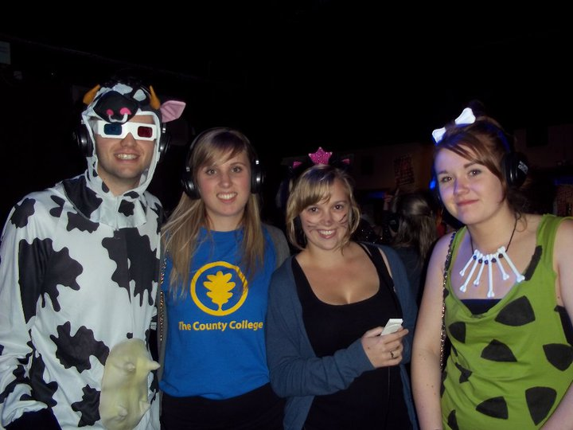
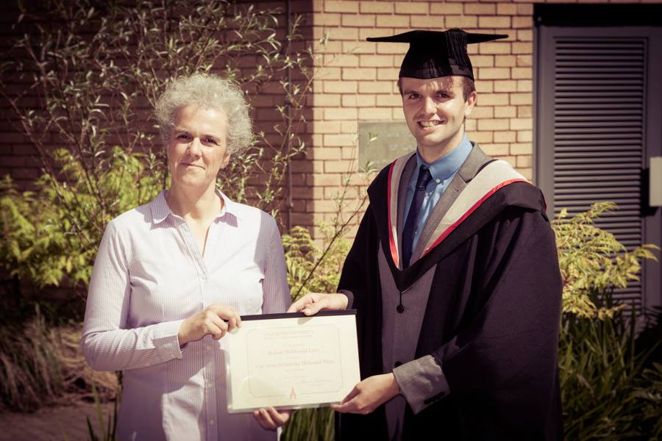
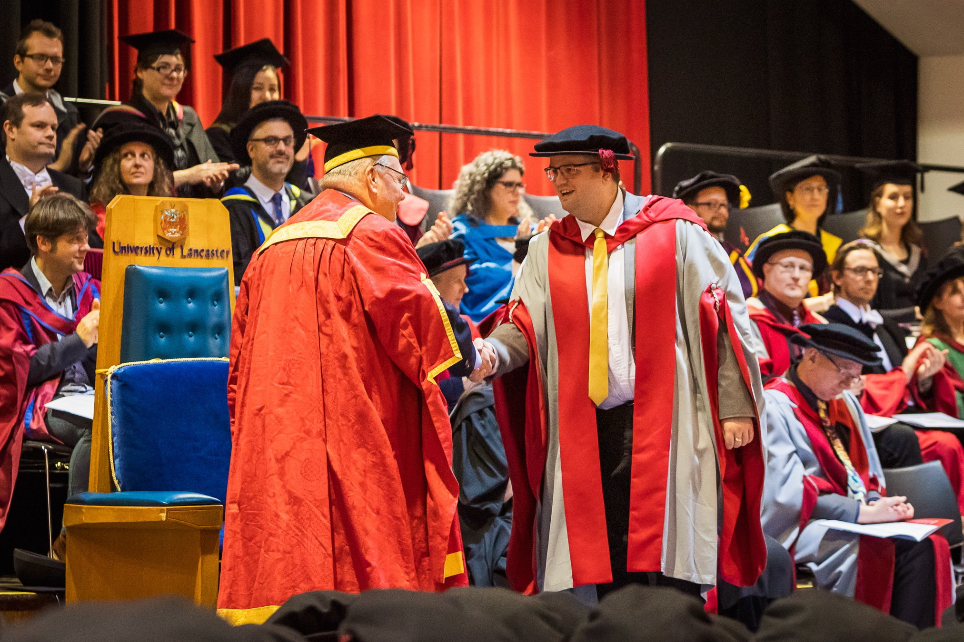
Part 2:
My academic story so far

Slide 30

2010-2013: Lancaster
BA (Hons) Linguistics

Slide 31

2013-2017: Lancaster
MA Language and Linguistics
PhD Linguistics

Slide 32

My PhD: the BNC2014 project

Slide 33


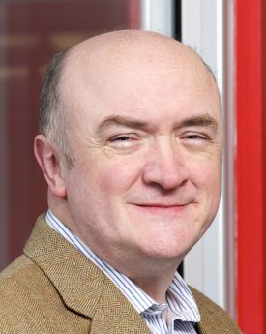
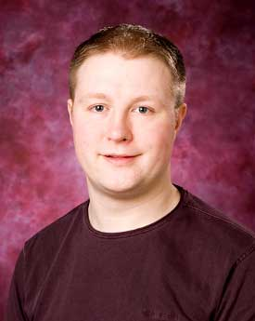
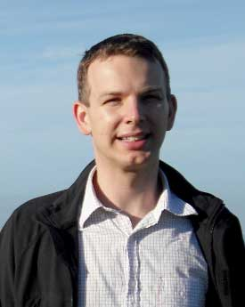

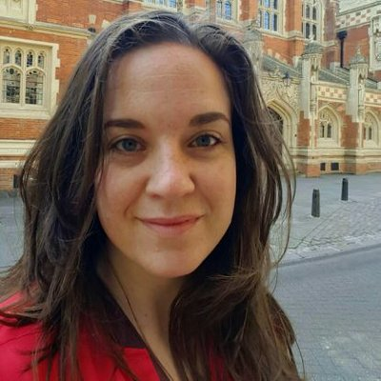

The Spoken BNC2014 team
Robbie
Love
Tony
McEnery
Andrew
Hardie
Vaclav
Brezina
Claire
Dembry
Olivia
Goodman

Slide 34
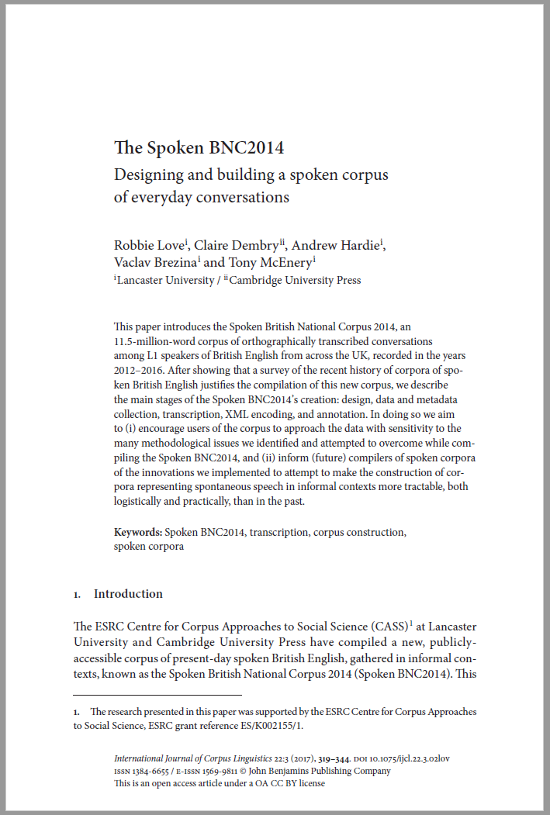








Building the Spoken BNC2014
SPOKEN
Existing corpora
Design
Representativeness
Target population
Sampling goals
Who is it for?
What do people want?
What have people done?
Finding participants
Recording equipment
Metadata collection
Automated? Manual?
Conventions
Accuracy
XML conversion
Annotation
Tool development
User guide
Website
Publications
What have we got?
Representativeness
Pilot research
Data collection
Transcription
Processing
Review
Document
Release

Slide 35
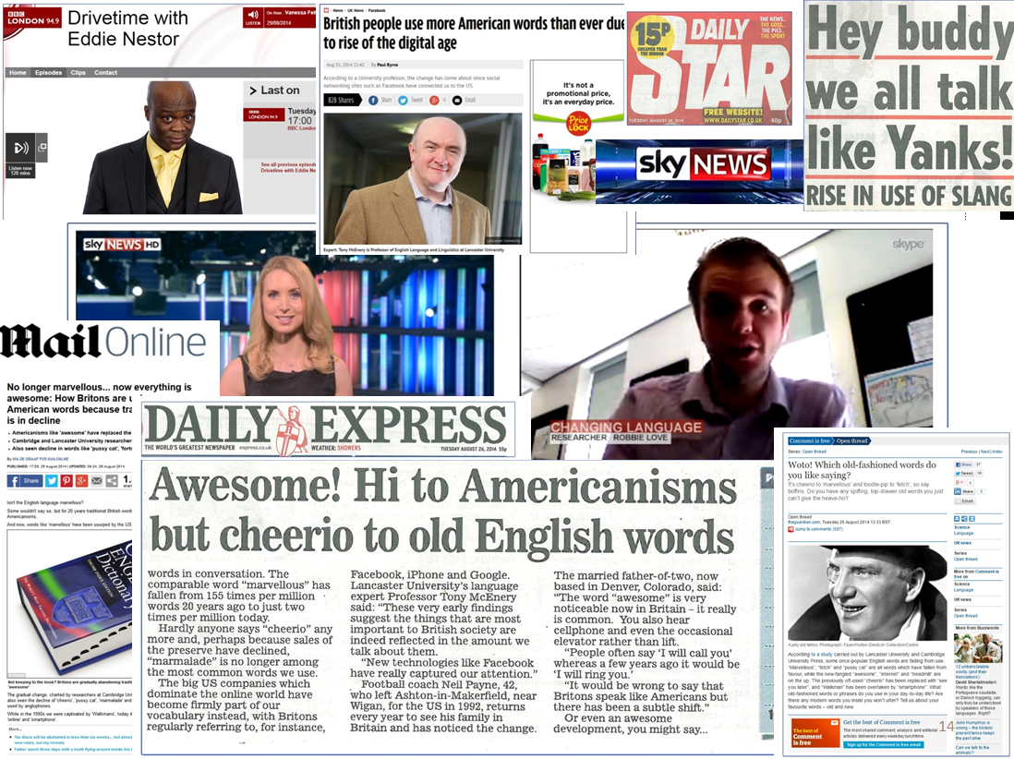
Engaging with the media

Slide 36
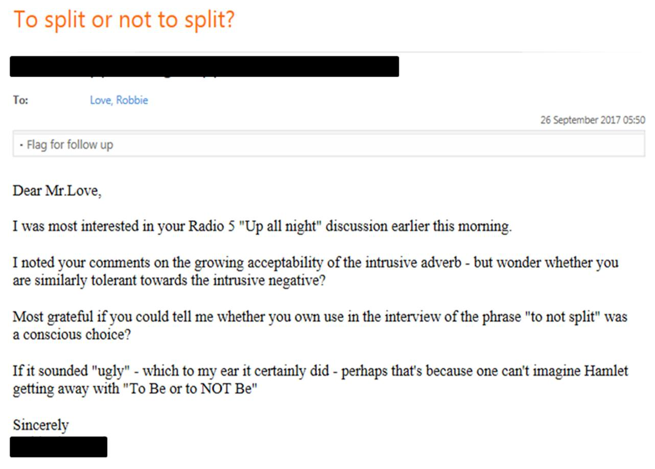
Prescriptive audiences
Some people think I am:
announcing the death of the English language
actively promoting the changes I am reporting

Slide 37
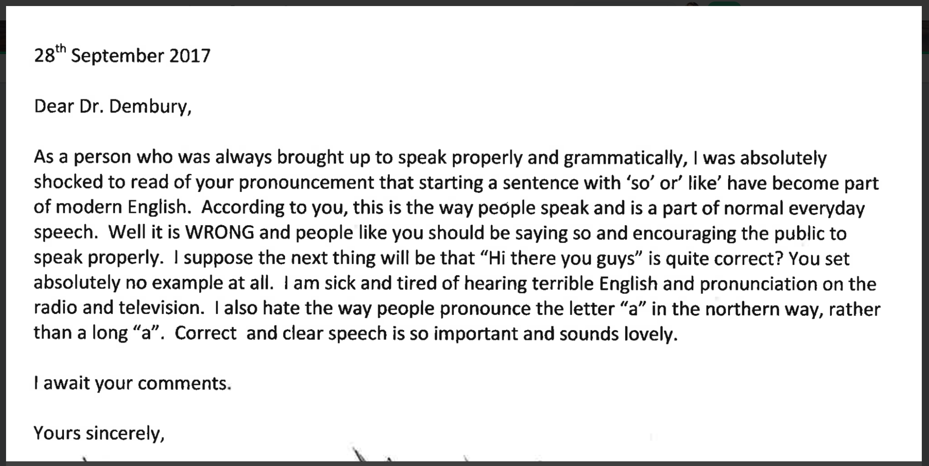
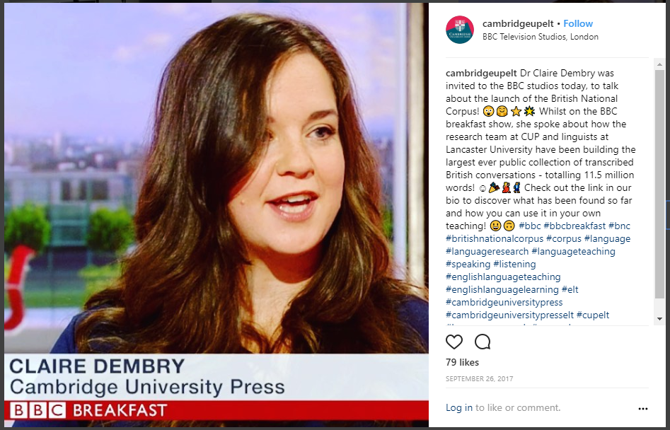
Prescriptive audiences

Slide 38
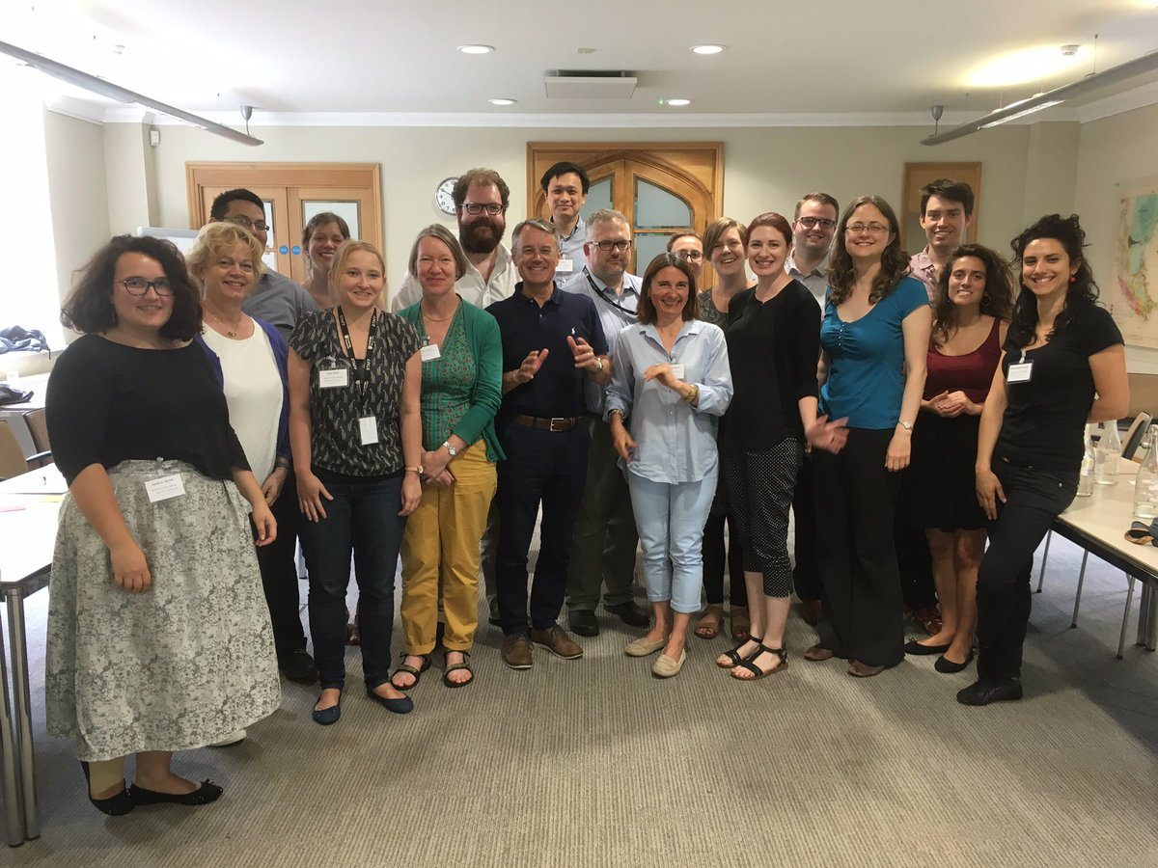

2017-2018: Cambridge
Senior Research Manager at Cambridge Assessment English

Slide 39

2018-present: Leeds
Research Fellow in Applied and Corpus Linguistics at the University of Leeds

Slide 40
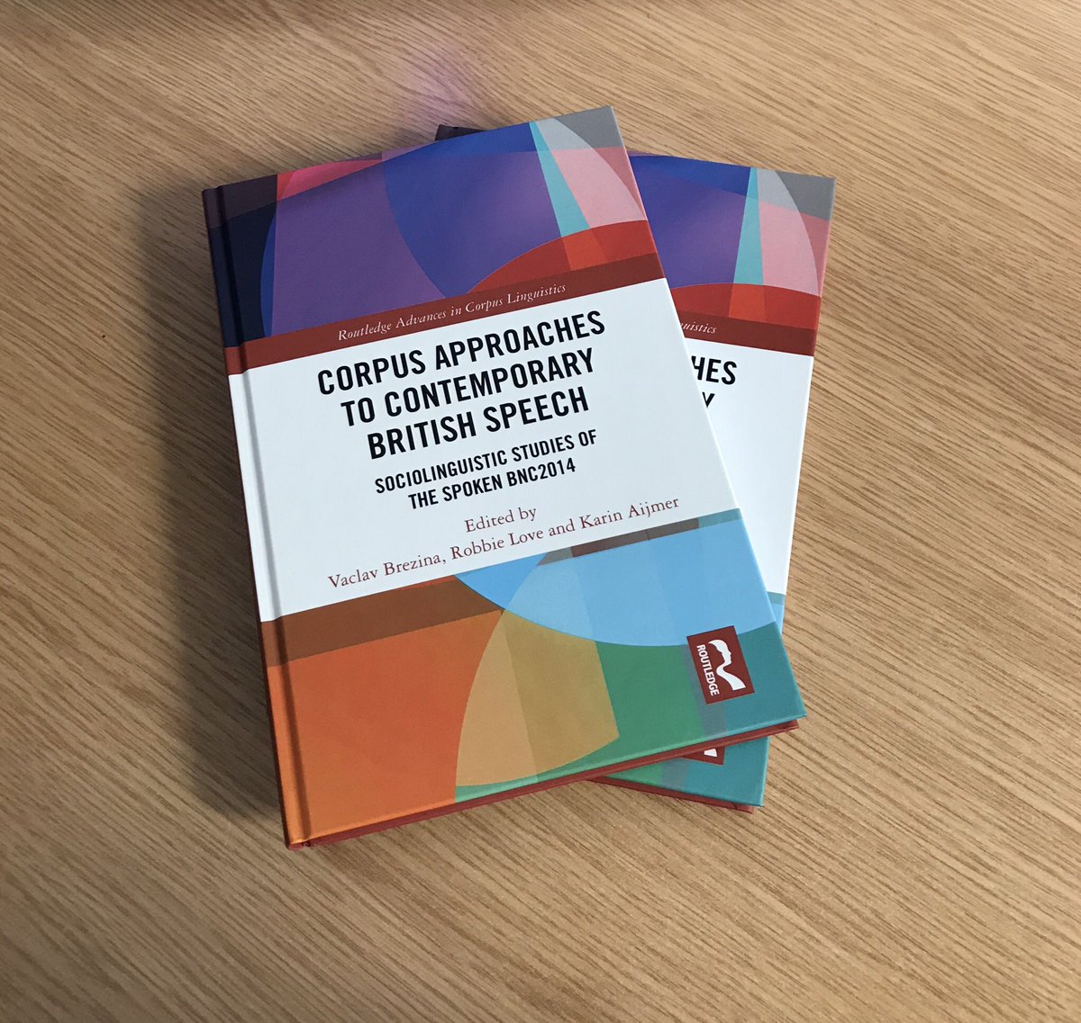
Opportunities I’ve had
Publish research
  Journal articles, edited books, a monograph
  swearing…LGBT rights…corpus linguistics…education…discourse analysis
Attend and present at amazing conferences
Learn from incredible colleagues and mentors
Teach UG and PG students
Travel! Where has my work taken me…
  Denmark, France, Germany, Poland, Czech Republic, USA, China, Hong Kong, Japan, Thailand, Malta, Georgia…

Slide 41
Top tips for LAEL undergrads
Success for LAEL undergrads from a successful LAEL undergrad
Increase your luck by working hard
Read…lots!
Read feedback on assignments and act on it in future
Use the day fully
Organise your study, especially when it’s dissertation time
Organise your exam revision
Most importantly, don’t sacrifice your social life and the opportunities being a student affords

Slide 42
Top tips for postgrad study
Seek funding from anywhere that may offer it
If you’re not sure what to specialise in:
  do an MA first – this may help you decide
If you want to stay at Lancaster:
  Speak to staff about research they want to supervise at PhD level
  Be prepared to see your lecturers more as colleagues
Be prepared to commit to an idea for several years
But don’t imagine that it has to become your entire life…
Be prepared to get things wrong and learn from mistakes
Be prepared to feel like everyone around you knows what they are doing and you don’t

Slide 43
Thank you
r.love@leeds.ac.uk
@lovermob

