Slide 1



The Spoken BNC2014: design, compilation and…bad language
Robbie Love
Lancaster University / Cambridge English
r.m.love@lancaster.ac.uk
@lovermob

Slide 2
Today’s talk
Background – the first BNC
Why build a new Spoken BNC?
Data collection
Metadata
Transcription
Case study: bad language
Forthcoming publications
Summary

Slide 3
Centre for Corpus Approaches to Social Science
Facilitating the uptake of corpus techniques in the social sciences:
Healthcare, aviation, climate change, immigration, translation, online aggression, distressed communities, genetically modified food, hate speech, language disorders, poverty, religion, history, learner language, language change, corporate communication…
All of this work requires DATA

Slide 4
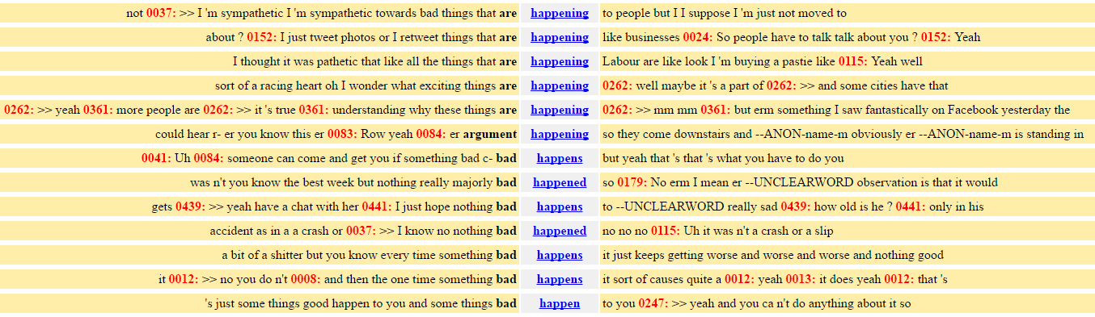
Corpus linguistics
Computer-assisted methods for the analysis of (usually large amounts of) language data
‘Corpus’ = body of texts under investigation
Unearthing patterns impossible to detect manually

Slide 5
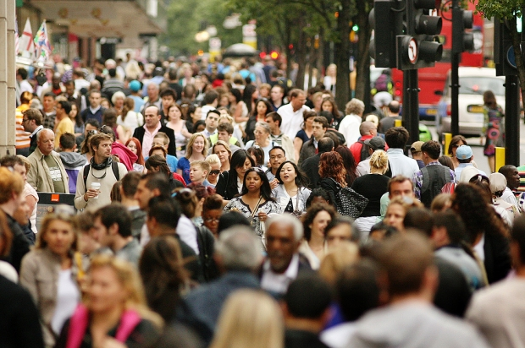
Language is everywhere

Slide 6

Language is everywhere

Slide 7

Language is everywhere

Slide 8

British National Corpus
“a corpus of 100 million words of written texts and spoken transcriptions of modern British English, to be stored on the computer in machine-readable form”
Leech (1993: 9)

Slide 9


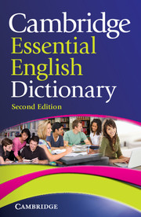
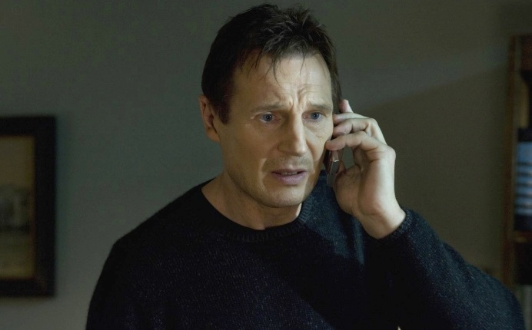

British National Corpus

Slide 10

Why build a new Spoken BNC?

Slide 11
Why build a new Spoken BNC?
The Spoken BNC1994 is getting old
Can no longer be used as a proxy for present day British English
Nothing since the Spoken BNC1994:
- orthographically transcribed
- large size
- general coverage of spoken British English
- (low or no cost) public access

Slide 12
Why make a new one now?
Language has very likely changed during this time – lexical innovations, perhaps grammatical change etc.
Two decade comparison (1990s-2010s) never been done before
Build towards a set of sampling points for diachronic analysis of spoken British English

Slide 13
Why make a new one? ELT perspective
What we teach vs. what we do
What are we talking about?
Speaking and ELT teaching
Notes:
What we teach vs. what we do – e.g. oughtn’t too; mustn’t; sentence medial restrictive relative clauses (my brother, who is a teacher, likes cheese). All things we teach regularly in ELT books, but things we never say – I think this needs to change, but to do this we need evidence
What are we talking about? – topics for elt. Motivation and learning
Speaking and ELT teaching – the paradox: learners measure progress through speaking, but teaching speaking is difficult

Slide 14
The Spoken BNC2014
Lancaster University + Cambridge University Press
Both parties
Plan & design
Encourage participation – media campaigns
Disseminate information
Fund project equally
CUP – Claire Dembry
Corresponds with contributors
Collects & transcribes recordings
Lancaster – Robbie Love, Andrew Hardie, Vaclav Brezina, Tony McEnery
Documents the compilation of the corpus
Carries out methodological investigations
Converts transcripts to XML, encoding
Annotates corpus
Initial analysis
Prepares for public release/hosts corpus

Slide 15

The corpus
1,000 hours of recordings (1,300 recordings)
More than 650 unique speakers
More than 11 million words

Slide 16
Data collection

Slide 17
Getting started & scaling up
How can we recruit & motivate participants?
Money!
How can we gather good quality recordings?
Smartphones!
How can we gather good quality metadata?
Condition of payment; careful data management

Slide 18
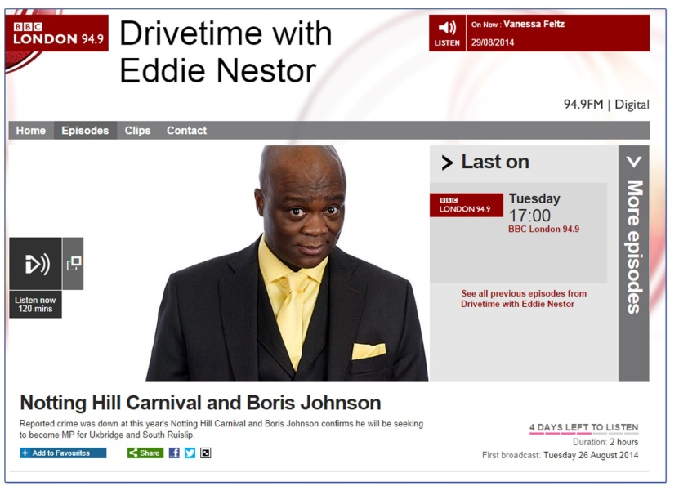
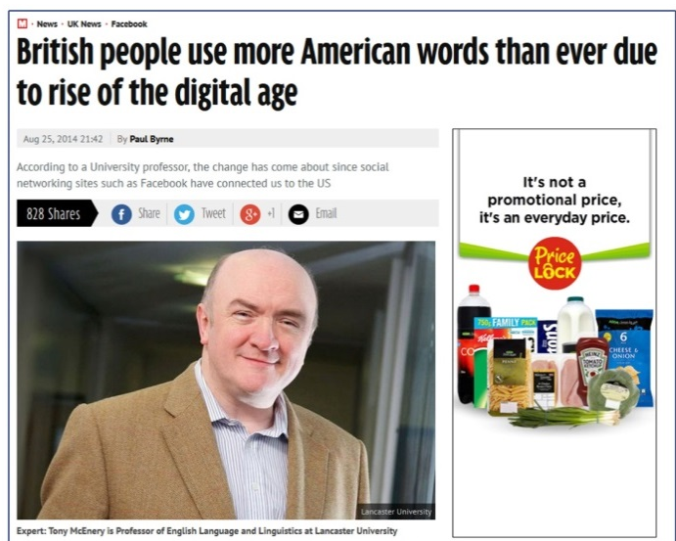
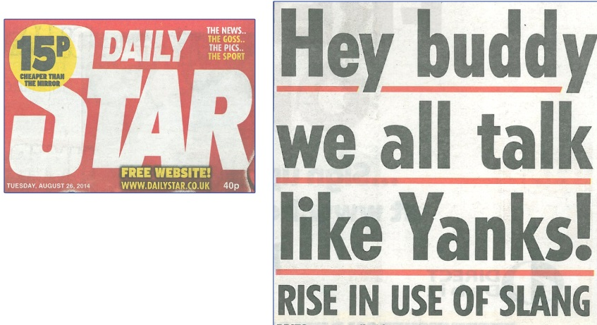
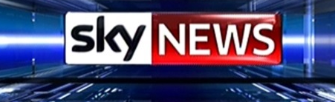

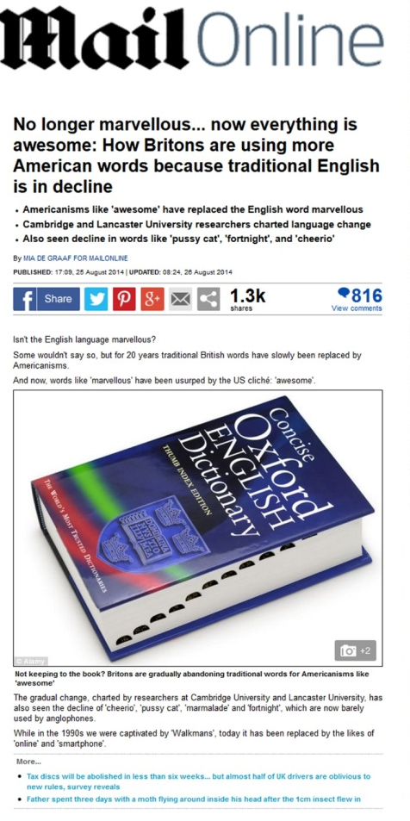
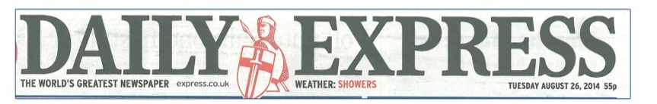
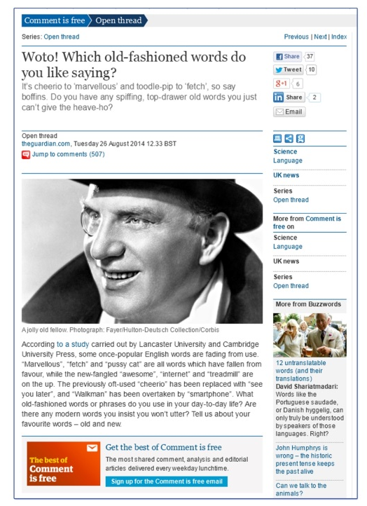
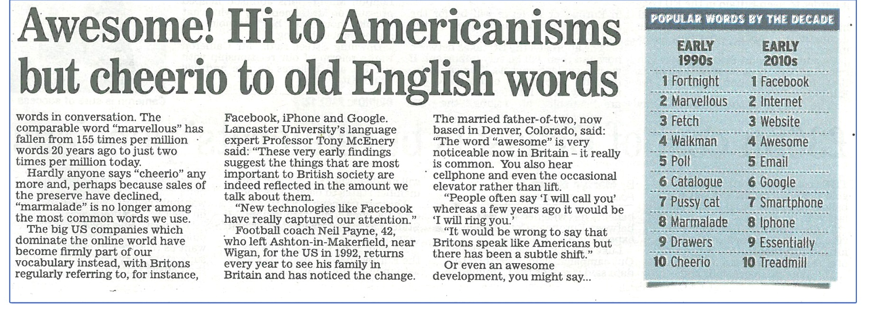
@lovermob
@lovermob
18

Slide 19
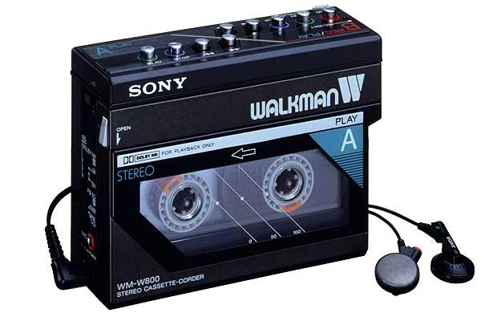
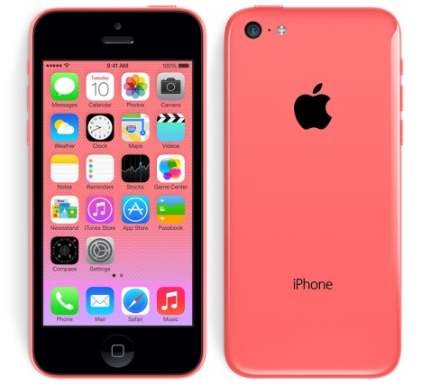


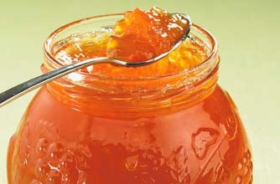



Slide 20
Recordings
 | Spoken BNC1994 | Spoken BNC2014
Interaction type | Demographic (40%); Context-governed (60%) | Demographic (100%)
Who? | “Carefully sampled individuals” (Leech 1993:6) | Open call for participation; Some targeting
How? | Tape recorders | Smartphone MP3 recordings
What? | All interactions in a given period | Conversations; some task-based interactions.
When? | Continuously over a 2-7 day period | As determined by participant
How many speakers? | 124 adults making recordings Over 1000 speakers | 700 unique speakers
Total data | ~10m words | 11+m

Slide 21
Metadata
 | Spoken BNC 1994 | Spoken BNC 2014
Speaker | Age Gender Education Occupation Accent/dialect Socio-economic category | Age Gender Education Occupation Accent/dialect Birthplace Linguistic origin Where do you currently live? How long have you lived there? Nationality Do you speak other languages?
Recording | Title Date Recording location | Title Date File name Recording length Recording location Speaker relationship Topics covered

Slide 22
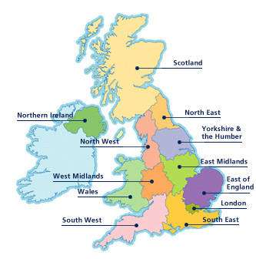
Metadata issues
Accent/dialect -> region
Occupation -> socio-economic status

Slide 23
Region
What is region anyway? What are we trying to represent here?
Birthplace?
Recording location?
Location of current residence?
Location during acquisition?

Slide 24
Region
Purely objective metadata seems insufficient
Subjective metadata offers an imperfect solution:
Self-reported dialect
British Library’s Evolving English WordBank (2011)
E.g. “Geordie” = north east England

Slide 25
Self-reported dialect categorisation
Central midlands, north-east midlands, midlands, south midlands, north-west midlands…
“southern”
“normal with a brummy twang”
“mixed northern/somerset/rp”

Slide 26
Dialect categorisation
Office for National Statistics’ scheme:
Nomenclature of Territorial Units for Statistics (NUTS)
Used in the census
(1) North East
(2) North West
(3) Merseyside
(4) Yorkshire & Humberside
(5) East Midlands
(6) West Midlands
(7) Eastern
(8) London
(9) South East
(10) South West
(11) Wales
(12) Scotland
(13) Northern Ireland

Slide 27
Dialect in the Spoken BNC2014
(1) Global | (2) Country | (3) Supra-region | (4) Region
UK | England | North | North East
 |  |  | Yorkshire & Humberside
 |  |  | North West (not Merseyside)
 |  |  | Merseyside
 |  | Midlands | East Midlands
 |  |  | West Midlands
 |  | South | Eastern
 |  |  | South West
 |  |  | South East (not London)
 |  |  | London
 | Scotland | Scotland | Scotland
 | Wales | Wales | Wales
 | Northern Ireland | Northern Ireland | Northern Ireland
Non-UK | Republic of Ireland | Republic of Ireland | Republic of Ireland
 | Other non-UK variety | Other non-UK variety | Other non-UK variety
Unspecified | Unspecified | Unspecified | Unspecified
Comparable with the Spoken BNC1994 too!

Slide 28
“Geordie”
(1) Global | (2) Country | (3) Supra-region | (4) Region
UK | England | North | North East
 |  |  | Yorkshire & Humberside
 |  |  | North West (not Merseyside)
 |  |  | Merseyside
 |  | Midlands | East Midlands
 |  |  | West Midlands
 |  | South | Eastern
 |  |  | South West
 |  |  | South East (not London)
 |  |  | London
 | Scotland | Scotland | Scotland
 | Wales | Wales | Wales
 | Northern Ireland | Northern Ireland | Northern Ireland
Non-UK | Republic of Ireland | Republic of Ireland | Republic of Ireland
 | Other non-UK variety | Other non-UK variety | Other non-UK variety
Unspecified | Unspecified | Unspecified | Unspecified

Slide 29
“Southern”
(1) Global | (2) Country | (3) Supra-region | (4) Region
UK | England | North | North East
 |  |  | Yorkshire & Humberside
 |  |  | North West (not Merseyside)
 |  |  | Merseyside
 |  | Midlands | East Midlands
 |  |  | West Midlands
 |  | South | Eastern
 |  |  | South West
 |  |  | South East (not London)
 |  |  | London
 | Scotland | Scotland | Scotland
 | Wales | Wales | Wales
 | Northern Ireland | Northern Ireland | Northern Ireland
Non-UK | Republic of Ireland | Republic of Ireland | Republic of Ireland
 | Other non-UK variety | Other non-UK variety | Other non-UK variety
Unspecified | Unspecified | Unspecified | Unspecified

Slide 30
Evaluating this approach
Montgomery (2012) – we aren’t very good at judging dialect boundaries reliably – perceptual dialectology
  One speaker’s “southern” might be another speaker’s “midlands”
Requires some inference – i.e. a subjective metadata set
Contradictions in speaker reports
But…
More reliable method than BNC1994 – speak for yourself!
The best we can get for a top-down scheme

Slide 31
Socio-economic status
BNC1994: Social Grade
Code | Description
A | Higher managerial, administrative and professional
B | Intermediate managerial, administrative and professional
C1 | Supervisory, clerical and junior managerial, administrative and professional
C2 | Skilled manual workers
D | Semi-skilled and unskilled manual workers
E | State pensioners, casual and lowest grade workers, unemployed with state benefits only

Slide 32
NS-SEC
Class | Analytic class
1 | Higher managerial, administrative and professional occupations
1.1 | Large employers and higher managerial and administrative occupations
1.2 | Higher professional occupations
2 | Lower managerial, administrative and professional occupations
3 | Intermediate occupations
4 | Small employers and own account workers
5 | Lower supervisory and technical occupations
6 | Semi-routine occupations
7 | Routine occupations
8 | Never worked and long-term unemployed
* | Students/unclassifiable

Slide 33
Mapping NS-SEC onto Social Grade
NS-SEC | Description | MAPS ON TO… | SG | Description
1 | Higher managerial, administrative and professional occupations |  | A | Higher managerial, administrative and professional
1.1 | Large employers and higher managerial and administrative occupations
1.2 | Higher professional occupations
2 | Lower managerial, administrative and professional occupations |  | B | Intermediate managerial, administrative and professional
3 | Intermediate occupations |  | C1 | Supervisory, clerical and junior managerial, administrative and professional
4 | Small employers and own account workers
5 | Lower supervisory and technical occupations |  | C2 | Skilled manual workers
6 | Semi-routine occupations |  | D | Semi-skilled and unskilled manual workers
7 | Routine occupations
8 | Never worked and long-term unemployed |  | E | State pensioners, casual and lowest grade workers, unemployed with state benefits only
* | Students/unclassifiable

Slide 34



Transcription

Slide 35
Why not simply reuse the original transcription scheme?
Crowdy (1994) “Spoken Corpus Transcription”
Generally, it’s pretty good, but:
16 features identified in the 1,900 word scheme – very few examples
Not enough clarity in some areas, leading to ambiguity

Slide 36
Why not simply reuse the original?
EXAMPLE
using full stops and commas to “approximate to use in written text”, but also indicating pauses with ellipses
<2> I think it’s always, deceptive on days like this because its, overcast and [er]
[…]
<2> But, but er, he’s…just broken away from his girlfriend and [<unclear>]
<1> [Oh has] he, oh. Well he seemed happy enough when he called.
Crowdy (1994: 28)

Slide 37
Resulting scheme
From 1,900 words to 5,000 words!
Lots of examples
Minimal room for ambiguity = maximal room for inter-rater consistency
Delicate balance sought between
  backwards compatibility, and
  optimal practice
Now available as part of corpus documentation

Slide 38
Transcription process
Audio recording & signed consent forms received
Metadata recorded from consent forms
Audio recording assigned to transcriber
Transcript produced
Check #1: Audio checking
Check #2: Proofreading
Proofread word doc sent to Lancaster

Slide 39
Corpus processing
Word docs -> text
Text -> XML, automatic conversion scripts to (a) translate transcripts into XML, (b) check & correct transcription convention errors
Used “modest” XML (Hardie 2014), a simpler derivative of TEI
Tagged for POS and lemma, CLAWS (Garside & Smith 1997)
Lancaster University’s CQPweb server (Hardie 2012)

Slide 40
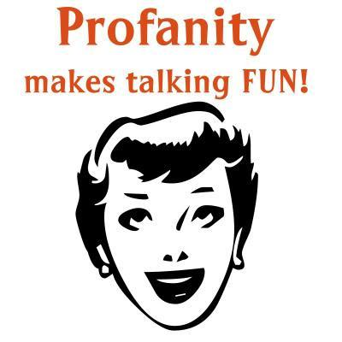

Case study: bad language*
*Contains bad language

Slide 41
Bad language
Swearing is fascinating…a “marker of distinction” between social groups (McEnery 2005: 24)
“a rich emotional, psychological, and sociocultural phenomenon” (Jay 2009: 153)
More psychologically arousing (Janschewitz 2008)
More memorable (Jay et al. 2008)
More stressful to produce (Bowers & Pleydell-Pearce 2011)

Slide 42
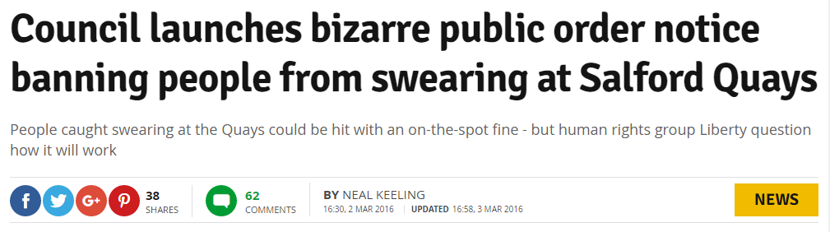
Bad language
People care about it – one way or another
e.g. links to anti-social behaviour

Slide 43
Bad language
McEnery (2005):
Bad language words = BLWs
  swear words, always taboo
  cunt, fuck, shit, twat
  words which are not inherently taboo but can be used to offend
  tart, pig, god, gay

Slide 44
Bad language revisited
Replication of McEnery (2005) on the new data
Over 150 BLWs, drawn from:
McEnery (2005)
ARSE, ARSEHOLE, BALLS, BASTARD, BIRD, BITCH, BLOODY, BOLLOCKS, BUGGER, CHRIST, COW, CRAP, CUNT, DAMN, DICKHEAD, FUCK, GAY, GIT, GOD, HELL, HUSSY, IDIOT, JESUS, JEW, MORON, MOTHERFUCKER, NIGGER, PAKI, PIG, PILLOCK, PISS, PISSED OFF, POOFTER, PRICK, SCREW, SHAG, SHIT, SLAG, SLUT, SOD, SON-OF-A-BITCH, SPASTIC, TART, TIT, TITS, TOSSER, TWAT, WANKER, WHORE
Ofcom (2016)
BATTY BOY, BEAVER, BEEF CURTAINS, BELLEND, BENDER, BINT, BLOODCLAAT, BONK, BUKKAKE, BULLSHIT, BUM BOY, BUMCLAT, BUMMER, CHI-CHI MAN, CHICK WITH A DICK, CHINKY, CHOC ICE, CLUNGE, COCK, COCKSUCKER, COFFIN DODGER, COLOURED, COON, CRETIN, CRIPPLE, DAGO, DARKY, DICK, DILDO, DIV, DYKE, FAGGOT, FAIRY, FANNY, FECK/EFFING, FENIAN, FLAPS, FOP (FUCKING OLD PERSON) , FUDGE-PACKER, GASH, GENDER BENDER, GINGER, GIPPO, GODDAM, GOLLIWOG, GOOK, HE-SHE, HO, HOMO, HONKY, HUN, JAP, JESUS CHRIST, JIZZ, JOCK, KAFIR/KUFAAR, KIKE*, KNOB, KRAUT, LEZZA/LESBO, LOONY, MENTAL, MIDGET, MINGE, MINGER, MONG, MUFF DIVER, MUNTER, NANCY, NAZI, NEGRO, NIG-NOG, NONCE, NUTTER, OLD BAG, PANSY, PAPIST, PIKEY, PISSED / PISSED OFF, POLACK, POOF, PRICKTEASER, PROD, PSYCHO, PUNANI, PUSSY, QUEER, RAGHEAD, RAPEY, RETARD, RUGMUNCHER/ CARPETMUNCHER, SAMBO, SCHIZO, SHIRT LIFTER, SKANK, SLAPPER, SLOPE, SNATCH, SOD-OFF, SON OF A BITCH, SPADE, SPASTIC/SPAKKA/SPAZ, SPECIAL, SPIC, TAFF, TAIG, TRANNY, VEGETABLE, WINDOW LICKER, WOG, WOP
Lutsky & Kehoe (2015)
BIMBO, BOLLOCK, BOOB, BUTT, CHAV, DORK, DOUCHE, DUMB, FAG, FART, FATASS, FFS, IMBECILE, JEEZ, JERK, OMG, PIMP, PRAT, SONOFABITCH, SUCK, SWINE, TURD, WANK, WTF, WUSS

Slide 45
Research questions
RQ1. (How) does the frequency of BLWs differ between the corpora?
RQ2. (How) does the distribution of BLW strength differ between the corpora?
RQ3. (How) does the social distribution of a sample of BLWs differ between the corpora?
RQ4. Using FUCK as an appropriate case study, what can manual annotation of the ‘category of insult’ reveal about possible differences in the meaning of this BLW between the two corpora?

Slide 46
Data
BNC (XML edition) – CQPweb
Spoken BNC1994DS (demographically-sampled)
5,014,655 words
1408 speakers of British English
153 texts
Date range: 1985-1993

Slide 47
Data
Spoken BNC2014S (Sample)
 | Spoken BNC2014 | Spoken BNC2014S
Tokens | 11,422,622 | 4,789,185
Speakers | 627 | 376
Texts | 1,251 | 567
Date range | 2012-2016 | 2012-2015

Slide 48
‘Dead’ & ‘new’ BLWs?
‘Dead’ BLWs:
jizz, nig-nog, snatch, wog, gender bender, wop, son of a bitch, golliwog, chinky, slapper
‘New’ BLWs:
beaver, bellend, bint, chav, clunge, douche, fop, gippo, gook, minger, munter, papist, prod, rapey, wuss

Slide 49
Fallers, risers, stable BLWS
Fallers:
bastard, bloody, bollock, bugger, Christ, cow, cunt, damn, fag, git, hell, ho, jock, prat, pussy, sod, spastic, taff, wank
Risers:
boob, bullshit, chav, douche, dyke, gay, god, idiot, jeez, jew, mental, nazi, psycho, retard, shit, wuss
Stable:
arse, bitch, crap, dick, fuck, Jesus

Slide 50
Overall frequency
1990s: 3,433 per million
2010s: 2,967 per million (*)
Some BLWs = zero in both corpora:
BATTY BOY, BEEF CURTAINS, BLOODCLAAT, BUKKAKE, BUM BOY, BUMCLAT, CHI-CHI MAN, CHICK WITH A DICK, COCKSUCKER, COFFIN DODGER, COON, DAGO, FATASS, FENIAN, FFS, FUDGE-PACKER, KAFIR/KUFAAR, KIKE, KRAUT, LEZZA/LESBO, MUFF DIVER, OMG, PRICKTEASER, PUNANI, RAGMUNCHER/CARPETMUNCHER, SCHIZO, SHIRT LIFTER, SPIC, TAIG, WINDOW LICKER, WTF

Slide 51
Strength

Slide 52
Strength
FUCK
Considered ‘strongest’ (Ofcom 2016), in the company of only 15 other BLWs including CUNT, FAGGOT, GOLLIWOG, MOTHERFUCKER, NIGGER, RETARD, SPASTIC
BUT
2nd most frequent BLW in both corpora
  Behind BLOODY (1990s)
  Behind GOD (2010s)

Slide 53
Sociolinguistic distribution
Subset of 12 high frequency BLWs selected based on frequency similarity/differences:
BASTARD, BLOODY, DAMN, HELL
GOD, SHIT
ARSE, BITCH, CRAP, DICK, FUCK, JESUS

Slide 54
Gender

Slide 55
Age

Slide 56
Socio-economic status

Slide 57
Socio-economic status
A
B
C1
C2
D
E

Slide 58
FUCK: annotation
The intensifier fucking was, and is, the most common
Negative intensification (PremNeg) = 14%
  the fucking twat
Positive intensification (AdvB) = 12%
  fucking awesome
Emphasise an entire clause (EmphAdv) = 24%
  I don’t fucking believe this
Two have notably risen; namely cursing (fuck that) and the predicative negative adjective (he got absolutely fucked)
Literal meaning among the least frequent = 0.7%

Slide 59
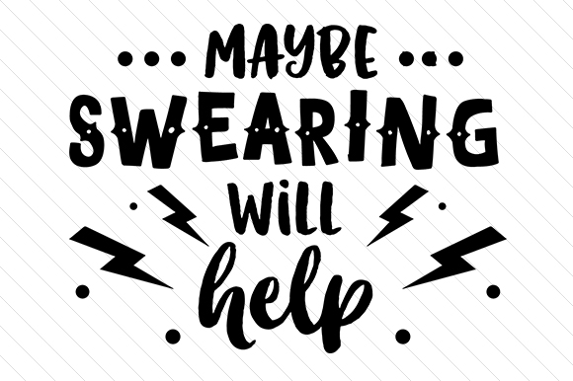
fuck: live demo
Notes:
[word=".*fuck.*"%c]

Slide 60
Bad language: conclusions
BLW use significantly lower in 2010s vs 1990s
FUCK is much more common than expected given it is rated so strongly
Interesting social changes among 12 high frequency BLWs
fucking is by far the most common & versatile form of FUCK
Methodological: awareness of corpus compilation is important

Slide 61
Limitations
Only two sampling points ≈ ‘change over time’
Some non-taboo uses included
Speaker awareness – frequency but not form?
Didn’t consider role of recipient/target of BLW
Need to look at all BLWs re: social distribution – this is now possible with fancy new search features in CQPweb
Individual speaker variation

Slide 62
Publications
International Journal of Corpus Linguistics
  Spoken BNC2014 special issue, eds. McEnery, Love & Brezina
  Love, Dembry, Hardie, Brezina & McEnery
  Fuchs; Laws et al.; Hessner & Gawlitzek; Calude
Routledge Advances in Corpus Linguistics book
  Corpus Approaches to Contemporary British Speech eds. Brezina, Love & Aijmer
  Wong & Kruger; Culpeper & Gillings; Aijmer; Jenset et al.; Caines et al.; Paterson

Slide 63
Spoken BNC2014: summary
Maximize efficiency of corpus construction in view of practical constraints: especially time
There is no one ‘right’ way to do this – e.g. data collection, metadata, transcription, processing
Decisions made = justified & transparent, including weaknesses e.g. imbalance, speaker identification
Ideal: (Spoken) BNC should be recollected more regularly – it’s getting easier
But, the issue of comparability versus improvement is unlikely to go away, e.g. Brown sampling frame

Slide 64
Thank you
r.m.love@lancaster.ac.uk
@lovermob
@BNC_2014
http://corpora.lancs.ac.uk/bnc2014/

Slide 65
References
Brezina, V., R. Love and K. Aijmer (eds.). (2018 fc). Corpus Approaches to Sociolinguistic Variation in Contemporary British English: An Exploration of the Spoken BNC2014. New York: Routledge.
Crowdy, S. (1993). Spoken Corpus Design. Literary and Linguistic Computing, 8(4), 259-265.
Crowdy, S. (1994). Spoken Corpus Transcription. Literary and Linguistic Computing, 9(1), 25-28.
Hardie, A. (2012). CQPweb – combining power, flexibility and usability in a corpus analysis tool. International Journal of Corpus Linguistics 17 (3): 380-409.
Hardie, A. (2014). Modest XML for corpora: not a standard, but a suggestion. ICAME Journal, 38, 73-103.
Leech, G. (1993). 100 million words of English. English Today, 9-15. doi:10.1017/S0266078400006854
Love, R., Dembry, C., Hardie, A., Brezina, V. and McEnery, T. (2017 fc). The Spoken BNC2014: designing and building a spoken corpus of everyday conversations. In International Journal of Corpus Linguistics, 22:3.
McEnery, T. (2005). Swearing in English: Bad language, purity and power from 1586 to the present. New York: Routledge.
McEnery, T., Baker, P. & Hardie, A. (2000). Swearing and abuse in modern British English. In: PALC ’99: Practical Applications in Language Corpora. Peter Lang, Frankfurt am Main, pp. 37-48.
McEnery, T., Love, R. and Brezina, V. (eds.). (2017 fc). International Journal of Corpus Linguistics, 22:3, Special Issue.
McEnery, T. and Love, R. (fc). Bad Language. In Culpeper, J., F. Katamba, P. Kerswill, R. Wodak and T. McEnery (eds.). (fc). English Language: Description, Variation and Context (2nd ed.). London: Palgrave.
McEnery, T. & Xiao, Z. (2004). Swearing in modern British English: the case of fuck in the BNC. In Language and Literature, 13(3). doi:10.1177/0963947004044873.

