Slide 1

The life and death of a gay footballer: from concern about homosexuality to concern about homophobia in the UK press
Robbie Love
Centre for Corpus Approaches to Social Science, Lancaster University
@lovermob

Slide 2
Background
Baker and Love (forthcoming)
Chapter on ‘corpus linguistics and sexuality’, Oxford Handbook of Language and Sexuality
@lovermob

Slide 3
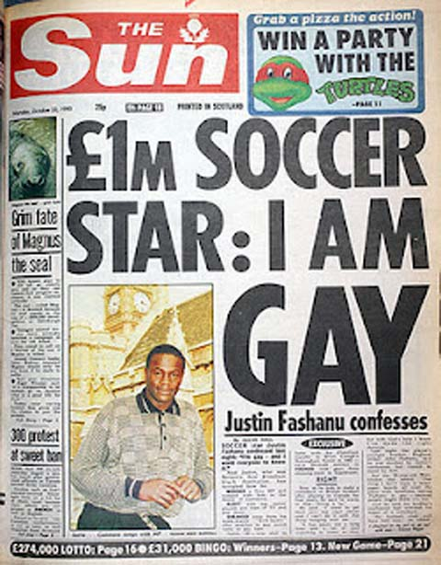
Justin Fashanu (1961-1998)
English pro footballer
1981: 1st black footballer to negotiate £1 million transfer fee
1990: 1st English pro footballer to come out as gay
1998: suicide in London, wanted by US police accused of sexual assault of teenaged male
@lovermob

Slide 4
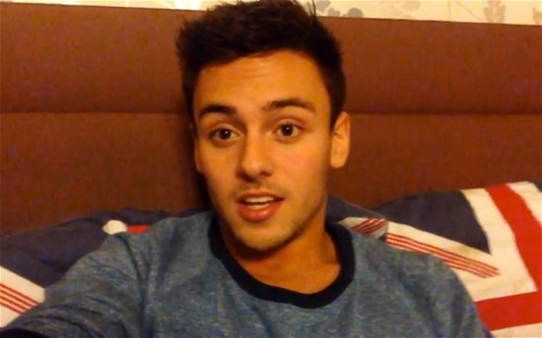
Wider context
One of two out British footballers
Being gay and famous in sport seems less prevalent than other public domains
  Recent e.g. Tom Daley – diver “it shouldn’t matter”
Media portrayal?
@lovermob

Slide 5
Research questions
RQ1: How did the UK press represent Fashanu from the time he came out until his death?
RQ2: In what ways did the UK press change their representation of Fashanu after his death?
@lovermob

Slide 6
Previous corpus work on sexuality
Language of sexuality
  gay online chatrooms
  speech
Language about sexuality
  large samples of writing, various genres
  UK parliamentary debates
    Age of consent
    Civil partnerships
    Same sex marriage
  Erotica
  Gay male/lesbian sexual narratives
@lovermob

Slide 7

Method – data
271,892 words
417 articles
879,516 words
1,173 articles
1990
1998
2014
@lovermob

Slide 8
Method – analysis
AntConc (Anthony 2014)
  Keywords
  Clusters
  Concordances
@lovermob

Slide 9
Findings - keywords
Both corpora compared to BE06 corpus (Baker 2009)
Top twenty keywords, ranked by log-likelihood
Characterising the two time periods
@lovermob

Slide 10
Findings - keywords
Rank | Pre-death corpus |  |  | Post-death corpus
 | Keyword | Freq. | Per million words | Keyword | Freq. | Per million words
1 | fashanu | 926 | 3406 | gay | 5131 | 5834
2 | justin | 555 | 2041 | football | 3669 | 4172
3 | hearts | 555 | 2041 | fashanu | 3056 | 3475
4 | manager | 485 | 1784 | justin | 2180 | 2479
5 | club | 482 | 1773 | players | 1984 | 2256
6 | football | 451 | 1659 | player | 1729 | 1966
7 | rangers | 324 | 1192 | he | 11834 | 13455
8 | season | 412 | 1515 | footballer | 1374 | 1562
9 | airdrie | 275 | 1011 | sport | 1304 | 1483
10 | division | 302 | 1111 | homophobia | 972 | 1105
11 | league | 327 | 1203 | game | 1332 | 1514
12 | player | 304 | 1118 | footballers | 877 | 997
13 | players | 341 | 1254 | league | 1036 | 1178
14 | striker | 225 | 828 | fans | 1014 | 1153
15 | united | 354 | 1302 | team | 1401 | 1593
16 | game | 363 | 1335 | sexuality | 780 | 887
17 | cup | 330 | 1214 | former | 1211 | 1377
18 | clough | 204 | 750 | his | 8000 | 9096
19 | milligan | 194 | 714 | out | 4283 | 4870
20 | gay | 277 | 1019 | professional | 928 | 1055
@lovermob

Slide 11
Findings - keywords
Pre-death (1990-1998)
  hearts, rangers, airdrie, division, milligan
Both corpora (1990-2014)
  fashanu, justin, manager, club, football, season, league, player, players, striker, united, game, cup, clough, gay
Post-death (1998-2014)
  sport, homophobia, footballers, fans, sexuality, out, professional
@lovermob

Slide 12
Findings - keywords
Using keywords as “lexical signposts” (Baker 2004: 90)
  gay
  homophobia
@lovermob

Slide 13
Findings – clusters around gay
 | 2 word clusters |  | 3 word clusters
 |  | Freq. |  | Freq.
 | gay men | 25 | gay footballer justin | 10
 | gay footballer | 19 | gay soccer star | 8
 | gay sex | 12 | gay footballer who | 3
 | gay soccer | 12 | gay men and | 3
 | gay christmas | 11 | gay sex romps | 3
Pre-death
Gay sex
 | 2 word clusters |  | 3 word clusters
 |  | Freq. |  | Freq.
 | gay footballers | 310 | gay and lesbian | 48
 | gay players | 268 | gay football supporters | 45
 | gay and | 220 | gay professional footballer | 39
 | gay footballer | 202 | gay players in | 37
 | gay in | 167 | gay players and | 32
Post-death
@lovermob

Slide 14
Findings – clusters around gay
Fashanu, 33, who also played for Airdrie during his British footballing career, was dumped as the Tynecastle club's star striker after a little local difficulty concerning his allegation that Tory MPs had joined him in gay sex romps . . . A claim instantly rejected by the electorate on the ground that such behaviour would be totally incompatible with that party's high moral standards.
(The Herald, 16 January 1997)
…the homosexual footballer Justin Fashanu had tried to do a pounds 300,000 deal for a gay sex ring story which was said to be capable of toppling the Government.
(The Independent, 13 February 1994)
@lovermob

Slide 15
Findings – clusters around gay
 | 2 word clusters |  | 3 word clusters
 |  | Freq. |  | Freq.
 | gay men | 25 | gay footballer justin | 10
 | gay footballer | 19 | gay soccer star | 8
 | gay sex | 12 | gay footballer who | 3
 | gay soccer | 12 | gay men and | 3
 | gay christmas | 11 | gay sex romps | 3
Pre-death
Plural nouns
 | 2 word clusters |  | 3 word clusters
 |  | Freq. |  | Freq.
 | gay footballers | 310 | gay and lesbian | 48
 | gay players | 268 | gay football supporters | 45
 | gay and | 220 | gay professional footballer | 39
 | gay footballer | 202 | gay players in | 37
 | gay in | 167 | gay players and | 32
Post-death
@lovermob

Slide 16
Findings – clusters around gay
What will it take to lure gay footballers out of the closet?
(Guardian.com, 04 January 2013)
40 per cent of fans blamed clubs and agents for keeping gay footballers under wraps
(MailOnline, 04 January 2013)
Gay footballers are obliged to keep quiet in a macho environment, where homosexuality is still largely seen as a symptom of weakness and thus mercilessly pilloried.
(The Guardian, 04 March 1999)
@lovermob

Slide 17
Findings - homophobia
Concordance analysis of homophobia
972 hits in post-death corpus
Manual concordance analysis in terms of agency – homophobia as object and subject
@lovermob

Slide 18
What is done to homophobia?
address (12), challenge (11), combat (17), condemn (3), confront (5), counter (1) crush (2), cut (1), denounce (1), discourage (2), discuss (2), eliminate (3), eradicate (7), erase (2), fight (12), highlight (2), kick (23), oppose (8), reject (1), remove (4), report (1), stamp (1), stop (2), tackle (86) and witness (2)
@lovermob

Slide 19
What is done to homophobia?
The FA has worked with the Kick It Out campaign to tackle homophobia but Funke Awoderu, the equality manager at the FA, has said that it could take a decade to eradicate the problem.
(The Times, 25 November 2010)
@lovermob

Slide 20
What does homophobia do?
exists (3), extends (1), remains (12), poisons (1), haunts (1), holds (1), prevents (1) and thrives (1)
@lovermob

Slide 21
What does homophobia do?
Athletes today are progressing to unprecedented levels of skill and strength," she said. "But homophobia slowly poisons the process and prevents people from realising their dreams.
(Guardian.com, 23 June 2011)
However, it appears that homophobia still haunts the game in Germany. Last July, in the build-up to Germany's successful World Cup, the agent of the former captain, Michael Ballack, said the team contained a "bunch of gays"
(The Daily Telegraph, 20 May 2011)
@lovermob

Slide 22
Fashanu + homophobia
Peter Tatchell, the gay rights campaigner, says Fashanu was destroyed by homophobia in football and beyond.
(Daily Mail, 02 March 2011)
The Kent Girls and Ladies Division Two game against league leaders Castle Colts was played under the banner of Justin Campaign's, which was founded to demonstrate that 10 years after Justin Fashanu's tragic suicide in 1998, homophobia is still hugely prevalent in both grass roots and professional football.
(Faversham Times, 24 February 2011)
@lovermob

Slide 23
Conclusions
RQ1 – Fashanu before his death
  Mysterious
  Controversial
  Vilified
RQ2 – Fashanu after his death
  More sympathetic over time
  An emblematic victim/hero
  Inspiration for change/criticism of status quo
@lovermob

Slide 24
Conclusions
concern about homosexuality
to
concern about homophobia
Recent and current understandings of sexuality are not fixed but subject to change
Corpus methods help to understand this in a rigorous and systematic way
@lovermob

Slide 25
References
Anthony, L. (2014) AntConc (Version 3.4.3w) [Computer Software]. Tokyo, Japan: Waseda University. Available from http://www.laurenceanthony.net/antconc_index.html [Accessed 24 September 2014].
Bachmann, Ingo. (2011) “Civil partnership – ‘Gay marriage in all but name’: A corpus-driven analysis of discourses of same-sex relationships in the UK Parliament.” Corpora 6(1): 77-105.
Baker, P. (2004) ‘Unnatural acts’: Discourses of homosexuality within the House of Lords debates on gay male law reform. Journal of Sociolinguistics 8(1): 88-106.
Baker, Paul. (2005) Public Discourses of Gay Men. London: Routledge.
Baker, P. (2006) Using Corpora for Discourse Analysis. London: Continuum.
Baker, P. (2009) The BE06 Corpus of British English and recent language change. In International Journal of Corpus Linguistics, 14(3): 312-337.
Bolton, R. (1995) Sex talk: Bodies and behaviors in gay erotica. In W. Leap (ed) Beyond the Lavender Lexicon: Authenticity, Imagination, and Appropriation in Lesbian and Gay Languages. Amsterdam: Gordon and Breach, pp. 173–206.
Caskey, D. M. (2011) Speak Like A Wo(Man): A Corpus Linguistic And Discourse Analysis Of Gendered Speech. Unpublished MA Thesis, Western Carolina University. Available at http://libres.uncg.edu/ir/wcu/f/Caskey2011.pdf.
Hoey, Michael (1997) ‘The organisation of narratives of desire.’ In K. Harvey and C. Shalom. (eds) Language and Desire: Encoding Sex, Romance and Intimacy. London: Routlege, pp. 85-105.
King, B. W. (2009). Building and analysing corpora of computer-mediated communication. In P. Baker (ed) Contemporary Corpus Linguistics. London. Continuum, pp. 301-20.
Love R. and Baker, P. (2015) ‘The Hate that Dare not Speak its Name?’ Journal of Language, Aggression and Conflict 3(1):xx.
@lovermob

Slide 26
Thank you
r.m.love@lancaster.ac.uk
@lovermob
@lovermob

