Slide 1


Critical issues in spoken corpus development: the Spoken BNC2014 transcription scheme
Robbie Love
Centre for Corpus Approaches to Social Science, Lancaster University
@lovermob

Slide 2
Today’s talk
The Spoken BNC2014
Transcription scheme development
Comparison between the original and the new
@lovermob

Slide 3


Why make a new one now?
@lovermob

Slide 4
Why make a new one now?
It’s getting old
Can no longer be used as a proxy for present day British English
Nothing since the Spoken BNC (1994):
- large size
- general coverage of spoken British English
- (low or no cost) public access
- transcribed
@lovermob

Slide 5
Why make a new one now?
Language has very likely changed during this time – lexical innovations, etc.
Grammar too - Geoff Leech’s work on modality (2003) shows that change can happen quickly
Two decade comparison (1990s-2010s) never been done before
Mystery – we don’t know how else things have changed – let’s find out
@lovermob

Slide 6
The Spoken BNC2014
Cambridge University Press started work
Lancaster joined in and formalised as BNC
10 million words spontaneous conversation
Smartphones (vs. tape recorders)
Non-surreptitious!
@lovermob

Slide 7
The Spoken BNC2014
Both parties
Fund project equally
Encourage participation – media campaigns
Disseminate information
CUP
Corresponds with contributors
Collects recordings
Transcribes data
Lancaster
Carries out methodological investigations
Converts transcripts to XML, encoding
Annotates corpus
Initial analysis
Prepares for public release/hosts finished corpus
@lovermob

Slide 8
Transcription scheme development
Cambridge already had a scheme for their privately hosted spoken corpora
We worked together to refine and improve this existing work
Reviewed a range of sources, then decided upon crucial investigations to make
Recommendations reviewed and implemented to produce new Spoken BNC2014 scheme
@lovermob

Slide 9
Why not simply reuse the original?
Crowdy (1994) “Spoken Corpus Transcription”
Generally, it’s pretty good, but:
16 features identified in the 1,900 word scheme – very few examples
Not enough clarity in some areas, leading to ambiguity
Compatibility with CASS XML standards for automatic conversion
@lovermob

Slide 10
Why not simply reuse the original?
EXAMPLE
using full stops and commas to “approximate to use in written text”, but also indicating pauses with ellipses
<2> I think it’s always, deceptive on days like this because its, overcast and [er]
[…]
<2> But, but er, he’s…just broken away from his girlfiend and [<unclear>]
<1> [Oh has] he, oh. Well he seemed happy enough when he called.
Crowdy (1994: 28)
@lovermob

Slide 11
How we investigated the issues
Set #1 = decisions made based on evidence from sources
Set #2 = decisions made based on evidence from pilot study (Love 2014)
Observations discussed between Lancaster and Cambridge
Implemented to create the new Spoken BNC2014 transcription scheme
@lovermob

Slide 12
Investigating transcription
Set 1
Overlaps
Filled pauses
Pauses
Events
+ non-English speech
+ capitalisation
Set 2
Anonymization
+ speaker identification
+ quotative speech
@lovermob

Slide 13
Investigating transcription
Overlaps
Crowdy’s (1994) rather complicated system:
<1> So she was virtually a [a house prisoner]
<2> [house {bound}]
<3> {prisoner}
Not in Trinity Lancaster corpus (Gablasova et al. under review)
Decision to use simpler <OL> tag instead
@lovermob

Slide 14
Investigating transcription
Filled pauses = sound over function
What it sounds like | How to write it
Has the vowel found in “father” or a similar vowel; usually = realisation, frustration or pain | ah
Has the vowel found in “road” or a similar vowel; usually = mild surprise or upset | oh
Has the vowel in “bed” or the vowel in “made” or something similar, without an “R” or “M” sound at the end; usually = uncertainty, or ‘please say again?’ | eh
A long or short “er” or “uh” vowel, as in “bird”; there may or may not be an “R” sound at the end; usually = uncertainty | er
As for “er” but ends as a nasal sound | erm
Has a nasally “M” or “N” sound from start to end; usually = agreement | mm
Like an “er” but with a clear “H” sound at the start; usually = surprise | huh
Two shortened “uh” or “er”-type vowels with an “H” sound between them, usually = disagreement; OR, a sound like the word “ahah!”; usually = success or realisation | uhu
@lovermob

Slide 15
Investigating transcription
Pauses
Two types of pause but omitted noting the length
<001> I had pizza and (.) chips last night
<002> I can’t believe (…) I can’t believe that
Short pause | (.) | Only use this tag for pauses which are between one second and five seconds, and only which occur during utterances. Do not record pauses which are less than one second.
Long pause | (…) | Use this tag for any pauses which are over five seconds, either during or between utterances.
@lovermob

Slide 16
Investigating transcription
Events
Made clear that this is any non-vocal noise that is relevant to the discourse
e.g. background talk, unintelligible, sound of X, music, abrupt end, recording skips
More specific than Crowdy’s (1994) contextual comments, e.g. “playing croquet”
@lovermob

Slide 17
Issues investigated in the pilot study
The Spoken BNC2014 pilot corpus (Love 2014)
5.5 hours of audio data
Replicated the style of recordings in the Spoken BNC2014
14 recordings, 32 speakers, 47,000 words, 6,552 turns
Transcribed by two full-time, professional transcribers at CASS

Slide 18
Issues investigated in the pilot study
Anonymization
Omit “any reference that would allow an individual to be identified” (Crowdy 1994)
NOT automatically (Hasund 1998)
Hasund: Bank of English includes gender in anonymization tag
e.g. I bumped into <name F> yesterday
(+ male, neutral)
@lovermob

Slide 19
Issues investigated in the pilot study
Pilot study
Of the 380 <name> tags, only 1.8% not coded for gender
Also added place + other personal information
@lovermob

Slide 20
Resulting scheme
From 1,900 words to 5,000 words!
Lots of examples
(Hopefully) minimal room for ambiguity = maximal room for inter-rater consistency
@lovermob

Slide 21
The bird’s eye view
SPOKEN BNC (1994) | SPOKEN BNC2014
Speaker turns | Speaker IDs
Overlapping speech | Overlaps
Use of punctuation, and 'sentence' boundaries | Punctuation – question marks
 | Utterances
 | Unfinished words (false starts)
Pauses | Pauses and events
Vocalised pauses | Pauses and events
Accent, dialect, and representation of nonstandard forms | Nonstandard words or sounds
 | Nonstandard contractions or shortenings
 | Native speaker accent/dialect
Paralinguistic features | Pauses and events
Non-verbal sounds | Non-linguistic vocalisations
Contextual comments | Pauses and events
Unclear or inaudible text | Unintelligible speech/guesses
Unfamiliar words | Unintelligible speech/guesses
Spelt-out words | Acronyms/spelling/capitalisation
Acronyms and abbreviations | Acronyms/spelling/capitalisation
Telephone conversations | Pauses and events
Codes used to preserve anonymity | Anonymization
Text read out | Pauses and events
Section headings
EXTRA SPOKEN BNC2014
General guidelines
Document format
Line height and spacing
Header information
Tag format
Non-English speech
Numbers
@lovermob

Slide 22
The bird’s eye view
Delicate balance sought between
  backwards compatibility, and
  optimal practice
Similar enough to compare with original
Different enough to be better
@lovermob

Slide 23
Comparison: 1994 and new
<1> It’s a funny old day isn’t it.
<2> Mm it’s not cold is it? [I]
<1> [Well] I thought it was when I went out and exercised the dog before lunch. I went up to Jubilee Park, and er I had a very brisk walk indeed and I was absolutely lathered by the time I got back to [the]
<2> [Mm]
<1> car after half an hour
<2> I think it’s always, deceptive on days like this because its, overcast and [er]
<001> it’s a funny old day isn’t it?
<002> mm it’s not cold is it? I
<001> <OL> well I thought it was when I went out and exercised the dog before lunch (.) I went up to <place> (.) and er I had a very brisk walk indeed and I was absolutely lathered by the time I got back to the
<002> <OL> mm
<001> car after half an hour
<002> I think it’s always (.) deceptive on days like this because it’s (.) overcast and er
@lovermob

Slide 24
eXtensible Markup Language (XML)
Makes possible for automated mapping to XML, with minimal manual editing
Original Spoken BNC was not initially in XML, but later converted, therefore comparable
But even in XML it adheres to the highly complex Text Encoding Initiative (TEI) – as released on CDs
So we’re using Hardie’s (2014) “Modest XML for Corpora”
“any linguist from the level of a bright undergraduate upwards should be able to understand it”
(p. 79)
@lovermob

Slide 25
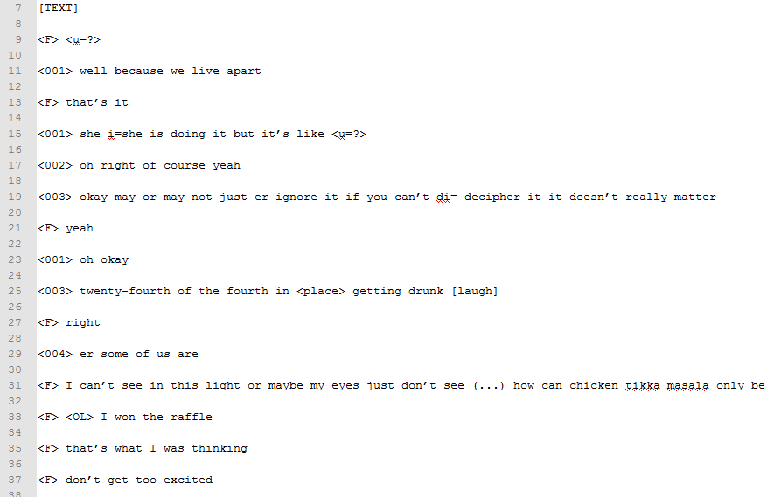
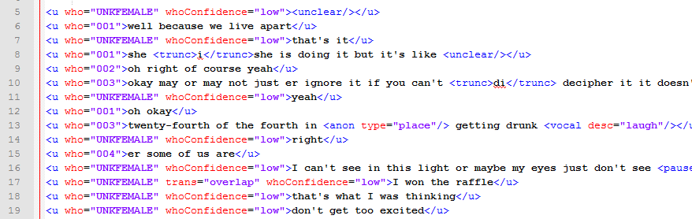
Comparison between original and new
@lovermob

Slide 26
References
Crowdy, S. (1994). Spoken Corpus Transcription. Literary and Linguistic Computing, 9(1), 25-28.
Gablasova, D., Brezina, V., McEnery, T. & Boyd, E. (under review) Epistemic stance in spoken L2 English: The effect of task type and speaker style, submitted to Applied Linguistics.
Hardie, A. (2014). Modest XML for corpora: not a standard, but a suggestion. ICAME Journal, 38, 73-103.
Hasund, K. (1998). Protecting the innocent: The issue of informants' anonymity in the COLT corpus. In A. Renouf (Ed.), Explorations in corpus linguistics (pp. 13-28). Amsterdam: Rodopi.
Leech, G. (1993). 100 million words of English. English Today, 9-15. doi:10.1017/S0266078400006854
Leech, G. (2003). Modals on the move: The English modal auxiliaries 1961–1992. In R. Facchinetti, F. R. Palmer & M. Krug (Eds.), Modality in Contemporary English. Berlin/New York: Mouton de Gruyter, 223–240
Love, R. (2014). Methodological issues in the compilation of spoken corpora: the Spoken BNC2014 pilot study. Lancaster University: unpublished Masters dissertation.
@lovermob

Slide 27
Thank you
r.m.love@lancaster.ac.uk
@lovermob
@lovermob

