Slide 1


Spoken English in Today’s Britain
Dr Claire Dembry, Cambridge University Press
Robbie Love, Lancaster University
Twitter: @ClaireDembry | @lovermob

Slide 2


What is language?
Hello!
Hello!

Slide 3

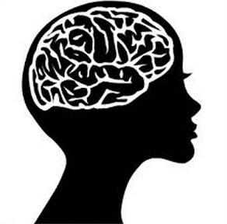
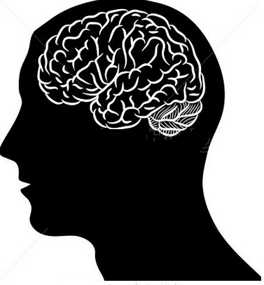
What is language?

Slide 4
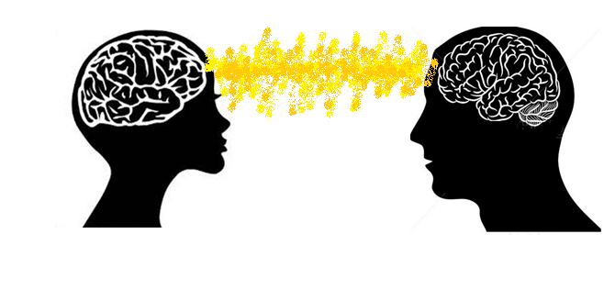
What is language?

Slide 5
What is language?
Hello!
Hello!

Slide 6
What is language?
Serbo-Croatian
Romanian
Igbo
Yoruba
Dutch
Deccan
Marathi
Pashto
Telugu
Hungarian
Polish
Japanese
Min Nan
Arabic
Mandarin
English
Uzbek
Zhuang
Vietnamese
Sundanese
Chittagonian
Portuguese
Min Dong
Bengali
Spanish
Malayalam
Gan
Madurese
Nepali
Sylheti
Hindi
Quechua
Hausa
Tamil
Min Bei
Bhojpuri
Gujarati
Korean
Punjabi
Ilokano
Kirundi
Assamese
Xiang
Swedish
Xhosa
Sinhalese
Uyghur
Ukrainian
Russian
Azerbaijani
Haitian Creole
German
Lao
Italian
Magahi
Mossi
Swahili
Urdu
Jin
Awadhi
Kannada
Thai
Tagalog
Hiligaynon
Haryanvi
Dhundhari
Cantonese
Czech
French
Malay/Indonesian
Somali
Oromo
Persian
Malagasy
Wu
Zulu
Marwari
Sindhi
Kazakh
Kinyarwanda
Greek
Fula
Cebuano
Javanese
Hmong
Turkish
Hakka
Burmese
Amharic
Maithili
Oriya
Kurdish
Chewa
Khmer
Akan
Saraiki
Chhattisgarhi
Shona

Slide 7
What is language?
привет
السلام علیکم
שלום
γεια σας
こんにちは
你好
مرحبا
բարև
Здравейте
ជំរាបសួរ
Notes:
I’ve changed this – what do you think?

Slide 8
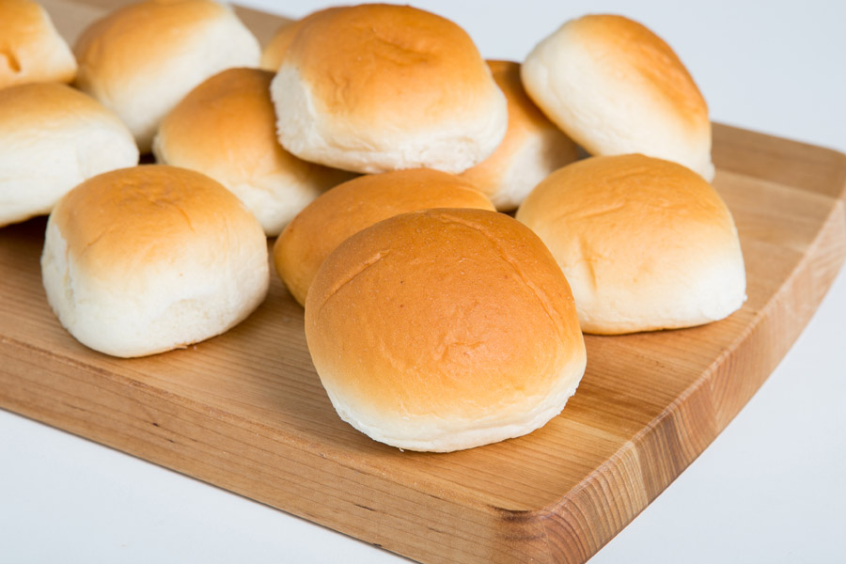
What are these called?
Twitter: @ClaireDembry | @lovermob

Slide 9
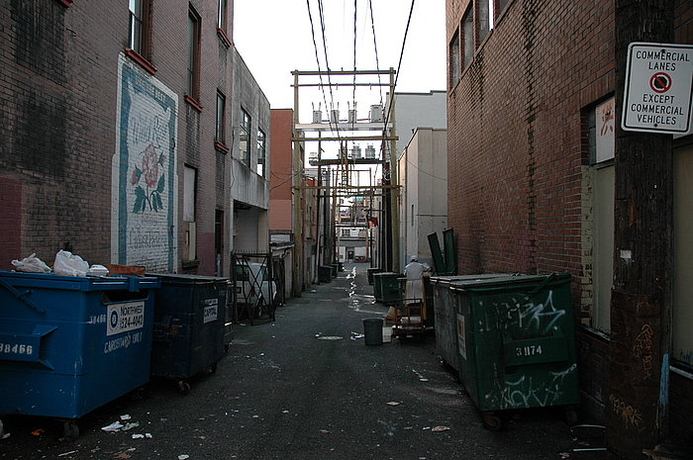
What is this called?
Twitter: @ClaireDembry | @lovermob

Slide 10
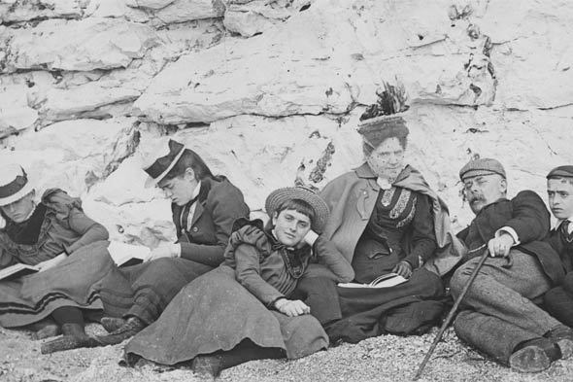
Fashion changes over time
Twitter: @ClaireDembry | @lovermob

Slide 11
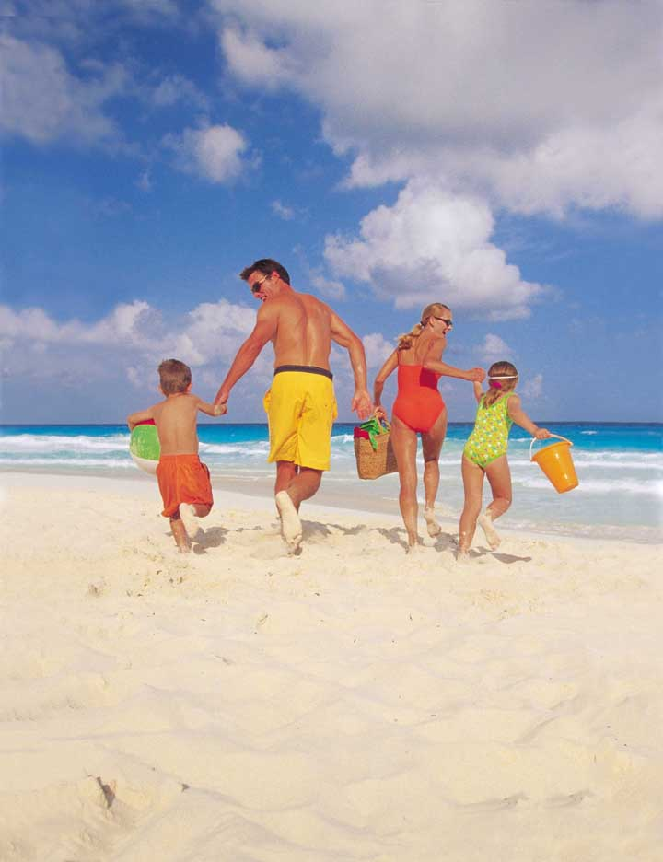
Fashion changes over time
Twitter: @ClaireDembry | @lovermob

Slide 12
Language changes over time
SILLY
Twitter: @ClaireDembry | @lovermob

Slide 13
Language changes over time
SILLY
BLISSFUL/ BLESSED
INNOCENT/ HARMLESS
WEAK/ IGNORANT
PITIABLE
FOOLISH
Time
Twitter: @ClaireDembry | @lovermob
Hollmann (2009: 307)

Slide 14
AGONY…should be used only in a context that suggests extreme physical or mental suffering. It is hackneyed to talk about…'the agonising decision about which chocolate to eat'
BRILLIANT in its figurative sense, meaning extremely clever or of superlative talent, is a much over-worked adjective. […] The word should now only be used to describe a bright light.
ONGOING is a tiresome and greatly overused word.
KEY has become an adjective overworked to exhaustion in phrases such as 'he was a key player' or 'this is a key policy'. Think of another adjective, such as important, central or essential.
PLUNGE was a verb that used to be restricted to describing an activity of divers or swimmers […].It is now used to describe anything that takes a precipitate fall, such as the prices of stocks and shares, and is therefore becoming a cliché.
Twitter: @ClaireDembry | @lovermob
The Daily Mail, 6 May 2014
Notes:
Have a look at the animation on this – see !what you think? More jazzy than the previous slide? Happy with either

Slide 15
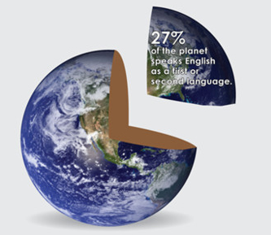

Slide 16

Spoken language
15,000 words in one hour
Twitter: @ClaireDembry | @lovermob

Slide 17

Measuring spoken language
HOW?
Twitter: @ClaireDembry | @lovermob

Slide 18
Measuring spoken language
<$058> is that red wine on your T-shirt?
<$179> oh
<$058> red wine?
<$179> er berries?
<$058> ah berries (.) it’s berries
<$179> maybe?
<$058> oh well
<$179> oh
<$058> never mind [laugh]
Twitter: @ClaireDembry | @lovermob

Slide 19
Measuring spoken language
I
YOU
Twitter: @ClaireDembry | @lovermob

Slide 20
Spoken BNC2014
Twitter: @ClaireDembry | @lovermob

Slide 21

Spoken BNC2014
1990s
2010s
Twitter: @ClaireDembry | @lovermob

Slide 22
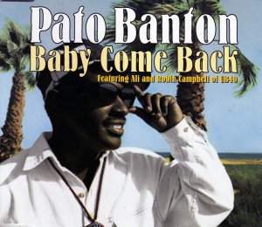
Spoken BNC2014
https://www.youtube.com/watch?v=pSywtiAirKE
Twitter: @ClaireDembry | @lovermob

Slide 23

Spoken BNC2014
https://www.youtube.com/watch?v=ekomXrzOF3A
Twitter: @ClaireDembry | @lovermob

Slide 24
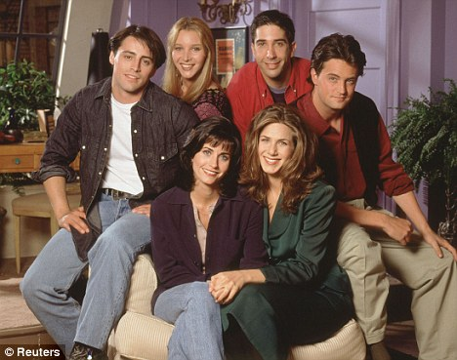
Spoken BNC2014
Twitter: @ClaireDembry | @lovermob

Slide 25
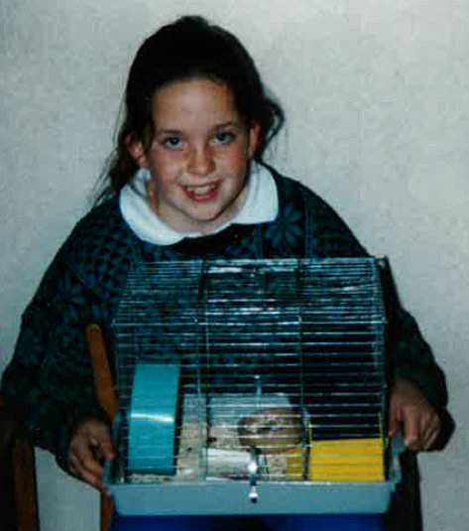
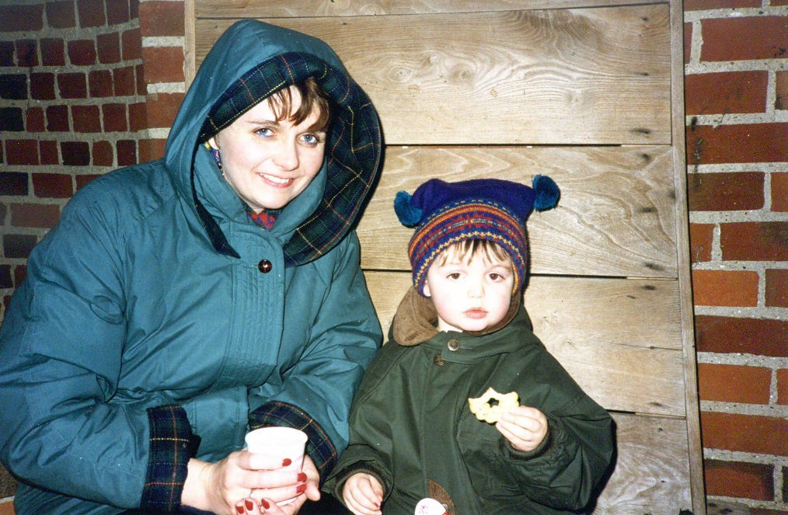

Slide 26
Spoken BNC2014
1990s
2010s
Twitter: @ClaireDembry | @lovermob

Slide 27
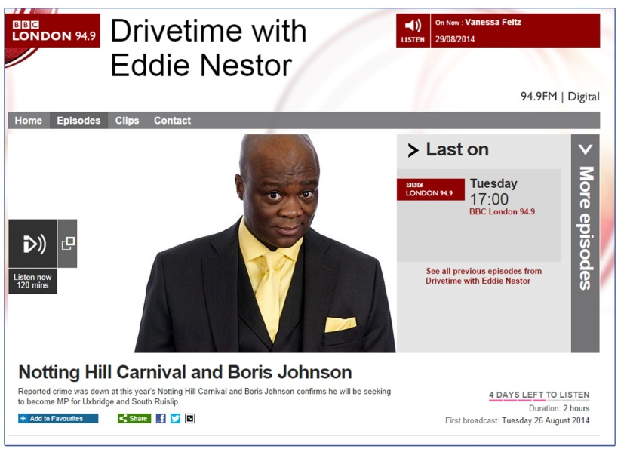
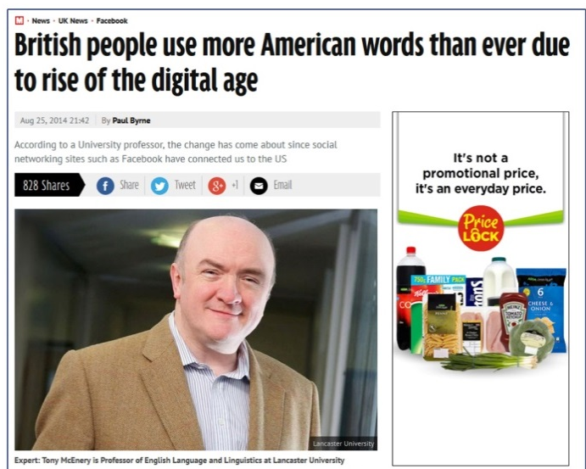
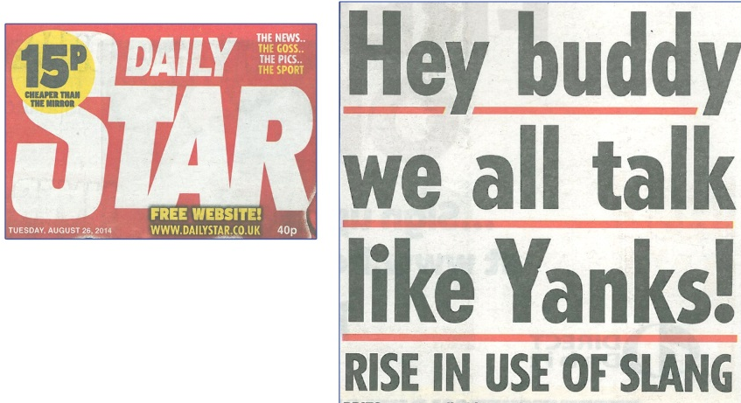
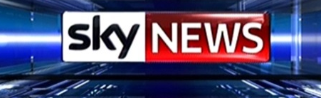

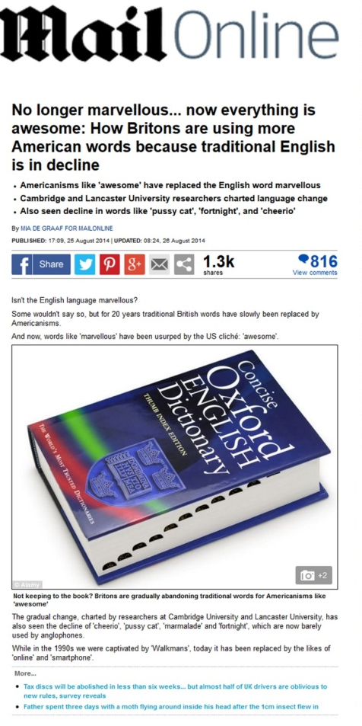
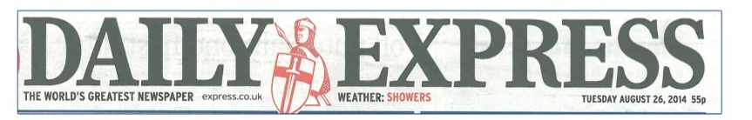
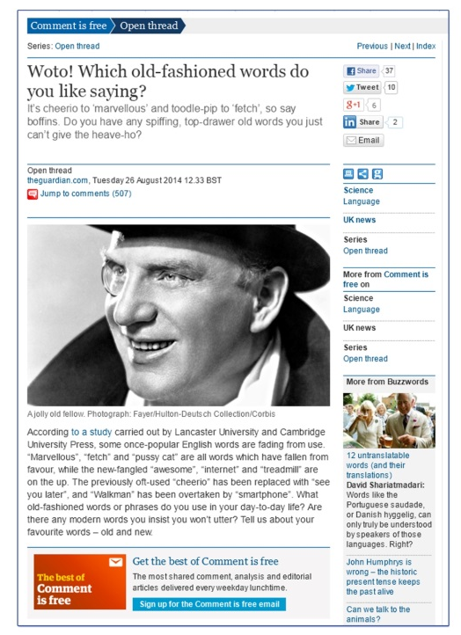
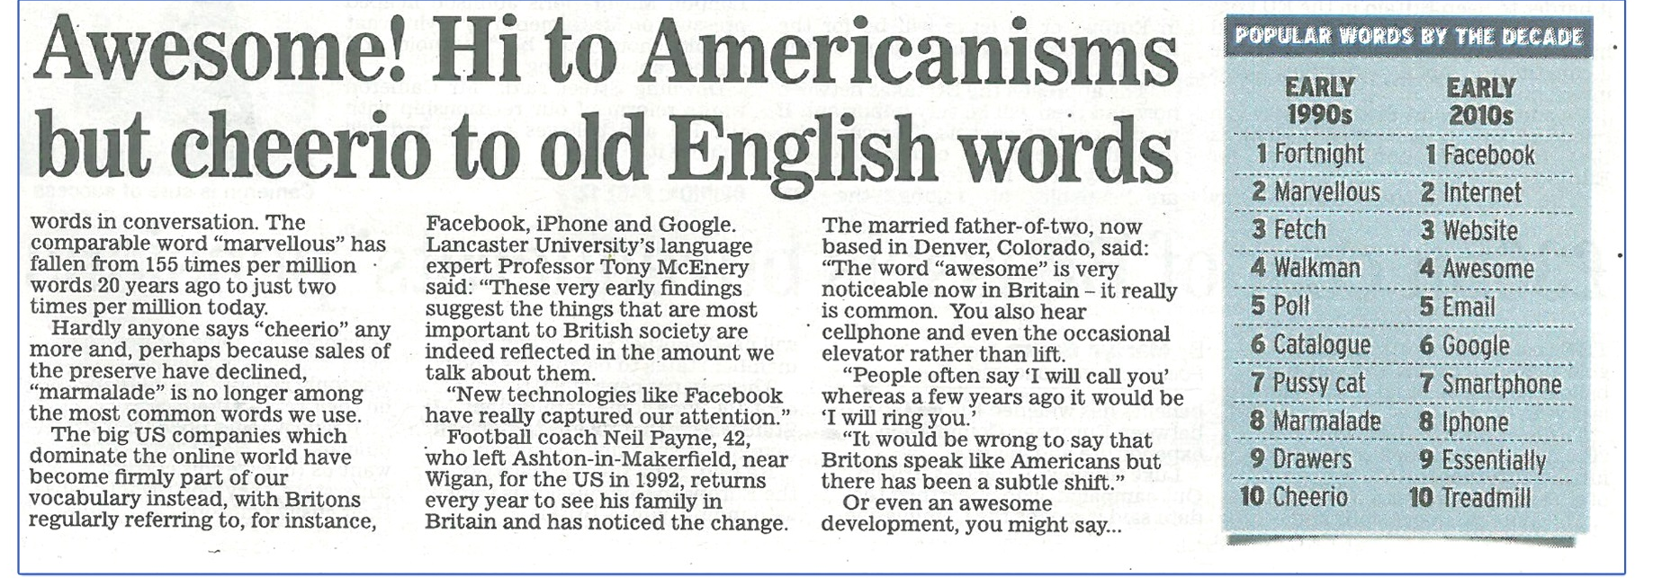

Slide 28
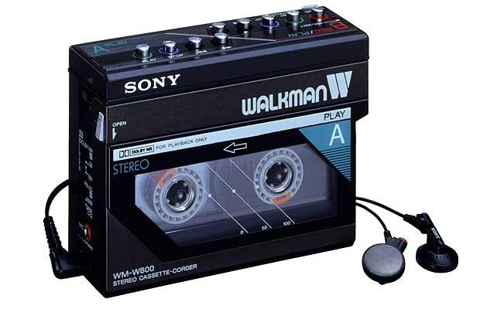
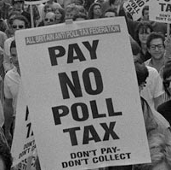
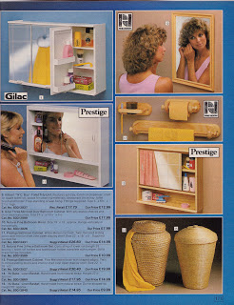
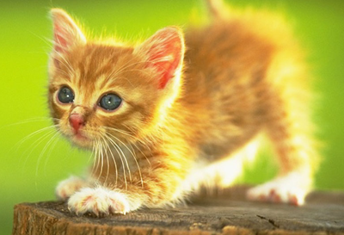
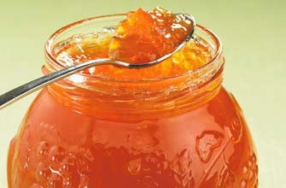
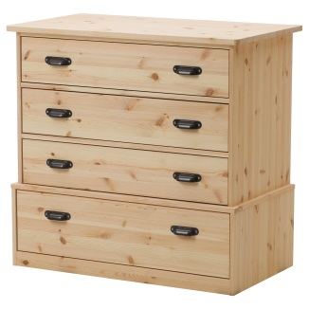
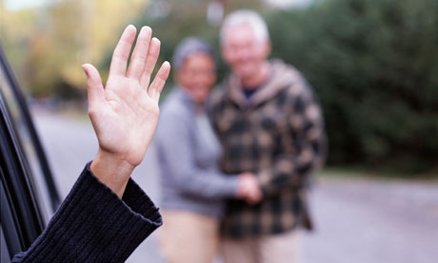
fortnight
marvellous
cheerio
fetch

Slide 29


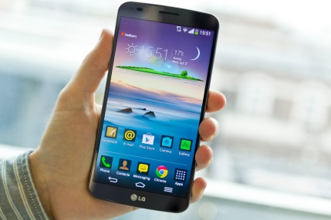

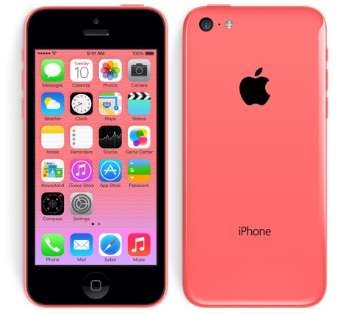
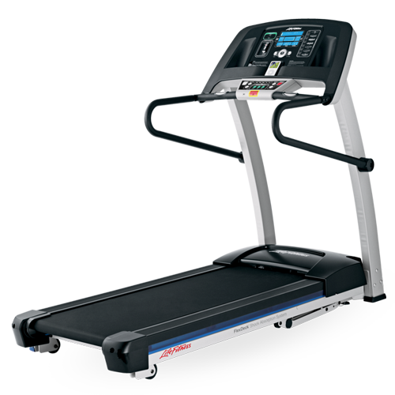

internet
website
essentially

Slide 30
Health
Twitter: @ClaireDembry | @lovermob

Slide 31
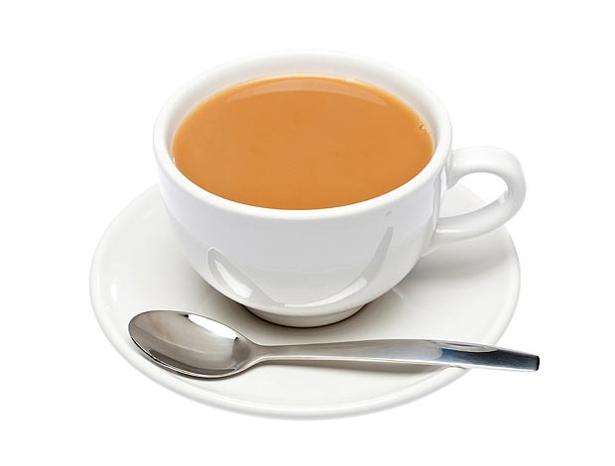
Food and drink
1990s
2010s
Twitter: @ClaireDembry | @lovermob

Slide 32
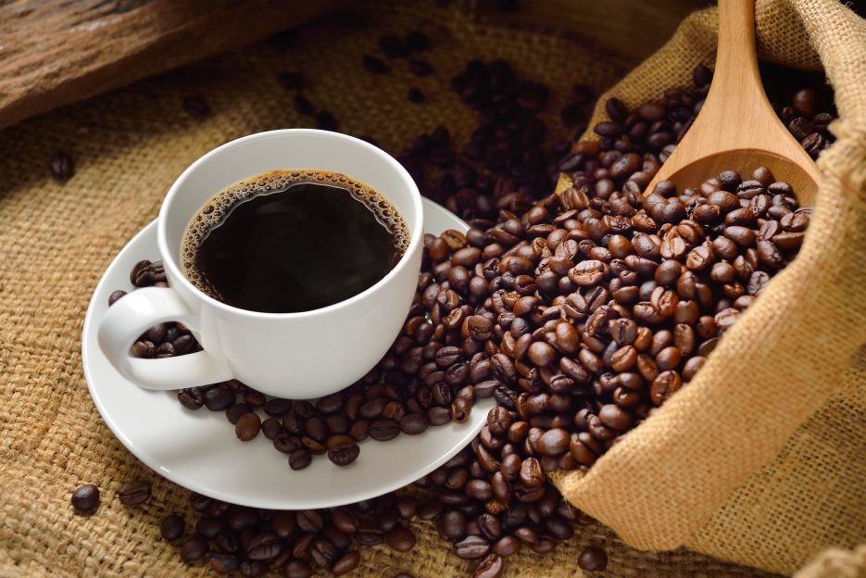
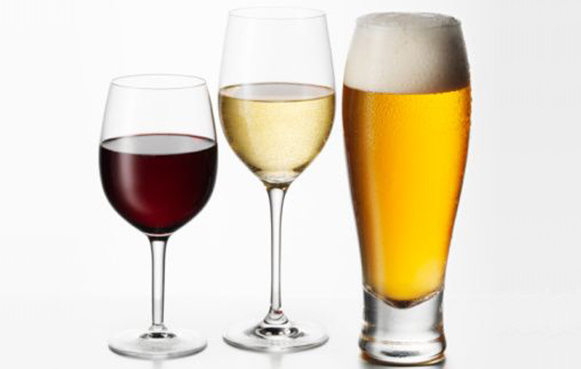
Food and drink
1990s
2010s
Twitter: @ClaireDembry | @lovermob

Slide 33
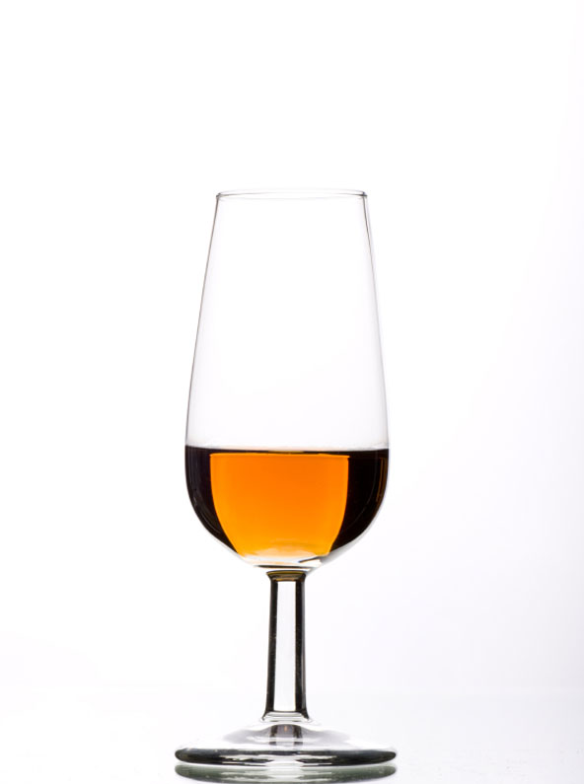
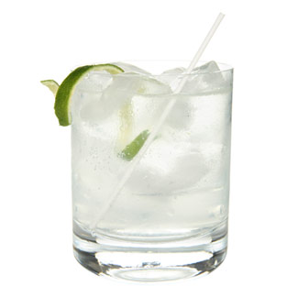

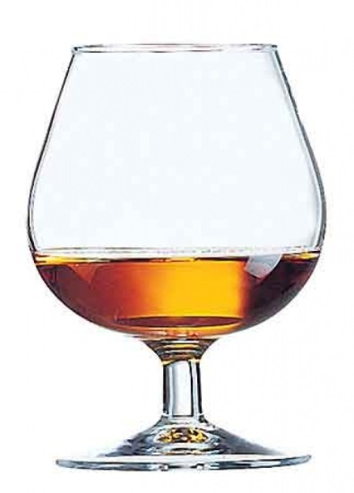

Food and drink
1990s
2010s
Twitter: @ClaireDembry | @lovermob

Slide 34
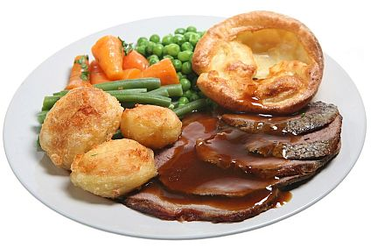
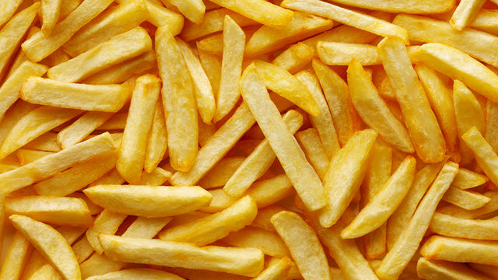
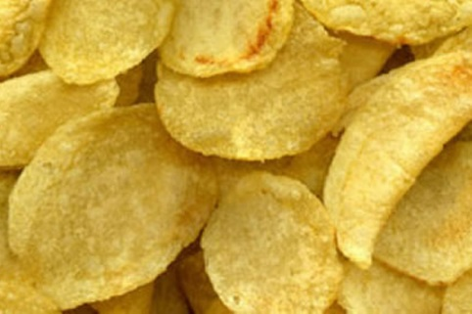
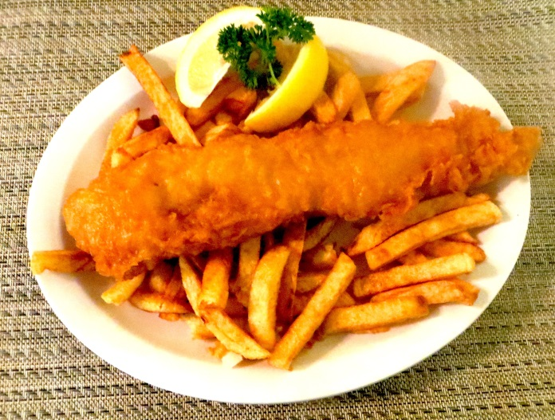
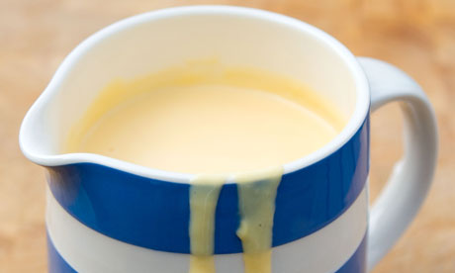
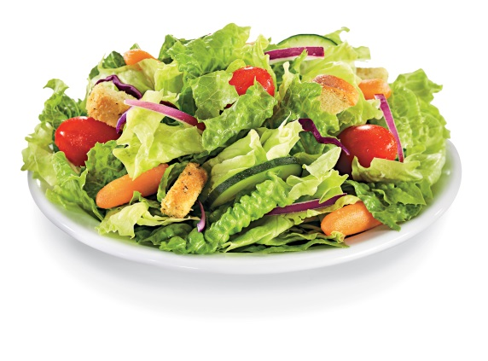
Food and drink – the ‘fallers’
Twitter: @ClaireDembry | @lovermob

Slide 35
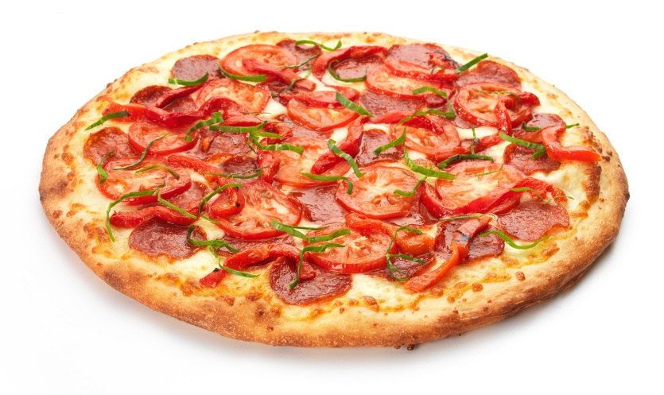
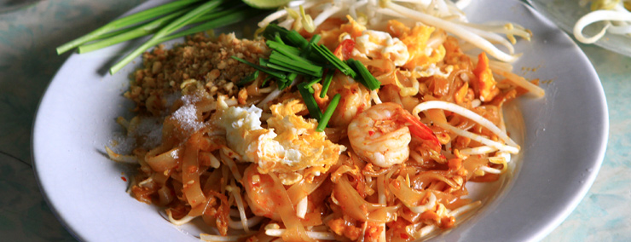
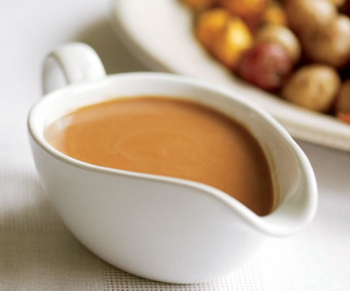
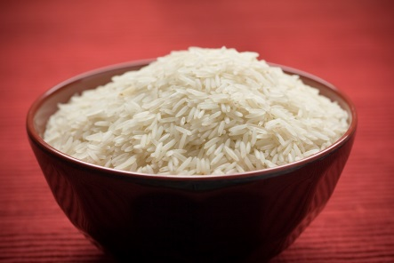
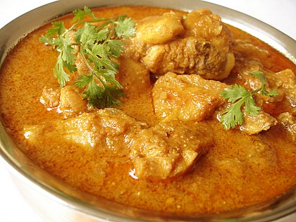
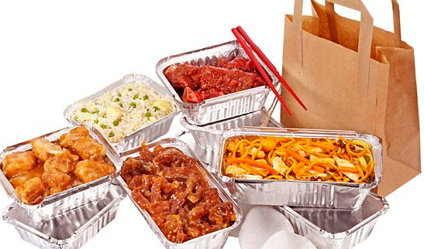
Food and drink – the ‘risers’
Twitter: @ClaireDembry | @lovermob

Slide 36

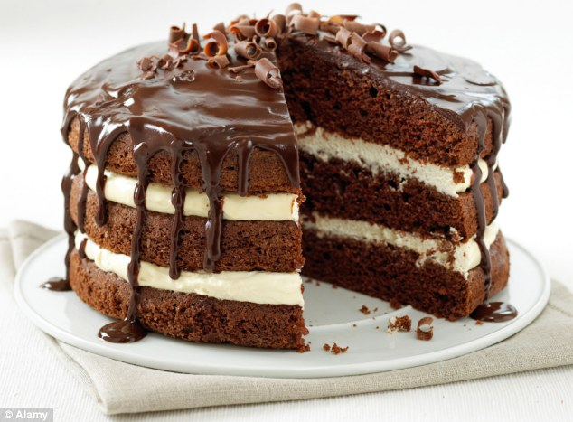


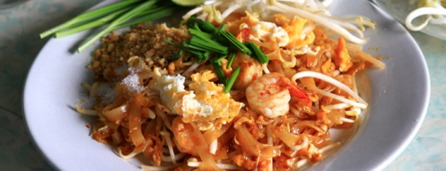


Food and drink
Twitter: @ClaireDembry | @lovermob

Slide 37




Love
1990s
2010s
Twitter: @ClaireDembry | @lovermob

Slide 38
Woman
old
young
stupid
pretty
big
naked
nice
silly
married
beautiful
old,
young,
other,
little,
many,
international,
different,
crazy,
fifty-year-old
gypsy
1990s
2010s
Twitter: @ClaireDembry | @lovermob

Slide 39
Family
family
family
1990s
2010s
Twitter: @ClaireDembry | @lovermob

Slide 40





Family
whole immediate
big
large
happy
nice
young
little
nuclear
small
business
piss-up
thing
day
event
trip
meal
wedding
friend
stuff
1990s
2010s
Twitter: @ClaireDembry | @lovermob

Slide 41

Help us with our research!
Have your say!
corpus@cambridge.org
=
£18 per hour
of good quality recording
Twitter: @ClaireDembry | @lovermob

Slide 42

Help us with our research!
Have your say!
What could £18 buy you?
Twitter: @ClaireDembry | @lovermob

Slide 43
Help us with our research!
Have your say!
Email us:
corpus@cambridge.org
Find out more:
www.cambridge.org/bnc
Twitter: @ClaireDembry | @lovermob

