Slide 1



Using corpora to explore the language challenges of the transition from primary to secondary school
Duygu Candarli, Robbie Love & Alice Deignan
School of Education
University of Leeds
d.candarli@leeds.ac.uk
r.love@leeds.ac.uk
a.h.deignan@education.leeds.ac.uk

Slide 2
Plan
1. The project
  Linguistic challenges of the transition
2. Background
  Academic school language
3. Project research questions and data
4. Case study
  Science and maths materials in KS2 & KS3
5. Conclusions

Slide 3
The project
Linguistic challenges of the transition

Slide 4
The project
Linguistic challenges of the transition from primary to secondary school
ESRC-funded, 2018-2021
University of Leeds
Alice Deignan (PI)
Gary Chambers (Co-I), Michael Inglis (Co-I)
Duygu Candarli (RF), Robbie Love (RA)
Lancaster University
Elena Semino (Co-I), Vaclav Brezina (Co-I)
Advisors/consultants
Marcus Jones (Huntington School), Constant Leung (KCL), Niall Curry (CUP)

Slide 5
Background: the project
Many students in England find the transition from primary to secondary school difficult
(Brooks, 2016; DfE, 2011; Evangelou et al., 2008; Howe & Richards, 2011)
- social reasons
- larger school
- change in friendship groups
- being among older students
- tougher academic demands
- tougher linguistic demands?

Slide 6
School language & the transition
Dip in attainment at start of Key Stage 3
Difference in language as a barrier to understanding the curriculum?
    [t]eaching environments […] and teachers’ language are very different in secondary schools from primary schools
(Braund & Driver, 2005: 78)
    Children are able to think but they can't articulate their thoughts because of the lack of language […] it is not the concepts they are finding difficult at Key Stage 3, it is the ability to access material given to them.
    Interview with history teacher

Slide 7
Academic school language
The language of school comprises numerous registers, not all of them academic
Our focus is on academic registers = ‘school language’ i.e. the instructional / regulative registers of academic learning
Comprises overlapping subject-specific registers (Christie, 2002; Christie & Derewianka, 2008)
    academic activities are associated with a kind of language that is different from that used in everyday activities
(Leung, 2014: 137)
Notes:
Slight changes.

Slide 8
Academic school language
Students’ writing has been extensively researched in the UK education contexts (e.g. Durrant & Brenchley, 2018; Nesi & Gardner, 2012)
We are interested in the language that students receive in academic contexts at school
What are they expected to understand and respond to in order to access the curriculum?
Notes:
Slight changes.

Slide 9

Project RQs
How does the academic language of KS3 differ from that of KS2?
How does the language of both KS2 and KS3 differ from everyday language?

Slide 10
Project data
Written corpora (Key Stage 2 and Key Stage 3)
Teacher-designed worksheets
Textbooks
Exams and assessment tasks
Lesson presentations
Vocabulary/glossary booklets
Web-based exercises
Spoken corpora (Key Stage 2 and Key Stage 3)
Audio recordings of lessons
Subjects: English, maths, sciences, history, geography

Slide 11
Case study
Science and maths materials in KS2 & KS3

Slide 12
CASE STUDY
Academic language of Key Stage 3
Comparing written KS3 data to written KS2 data
Lexical sophistication – TAALES 2.2 (Kyle et al., 2018)
  Maths
Keywords in KS3 corpus (with KS2 corpus as reference) and vice versa
  science and maths
RQ: how does academic language differ between KS3 and KS2?

Slide 13
CASE STUDY
Data
Key stage | Subject | Tokens | Types | Texts
2 | Science | 25,864 | 3,247 | 62
2 | Maths | 58,877 | 2,983 | 395
3 | Science | 137,595 | 7,040 | 341
3 | Maths | 124,952 | 5,355 | 549
 | Total | 347,288 | 11,428 | 1,347

Slide 14
CASE STUDY
Lexical sophistication
A multi-dimensional construct that is concerned with the relative difficulty of learning words and phrases
It is measured by 484 indices that are related to academic language, word and n-gram frequencies and their range derived from the BNC and COCA, and psycholinguistic word information (Kyle & Crossley, 2015; Kyle et al., 2018)
  Academic language: AWL (Coxhead, 2000)
  Word frequency: BNC written frequency logged transformed (BNC Consortium, 2007)
  Psycholinguistic word information: Age of exposure (Dascalu et al., 2016)

Slide 15
CASE STUDY
AWL (Maths)

Slide 16
CASE STUDY
AWL (Maths)
Examples
Create two equations in the spaces below.
Show, step by step, how you make your equations, by writing an operation next to each arrow.
(w00274 – Year 8 maths)
Write in figures: Ten million, six hundred and one thousand, one hundred and five.
Write in words: 3,120,000
(w00891 – Year 6 maths)

Slide 17
CASE STUDY
BNC_Written_Freq_Logged (Maths)

Slide 18
CASE STUDY
BNC_Written_Freq_Logged (Maths)
Examples
Describe the difference between a trapezium and a parallelogram.
(w00558 – Year 7 maths)
A and B are two numbers on the number line below.
The difference between A and B is 140.
(w00936 – Year 6 maths)

Slide 19
CASE STUDY
Lexical sophistication: Age of exposure

Slide 20
CASE STUDY
Lexical sophistication: Age of exposure
Examples:
Factors and multiples
List the factors of 20.
(w00284 – Year 7 maths)
Four friends share a pizza.
Whitney eats 35% of the pizza.
Teddy eats 0.4 of the pizza.
Dora eats 12.5% of the pizza.
Alex eats 0.125 of the pizza.
Is there any pizza left? (w01034 – Year 6 maths)

Slide 21
CASE STUDY
Keywords
Keyword analysis in AntConc (Anthony, 2018)
Ranked by effect (Dice coefficient) and filtered by significance (p<0.05)
KS2 science (target) against KS3 science (reference)
KS3 science (target) against KS2 science (reference)
KS2 maths (target) against KS3 maths (reference)
KS3 maths (target) against KS2 maths (reference)

Slide 22
CASE STUDY
Findings: KS2 science keywords
and, that, it, I, living, can, was, evolution, from, as, were, animals, things, have, they, had, not, all, would, Darwin
coordinating conjunction and
pronoun I + was = 1st person accounts of philosophers
pronoun I + can = learning objectives written in 1st person
noun phrase living + things
KS2

Slide 23
CASE STUDY
Findings: KS3 science keywords
the, a, is, you, are, on, what, your, energy, an, water, will, force, do, mass, N, up, use, chemical, m
determiners the, a, what, your, an = variety of more complex NPs
new scientific terminology energy, force, mass, chemical
2nd person pronoun you = imperatives, instructions, learning objectives
N = Newton (unit), m = metres, also M (molar concentration)
modal verb will = learning objectives, predicting outcome of experiments
KS3

Slide 24
CASE STUDY
Findings: KS2 maths keywords
to, how, number, o, has, many, numbers, have, use, one, fractions, than, I, does, he, she, do, much, answer, these
number, numbers, fractions
how = How many…? How much…? (also How long…? How old?)
do = What do you think…? How do you know…?
personal pronouns I, he, she = problems based on people
has/have = declaratives (e.g. Emma has a plank of wood)
KS2

Slide 25
CASE STUDY
Findings: KS3 maths keywords
a, x, b, for, I, c, cm, be, s, angles, d, y, m, if, question, p, will, g, e, probability
a, x, b, i, c, s, d, y, m, p, g, e = algebraic equations / labelling devices
pronoun I = some objectives / questions
be = objectives expressed as infinitive (e.g. To be fluent in…)
if = conditional (if this is x, then what is y?)
KS3

Slide 26
CASE STUDY
Keywords: summary
From personal to impersonal
Key Stage 2
  More personal/involved
  Problems clearly related to simple, real-world scenarios
  More familiar, everyday lexis
  Simpler grammar?
Key Stage 3
  Less personal/involved – more ‘clinical’
  Tasks detached from the real-world (e.g. algebra)
  More scientific notation
  Variation in how learning objectives are expressed

Slide 27
Conclusions
Linguistic challenges of the transition

Slide 28
Discussion
Does the transition from KS2 and KS3 present language barriers which prevent students from accessing the curriculum?
We believe that the transition to secondary school seems to involve a step change in academic language, which is likely to be especially difficult for children from lower SES backgrounds
Corpus methods allow us to examine this in order to inform the design of more accessible curricula for all students

Slide 29
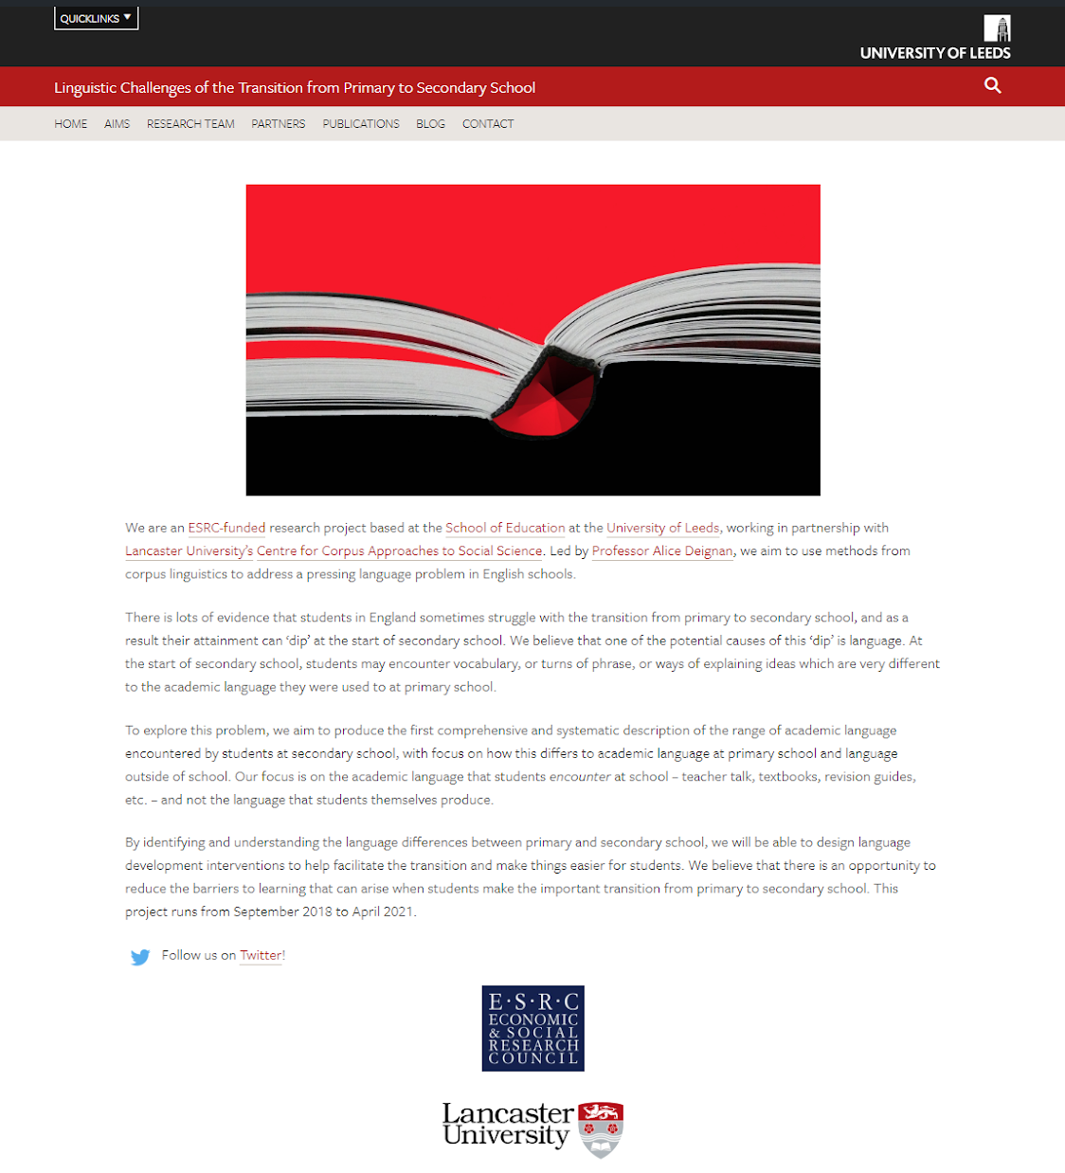
Thank you
https://linguistictransition.leeds.ac.uk/
@LeedsTransition
d.candarli@leeds.ac.uk
@duygucandarli
r.love@leeds.ac.uk
@lovermob
a.h.deignan@education.leeds.ac.uk
@alicedeignan

Slide 30
References
    ﻿Anthony, L. (2018). AntConc (Version 3.5. 7) [Computer Software], Waseda University, Tokyo, Japan.
    BNC Consortium. (2007). The British National Corpus, version 3. BNC Consortium. Retrieved from www.natcorp.ox.ac.uk
    Braund, M. & Driver, M. (2005). Pupils' perceptions of practical science in primary and secondary school: implications for improving progression and continuity of learning. Educational Research, 47, 77-91.
    Brooks, G. (2016). What works for children and young people with literacy difficulties? The effectiveness of intervention schemes. The Dyslexia/ SpLD Trust.
    Christie, F. (2002). Classroom discourse analysis: A functional perspective. London: Continuum.
    Christie, F. & Derewianka, B. (2008). School discourse: Learning to write across the school years. London: Continuum.
    Coxhead, A. (2000). A new academic word list. TESOL Quarterly, 34, 213–238.
    ﻿Dascalu, M., McNamara, D. S., Crossley, S., & Trausan-Matu, S. (2016). Age of exposure: A model of word learning. Paper presented at the Thirtieth AAAI Conference on Artificial Intelligence, Phoenix, AZ.
    Department for Education. (2011). How do pupils progress between Key Stages 3 and Research Report.
    ﻿Evangelou, M., Taggart, B., Sylva, K., Melhuish, E., & Sammons, P. (2008). Effective Pre-school, Primary and Secondary Education 3-14 Project (EPPSE 3-14). What Makes a Successful Transition from Primary to Secondary School? Nottingham: Department for Children, Schools and Families Publications.
    Durrant, P., & Brenchley, M. (2018). Development of vocabulary sophistication across genres in English children’s writing. Reading and Writing.
    Howe, A., & Richards, V. (2011). Bridging the transition from primary to secondary school. Abingdon: Routledge.
    ﻿Kyle, K., & Crossley, S. A. (2015). Automatically assessing lexical so- phistication: Indices, tools, findings, and application. TESOL Quarterly, 49, 757–786.
    Kyle, K., Crossley, S. A., & Berger, C. (2018). The tool for the analysis of lexical sophistication (TAALES): Version 2.0. Behavior Research Methods, 50, 1030-1046.
    Leung, C. (2014). Researching language and communication in schooling. Linguistics in Education, 26, 136-144.
    Nesi, H., & Gardner, S. (2012). Genres across the disciplines: Student writing in higher education. Cambridge: Cambridge University Press.

