Slide 1


Investigating language: life after Astley…
Robbie Love
ESRC Centre for Corpus Approaches to Social Science (CASS)
Lancaster University, UK
https://lancaster.academia.edu/RobbieLove
lovermob r.m.love@lancaster.ac.uk

Slide 2
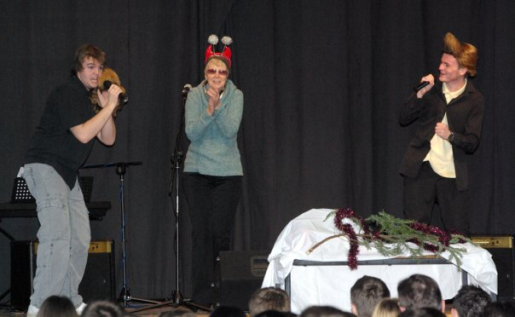
About me
Astley student, 2005-2010
A levels: English Language, English Literature, Maths and Chemistry (AS)
Lancaster University, BA Linguistics (2010-13)
MA Linguistics (2013-14)
PhD Corpus Linguistics
(2014-17)
lovermob r.m.love@lancaster.ac.uk

Slide 3
Investigating language
at university
Literacy in the workplace
Comparison of Japanese, Punjabi and Lango
Politeness in a TV interview
English pronunciation
Geordie grammar
Institutional language
Classroom interaction
Early Middle English
Synonyms…or are they?
How we structure meaning in our heads
Lie detection
Parliamentary language
Word construction
lovermob r.m.love@lancaster.ac.uk

Slide 4
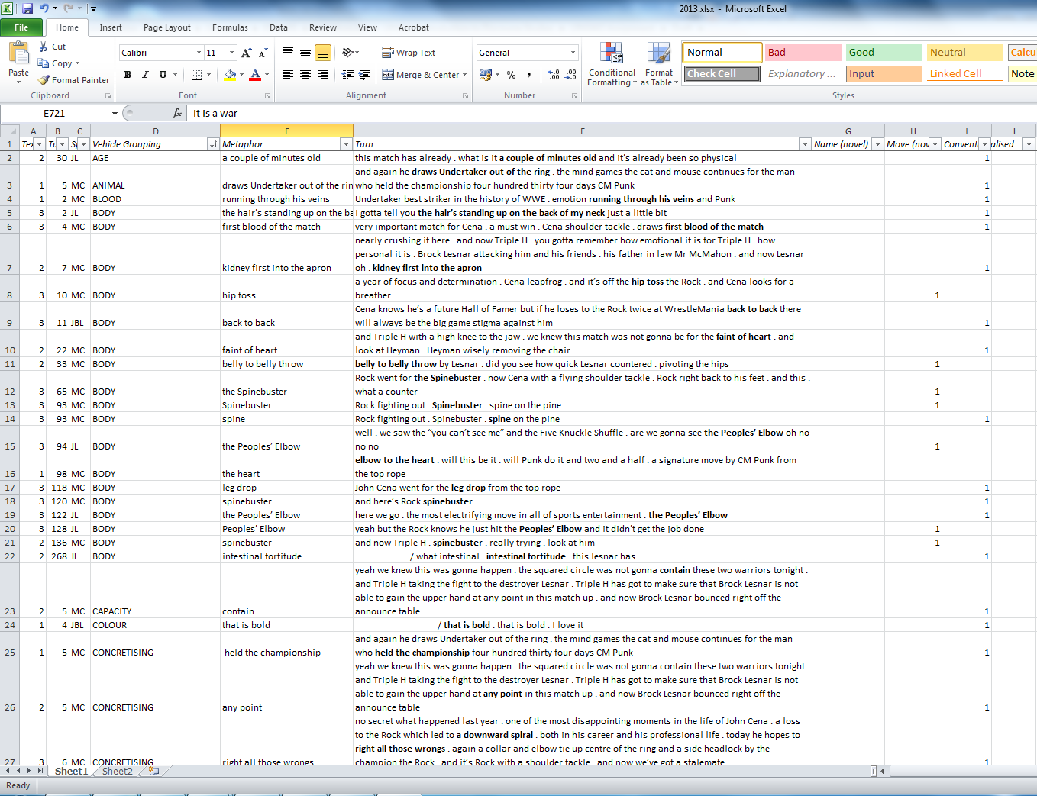
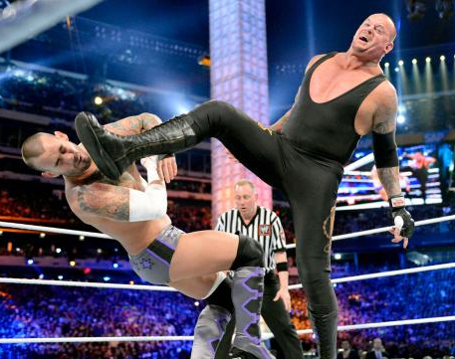
Small scale investigation
Metaphor in professional wrestling commentary
9,000 word transcript of 3 matches
Manual analysis…took days!
lovermob r.m.love@lancaster.ac.uk

Slide 5
Small scale investigation
lovermob r.m.love@lancaster.ac.uk

Slide 6
Small scale investigation
Metaphor is a huge part of how we talk/think
Creating vivid images of physical movements
Exaggerating aspects of characters
Creation of (fictional) suspense
WRESTLERS ARE NOT HUMANS
WRESTLERS ARE CONTAINERS
WRESTLING IS WAR
lovermob r.m.love@lancaster.ac.uk

Slide 7
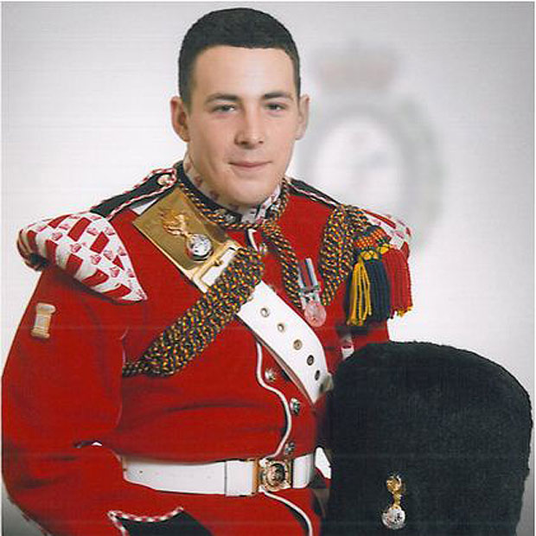
Large scale investigation
UK press
Representation of Muslim people and Islam
After the Woolwich attack
3,632 articles
2.5 MILLION words!!!
(7,000 pages of A4…)
Corpus linguistics
lovermob r.m.love@lancaster.ac.uk

Slide 8
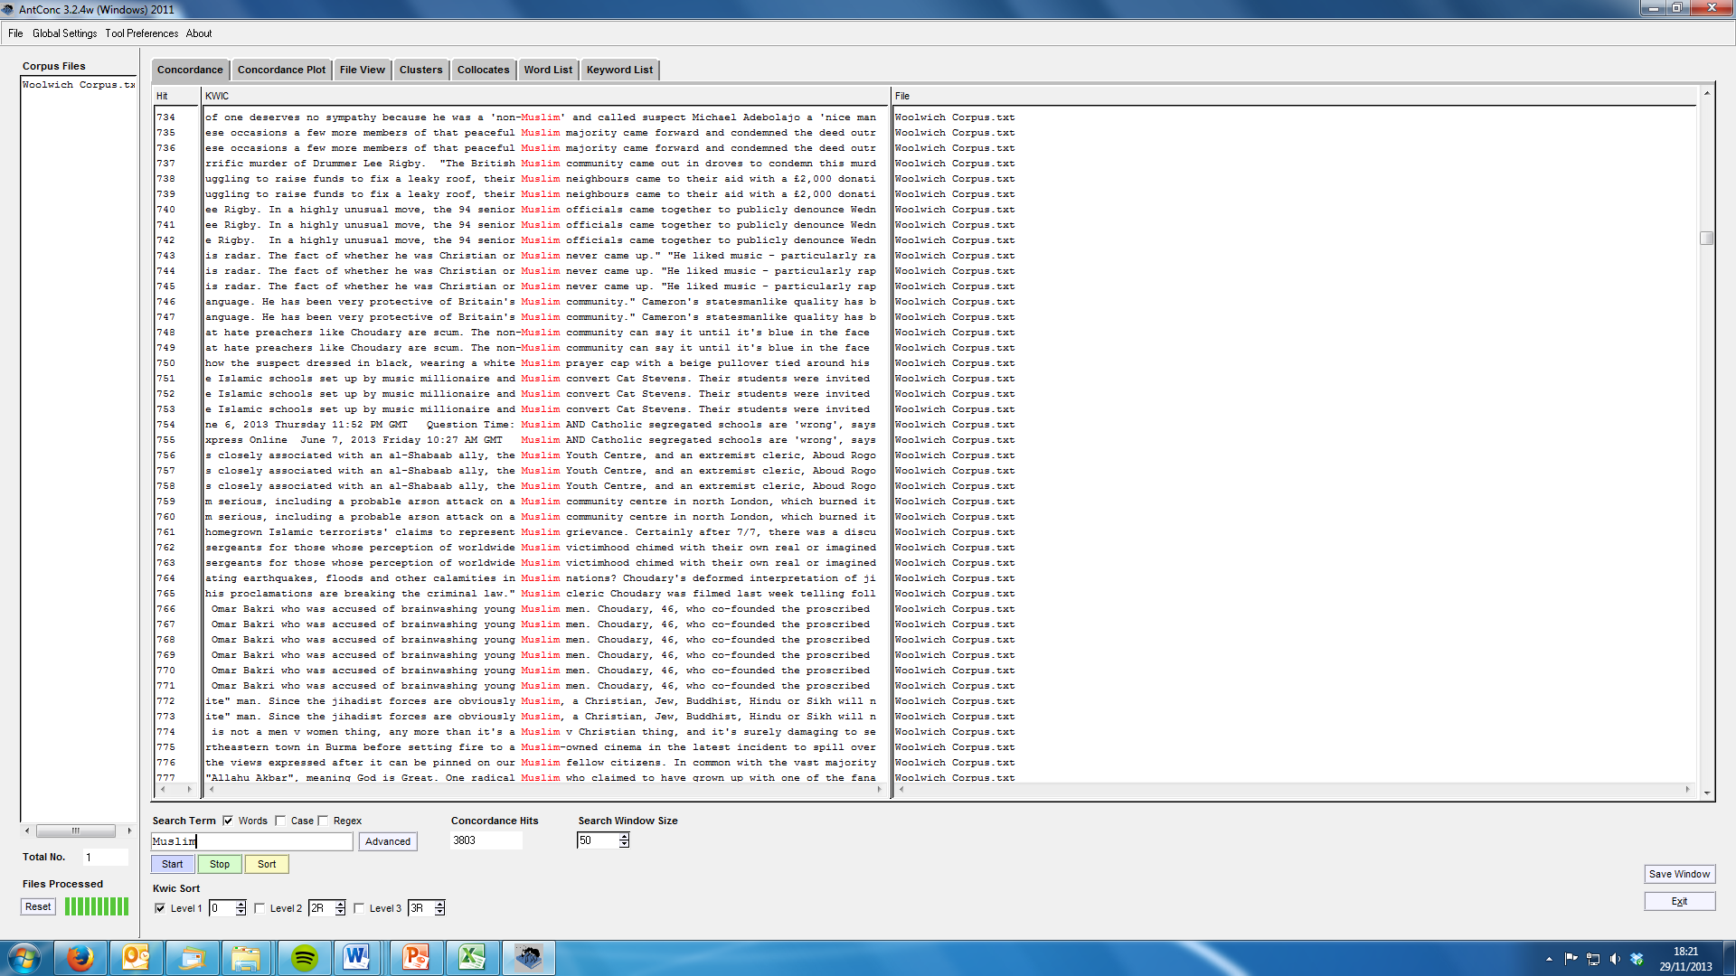
Large scale investigation
lovermob r.m.love@lancaster.ac.uk

Slide 9
Large scale investigation
Press mostly responsible
Murder = not representative of Muslim people
Islamophobia condemned
‘Muslims’ and ‘non-Muslims’ different
Underlying distrust of potential terrorists
Example of widespread mis-reporting…
lovermob r.m.love@lancaster.ac.uk

Slide 10
Spot the difference
"The only reason we have killed this man today…
Quote A:
…is because Muslims are dying daily by British soldiers"
Quote B:
…is because Muslims are dying every day”
lovermob r.m.love@lancaster.ac.uk

Slide 11
Spot the difference
"The only reason we have killed this man today…
Quote A:
…is because Muslims are dying daily by British soldiers” CORRECT QUOTE = 45%
Quote B:
…is because Muslims are dying every day”
INCORRECT QUOTE = 40%
lovermob r.m.love@lancaster.ac.uk

Slide 12
Let’s chat
Ask me anything!
lovermob r.m.love@lancaster.ac.uk

