Slide 1




The linguistic challenges of the transition from primary to secondary school:
challenges in corpus design
Dr Duygu Candarli, Dr Robbie Love & Professor Alice Deignan
School of Education
University of Leeds
d.candarli@leeds.ac.uk @duygucandarli
r.love@leeds.ac.uk @lovermob
a.h.deignan@education.leeds.ac.uk @alicedeignan

Slide 2
Plan
England’s school system
Background to the project
Research questions
Challenges in corpus design and data collection
Discussion

Slide 3
Background: English state schools
Key Stage Year Age
Early years Nursery 3-4
Reception 4-5
Key Stage 1 Years 1 & 2 5-7
Key Stage 2 Years 3-6 7-11
Key Stage 3 Years 7-9 11-14
Key Stage 4 Years 10 & 11 14-16
Key Stage 5 Years 12 & 13 16-18
Primary school
Secondary school

Slide 4
Background: the project
Many students in England find the transition from primary to secondary school difficult (DfE 2011; Howe & Richards 2011; Evangelou et al. 2008; Brooks 2016)
- social reasons
- larger school
- change in friendship groups
- being the youngest again
- tougher academic demands
- tougher linguistic demands?

Slide 5
Academic school language
The language of school comprises numerous registers, not all of them academic
Our focus is on academic registers = ‘school language’ i.e. the instructional / regulative registers of academic learning
Comprises overlapping subject-specific registers (Christie 2002; Christie & Derewianka 2008)
    academic activities are associated with a kind of language that is different from that used in everyday activities
(Leung 2014: 137)
Notes:
Slight changes.

Slide 6
Academic school language
Students’ writing has been extensively researched in the UK education contexts (e.g. Durrant & Brenchley 2018; Nesi & Gardner 2012)
We are interested in the language that students receive in academic contexts at school
What are they expected to understand and respond to in order to access the curriculum?
Notes:
Slight changes.

Slide 7
School language & the transition
Dip in attainment at start of Key Stage 3
Difference in language as a barrier to understanding the curriculum?
    [t]eaching environments […] and teachers’ language are very different in secondary schools from primary schools
(Braund & Driver 2005: 78)
    Children are able to think but they can't articulate their thoughts because of the lack of language […] it is not the concepts they are finding difficult at Key Stage 3, it is the ability to access material given to them.
    Interview with history teacher

Slide 8
What might be unfamiliar at KS3?
A few ideas…
academic and semi-technical words
multiword verbs
grammatical metaphor
tendency to compress information into complex noun groups
use of passive voice
subordination and other complex embedding
unfamiliar discourse structures in both speaking and writing
Notes:
Add more.

Slide 9
Research questions
RQ1: What are the linguistic characteristics of texts that students are required to understand and respond to at Key Stage 2, in terms of lexis, grammar and discourse?
RQ2: What are the linguistic characteristics of texts that students are required to understand and respond to at Key Stage 3, in terms of lexis, grammar and discourse?
RQ3: How does the language of Key Stage 3 vary according to subject area?
RQ4: How does the language of Key Stage 3 differ from the language students have previously encountered, at the levels of lexis, grammar and discourse?
RQ5: How do teachers and students perceive the linguistic challenges of the transition from primary to secondary school?

Slide 10
The project
Linguistic challenges of the transition from primary to secondary school
ESRC-funded, 2018-2021
University of Leeds
Alice Deignan (PI)
Gary Chambers (Co-I), Michael Inglis (Co-I)
Duygu Candarli (RF), Robbie Love (RA)
Lancaster University
Elena Semino (Co-I), Vaclav Brezina (Co-I)
Advisors/consultants
Niall Curry (CUP), Marcus Jones (Huntington School), Constant Leung (KCL)

Slide 11
Project plans
the first comprehensive and systematic description of the academic registers of secondary school
with focus on how they differ from primary school and non-specialist language outside the school
engaging with a range of schools in England
building corpora of spoken and written academic language that students encounter at end of KS2 and start of KS3
corpus analysis to compare to each other, & across subjects, & to reference corpora of British English, including the BNC2014
plus, interviews with students / teachers about their views on the transition

Slide 12
Challenges in design and
data collection

Slide 13
School recruitment
So far…11 schools
Yorkshire
3 secondary schools, 4 primary schools
Newcastle
1 secondary school, 3 primary schools
Things at schools change far quicker than in the academy...

Slide 14
Corpus design - background
Interviews with school teachers
Curriculum (timetable and distribution of lesson time)
Literature review
Representativeness - what are we trying to sample?

Slide 15
Corpus design
Written corpora (Key Stage 2 and Key Stage 3)
Teacher-designed worksheets
Textbooks
Exams, rubrics
PowerPoint presentations
Vocabulary/glossary booklets
Web-based exercises (maths)
Spoken corpora (Key Stage 2 and Key Stage 3)
Audio recordings of lessons
Subjects: English, maths, sciences, history, geography

Slide 16
Representativeness
Science lessons in secondary schools
Textbooks 20% - sampling the textbooks
Worksheets 60%
Marking rubrics 20%
English lessons in secondary schools
Fiction – Of Mice and Men, Private Peaceful

Slide 17
Representativeness
Text length
Size of the corpus – Key Stage 2 and Key Stage 3
Short texts (< 100 words at Key Stage 2)
Written vs spoken
Other variables that we cannot control

Slide 18
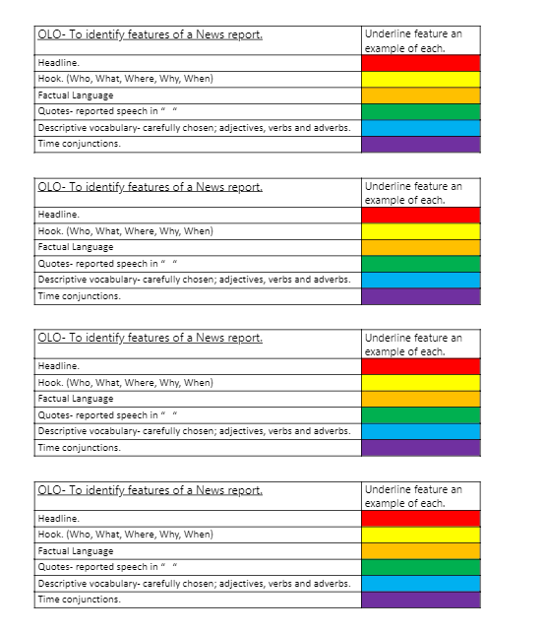
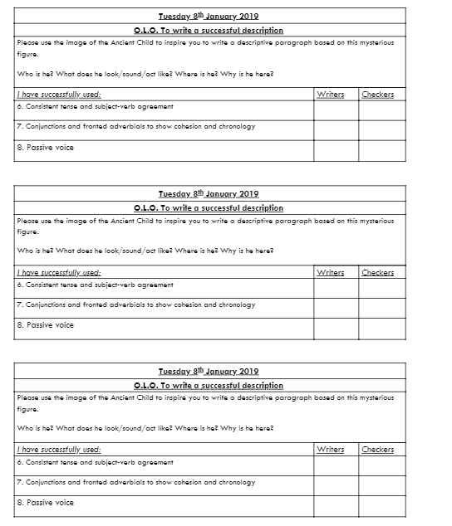
Example texts
Year 5 (156 words) Year 6 (355 words)

Slide 19
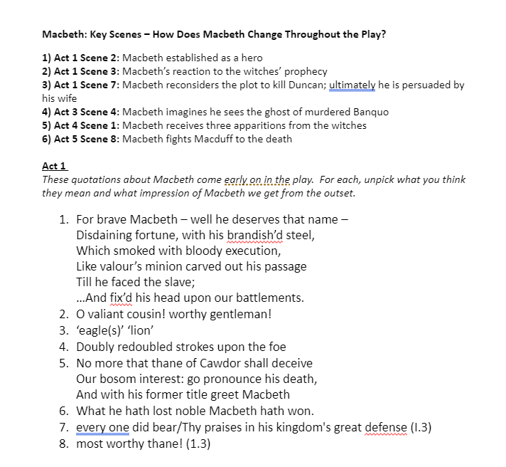

Example texts
Year 7 ( > 3000 words)

Slide 20
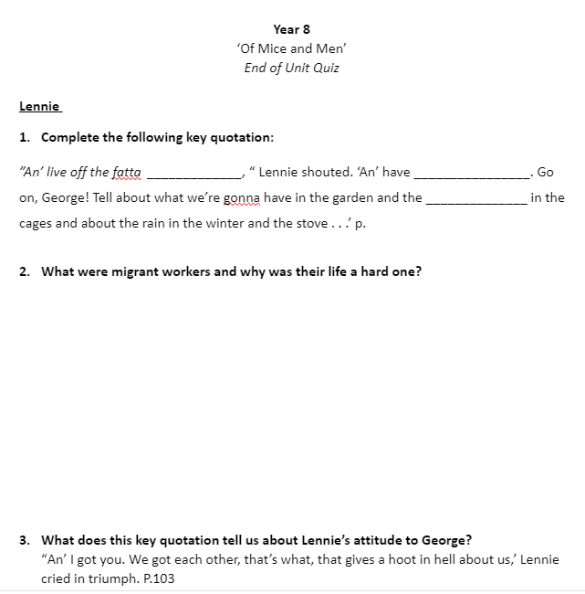

Example texts
Year 8 ( > 1000 words)

Slide 21
Early findings - 1
The keywords in Maths written sub-corpus at Key Stage 3 in comparison to Key Stage 2
Single-words | Keyness | Effect size
mean | +71.96 | 0.01
data | +67.8 | 0.01
median | +56.02 | 0.009
mode | +52.56 | 0.008
pie | +43.55 | 0.007
factors | +39.4 | 0.006
range | +34.56 | 0.005
multiple | +31.79 | 0.005
prime | +29.02 | 0.005
average | +28.33 | 0.004

Slide 22
Keywords at Key Stage 3
Data
Each group has a statement, a set of data and one extra
piece of data to make the statement true. (KS3_M8_3)
Match these types of data to their meanings.
Primary data
Secondary data…. (KS3_M8_8)

Slide 23
Early findings - 2
The key multi-words in Maths written sub-corpus at Key Stage 3 in comparison to Key Stage 2
Multi-words | Score
pie chart | +1299.83
prime number | +547.88
bar chart | +513.7
same time | +342.8
total number | +308.62
ascending order | +240.26
perfect number | +171.9
square root | +171.9
frequency table | +171.9
high degree | +137.72

Slide 24
Keywords at Key Stage 3
The same time
Challenge! Two Formula 1 cars race around a track. The first car take 54 seconds to complete a lap. The second car is slower and takes 63 seconds. After how many seconds will they be at the starting place at exactly the same time? (KS3_M7_12)
A green light flashes every 8 seconds, a red light flashes every 15 seconds. After how many seconds will they both flash at the same time? (KS3_M7_9)

Slide 25
Discussion
Does the transition from KS2 and KS3 present language barriers which prevent students from accessing the curriculum?
We believe that the transition to secondary school seems to involve a step change in academic language, which is likely to be especially difficult for children from lower SES backgrounds
We aim to investigate this in order to inform the design of more accessible curricula for all students

Slide 26
Discussion – design and data collection
Representativeness, representativeness, representativeness...
  Designing a sampling frame is much more complicated than we first expected
Responsiveness to changes at schools
  Schools are very keen, but we have learned to expect the unexpected
Communication & avoiding intrusion

Slide 27
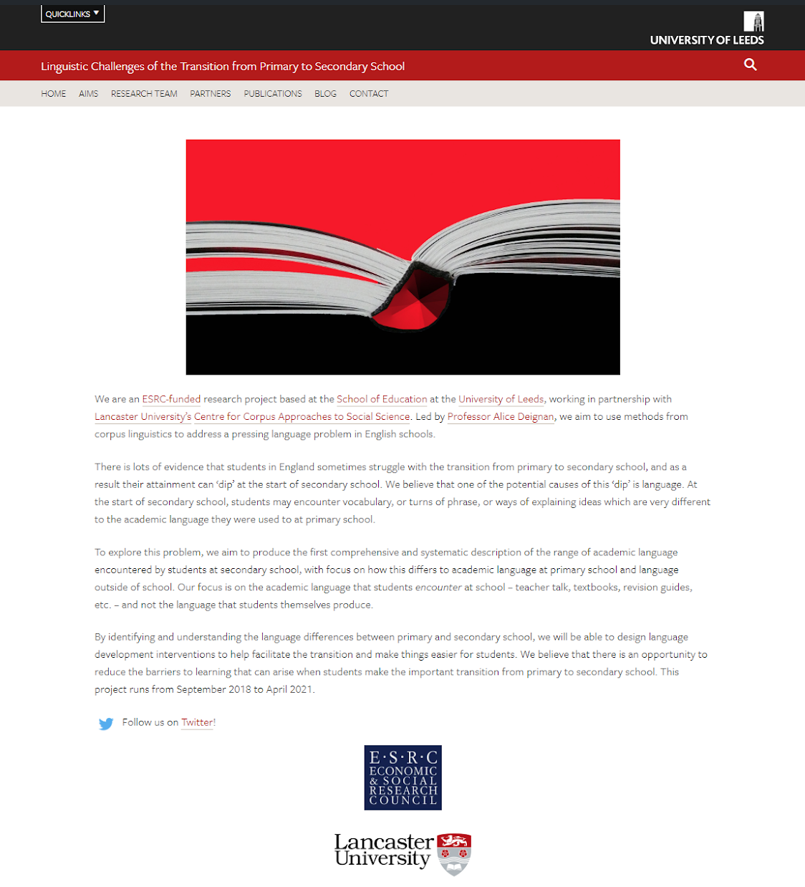
Thank you
https://linguistictransition.leeds.ac.uk/
@LeedsTransition
d.candarli@leeds.ac.uk
@duygucandarli
r.love@leeds.ac.uk
@lovermob

Slide 28
References
Braund, M. & Driver, M. (2005). Pupils' perceptions of practical science in primary and secondary school: implications for improving progression and continuity of learning. Educational Research, 47, 77-91
Christie, F. (2002). Classroom discourse analysis: A functional perspective. London: Continuum.
Christie, F. & Derewianka, B. (2008). School discourse: Learning to write across the school years. London: Continuum.
Coxhead, A. (2000). A new academic word list. TESOL Quarterly, 34, 213–238.
Cummins, J. (1980). The cross-lingual dimensions of language proficiency: implications for bilingual education and the optimal age issue. TESOL Quarterly, 14(2), 175-187.
Cummins, J. (2008). BICS and CALP: Empirical and theoretical status of the distinction. In Street, B. & Hornberger, N. H. (Eds.). (2008). Encyclopedia of Language and Education, 2nd Edition, Volume 2: Literacy. (pp. 71-83). New York: Springer Science & Business Media LLC.
Cummins, J. (2014). Beyond Language: Academic communication and student success. Linguistics and Education, 26, 145-154
Deignan, A., Semino, E., & Paul, S. (2017). Metaphors of climate science in three genres : research articles, educational texts, and secondary school student talk. Applied Linguistics, 1–26.
Department for Education. (2011). How do pupils progress between Key Stages 3 and Research Report.
Durrant, P., & Brenchley, M. (2018). Development of vocabulary sophistication across genres in English children’s writing. Reading and Writing.
Howe, A., & Richards, V. (2011). Bridging the transition from primary to secondary school. Abingdon: Routledge.
Kyle, K., Crossley, S. A., & Berger, C. (2018). The tool for the analysis of lexical sophistication (TAALES): Version 2.0. Behavior Research Methods, 50, 1030-1046.
Leung, C. (2014). Researching language and communication in schooling. Linguistics in Education, 26, 136-144.
Love, R., Dembry, C., Hardie, A., Brezina, V., & McEnery, T. (2017). The Spoken BNC2014: designing and building a spoken corpus of everyday conversations. In International Journal of Corpus Linguistics, 22(3), 319-344.
Nesi, H., & Gardner, S. (2012). Genres across the disciplines: Student writing in higher education. Cambridge: Cambridge University Press.
Simpson–Vlach, R., & Ellis, N. C. (2010). An academic formulas list: New methods in phraseology research. Applied Linguistics, 31, 487–512.

