Slide 1



The linguistic challenges of the transition from primary to secondary school
Using the BNC2014 in applied linguistics research
Dr Robbie Love & Professor Alice Deignan
School of Education
University of Leeds
r.love@leeds.ac.uk @lovermob
A.H.Deignan@education.leeds.ac.uk @alicedeignan

Slide 2
Plan
UK school system
Background to the project
Research questions
Case study: school textbooks vs. the Spoken BNC2014
Conclusions

Slide 3
Background: English state schools
Key Stage Year Age
Early years Nursery 3-4
Reception 4-5
Key Stage 1 Years 1 & 2 5-7
Key Stage 2 Years 3-6 7-11
Key Stage 3 Years 7-9 11-14
Key Stage 4 Years 10 & 11 14-16
Key Stage 5 Years 12 & 13 16-18
Primary school
Secondary school

Slide 4
Background: the project
Many students in England find the transition from primary to secondary school difficult (DfE 2011; Howe & Richards 2011; Evangelou et al. 2008; Brooks 2016)
- social reasons
- larger school
- change in friendship groups
- being the youngest again
- tougher academic demands
- tougher linguistic demands

Slide 5
Academic school language
The language of school comprises numerous registers, not all of them academic
Our focus is on academic registers = ‘school language’
The instructional / regulative registers of academic learning
    academic activities are associated with a kind of language that is different from that used in everyday activities
(Leung 2014: 137)

Slide 6
School language & the transition
Dip in attainment at start of Key Stage 3
Difference in language as a barrier to understanding the curriculum?
    [t]eaching environments […] and teachers’ language are very different in secondary schools from primary schools
(Braund & Driver 2005: 78)
    Children are able to think but they can't articulate their thoughts because of the lack of language […] it is not the concepts they are finding difficult at Key Stage 3, it is the ability to access material given to them.
    Interview with history teacher

Slide 7
What might be unfamiliar at KS3?
academic and semi-technical words
multiword verbs
grammatical metaphor
tendency to compress information into complex noun groups
use of passive voice
subordination and other complex embedding
unfamiliar discourse structures in both speaking and writing

Slide 8
Research questions
RQ1: What are the linguistic characteristics of texts that students are required to understand and respond to at Key Stage 2, in terms of lexis, grammar and discourse?
RQ2: What are the linguistic characteristics of texts that students are required to understand and respond to at Key Stage 3, in terms of lexis, grammar and discourse?
RQ3: How does the language of Key Stage 3 vary according to subject area?
RQ4: How does the language of Key Stage 3 differ from the language students have previously encountered, at the levels of lexis, grammar and discourse?
RQ5: How do teachers and students perceive the linguistic challenges of the transition from primary to secondary school?

Slide 9
Project plans
the first comprehensive and systematic description of the academic registers of secondary school
with focus on how they differ from primary school and non-specialist language outside the school
Engaging with a range of schools in England
Building corpora of spoken and written academic language that students encounter at end of KS2 and start of KS3
Corpus analysis to compare to each other, & across subjects, & to reference corpora of British English, including the BNC2014
Plus, interviews with students / teachers about their views on the transition

Slide 10
Case study
Science words compared to previously encountered meanings/uses
Based on previous project with a focus on science (Deignan et al. 2017)
Meanings that students might ‘bring with them’ to the KS3 classroom
Question: are scientific uses of everyday words in KS3 different/unfamiliar for KS3 students?

Slide 11
The Spoken BNC2014 as a reference corpus
The Spoken BNC2014 as a reference corpus of general spoken English
= a proxy for meanings of ‘known’ words in British English public
What is and isn’t the Spoken BNC2014?
Comparing writing to speech…
…although this is not discourse/register analysis

Slide 12


Case study
Key Stage 3 science textbooks and websites, text samples on the topic of climate change
26,853 tokens
188,282 tokens

Slide 13
Case study
Three words:
impact impact(s), impacted, impacting
response response(s)
adapt adapt(s), adapted, adapting, adaptation(s), adaptable, adaptability, adaption(s), adaptive
Identified through interviews with Key Stage 3 students (Deignan et al. 2017)
Climate change corpora uploaded to Sketch Engine
Analysis of collocates in (a) textbooks and websites corpora and (b) the Spoken BNC2014
(Textbooks data often too small to reveal collocates)
Collocates ranked according to Mutual Information

Slide 14
IMPACT
Student websites |  |  |  | Spoken BNC2014
rank | collocate | co-occurrence | MI | rank | collocate | co-occurrence | MI
1 | potsdam | 3 | 8.913 | 1 | huge | 6 | 5.501
2 | unavoidable | 3 | 8.65 | 2 | massive | 5 | 4.768
3 | irreversible | 4 | 8.328 | 3 | an | 26 | 3.717
4 | climate-related | 3 | 7.913 | 4 | has | 15 | 3.468
5 | having | 12 | 7.62 | 5 | our | 7 | 3.186
6 | worst | 7 | 7.457 | 6 | on | 46 | 2.56
7- | forecast | 4 | 7.328 | 7 | make | 6 | 2.519
7- | direct | 4 | 7.257 | 8 | their | 5 | 2.219
9- | immediate | 3 | 6.913 | 9 | more | 7 | 1.927
9- | poorer | 3 | 6.913 | 10 | people | 9 | 1.781

Slide 15
IMPACT: science corpus
Use of impact is negative, describing climate change as irreversible and gradual, and caused by human activity
Getting a global climate deal Climate change is a global problem - that's why we need international agreement on how to reduce greenhouse gas emissions, conserve forests and help poorer countries adapt to the impacts of a changing climate. (WWF)
The Intergovernmental Panel on Climate Change warned in November of "severe, widespread, and irreversible impacts " from global warming. (Guardian)
Typhoons and other disasters with immediate high impact hit the headlines, but slow, incipient, creeping change can be just as harmful. (FOE)
The impact that humans are having on our planet is always in the news. (GCSE Higher Science, OCR)

Slide 16
IMPACT: Spoken BNC2014
Impacts are immediate and observable, and humans are recipients of impact, rather than the cause
it's had a huge im- a huge impact on people die of heart attacks and cancer (BNC2014 SKL3)
I think it has uh a huge u- impact on people 's daily lives (BNC2014 SF2F)
if I have a child I could make a strong impact on one person if I follow academia I could have a strong impact on thousands of people (BNC2014 SJB4)

Slide 17
Interpretation
Student expectations…?
climate change to have immediate and observable effects on humans
global warming is a sudden and noticeable rise in temperature rather than a gradual process which will take place over many centuries
they may also struggle with the fact that humans are, at least in part, responsible for climate change, since impact is usually associated with events which affect humans rather than events which are caused by them

Slide 18
RESPONSE
Student websites |  |  |  | Spoken BNC2014
rank | collocate | co-occurrence | MI | rank | collocate | co-occurrence | MI
1 | policy | 3 | 8.054 | 1 | response | 8 | 9.04
2 | earth's | 3 | 6.541 | 2 | positive | 5 | 7.65
3 | temperatures | 3 | 5.771 | 3 | better | 5 | 3.073
4 | an | 3 | 5.054 | 4 | kind | 9 | 2.628
5 | climate | 10 | 4.663 | 5 | his | 9 | 2.298
6 | change | 7 | 4.640 | 6 | probably | 5 | 1.825
7 | to | 21 | 4.597 | 7 | get | 17 | 1.751
8 | from | 3 | 4.2 | 8 | from | 7 | 1.549
9 | as | 4 | 4.076 | 9 | back | 5 | 1.341
10 | that | 7 | 4.046 | 10 | people | 7 | 1.322

Slide 19
RESPONSE: science corpus
Use of response is mostly metaphorical, with mostly non-human agency
[T]emperatures warm in response to increasing amounts of greenhouse gases in the air (climatecentral.org)
the Earth's temperature is rising in response to emissions of greenhouse gases from the burning of oil, coal and gas (geographical.co.uk)
Shaped by orbital variations, responses such as the rise and fall of continental ice sheets and significant sea-level changes helped create the climate. (Wikipedia)

Slide 20
RESPONSE: Spoken BNC2014
Use of response is mostly literal, with human agency
he says it's quite (.) easy (.) to see whether people are (.) er in their response he says it's quite easy to see whether people are bringing stuff through or not (BNC2014 SKRC)
erm well I I was ah relatively positive with my response (BNC2014 S59R)
there was no response on Facebook (BNC2014 S23A)
I bet you any money at all if you emailed the suppliers direct you'd get a you'd get a better response and a quicker response (BNC2014 SUGJ)

Slide 21
Interpretation
Student expectations…?
misinterpret the metaphorical use of response in their learning materials as literal
that global temperatures may increase in response to increasing amounts of greenhouse gases in the atmosphere could, if taken literally, suggest that such temperature increases are sudden and noticeable, rather than gradual and hard to notice day by day

Slide 22
ADAPT
Student websites |  |  |  | Spoken BNC2014
rank | collocate | co-occurrence | MI | rank | collocate | co-occurrence | MI
1 | capacity | 3 | 8.382 | 1 | different | 5 | 2.95
2 | quickly | 5 | 8.303 | 2 | to | 56 | 1.538
3- | wildlife | 3 | 7.634 | 3 | ca (n’t) | 5 | 1.448
3- | able | 3 | 7.634 | 4 | from | 5 | 1.402
3- | help | 12 | 7.634 | 5 | now | 5 | 1.255
6 | farmers | 3 | 7.6 | 6 | could | 5 | 1.223
7 | changing | 8 | 7.571 | 7 | how | 5 | 1.168
8 | systems | 3 | 7.471 | 8 | because | 5 | 1.061
9 | ca (n’t) | 3 | 7.298 | 9 | them | 6 | 1.028
10 | communities | 3 | 7.026 | 10 | my | 8 | 1.003

Slide 23
ADAPT: science corpus
Humans making immediate lifestyle changes (to prepare for climate change)
As a result there will be huge pressure to adapt to a changing climate, and policies which address that should be given much more urgent attention, they said. (Daily Mail)
Rapid action to tackle global emissions and help communities adapt is crucial to reduce the threats of ill-health, hunger and additional hardship. (Guardian)
Evolutionary adaptation
ECOSYSTEMS Many ecosystems are likely to be challenged beyond their capacity to adapt over the course of the century. (BBC News)
climate change is happening too quickly for many species to adapt . (WWF)

Slide 24
ADAPT: Spoken BNC2014
Solely the non-evolutionary sense of adapt
I think I tend to adapt to the people around me (BNC2014 SMEB)
from one year to the next year you have to adapt it for the children (BNC2014 STJD)
I can adapt to a variety of different people to teach them stuff (BNC2014 S63L)

Slide 25
Interpretation
Student expectations…?
Missing the distinction between senses of adapt in the science materials
Missing that the scientific meaning of adapt does not refer to an immediate change but rather a gradual process which takes thousands or millions of years

Slide 26
Discussion
Do students encounter new subject-specific/academic uses of words at KS3 such as impact, response and adapt and, using their existing knowledge of these words in everyday life, assume that such processes are sudden and immediately observable?
More broadly…
Does the transition from KS2 and KS3 present language barriers which prevent students from accessing the curriculum?
We believe that the transition to secondary school seems to involve a step change in academic language, which is likely to be especially difficult for children from lower SES backgrounds
The Spoken BNC2014 can be used as a reference corpus to approximate to ‘everyday’ meanings of words

Slide 27
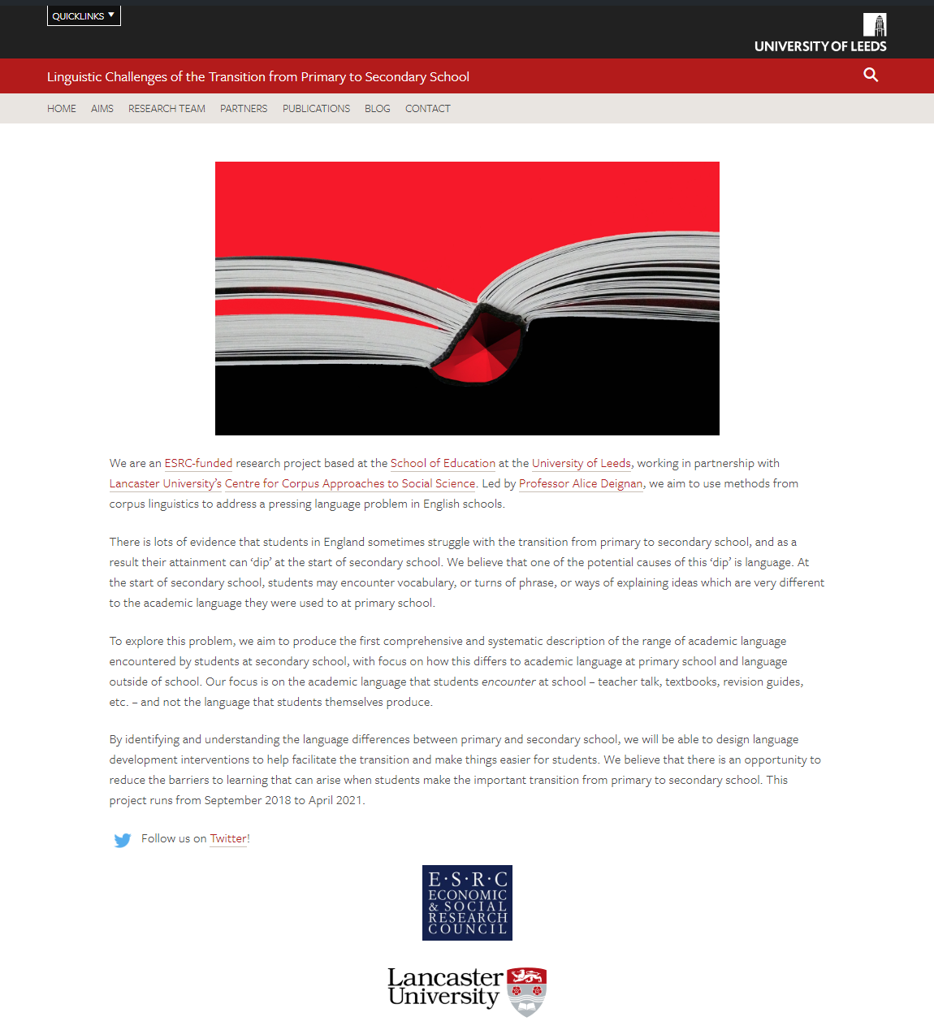
Thank you
https://linguistictransition.leeds.ac.uk/
@LeedsTransition
r.love@leeds.ac.uk
@lovermob
A.H.Deignan@education.leeds.ac.uk@alicedeignan

Slide 28
References
Braund, M. & Driver, M. 2005. Pupils' perceptions of practical science in primary and secondary school: implications for improving progression and continuity of learning. Educational Research, 47/ 77-91.
Brooks, G. 2016 What works for children and young people with literacy difficulties? The effectiveness of intervention schemes. The Dyslexia/ SpLD Trust.
Deignan, A., Semino, E., & Paul, S-A. (2017). Metaphors of Climate Science in Three Genres: Research Articles, Educational Texts, and Secondary School Student Talk. Applied Linguistics. DOI: 10.1093/applin/amx035
Department for Education, 2011. How do pupils progress between Key Stages 3 and Research Report.
Evangelou, M, Taggart, B, Sylva, K, Melhuish, E, Sammons, P., 2008. Effective Pre-school, Primary and Secondary Education 3-14 Project (EPPSE 3-14). What Makes a Successful Transition from Primary to Secondary School?. Nottingham: Department for Children, Schools and Families Publications.
Howe, A., and Richards, V., 2011. Bridging the transition from primary to secondary school. Abingdon: Routledge.
Leung, C. 2014. Researching language and communication in schooling. Linguistics in Education, 26/ 136-144.
Love, R., Dembry, C., Hardie, A., Brezina, V., & McEnery, T. (2017). The Spoken BNC2014: Designing and building a spoken corpus of everyday conversations. International Journal of Corpus Linguistics, 22(3), 319-344.

