Slide 1


Designing and building the Spoken BNC2014
Reflections on the Spoken BNC2014
Dr Robbie Love
Research Fellow
School of Education
University of Leeds
r.love@leeds.ac.uk
lovermob
Batumi VII International Summer School in Digital Humanities, 26 August 2018, 14.00

Slide 2
Plan of action
Background – the original British National Corpus
The BNC2014 project
Building the spoken BNC2014
Evaluating the Spoken BNC2014
Some challenges and reflections
Questions?
BREAK
7. Practical: using the Spoken BNC2014 with CQPweb

Slide 3
Digital humanities & corpus linguistics
DH = applying computing / digital technologies to traditional humanities disciplines
CL = Computer-assisted methods for the analysis of language data
‘Corpus’ = body of texts under investigation
Corpus linguistics can be viewed as simply a method of linguistics, or as a subdiscipline of linguistics
Despite similarities, it is rarely acknowledged as part of Digital Humanities
Simultaneous but separate development?
Corpus methods emerging from linguistics?
Linguistics as social science vs. “humanities”

Slide 4

The British National Corpus (1994)
“a corpus of 100 million words of written texts and spoken transcriptions of modern British English, to be stored on the computer in machine-readable form”
(Leech 1993: 9)

Slide 5

The BNC2014 project

Slide 6
Aims of the BNC2014
Broadly comparable to the BNC1994, compiled two decades later
A new resource for research & teaching
100 million words of written British English, variety of registers
10 million words of spoken British English, one register = casual conversation
Phase 1 (2014-2017) = Spoken BNC2014
Lancaster University + Cambridge University Press
Phase 2 (2015-present) = Written BNC2014
Lancaster University

Slide 7
Why?
Nothing since the Spoken BNC1994:
orthographically transcribed
large size
general coverage of spoken British English
(low or no cost) public access
Language has very likely changed during this time – lexical innovations, perhaps grammatical change etc.
Two decade comparison (1990s-2010s) never been done before
Build towards a set of sampling points for diachronic analysis of spoken British English

Slide 8

English language teaching
What we teach vs. what we do
Focus less on structures we produce less frequently
What are we talking about?
Inspiration for current/realistic conversational topics
Speaking and ELT teaching
Teaching speaking is tough

Slide 9


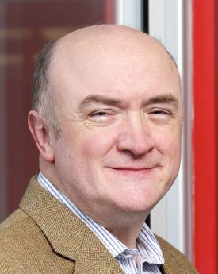
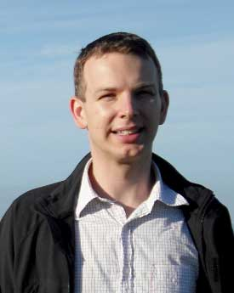
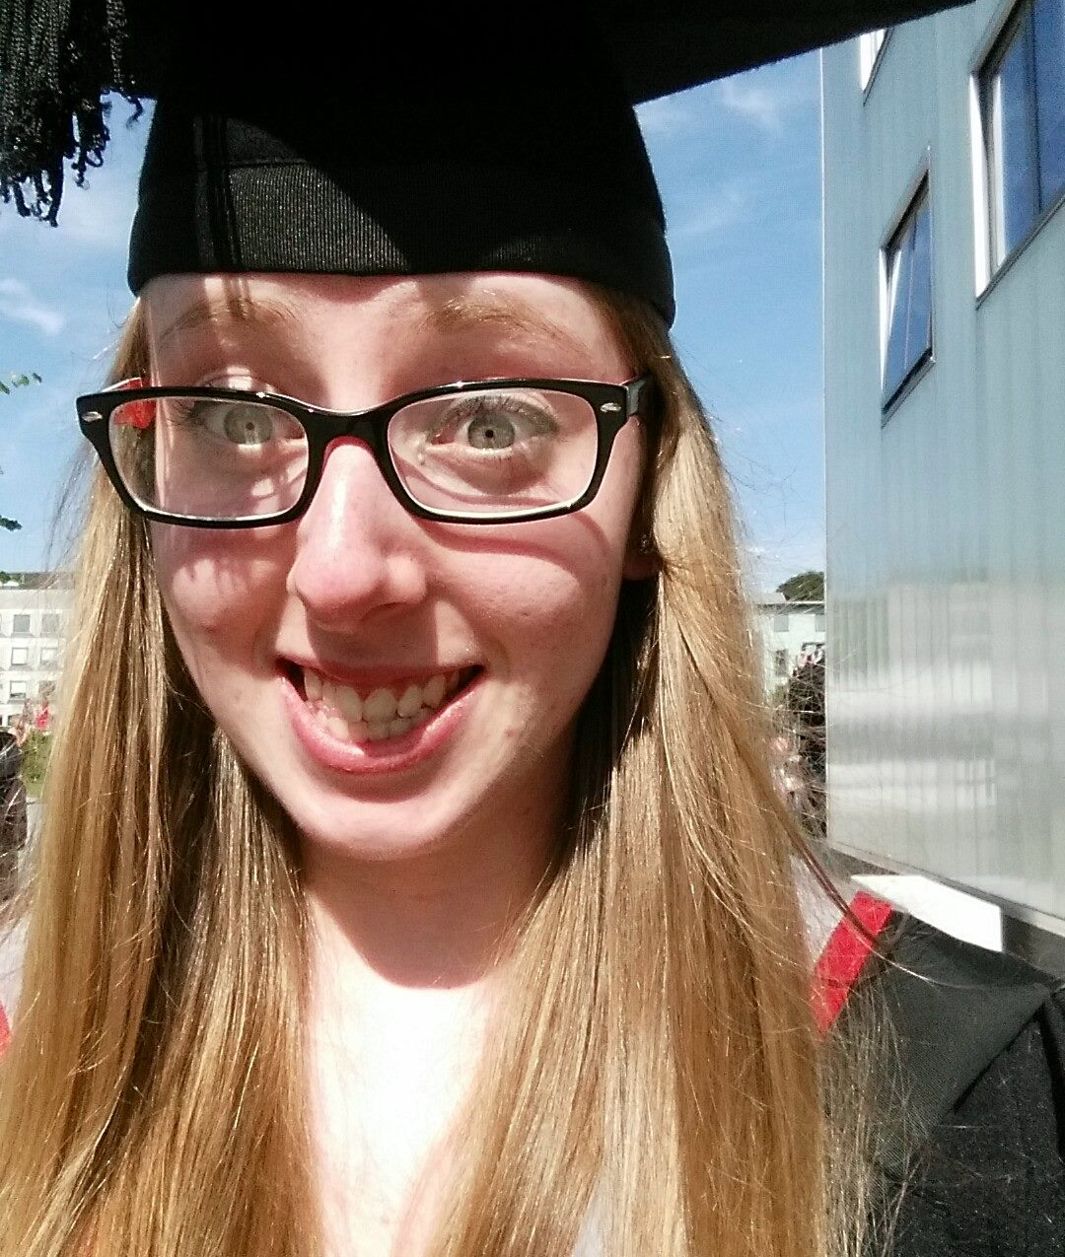
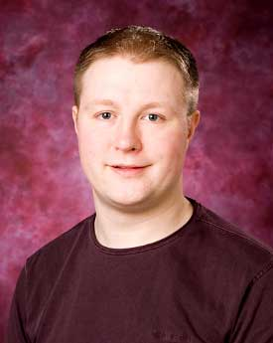
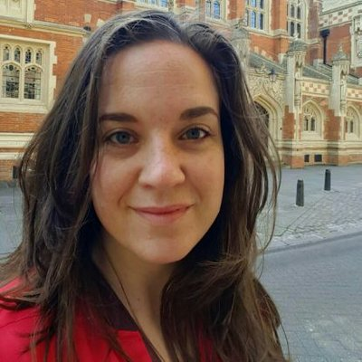

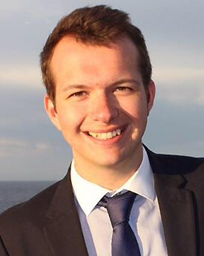
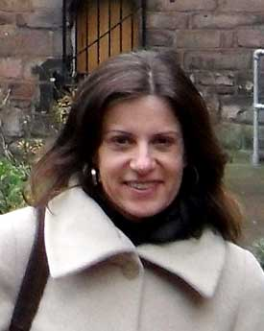
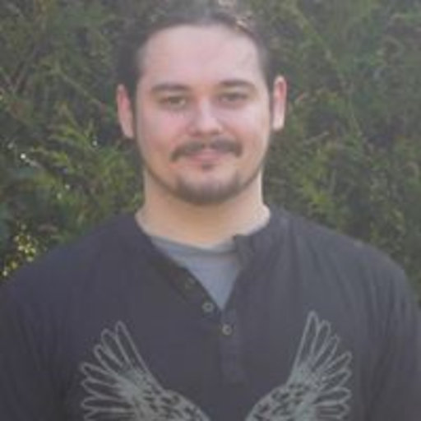
The BNC2014 team
10 million words
Phase 1 (2013-2017):
Spoken BNC2014
Phase 2 (2014-):
Written BNC2014
90 million words
Tony
McEnery
Vaclav
Brezina
Robbie
Love
Abi
Hawtin
Andrew
Hardie
Claire
Dembry
Olivia
Goodman
Mathew
Gillings
Carmen
Dayrell
Matt
Timperley

Slide 10
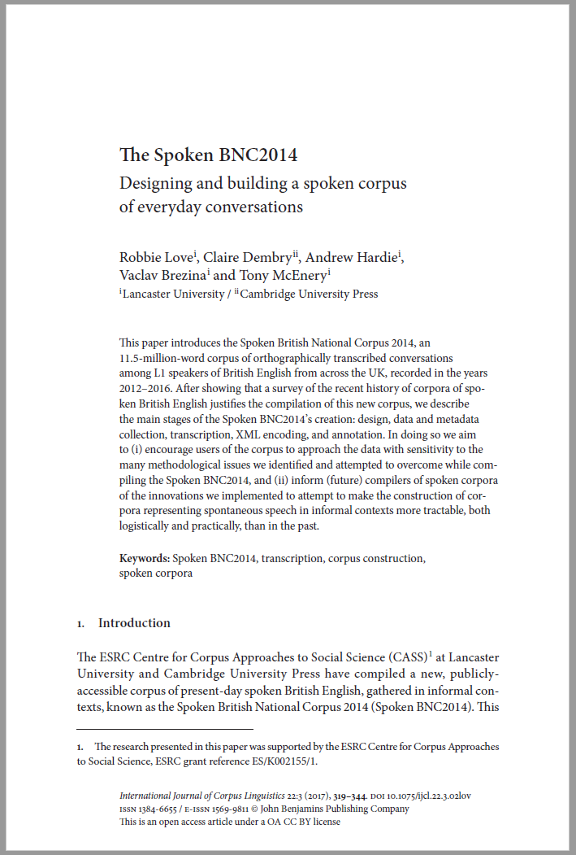


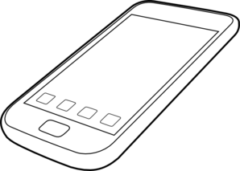





Building the Spoken BNC2014
SPOKEN
Existing corpora
Design
Representativeness
Target population
Sampling goals
Who is it for?
What do people want?
What have people done?
Finding participants
Recording equipment
Metadata collection
Automated? Manual?
Conventions
Accuracy
XML conversion
Annotation
Tool development
User guide
Website
Publications
What have we got?
Representativeness
Pilot research
Data collection
Transcription
Processing
Review
Document
Release

Slide 11
Corpus design
“The design of a representative corpus is not truly finalized until the corpus is completed, and analyses of the parameters of variation are required throughout the process of corpus development in order to fine-tune the representativeness of the resulting collection of texts”
(Biber 1993)
“A seminal article by Biber (1993) has frequently been cited, but no attempt (to my knowledge) has been made to implement Biber’s plan for building a representative corpus. […] Without representativeness, whatever is found to be true of a corpus, is simply true of that corpus – and cannot be extended to anything else.”
(Leech 2006)

Slide 12
Corpus design
The 2nd version of the BNC – promise and expectation of comparability
In terms of spoken data, needs had changed – just informal conversation
Goals:
- priority = England; aim for rest of UK
- spread of age, gender, region, socio-economic status etc.
- but: no pre-determined category sizes
- broadly comparable to the Spoken BNC1994DS
Describe representativeness upon completion
We had to facilitate comment on some wider population, otherwise what is the point?

Slide 13
Corpus design
 | Spoken BNC1994 | Spoken BNC2014
Interaction type | Demographic (40%); Context-governed (60%) | Demographic (100%)
Who? | “Carefully sampled individuals” (Leech 1993:6) | Open call for participation; Some targeting
How? | Tape recorders | Smartphone MP3 recordings
What? | All interactions in a given period | Conversations; some task-based interactions.
When? | Continuously over a 2-7 day period | As determined by participant
How many speakers? | 124 adults making recordings Over 1000 speakers | 700 unique speakers
Total data | ~10m words | 11+m

Slide 14
Corpus design
 | Spoken BNC1994 | Spoken BNC2014
Speaker | Age Gender Education Occupation Accent/dialect Socio-economic category | Age Gender Education Occupation Accent/dialect Birthplace Linguistic origin Where do you currently live? How long have you lived there? Nationality Do you speak other languages?
Recording | Title Date Recording location | Title Date File name Recording length Recording location Speaker relationship Topics covered

Slide 15

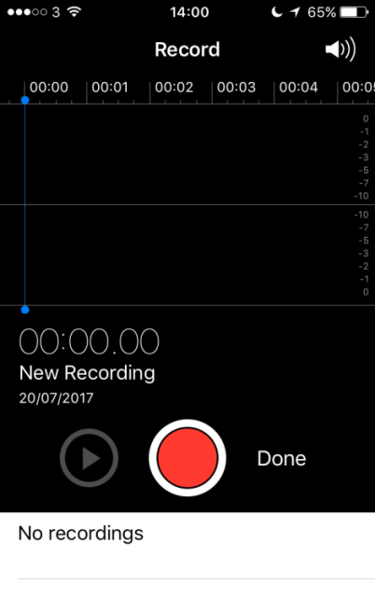
Data collection
How can we recruit & motivate participants?
Money!
How can we gather good quality recordings?
Smartphones!
How can we gather good quality metadata?
Condition of payment; careful data management

Slide 16
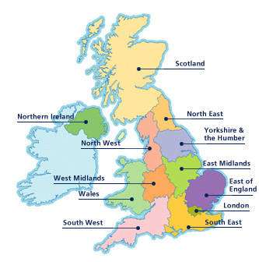
Metadata issues
Accent/dialect -> region
Occupation -> socio-economic status

Slide 17
Metadata issues
Region
What is region anyway? What are we trying to represent here?
Birthplace?
Recording location?
Location of current residence?
Location during acquisition?

Slide 18
Metadata issues
Region
Purely objective metadata seems insufficient
Subjective metadata offers an imperfect solution:
Self-reported dialect
British Library’s Evolving English WordBank (2011)
E.g. “Geordie” = north east England

Slide 19
Metadata issues
Self-reported dialect categorisation
central midlands, north-east midlands, midlands, south midlands, north-west midlands…
“southern”
“normal with a brummy twang”
“mixed northern/somerset/rp”

Slide 20
Metadata issues
Dialect categorisation
Office for National Statistics’ scheme:
Nomenclature of Territorial Units for Statistics (NUTS)
Used in the census
(1) North East
(2) North West
(3) Merseyside
(4) Yorkshire & Humberside
(5) East Midlands
(6) West Midlands
(7) Eastern
(8) London
(9) South East
(10) South West
(11) Wales
(12) Scotland
(13) Northern Ireland

Slide 21
Dialect in the Spoken BNC2014
(1) Global | (2) Country | (3) Supra-region | (4) Region
UK | England | North | North East
 |  |  | Yorkshire & Humberside
 |  |  | North West (not Merseyside)
 |  |  | Merseyside
 |  | Midlands | East Midlands
 |  |  | West Midlands
 |  | South | Eastern
 |  |  | South West
 |  |  | South East (not London)
 |  |  | London
 | Scotland | Scotland | Scotland
 | Wales | Wales | Wales
 | Northern Ireland | Northern Ireland | Northern Ireland
Non-UK | Republic of Ireland | Republic of Ireland | Republic of Ireland
 | Other non-UK variety | Other non-UK variety | Other non-UK variety
Unspecified | Unspecified | Unspecified | Unspecified
Comparable with the Spoken BNC1994 too!

Slide 22
Dialect in the Spoken BNC2014
(1) Global | (2) Country | (3) Supra-region | (4) Region
UK | England | North | North East
 |  |  | Yorkshire & Humberside
 |  |  | North West (not Merseyside)
 |  |  | Merseyside
 |  | Midlands | East Midlands
 |  |  | West Midlands
 |  | South | Eastern
 |  |  | South West
 |  |  | South East (not London)
 |  |  | London
 | Scotland | Scotland | Scotland
 | Wales | Wales | Wales
 | Northern Ireland | Northern Ireland | Northern Ireland
Non-UK | Republic of Ireland | Republic of Ireland | Republic of Ireland
 | Other non-UK variety | Other non-UK variety | Other non-UK variety
Unspecified | Unspecified | Unspecified | Unspecified
“Geordie”

Slide 23
Dialect in the Spoken BNC2014
(1) Global | (2) Country | (3) Supra-region | (4) Region
UK | England | North | North East
 |  |  | Yorkshire & Humberside
 |  |  | North West (not Merseyside)
 |  |  | Merseyside
 |  | Midlands | East Midlands
 |  |  | West Midlands
 |  | South | Eastern
 |  |  | South West
 |  |  | South East (not London)
 |  |  | London
 | Scotland | Scotland | Scotland
 | Wales | Wales | Wales
 | Northern Ireland | Northern Ireland | Northern Ireland
Non-UK | Republic of Ireland | Republic of Ireland | Republic of Ireland
 | Other non-UK variety | Other non-UK variety | Other non-UK variety
Unspecified | Unspecified | Unspecified | Unspecified
“Southern”

Slide 24
Evaluation
Montgomery (2012) – we aren’t very good at judging dialect boundaries reliably – perceptual dialectology
  One speaker’s “southern” might be another speaker’s “midlands”
Requires some inference – i.e. a subjective metadata set
Contradictions in speaker reports
But…
More reliable method than BNC1994 – speak for yourself!
The best we can get for a top-down scheme

Slide 25
Metadata issues
Socio-economic status
BNC1994: Social Grade
Code | Description
A | Higher managerial, administrative and professional
B | Intermediate managerial, administrative and professional
C1 | Supervisory, clerical and junior managerial, administrative and professional
C2 | Skilled manual workers
D | Semi-skilled and unskilled manual workers
E | State pensioners, casual and lowest grade workers, unemployed with state benefits only

Slide 26
Metadata issues
NS-SEC
Class | Analytic class
1 | Higher managerial, administrative and professional occupations
1.1 | Large employers and higher managerial and administrative occupations
1.2 | Higher professional occupations
2 | Lower managerial, administrative and professional occupations
3 | Intermediate occupations
4 | Small employers and own account workers
5 | Lower supervisory and technical occupations
6 | Semi-routine occupations
7 | Routine occupations
8 | Never worked and long-term unemployed
* | Students/unclassifiable

Slide 27
Metadata issues
Mapping NS-SEC onto Social Grade
NS-SEC | Description | MAPS ON TO… | SG | Description
1 | Higher managerial, administrative and professional occupations |  | A | Higher managerial, administrative and professional
1.1 | Large employers and higher managerial and administrative occupations
1.2 | Higher professional occupations
2 | Lower managerial, administrative and professional occupations |  | B | Intermediate managerial, administrative and professional
3 | Intermediate occupations |  | C1 | Supervisory, clerical and junior managerial, administrative and professional
4 | Small employers and own account workers
5 | Lower supervisory and technical occupations |  | C2 | Skilled manual workers
6 | Semi-routine occupations |  | D | Semi-skilled and unskilled manual workers
7 | Routine occupations
8 | Never worked and long-term unemployed |  | E | State pensioners, casual and lowest grade workers, unemployed with state benefits only
* | Students/unclassifiable

Slide 28
Transcription
Audio recording & signed consent forms received
Metadata recorded from consent forms
Audio recording assigned to transcriber
Transcript produced
Check #1: Audio checking
Check #2: Proofreading
Proofread word doc sent to Lancaster

Slide 29
Transcription
Why not use exactly the same transcription scheme as the original?
EXAMPLE
using full stops and commas to “approximate to use in written text”, but also indicating pauses with ellipses
<2> I think it’s always, deceptive on days like this because its, overcast and [er]
[…]
<2> But, but er, he’s…just broken away from his girlfriend and [<unclear>]
<1> [Oh has] he, oh. Well he seemed happy enough when he called.
Crowdy (1994: 28)

Slide 30
Processing
Word docs -> text
Text -> XML, automatic conversion scripts to (a) translate transcripts into XML, (b) check & correct transcription convention errors
Used “modest” XML (Hardie 2014), a simpler derivative of TEI
Tagged for POS and lemma, CLAWS (Garside & Smith 1997)
Lancaster University’s CQPweb server (Hardie 2012)

Slide 31
The Spoken BNC2014
Conversational, L1 British English
2012-2016
672 speakers
1,251 texts
11,422,617 words
Freely available to the public:
    (1) on Lancaster’s CQPweb, then
    (2) file download

Slide 32
The Spoken BNC2014

Slide 33
The Spoken BNC2014

Slide 34
So…what the Spoken BNC2014 is
A large corpus of informal spoken British English, as spoken mostly in England
Within England, it represents a spread of demographics including gender, age, socio-economic status and region
Comparable in terms of register to the Spoken BNC1994DS
A resource for the study of:
- lexical/grammatical variation & change in England
- how inf. English is spoken in England (2012-2016)
- functional variation according to situational context
- how inf. spoken English differs from writing & online comm.
- how inf. spoken English differs from other spoken registers
- (critical) discourse analysis
- much more…

Slide 35
What the Spoken BNC2014 isn’t
Perfect!
A corpus of a range of spoken registers
Comparable in terms of register with the whole Spoken BNC1994
A corpus built in exactly the same way as the Spoken BNC1994
A corpus designed with phonetics in mind
A corpus that represents the whole of the UK – more to come

Slide 36
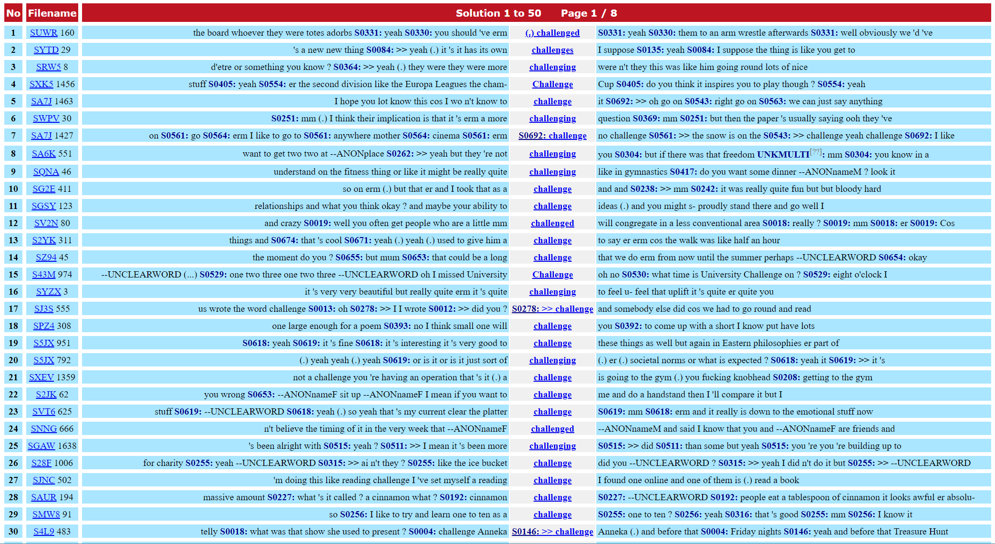
Some challenges
Engaging with the media
Increasing mobility
The growth of corpus linguistics
‘Blind faith’ in corpus linguistics

Slide 37
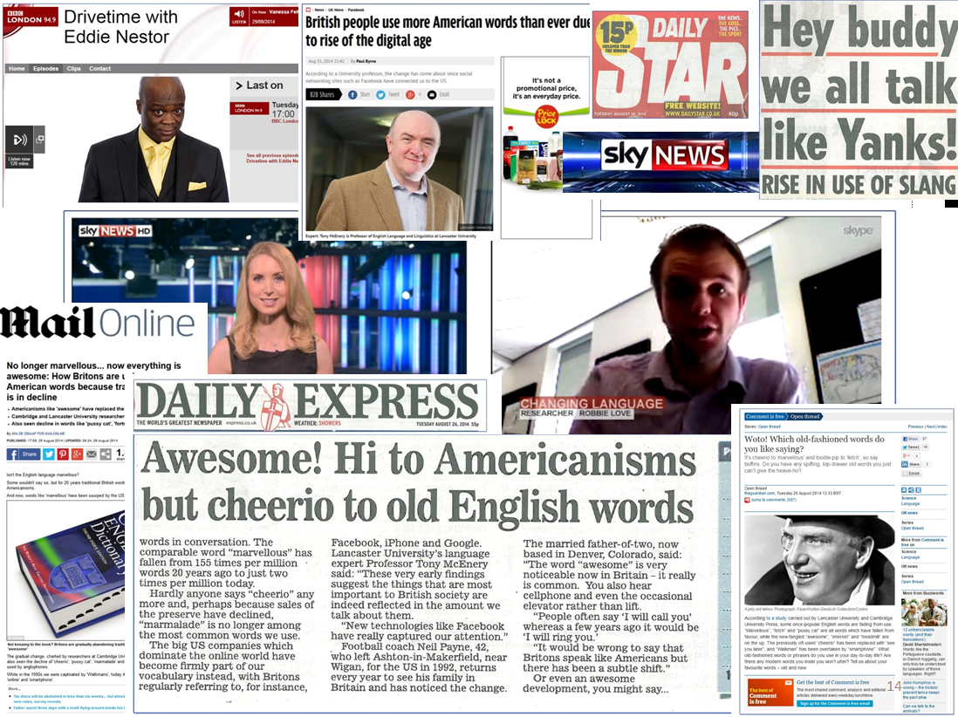
Engaging with the media
Finding and recruiting participants for the Spoken BNC2014
The media as an advertising tool
Working with university press office
Researchers and journalists…a love/hate relationship
The truth of the matter is that the principles we hold dear (thoroughness, accuracy, taking your time to get it 100% right) are not conducive to getting headlines
Often, my work was watered down, censored and simplified

Slide 38
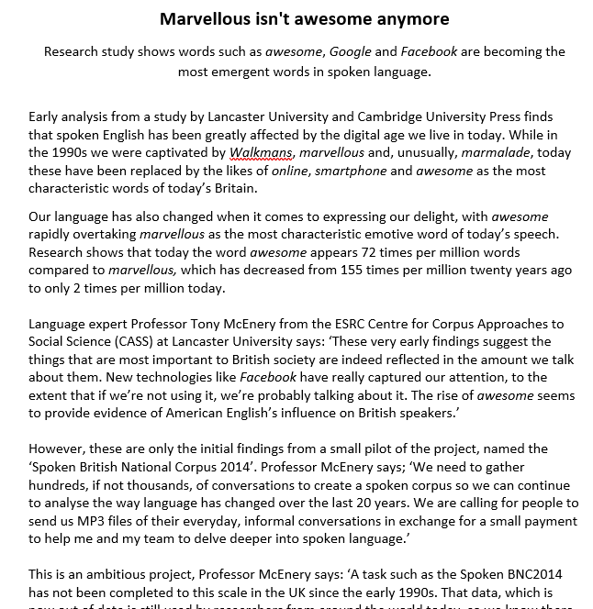
Example: the pussy cat
Early 1990s Early 2010s
fortnight facebook
marvellous internet
fetch website
walkman awesome
poll email
catalogue google
pussy cat smartphone
marmalade iphone
drawers essentially
cheerio treadmill

Slide 39
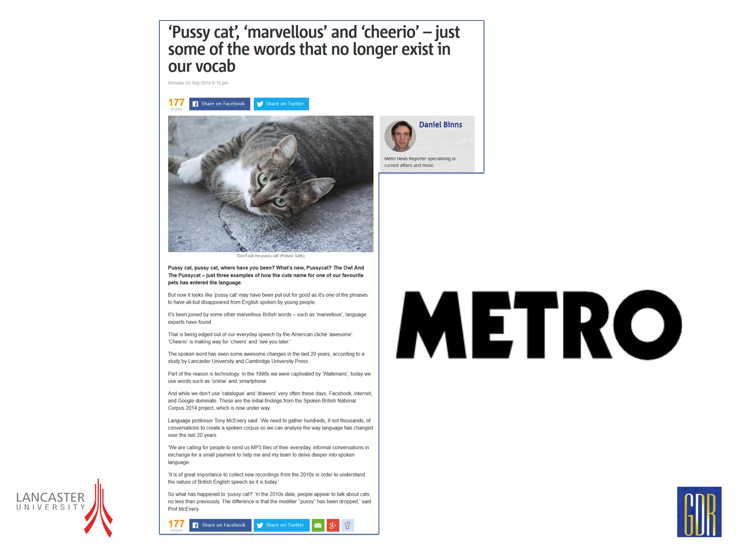
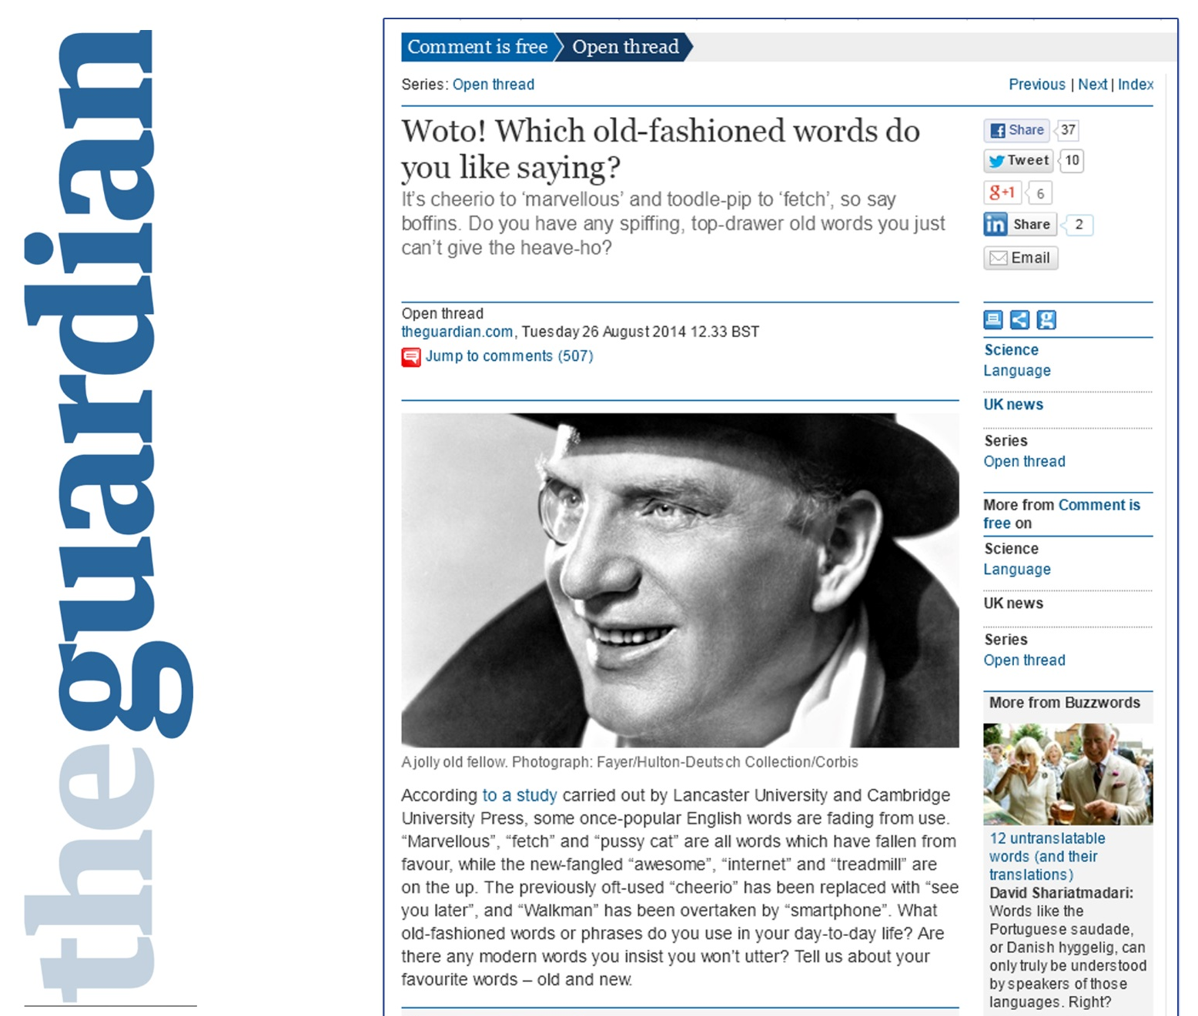
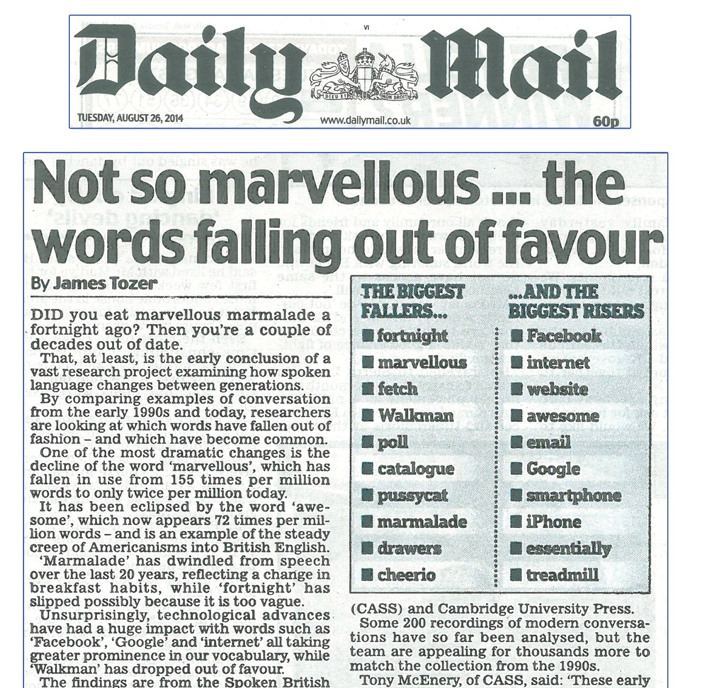
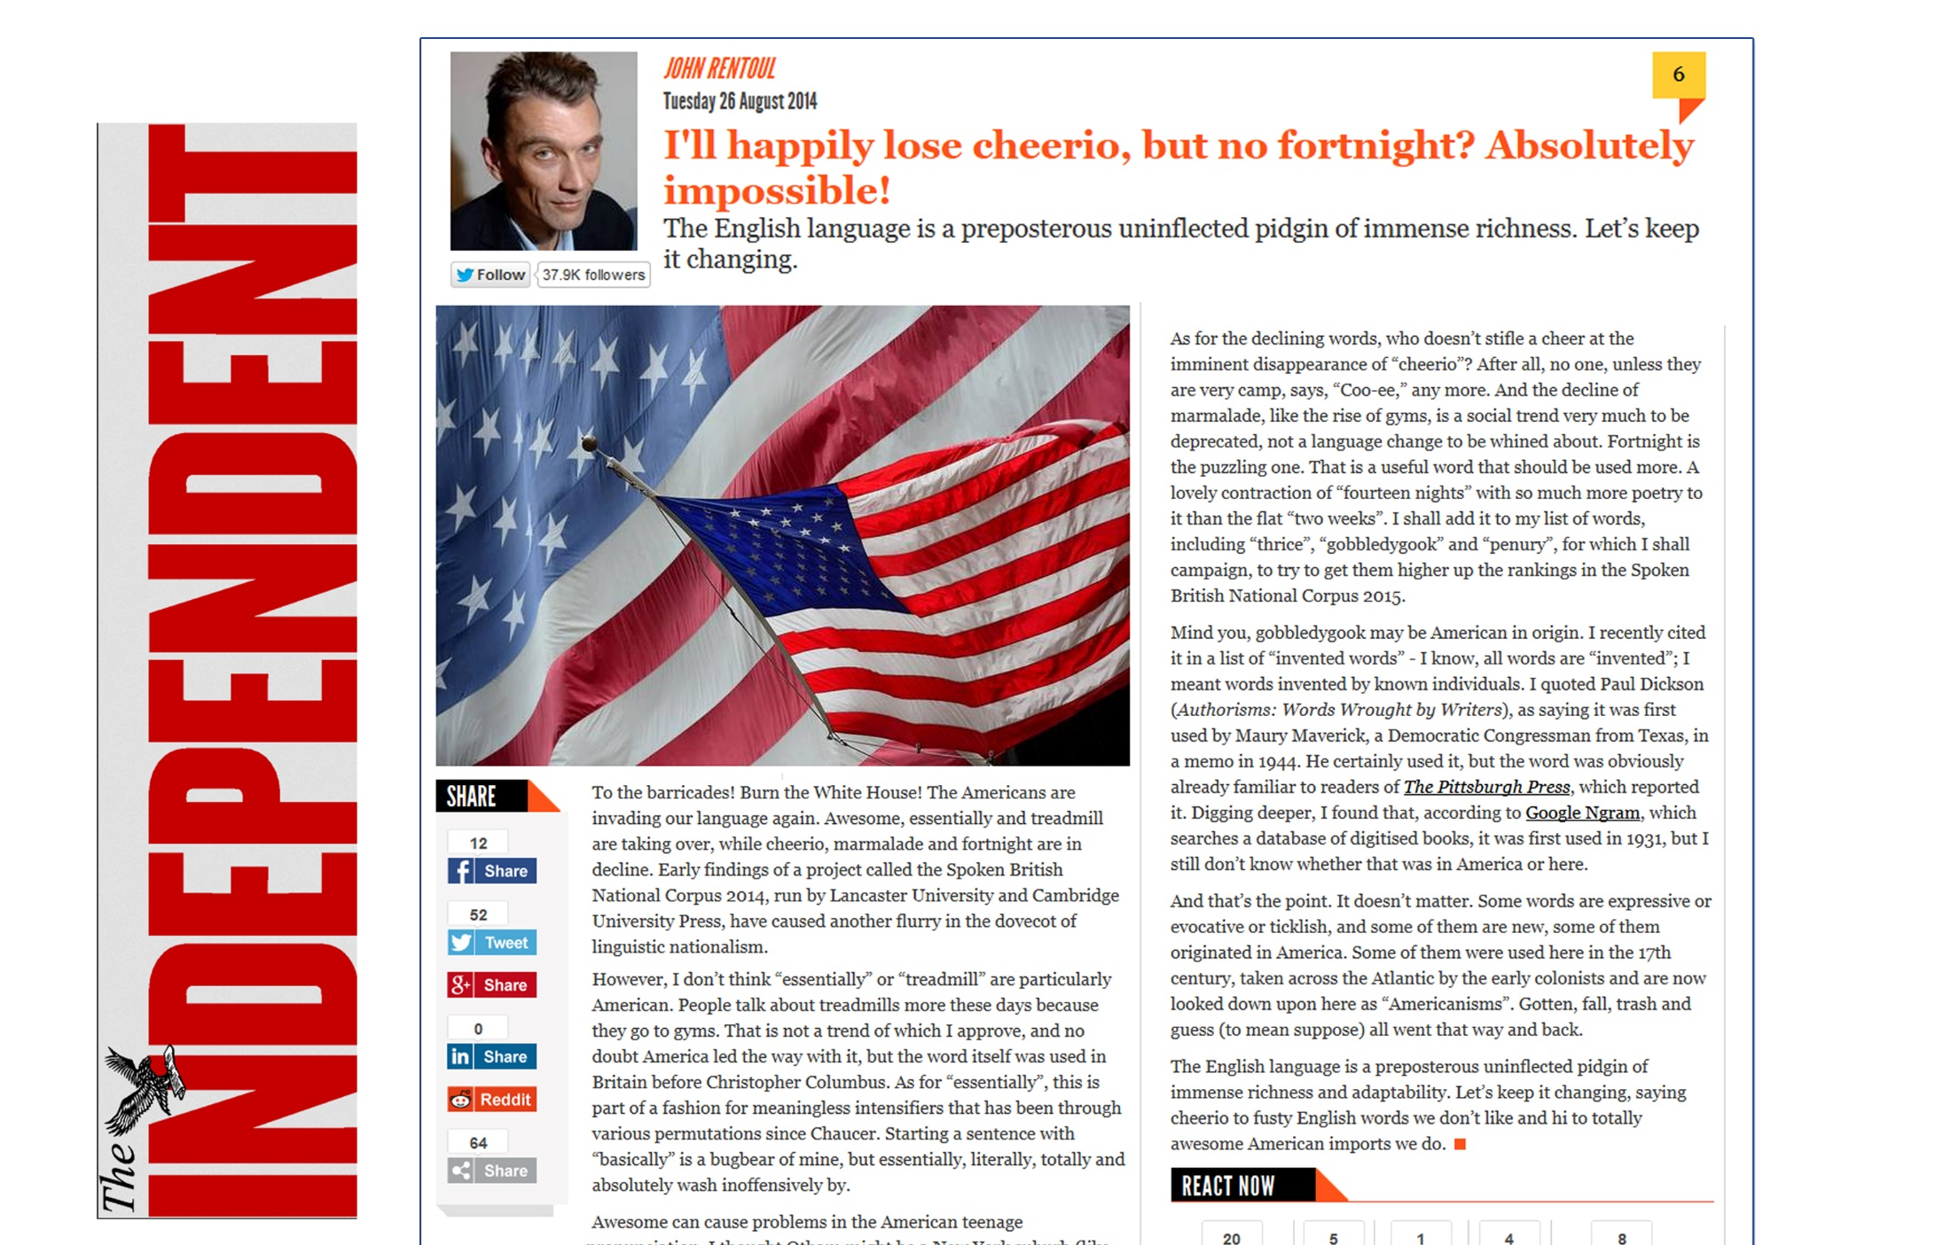
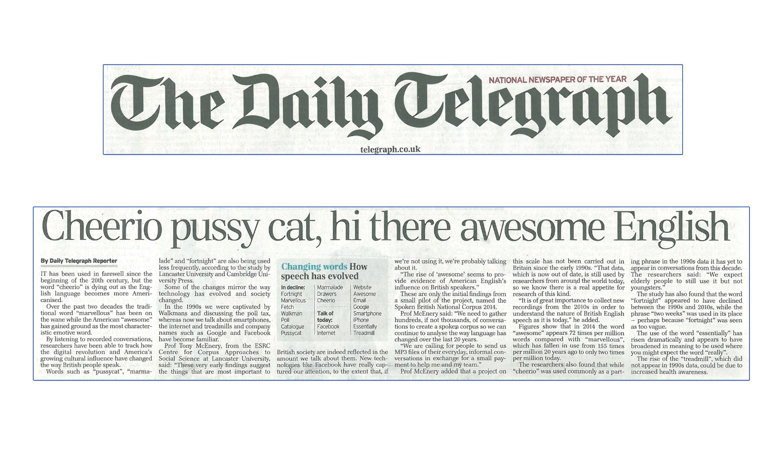
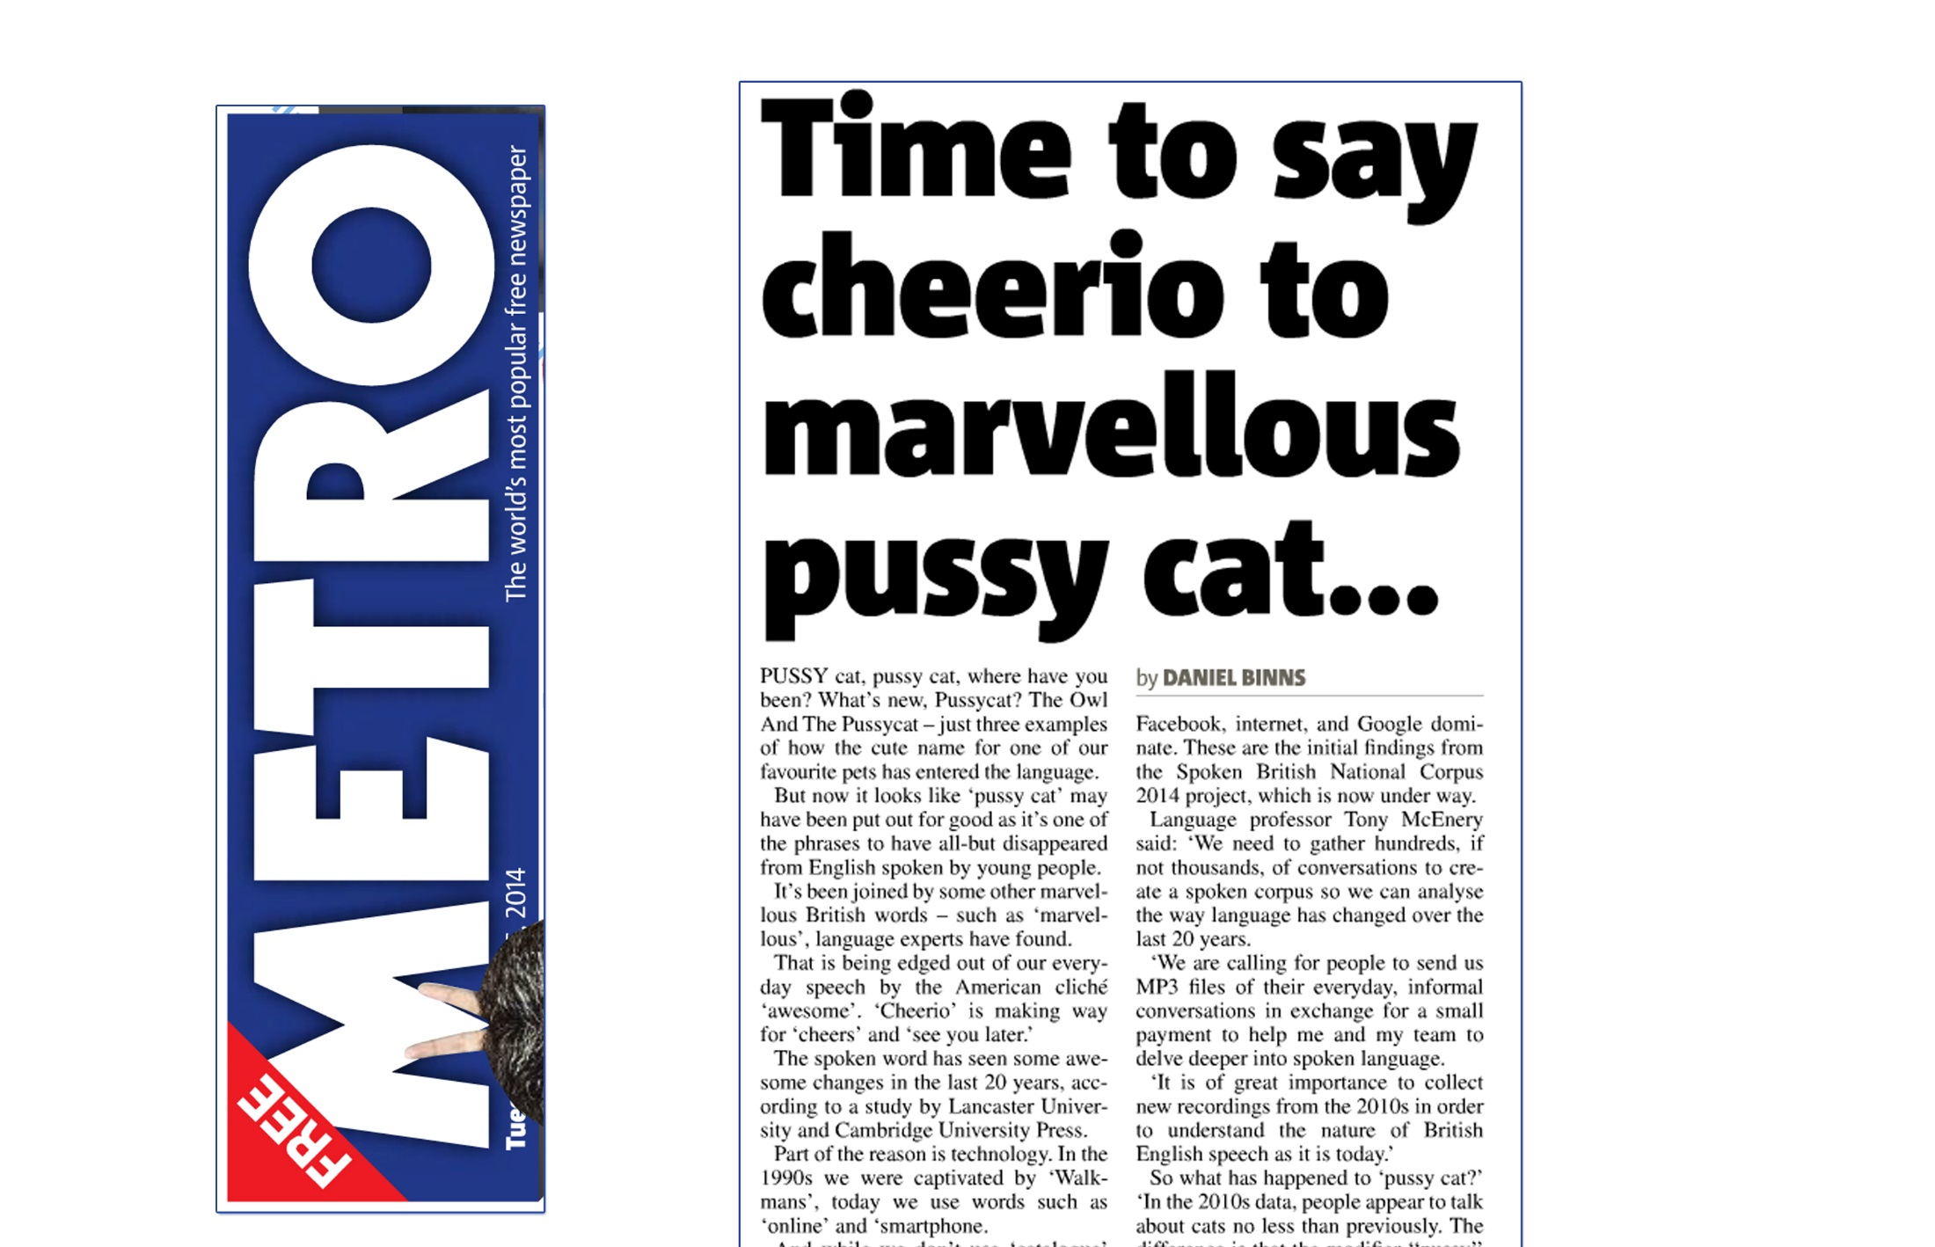
Example: the pussy cat

Slide 40
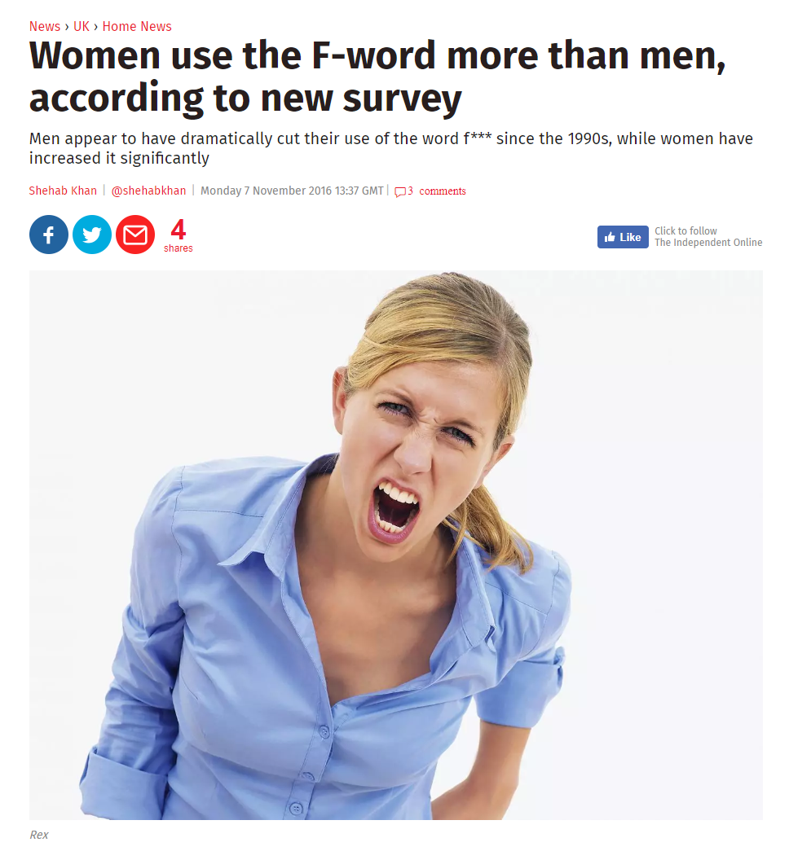
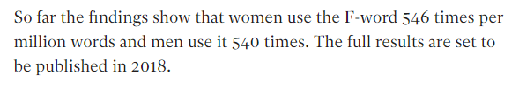
Example: swearing

Slide 41
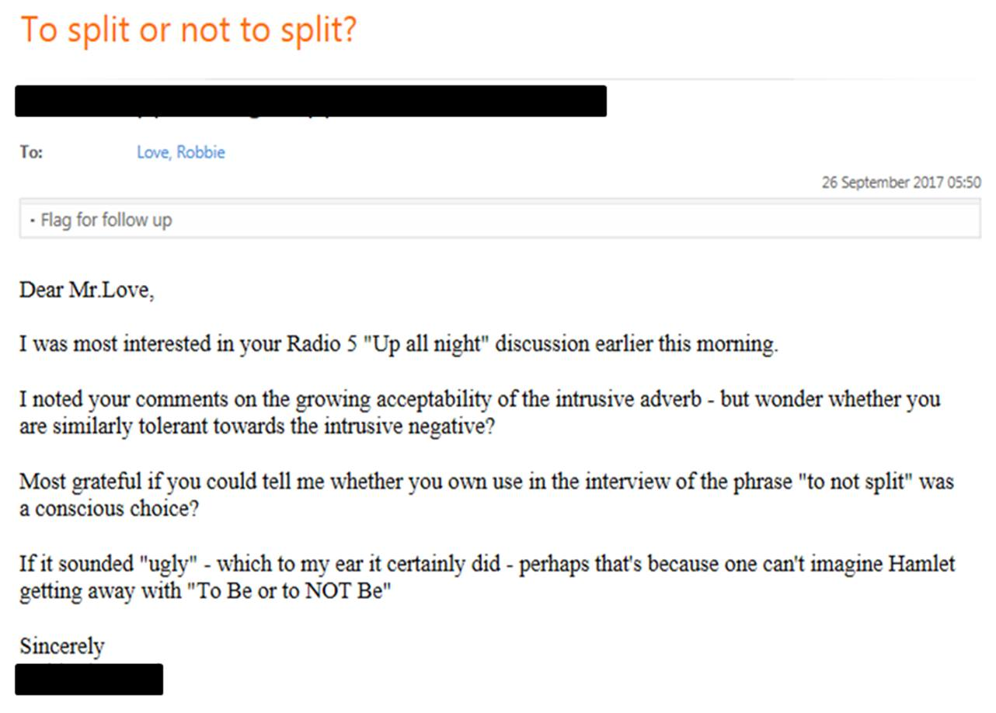
Prescriptive audiences
Some people think I am:
announcing the death of the English language
actively promoting the changes I am reporting

Slide 42
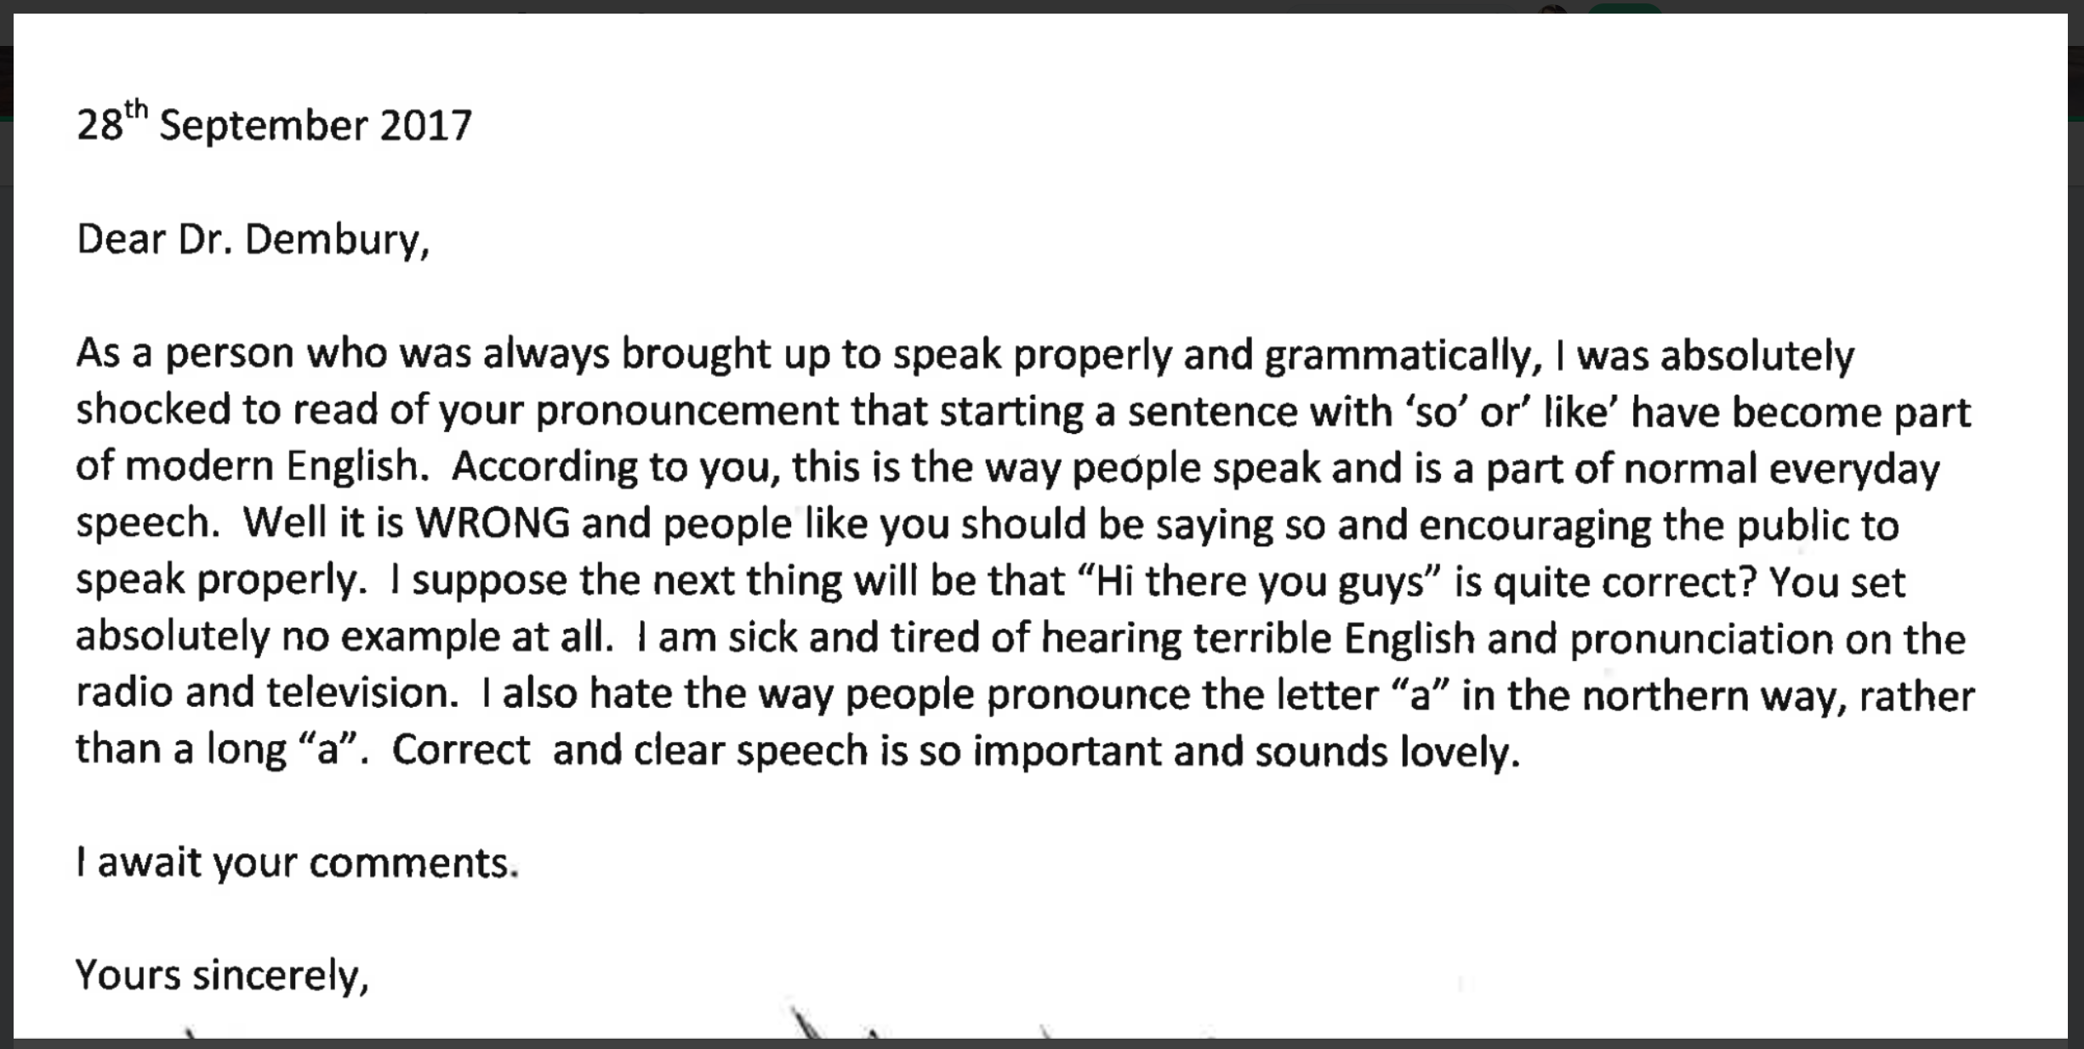
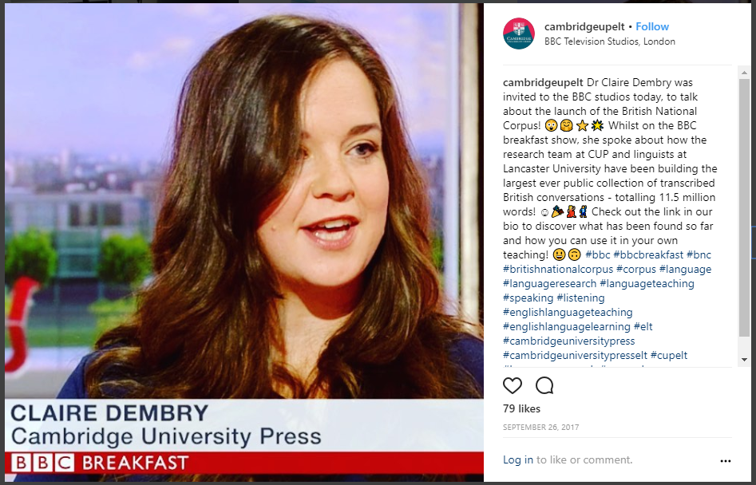
Prescriptive audiences

Slide 43
Increasing mobility
“we chose to define ‘British’ as speakers whose L1…is British English, rather than speaker nationality”
(Love forth.)
Spoken BNC2014 does not represent the whole of the UK…but even if it did claim to…
Scots, Ulster Scots, Welsh, British Sign Language, Irish, Angloromani, Scottish Gaelic, Cornish, Shelta, Irish Sign Language, Northern Ireland Sign Language…
Polish, Punjabi, Urdu, Bengali, Gujarati, Arabic, French, Chinese, Portuguese, Spanish, Tamil, Turkish, Italian, Somali, Lithuanian, German, Persian, Philippine languages, Romanian…

Slide 44
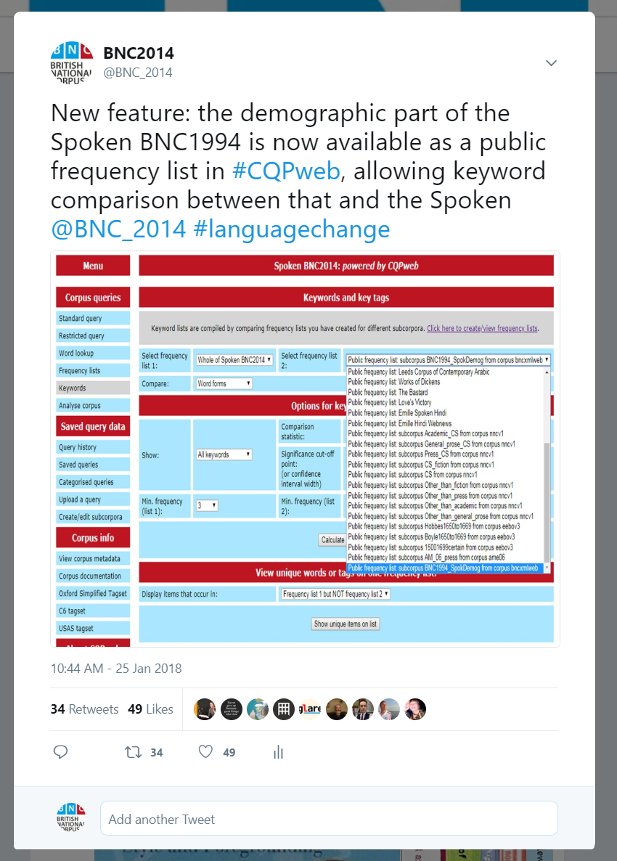
Blind faith in corpus linguistics

Slide 45
Example: keywords
XXUNCLEARWORD
l-
a-
e-
st-
XXANONnameM
c-
internet
o-
woah
XXANONnameF
n-
u-
ye-
th-
XXANONplace
D-
T-
awesome
ma-
s-
email
b-
XXFOREIGNWORD
emails
XXANONnameN
g-
m-
twenty-four
youtube
uhu
I-
website
ca-
thi-
y-
facebook
UK
uh-huh
ch-
w-
h-
google
laptop
ipad
f-
ha-
r-
online
XXANONmiscPersonalInfo

Slide 46
Example: keywords
s-
g-
m-
ca-
thi-
XXUNCLEARWORD
uhu
I-
website
uh-huh
ch-
XXANONnameM
y-
facebook
UK
laptop
ipad
XXANONnameF
w-
h-
google
online
XXANONplace
f-
ha-
r-
st-
XXANONnameN
l-
a-
e-
woah
XXFOREIGNWORD
c-
internet
o-
th-
XXANONmiscPersonalInfo
n-
u-
ye-
ma-
D-
T-
awesome
emails
email
b-
twenty-four
youtube

Slide 47
Example: keywords
uhu
laptop
XXUNCLEARWORD
f-
u-
th-
email
online
XXANONnameM
l-
T-
ma-
facebook
woah
XXANONnameF
c-
b-
thi-
internet
emails
XXANONplace
n-
m-
ch-
website
youtube
XXANONnameN
D-
r-
UK
ipad
XXFOREIGNWORD
g-
e-
google
XXANONmiscPersonalInfo
I-
o-
awesome
s-
ye-
h-
twenty-four
y-
ha-
ca-
uh-huh
w-
a-
st-

Slide 48
Example: keywords
email
ipad
XXUNCLEARWORD
f-
u-
th-
facebook
XXANONnameM
l-
T-
ma-
internet
XXANONnameF
c-
b-
thi-
website
XXANONplace
n-
m-
ch-
google
XXANONnameN
D-
r-
uhu
awesome
XXFOREIGNWORD
g-
e-
UK
laptop
XXANONmiscPersonalInfo
I-
o-
twenty-four
online
s-
ye-
uh-huh
h-
emails
y-
ha-
ca-
woah
youtube
w-
a-
st-

Slide 49
Conclusions
BNC2014: a contribution to corpus linguistics and beyond
It is an incredibly exciting time to be involved in corpus linguistics
But, as CL grows, so should the responsibility of all to protect its integrity
Be honest, critical and realistic about representativeness
Maximize efficiency of corpus construction in view of practical constraints: especially time
There is no one ‘right’ way to do this – e.g. data collection, metadata, transcription, processing
Decisions made = justified & transparent, including weaknesses e.g. imbalance, speaker identification
Language is always changing and we need to keep up for the benefit of learners
Ideal: (Spoken) BNC should be recollected more regularly – it’s getting easier

Slide 50
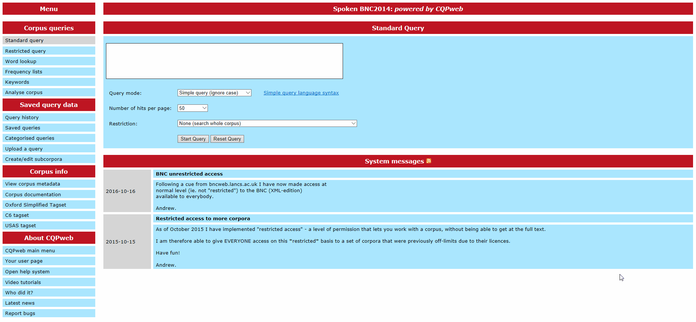
Thank you – questions?

Slide 51
Using the Spoken BNC2014 with CQPweb
Reflections on the Spoken BNC2014
Dr Robbie Love
Research Fellow
School of Education
University of Leeds
r.love@leeds.ac.uk
lovermob
Batumi VII International Summer School in Digital Humanities, 26 August 2018, 15.30

Slide 52
Logging in
Follow steps 1 and 2 on the handout
Sign up for an account with CQPweb
Sign the user agreement for the Spoken BNC2014
http://corpora.lancs.ac.uk/bnc2014
https://cqpweb.lancs.ac.uk/

Slide 53
Practical activities
Concordance analysis
Raw & relative frequency
Keywords
Collocation
Distribution

Slide 54
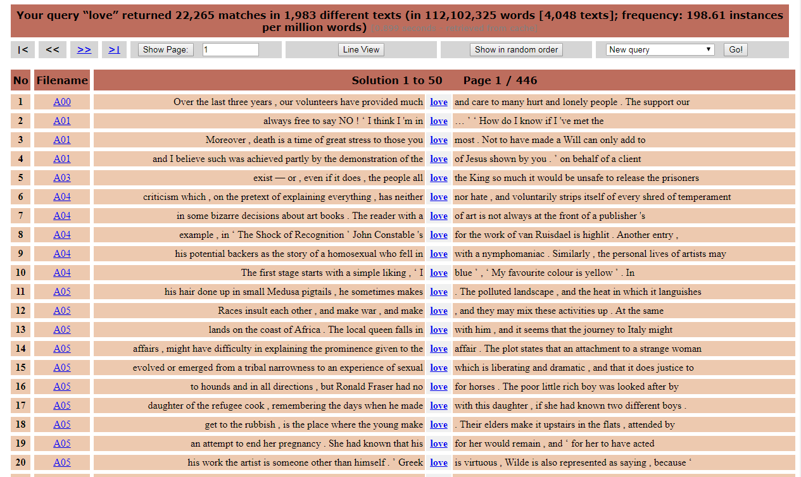
Concordance lines

Slide 55
Concordance lines
A comprehensive index of the words used in a text or a corpus
‘A set of concordance lines’ shows this index in its immediate context
The most common concordance format is the KWIC concordance - Key Word in Context
  In a KWIC concordance of your search word, i.e. the node word, is in a central position with all lines vertically aligned around the node
Can be sorted to reveal patterns of usage
  E.g. to the left or right at various intervals

Slide 56
Concordance lines
Annotate concordance lines, for instance:
  When disambiguating senses of a word
  To categorise complex results
  To investigate patterns in meaning
This can be done two ways:
  Automatically, using CQPweb’s ‘categorise’ function
  Manually, using an Excel spreadsheet (or database manager of your choice)
    (but use Excel, it’s easier)

Slide 57
Concordance lines: task (3)
Search for the word “big” in the Spoken BNC2014
Click “show in random order”
Glance over first page of concordance lines – what sorts of things are coming up?
Open a new tab & repeat for the word “massive”
Can you notice any differences between these words?

Slide 58
Raw frequency
The arithmetic count of the number of a word (or phrase, etc.)
The most direct quantitative data provided by a corpus
Frequency itself does NOT tell you much in terms of the validity of a hypothesis
  There are 250 instances of ‘hi’ in a spoken corpus…so what?
    Does this mean that people say ‘hi’ frequently – or infrequently – when they speak?

Slide 59
Relative frequency
…in relation to what?
Corpus analysis is inherently comparative
There are 250 instances of ‘hi’ in the Spoken corpus and 500 instances in the Written corpus
Do people say hi twice as often in writing as in speech?
The written corpus is 9 times as large as the spoken
Written
(90 million words)
Spoken (10 million words)
250
500

Slide 60
Relative frequency
When comparing corpora of different sizes, we need to normalize the frequencies to a common base (e.g. per million tokens)
  Relative freq = (raw freq / token number) * common base
    ‘Hi’ in spoken corpus
    = (250 / 10,000,000) * 1,000,000 = 25 per million tokens
    ‘Hi’ in written corpus
    = (500 / 90,000,000) * 1,000,000 = 6 per million tokens
  Therefore: 4 times more frequent in the Spoken corpus relative to the Written corpus

Slide 61
Relative frequency: task (4)
Return to your concordance lines for “big” and “massive”
What is the raw frequency of “big” and “massive”?
What is the relative frequency of “big” and “massive”?
Which is more common in present day British English speech?

Slide 62
Keyword analysis: task (5)
Using the instructions on the handout, generate a list of keywords, comparing young and old speakers
Look at the list
Can you categorise any of the words? What do they tell you about language and age differences?

Slide 63
Collocation
Words that co-occur unusually frequently
  e.g. the collocates of ‘home’ may include office, go, from, nursing, your, back, abroad, residential etc.
  Collocates co-occur with the search term more so than other words, relatively speaking
Very useful in corpus linguistics to analyse the use of a word and, therefore, its meaning
  how the use of a word changes over time (compare collocates over time periods)
  how the meanings of similar words actually differ

Slide 64
Collocation: task (6)
Search for the word “big” in the Spoken BNC2014
Click “Collocations” in the top right drop down menu, and click “Go!”
Click “Create collocation database”
Change the statistic at the top right to “Log Ratio”, and click “Go!”
What do the collocates tell you about “big”?
Open a new tab & repeat for the word “massive”
What are the differences between the collocates?
What new info did you learn which the concordance lines couldn’t show you?

Slide 65
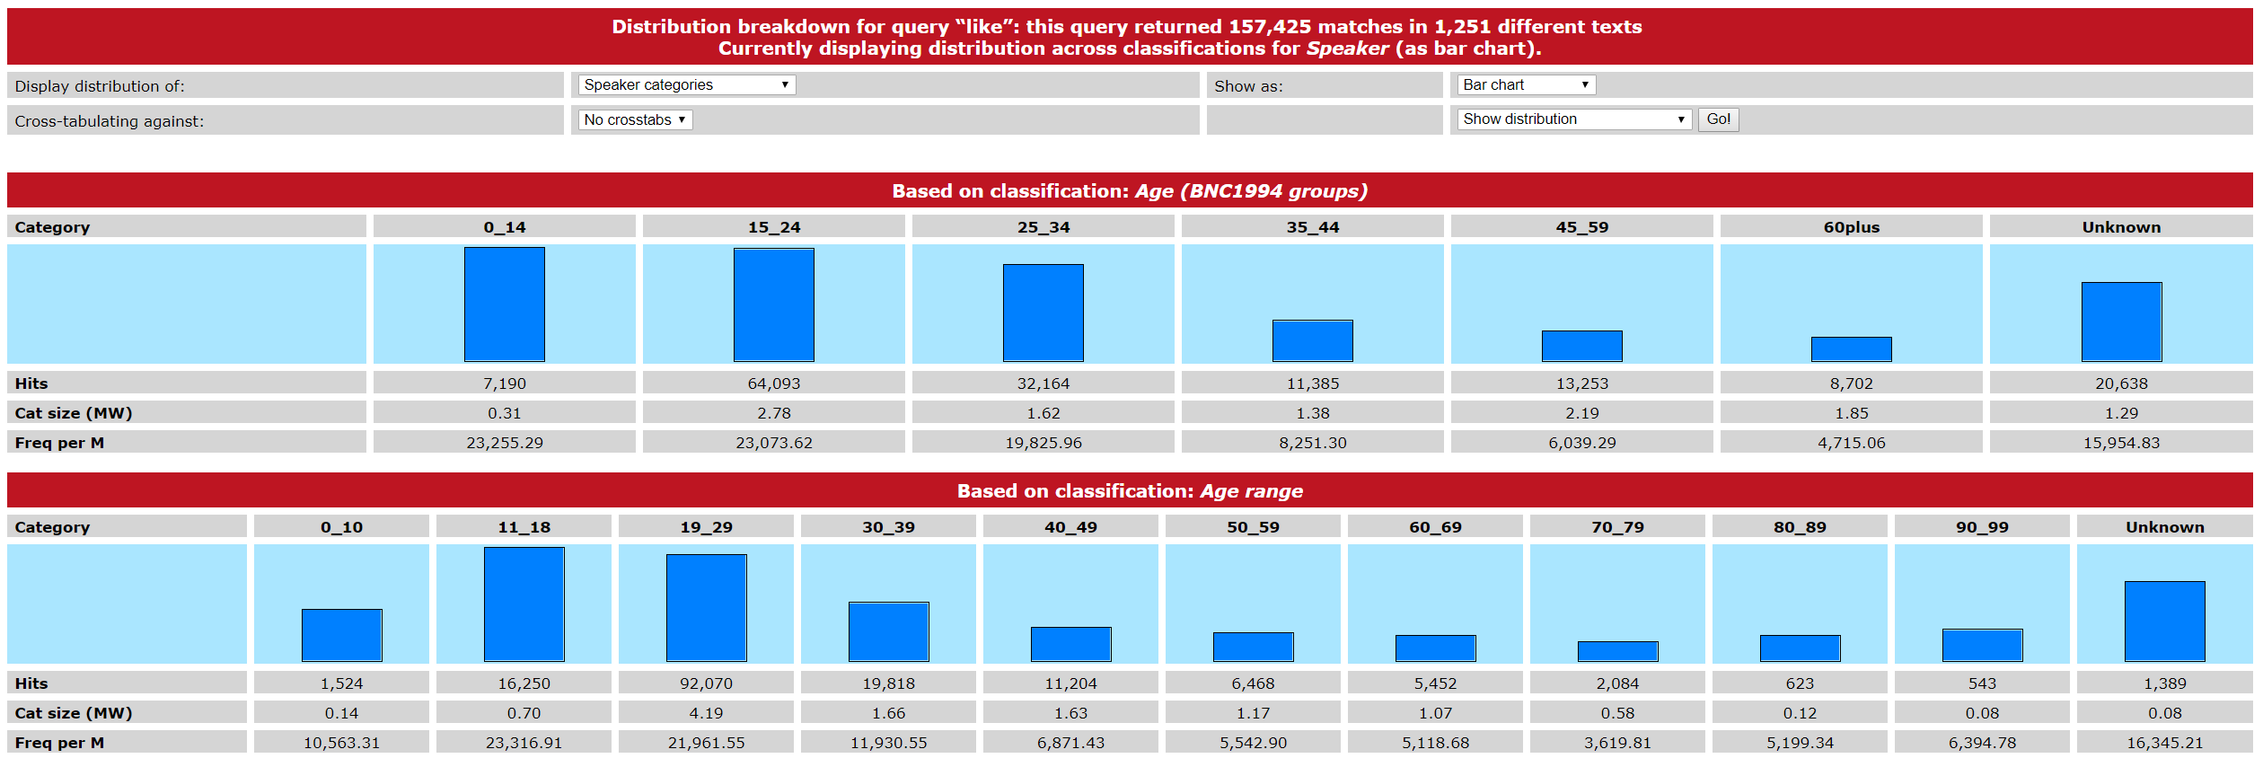
Distribution
How are words distributed across social categories like age, gender and socio-economic status?

Slide 66
Challenge: task (7)
Search for the following pairs of words
  hello and hi
  literally and really
  beautiful and stunning
  pounds and quid
  toilet and loo
Using the ‘distribution’ function, explore how they are distributed across age, gender and socio-economic status
What can you observe?
What limitations exist with this approach?

Slide 67
Thank you!
@lovermob
@education_leeds
@BNC_2014

Slide 68
References
Biber, D. (1993). Representativeness in corpus design. Literary and Linguistic Computing, 8(4), 243-257.
Crowdy, S. (1995). The BNC spoken corpus. In G. Leech, G. Myers, & J. Thomas (Eds.), Spoken English on Computer: Transcription, Mark-Up and Annotation (pp. 224-234). Harlow: Longman.
Knight, D., Neale, S., Watkins, G., Spasić, I., Morris, S., & Fitzpatrick, T. (2016, June). Crowdsourcing corpus construction: contextualizing plans for CorCenCC (Corpws Cenedlaethol Cymraeg Cyfoes – The National Corpus of Contemporary Welsh). Paper presented at the IVACS 2016 conference, Bath Spa University, UK.
Leech, G. (2007). New resources, or just better old ones? The Holy Grail of representativeness. In: Corpus Linguistics and the Web. Rodopi, Amsterdam, pp. 133-149.
Love, R. (forth). Overcoming Challenges in Corpus Construction: The Spoken British National Corpus 2014. New York: Routledge.
Love, R., Dembry, C., Hardie, A., Brezina, V., & McEnery, T. (2017). The Spoken BNC2014: Designing and building a spoken corpus of everyday conversations. International Journal of Corpus Linguistics, 22(3), 319-344.
Römer, U. (2013). No corpus linguist is an island: Collaborative and cross-disciplinary work in researching phraseology. Invited plenary at the International Corpus Linguistics Conference 2013. Lancaster University, UK.
Schmidt, T. (2016). Good practices in the compilation of FOLK, the Research and Teaching Corpus of Spoken German. International Journal of Corpus Linguistics, 21(3), 396-418.

