Slide 1


Designing and building the Spoken BNC2014
Reflections on the Spoken BNC2014
Dr Robbie Love
Research Fellow
School of Education
University of Leeds
r.love@leeds.ac.uk
lovermob

Slide 2
Plan of action
Background – the original British National Corpus
The BNC2014 project
Building the spoken BNC2014
Evaluating the Spoken BNC2014
Some challenges and reflections

Slide 3

The British National Corpus (1994)
“a corpus of 100 million words of written texts and spoken transcriptions of modern British English, to be stored on the computer in machine-readable form”
(Leech 1993: 9)

Slide 4

The BNC2014 project

Slide 5
Aims of the BNC2014
Broadly comparable to the BNC1994, compiled two decades later
A new resource for research & teaching
100 million words of written British English, variety of registers
10 million words of spoken British English, one register = casual conversation
Phase 1 (2014-2017) = Spoken BNC2014
Lancaster University + Cambridge University Press
Phase 2 (2015-present) = Written BNC2014
Lancaster University

Slide 6
Why?
Nothing since the Spoken BNC1994:
orthographically transcribed
large size
general coverage of spoken British English
(low or no cost) public access
Language has very likely changed during this time – lexical innovations, perhaps grammatical change etc.
Two decade comparison (1990s-2010s) never been done before
Build towards a set of sampling points for diachronic analysis of spoken British English

Slide 7

English language teaching
What we teach vs. what we do
Focus less on structures we produce less frequently
What are we talking about?
Inspiration for current/realistic conversational topics
Speaking and ELT teaching
Teaching speaking is tough
More on the ELT perspective tomorrow!

Slide 8


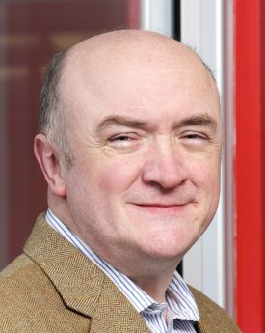
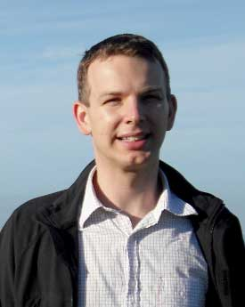
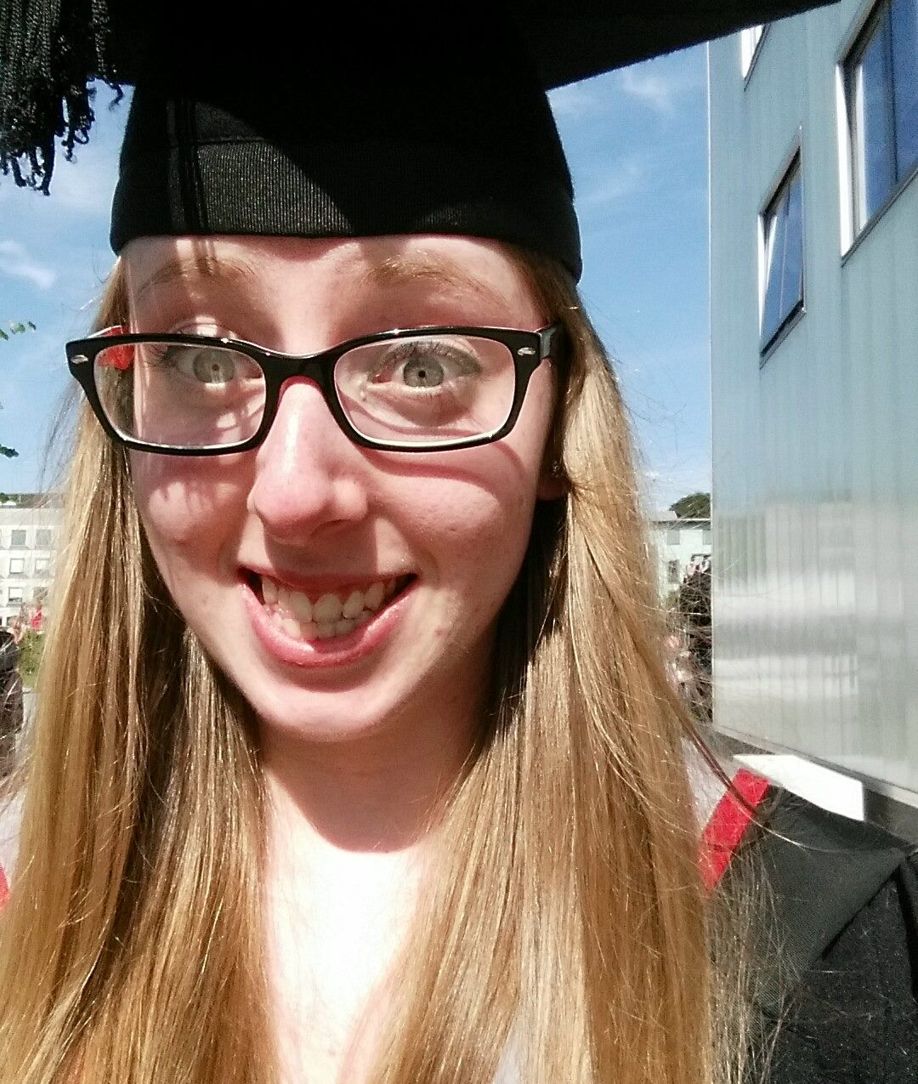
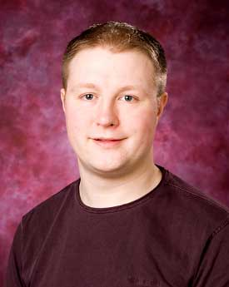
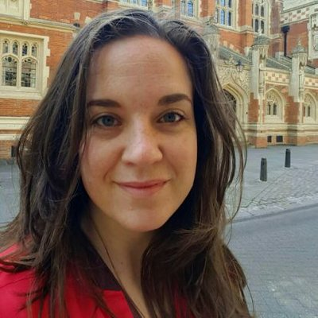

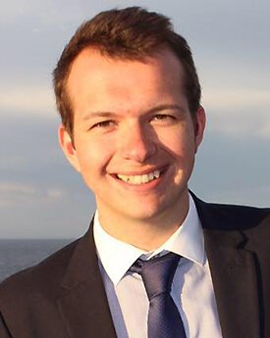
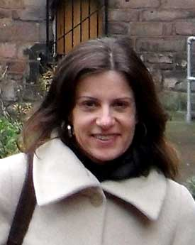
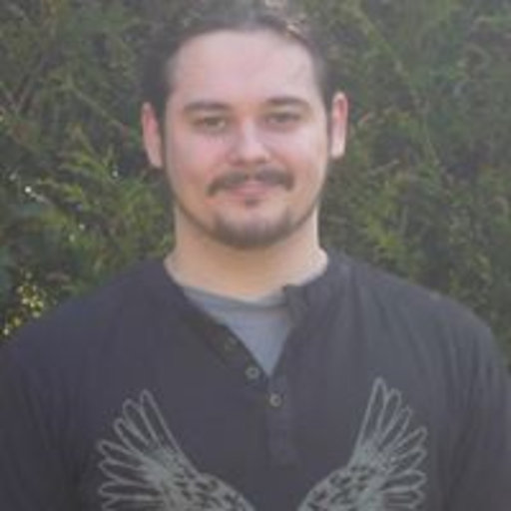
The BNC2014 team
10 million words
Phase 1 (2013-2017):
Spoken BNC2014
Phase 2 (2014-):
Written BNC2014
90 million words
Tony
McEnery
Vaclav
Brezina
Robbie
Love
Abi
Hawtin
Andrew
Hardie
Claire
Dembry
Olivia
Goodman
Mathew
Gillings
Carmen
Dayrell
Matt
Timperley

Slide 9
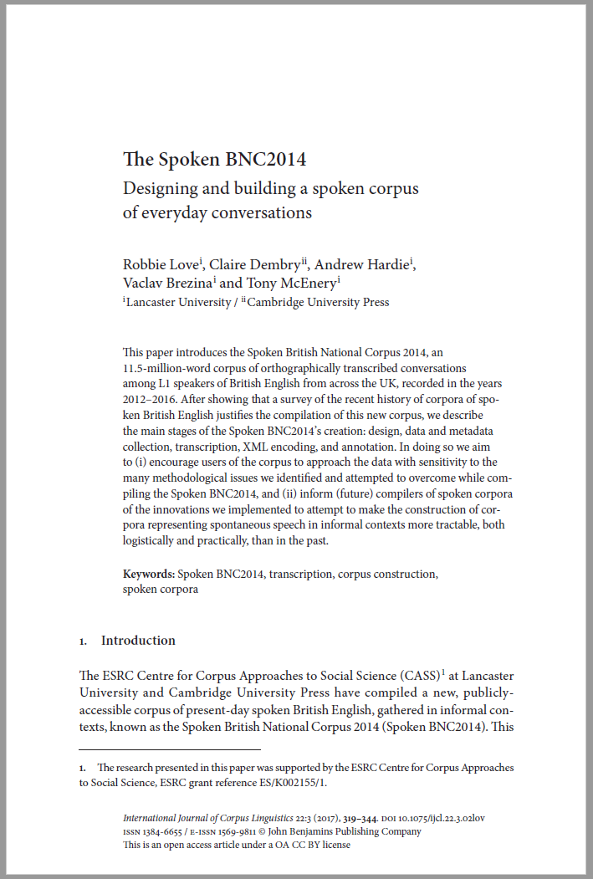


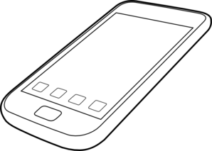





Building the Spoken BNC2014
SPOKEN
Existing corpora
Design
Representativeness
Target population
Sampling goals
Who is it for?
What do people want?
What have people done?
Finding participants
Recording equipment
Metadata collection
Automated? Manual?
Conventions
Accuracy
XML conversion
Annotation
Tool development
User guide
Website
Publications
What have we got?
Representativeness
Pilot research
Data collection
Transcription
Processing
Review
Document
Release

Slide 10
Corpus design
“The design of a representative corpus is not truly finalized until the corpus is completed, and analyses of the parameters of variation are required throughout the process of corpus development in order to fine-tune the representativeness of the resulting collection of texts”
(Biber 1993)
“A seminal article by Biber (1993) has frequently been cited, but no attempt (to my knowledge) has been made to implement Biber’s plan for building a representative corpus. […] Without representativeness, whatever is found to be true of a corpus, is simply true of that corpus – and cannot be extended to anything else.”
(Leech 2006)

Slide 11
Corpus design
The 2nd version of the BNC – promise and expectation of comparability
In terms of spoken data, needs had changed – just informal conversation
Goals:
- priority = England; aim for rest of UK
- spread of age, gender, region, socio-economic status etc.
- but: no pre-determined category sizes
- broadly comparable to the Spoken BNC1994DS
Describe representativeness upon completion
We had to facilitate comment on some wider population, otherwise what is the point?

Slide 12
Corpus design
 | Spoken BNC1994 | Spoken BNC2014
Interaction type | Demographic (40%); Context-governed (60%) | Demographic (100%)
Who? | “Carefully sampled individuals” (Leech 1993:6) | Open call for participation; Some targeting
How? | Tape recorders | Smartphone MP3 recordings
What? | All interactions in a given period | Conversations; some task-based interactions.
When? | Continuously over a 2-7 day period | As determined by participant
How many speakers? | 124 adults making recordings Over 1000 speakers | 700 unique speakers
Total data | ~10m words | 11+m

Slide 13
Corpus design
 | Spoken BNC1994 | Spoken BNC2014
Speaker | Age Gender Education Occupation Accent/dialect Socio-economic category | Age Gender Education Occupation Accent/dialect Birthplace Linguistic origin Where do you currently live? How long have you lived there? Nationality Do you speak other languages?
Recording | Title Date Recording location | Title Date File name Recording length Recording location Speaker relationship Topics covered

Slide 14

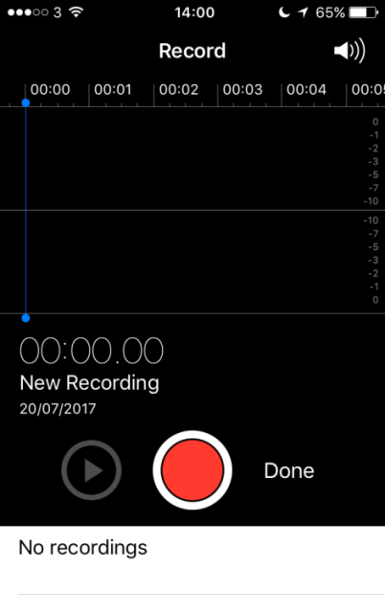
Data collection
How can we recruit & motivate participants?
Money!
How can we gather good quality recordings?
Smartphones!
How can we gather good quality metadata?
Condition of payment; careful data management

Slide 15
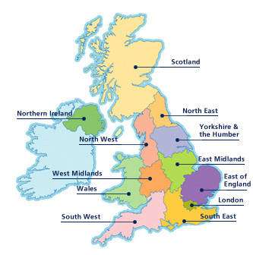
Metadata issues
Accent/dialect -> region

Slide 16
Metadata issues
Region
What is region anyway? What are we trying to represent here?
Birthplace?
Recording location?
Location of current residence?
Location during acquisition?

Slide 17
Metadata issues
Region
Purely objective metadata seems insufficient
Subjective metadata offers an imperfect solution:
Self-reported dialect
British Library’s Evolving English WordBank (2011)
E.g. “Geordie” = north east England

Slide 18
Metadata issues
Self-reported dialect categorisation
central midlands, north-east midlands, midlands, south midlands, north-west midlands…
“southern”
“normal with a brummy twang”
“mixed northern/somerset/rp”

Slide 19
Metadata issues
Dialect categorisation
Office for National Statistics’ scheme:
Nomenclature of Territorial Units for Statistics (NUTS)
Used in the census
(1) North East
(2) North West
(3) Merseyside
(4) Yorkshire & Humberside
(5) East Midlands
(6) West Midlands
(7) Eastern
(8) London
(9) South East
(10) South West
(11) Wales
(12) Scotland
(13) Northern Ireland

Slide 20
Dialect in the Spoken BNC2014
(1) Global | (2) Country | (3) Supra-region | (4) Region
UK | England | North | North East
 |  |  | Yorkshire & Humberside
 |  |  | North West (not Merseyside)
 |  |  | Merseyside
 |  | Midlands | East Midlands
 |  |  | West Midlands
 |  | South | Eastern
 |  |  | South West
 |  |  | South East (not London)
 |  |  | London
 | Scotland | Scotland | Scotland
 | Wales | Wales | Wales
 | Northern Ireland | Northern Ireland | Northern Ireland
Non-UK | Republic of Ireland | Republic of Ireland | Republic of Ireland
 | Other non-UK variety | Other non-UK variety | Other non-UK variety
Unspecified | Unspecified | Unspecified | Unspecified
Comparable with the Spoken BNC1994 too!

Slide 21
Dialect in the Spoken BNC2014
(1) Global | (2) Country | (3) Supra-region | (4) Region
UK | England | North | North East
 |  |  | Yorkshire & Humberside
 |  |  | North West (not Merseyside)
 |  |  | Merseyside
 |  | Midlands | East Midlands
 |  |  | West Midlands
 |  | South | Eastern
 |  |  | South West
 |  |  | South East (not London)
 |  |  | London
 | Scotland | Scotland | Scotland
 | Wales | Wales | Wales
 | Northern Ireland | Northern Ireland | Northern Ireland
Non-UK | Republic of Ireland | Republic of Ireland | Republic of Ireland
 | Other non-UK variety | Other non-UK variety | Other non-UK variety
Unspecified | Unspecified | Unspecified | Unspecified
“Geordie”

Slide 22
Dialect in the Spoken BNC2014
(1) Global | (2) Country | (3) Supra-region | (4) Region
UK | England | North | North East
 |  |  | Yorkshire & Humberside
 |  |  | North West (not Merseyside)
 |  |  | Merseyside
 |  | Midlands | East Midlands
 |  |  | West Midlands
 |  | South | Eastern
 |  |  | South West
 |  |  | South East (not London)
 |  |  | London
 | Scotland | Scotland | Scotland
 | Wales | Wales | Wales
 | Northern Ireland | Northern Ireland | Northern Ireland
Non-UK | Republic of Ireland | Republic of Ireland | Republic of Ireland
 | Other non-UK variety | Other non-UK variety | Other non-UK variety
Unspecified | Unspecified | Unspecified | Unspecified
“Southern”

Slide 23
Evaluation
Montgomery (2012) – we aren’t very good at judging dialect boundaries reliably – perceptual dialectology
  One speaker’s “southern” might be another speaker’s “midlands”
Requires some inference – i.e. a subjective metadata set
Contradictions in speaker reports
But…
More reliable method than BNC1994 – speak for yourself!
The best we can get for a top-down scheme

Slide 24
Transcription
Audio recording & signed consent forms received
Metadata recorded from consent forms
Audio recording assigned to transcriber
Transcript produced
Check #1: Audio checking
Check #2: Proofreading
Proofread word doc sent to Lancaster

Slide 25
Transcription
Why not use exactly the same transcription scheme as the original?
EXAMPLE
using full stops and commas to “approximate to use in written text”, but also indicating pauses with ellipses
<2> I think it’s always, deceptive on days like this because its, overcast and [er]
[…]
<2> But, but er, he’s…just broken away from his girlfriend and [<unclear>]
<1> [Oh has] he, oh. Well he seemed happy enough when he called.
Crowdy (1994: 28)

Slide 26
Processing
Word docs -> text
Text -> XML, automatic conversion scripts to (a) translate transcripts into XML, (b) check & correct transcription convention errors
Used “modest” XML (Hardie 2014), a simpler derivative of TEI
Tagged for POS and lemma, CLAWS (Garside & Smith 1997)
Lancaster University’s CQPweb server (Hardie 2012)

Slide 27
The Spoken BNC2014
Conversational, L1 British English
2012-2016
672 speakers
1,251 texts
11,422,617 words
Freely available to the public:
    (1) on Lancaster’s CQPweb, then
    (2) file download

Slide 28
The Spoken BNC2014

Slide 29
The Spoken BNC2014

Slide 30
So…what the Spoken BNC2014 is
A large corpus of informal spoken British English, as spoken mostly in England
Within England, it represents a spread of demographics including gender, age, socio-economic status and region
Comparable in terms of register to the Spoken BNC1994DS
A resource for the study of:
- lexical/grammatical variation & change in England
- how inf. English is spoken in England (2012-2016)
- functional variation according to situational context
- how inf. spoken English differs from writing & online comm.
- how inf. spoken English differs from other spoken registers
- (critical) discourse analysis
- much more…

Slide 31
What the Spoken BNC2014 isn’t
Perfect!
A corpus of a range of spoken registers
Comparable in terms of register with the whole Spoken BNC1994
A corpus built in exactly the same way as the Spoken BNC1994
A corpus designed with phonetics in mind
A corpus that represents the whole of the UK – more to come

Slide 32
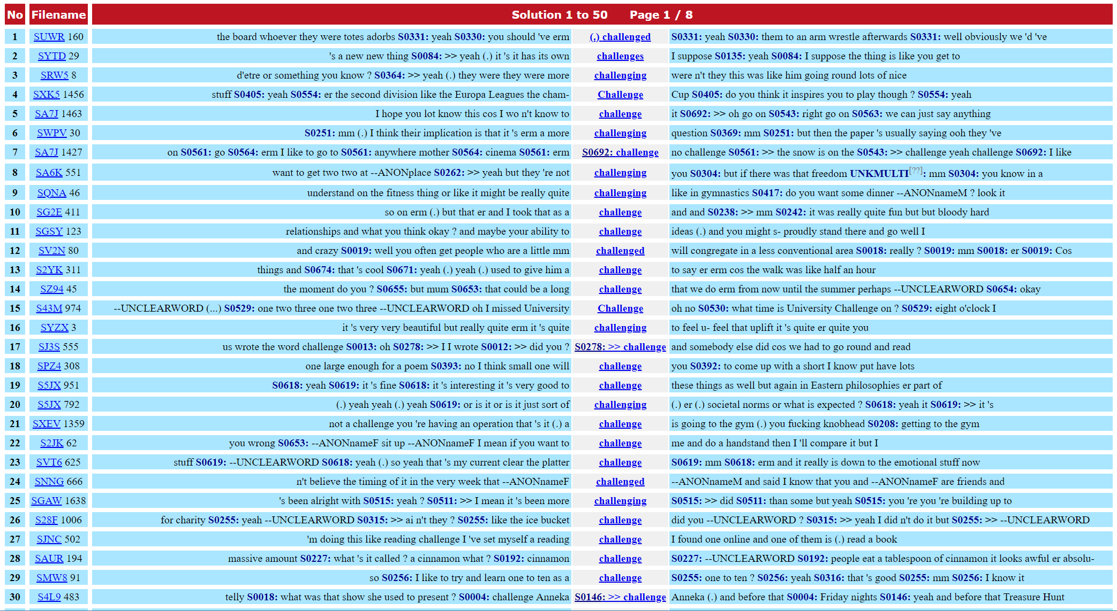
Some challenges
Engaging with the media
Increasing mobility
The growth of corpus linguistics
‘Blind faith’ in corpus linguistics

Slide 33
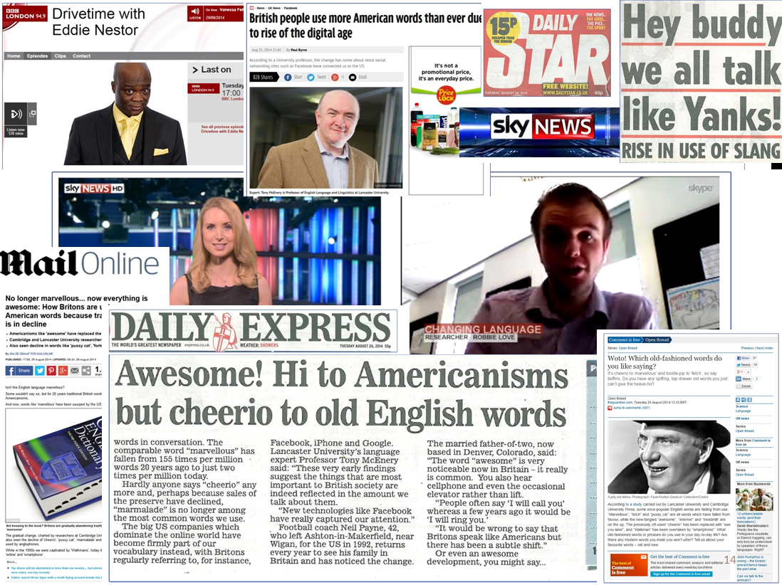
Engaging with the media
Finding and recruiting participants for the Spoken BNC2014
The media as an advertising tool
Working with university press office
Researchers and journalists…a love/hate relationship
The truth of the matter is that the principles we hold dear (thoroughness, accuracy, taking your time to get it 100% right) are not conducive to getting headlines
Often, my work was watered down, censored and simplified

Slide 34
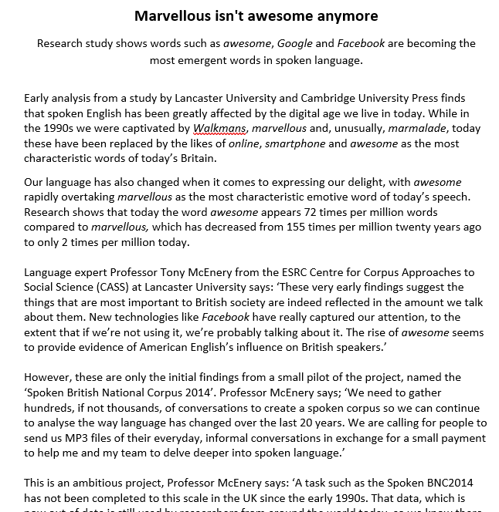
Example: the pussy cat
Early 1990s Early 2010s
fortnight facebook
marvellous internet
fetch website
walkman awesome
poll email
catalogue google
pussy cat smartphone
marmalade iphone
drawers essentially
cheerio treadmill

Slide 35
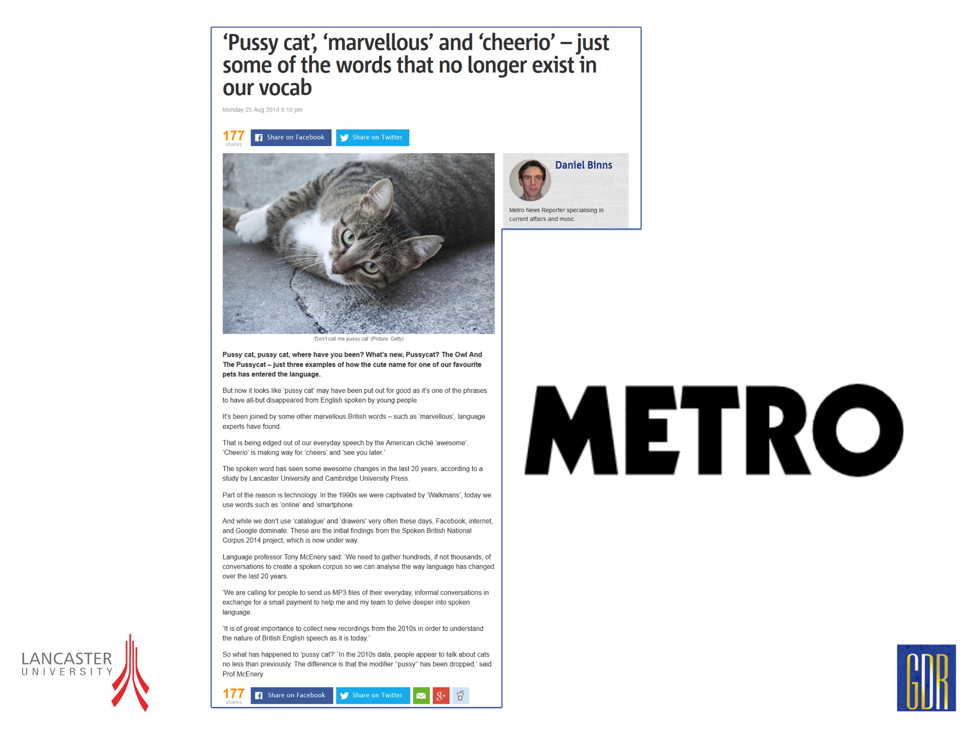
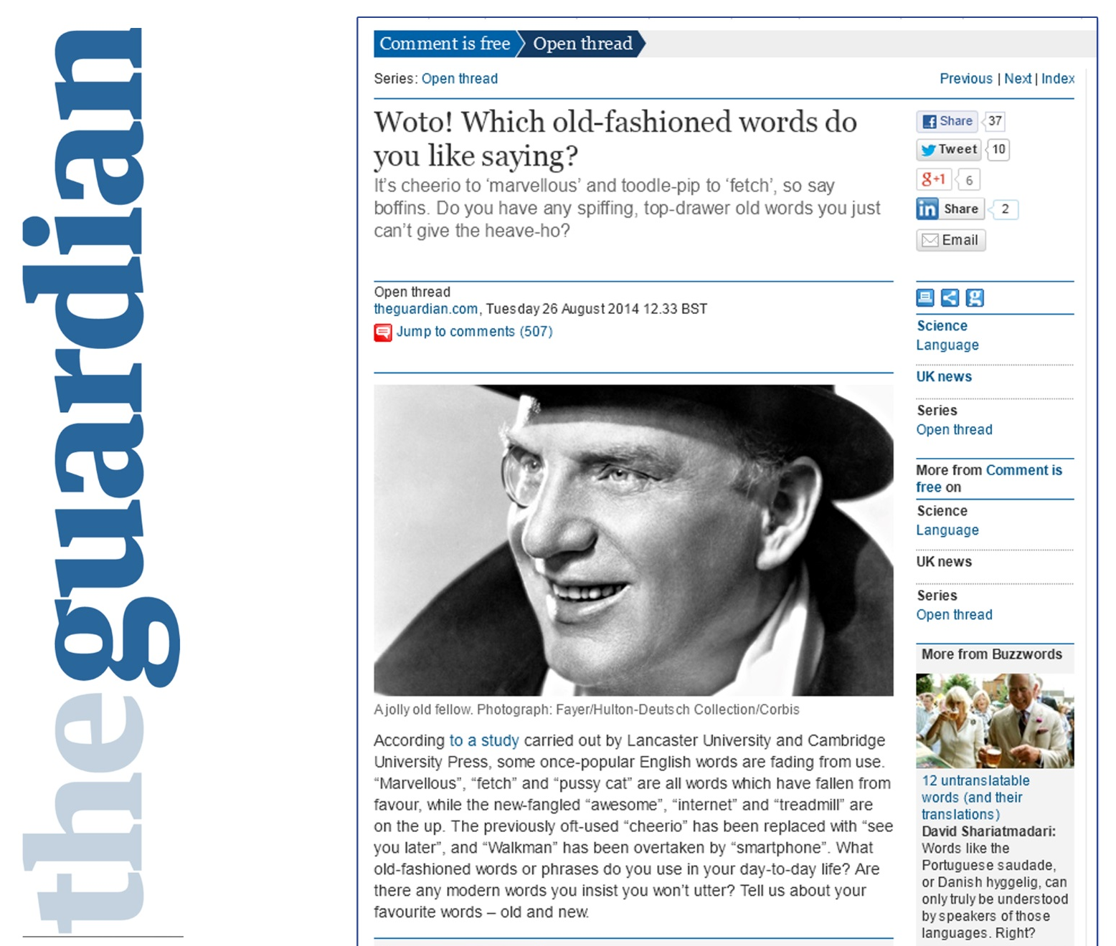
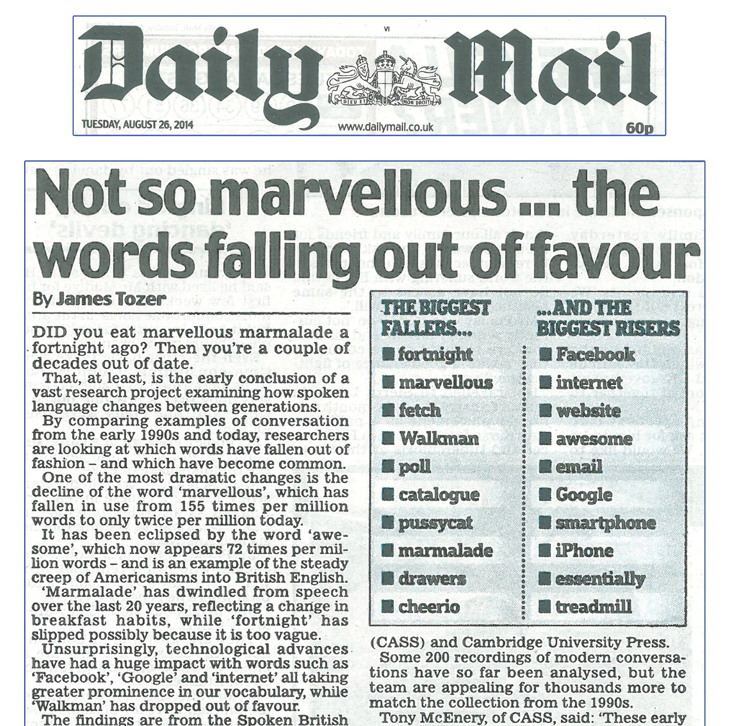
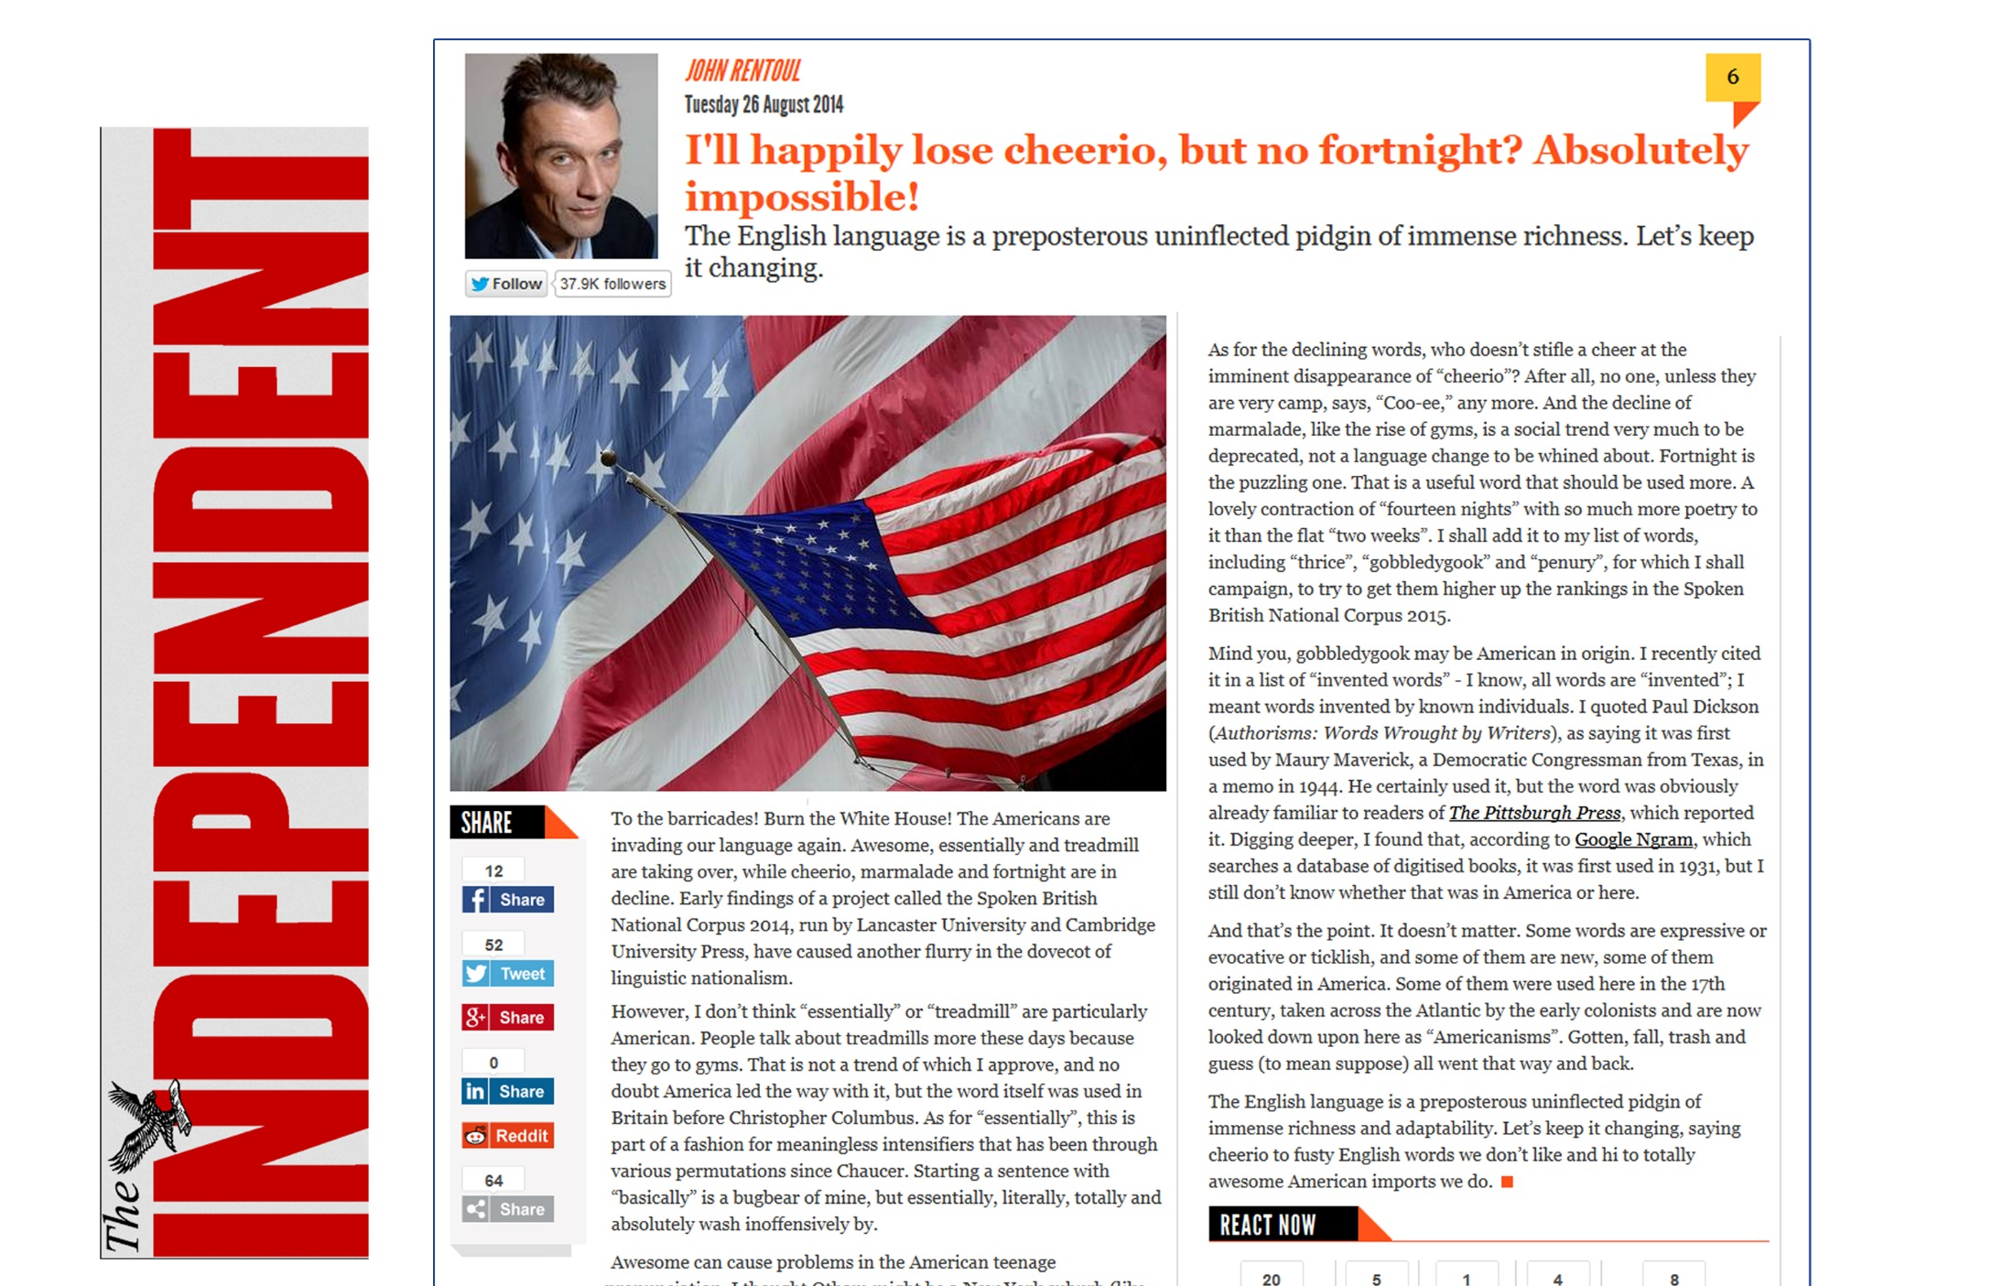
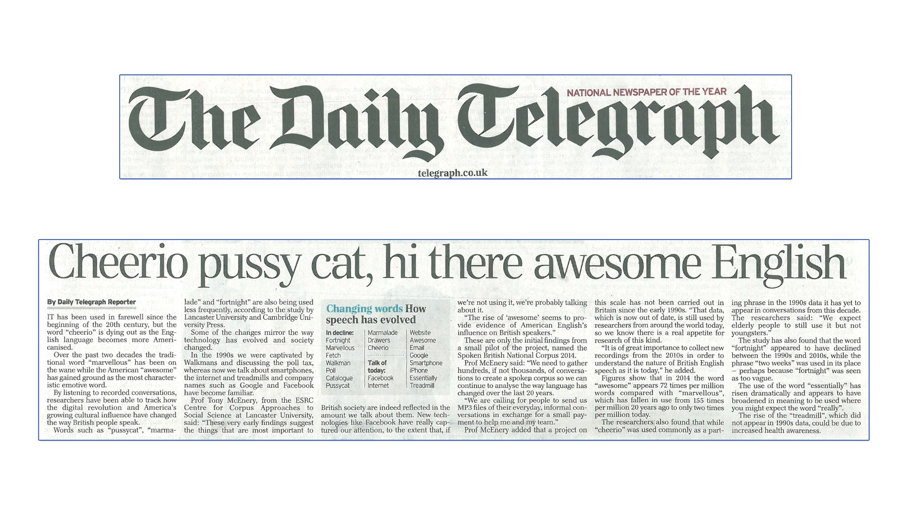
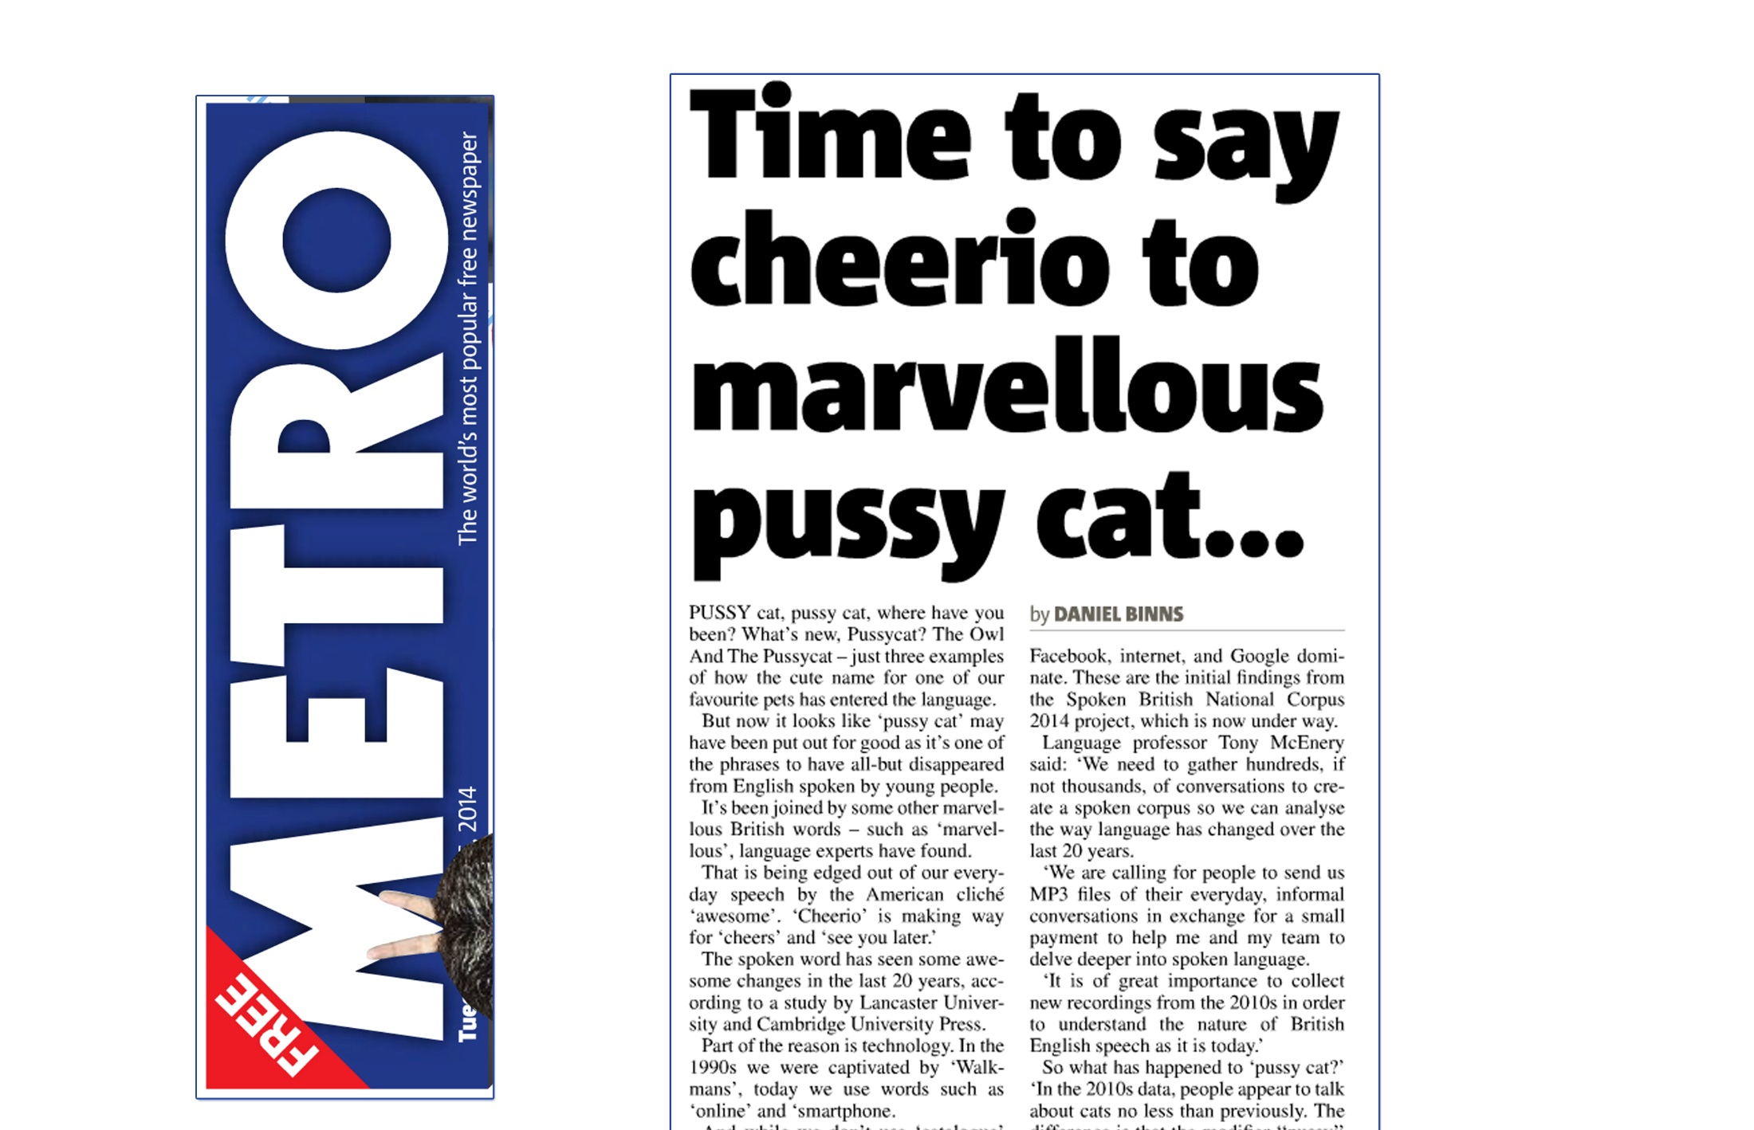
Example: the pussy cat

Slide 36
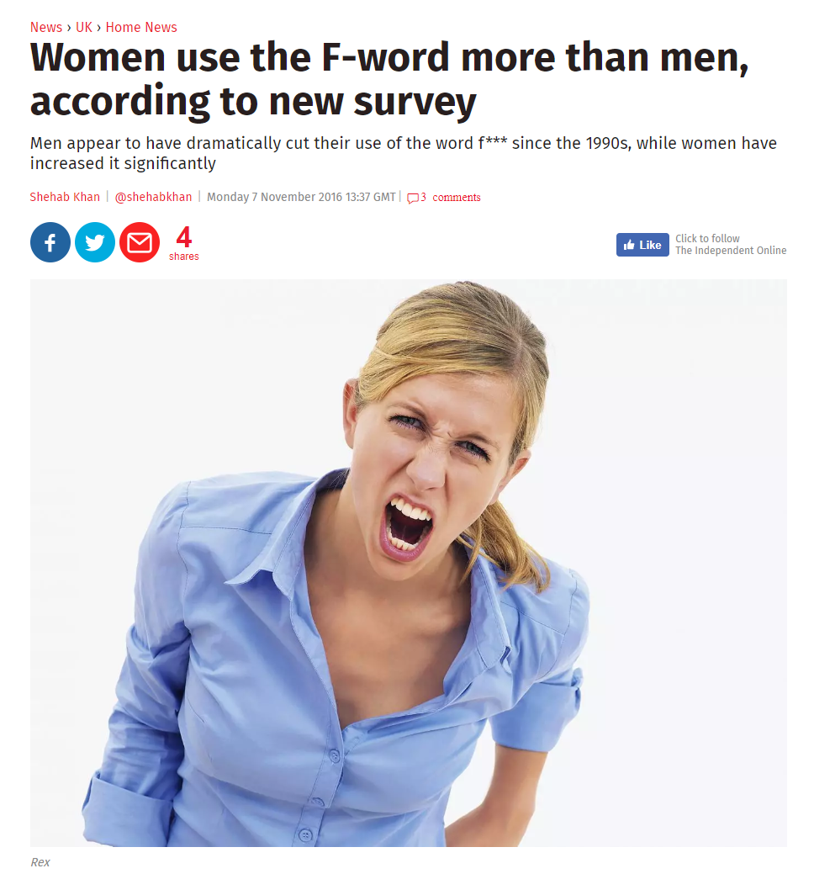
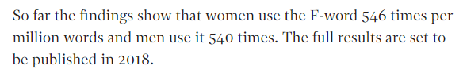
Example: swearing

Slide 37
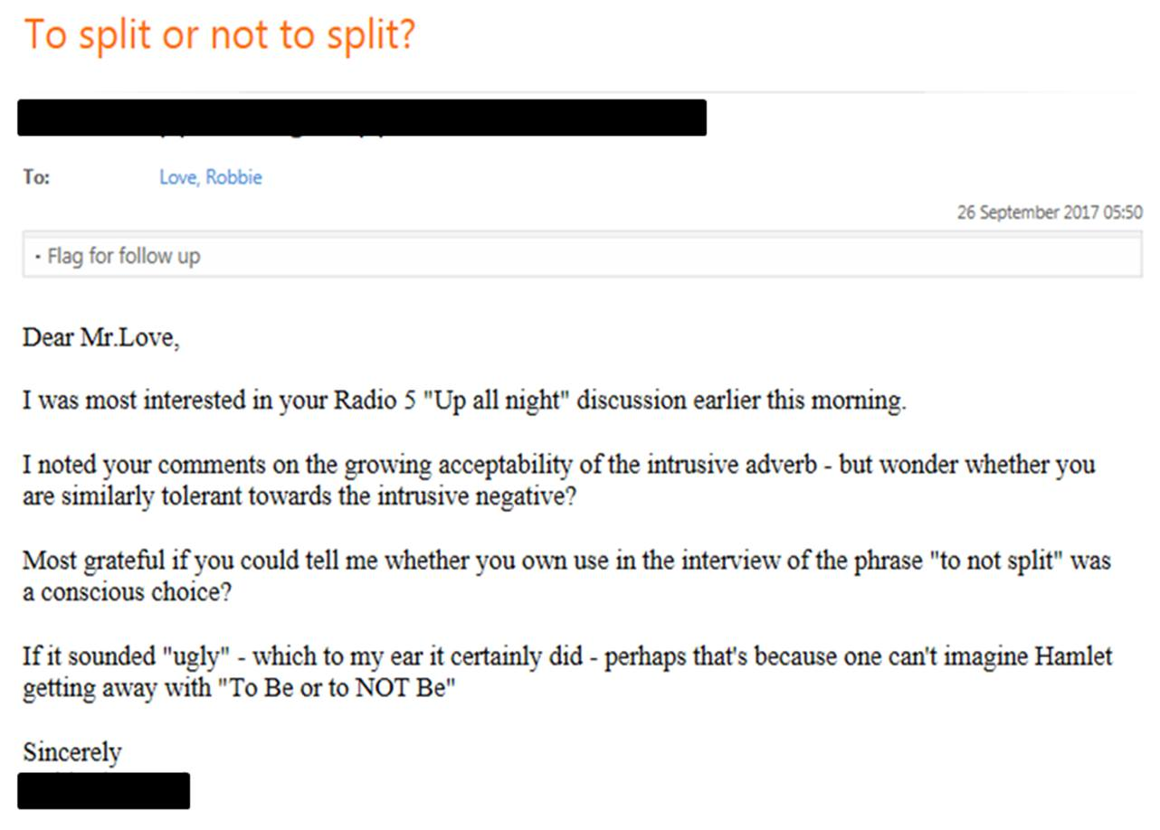
Prescriptive audiences
Some people think I am:
announcing the death of the English language
actively promoting the changes I am reporting

Slide 38
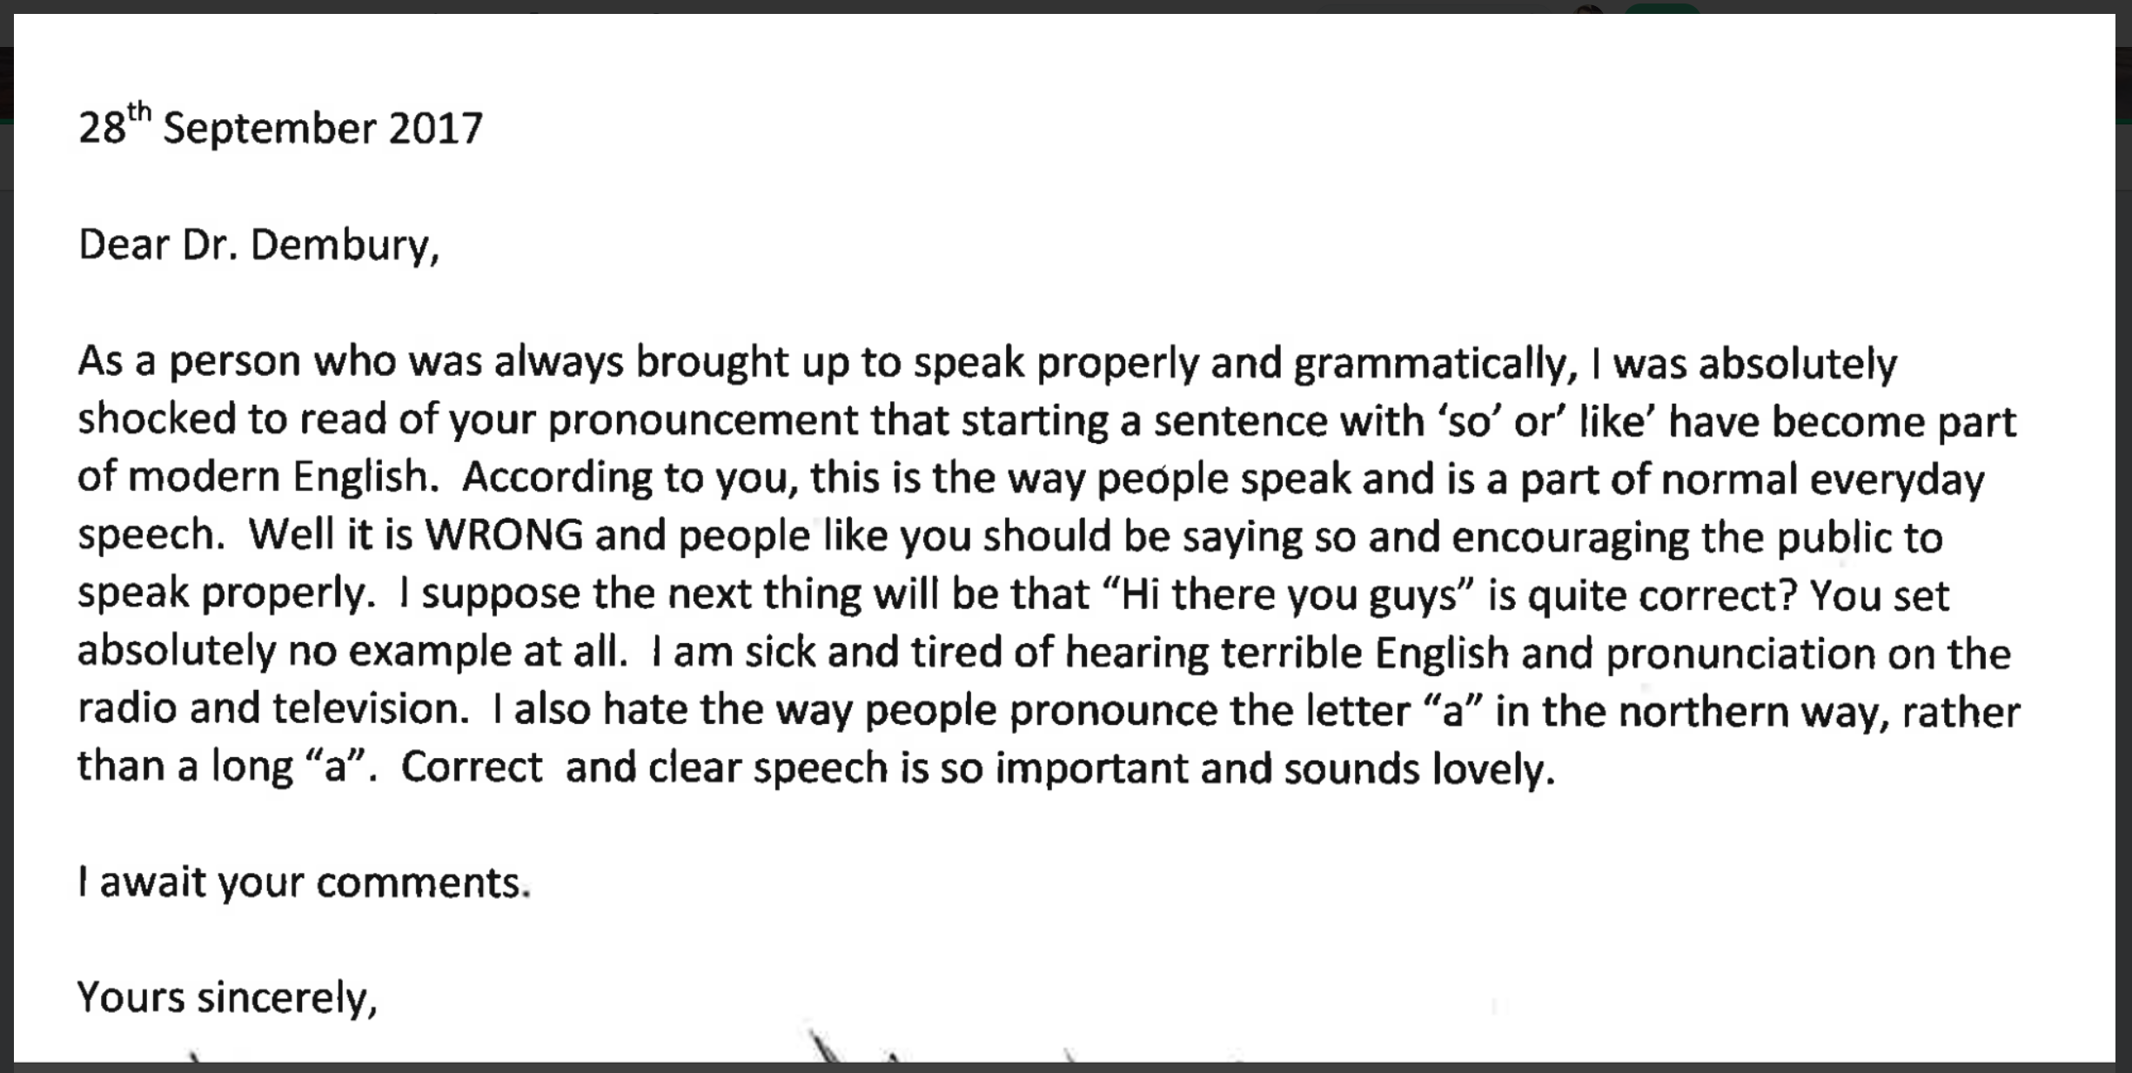
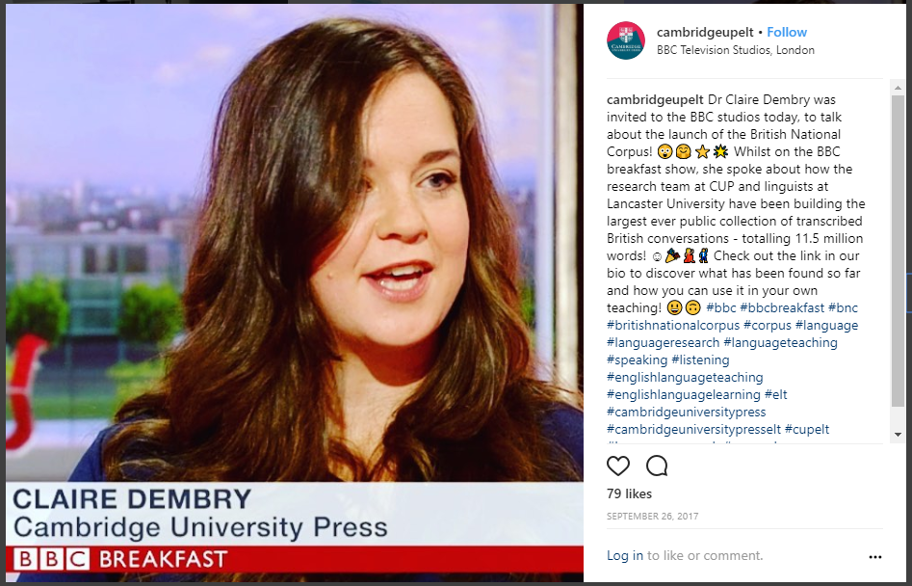
Prescriptive audiences

Slide 39
Increasing mobility
“we chose to define ‘British’ as speakers whose L1…is British English, rather than speaker nationality”
(Love forth.)
Spoken BNC2014 does not represent the whole of the UK…but even if it did claim to…
Scots, Ulster Scots, Welsh, British Sign Language, Irish, Angloromani, Scottish Gaelic, Cornish, Shelta, Irish Sign Language, Northern Ireland Sign Language…
Polish, Punjabi, Urdu, Bengali, Gujarati, Arabic, French, Chinese, Portuguese, Spanish, Tamil, Turkish, Italian, Somali, Lithuanian, German, Persian, Philippine languages, Romanian…

Slide 40
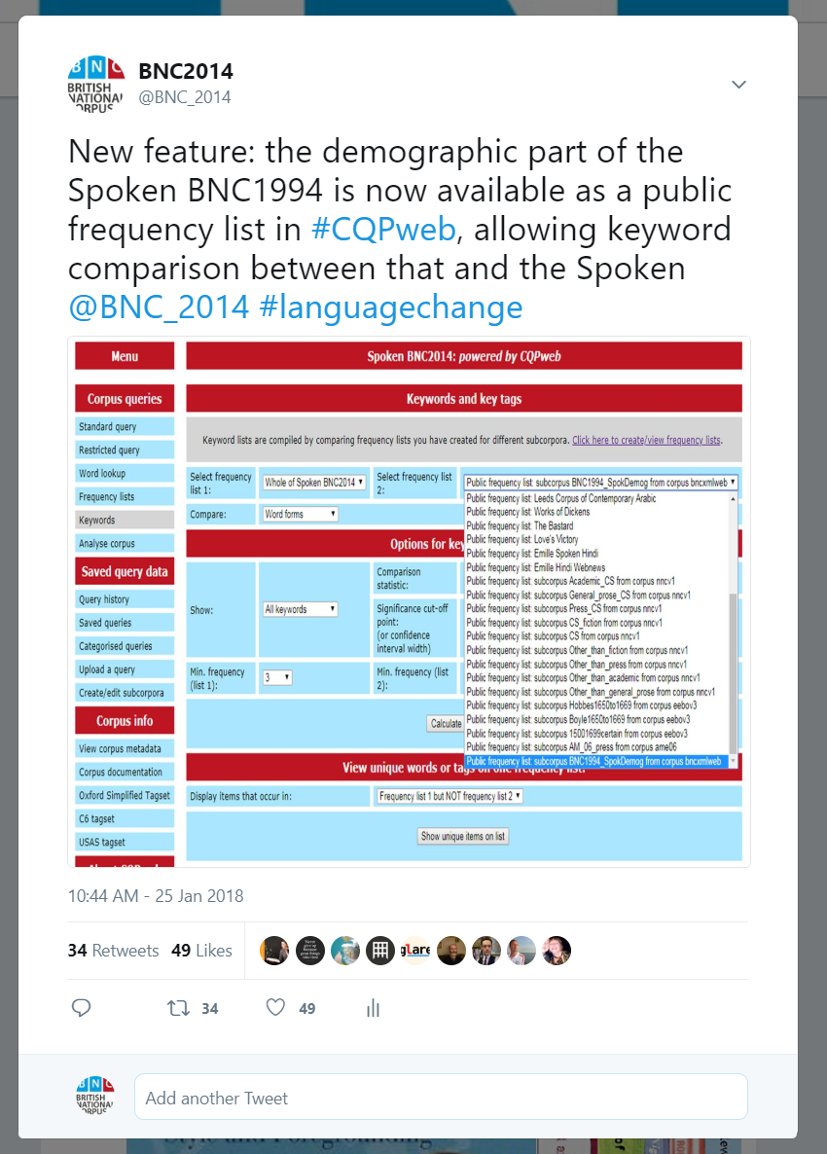
Blind faith in corpus linguistics

Slide 41
Example: keywords
XXUNCLEARWORD
l-
a-
e-
st-
XXANONnameM
c-
internet
o-
woah
XXANONnameF
n-
u-
ye-
th-
XXANONplace
D-
T-
awesome
ma-
s-
email
b-
XXFOREIGNWORD
emails
XXANONnameN
g-
m-
twenty-four
youtube
uhu
I-
website
ca-
thi-
y-
facebook
UK
uh-huh
ch-
w-
h-
google
laptop
ipad
f-
ha-
r-
online
XXANONmiscPersonalInfo

Slide 42
Example: keywords
s-
g-
m-
ca-
thi-
XXUNCLEARWORD
uhu
I-
website
uh-huh
ch-
XXANONnameM
y-
facebook
UK
laptop
ipad
XXANONnameF
w-
h-
google
online
XXANONplace
f-
ha-
r-
st-
XXANONnameN
l-
a-
e-
woah
XXFOREIGNWORD
c-
internet
o-
th-
XXANONmiscPersonalInfo
n-
u-
ye-
ma-
D-
T-
awesome
emails
email
b-
twenty-four
youtube

Slide 43
Example: keywords
uhu
laptop
XXUNCLEARWORD
f-
u-
th-
email
online
XXANONnameM
l-
T-
ma-
facebook
woah
XXANONnameF
c-
b-
thi-
internet
emails
XXANONplace
n-
m-
ch-
website
youtube
XXANONnameN
D-
r-
UK
ipad
XXFOREIGNWORD
g-
e-
google
XXANONmiscPersonalInfo
I-
o-
awesome
s-
ye-
h-
twenty-four
y-
ha-
ca-
uh-huh
w-
a-
st-

Slide 44
Example: keywords
email
ipad
XXUNCLEARWORD
f-
u-
th-
facebook
XXANONnameM
l-
T-
ma-
internet
XXANONnameF
c-
b-
thi-
website
XXANONplace
n-
m-
ch-
google
XXANONnameN
D-
r-
uhu
awesome
XXFOREIGNWORD
g-
e-
UK
laptop
XXANONmiscPersonalInfo
I-
o-
twenty-four
online
s-
ye-
uh-huh
h-
emails
y-
ha-
ca-
woah
youtube
w-
a-
st-

Slide 45
Conclusions
BNC2014: a contribution to corpus linguistics and beyond
Be honest, critical and realistic about representativeness
Maximize efficiency of corpus construction in view of practical constraints: especially time
There is no one ‘right’ way to do this – e.g. data collection, metadata, transcription, processing
Decisions made = justified & transparent, including weaknesses e.g. imbalance

Slide 46
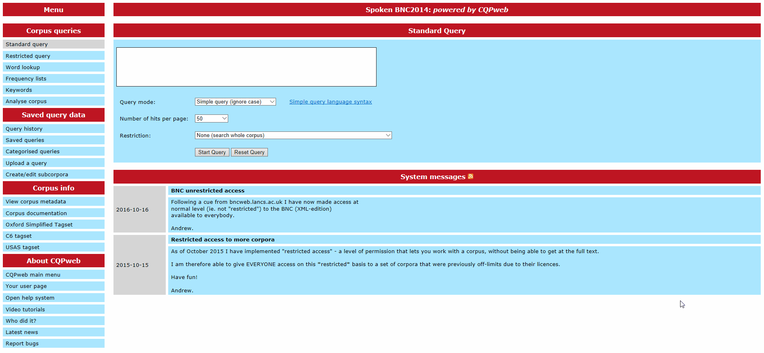
Thank you – questions?

Slide 47
References
Biber, D. (1993). Representativeness in corpus design. Literary and Linguistic Computing, 8(4), 243-257.
Crowdy, S. (1995). The BNC spoken corpus. In G. Leech, G. Myers, & J. Thomas (Eds.), Spoken English on Computer: Transcription, Mark-Up and Annotation (pp. 224-234). Harlow: Longman.
Garside, R., & Smith, N. (1997). A hybrid grammatical tagger: CLAWS4. In R. Garside, G. Leech & A. McEnery (Eds.), Corpus Annotation: Linguistic Information from Computer Text Corpora (pp. 102-121). London: Longman.
Hardie, A. (2012). CQPweb – Combining power, flexibility and usability in a corpus analysis tool. International Journal of Corpus Linguistics, 17(3), 380-409.
Hardie, A. (2014). Modest XML for corpora: not a standard, but a suggestion. ICAME Journal, 38, 73-103.
Leech, G. (2007). New resources, or just better old ones? The Holy Grail of representativeness. In: Corpus Linguistics and the Web. Rodopi, Amsterdam, pp. 133-149.
Love, R., Dembry, C., Hardie, A., Brezina, V., & McEnery, T. (2017). The Spoken BNC2014: Designing and building a spoken corpus of everyday conversations. International Journal of Corpus Linguistics, 22(3), 319-344.

